Slide 1
Deleting your domain? Preventing data leaks at TLD scale
Maarten Wullink | DNS OARC 41

Slide 2
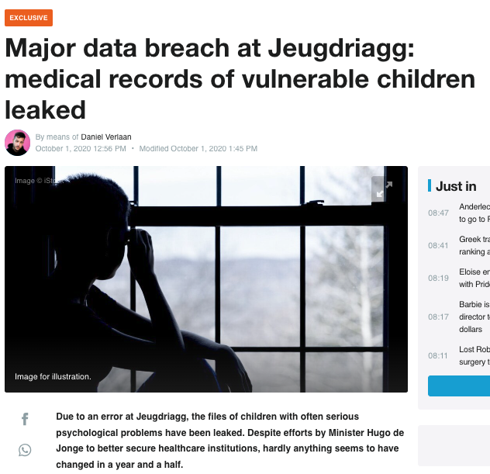
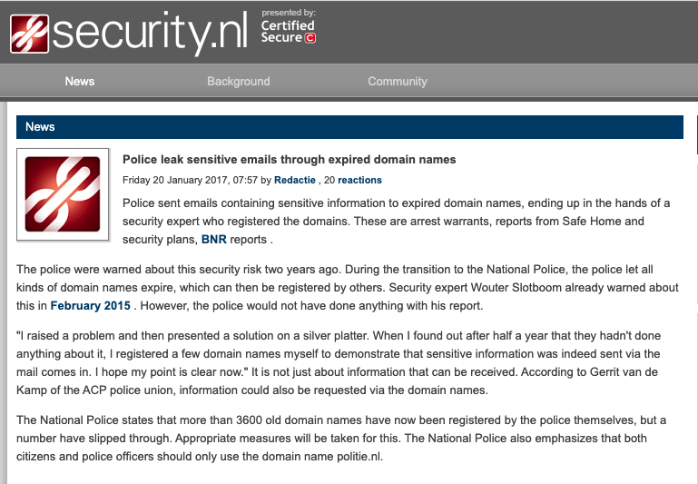
The (old) Problem
A deleted domain may lead to an accidental data leak
Notes:
Re-registration of a deleted domain may leak mail intented for the previous owner
A single leaky domain may have a high impact.
Single domain with leak my have high impact such as examples we’ve seen in .nl for healthcare provider and the Dutch police.

Slide 3
Goal
Warn registrants about of the potential danger of a deleted domain
Analyse DNS MX queries for deleted domains.
Send alert to former registrant, when following is true:
Indication of legitimate email transactions
Domain not yet exited quarantineperiod (1)
[1] Only the former registrant is allowed to remove the domain from quarantine
Notes:
Do not send all registrants, this might cause complaints
Assumption is that MX query shows intent to send mail, try filter out researchers scannning/measureing internet
In quarantaineperiode dit al vaststellen omdat na quarantaine het te laat ism, dan is de domeinnaam beschikbaar voor iedereen en misschien al opgepikt door een domainer.

Slide 4
Domain Life Cycle
Cancel-Delete
Re-Register
Active
Quarantine
Free
Delete
Exit
40 days
Mail: OK
Mail: Bounce
Mail: Bounce
LEMMINGS
Day 1 - 30
Notes:
While in quarantine mail bounce back to sender, previous domain owner does not see someone tried to send email

Slide 5
LEMMINGS
(deLetEd doMain MaIl warNinG System)
A system for detecting legitimate mail transactions by analysing DNS data
Challenges
Filtering out noise mail; (Marketing, Spam, social media)
Explaining the security risk to a registrant
Not every registrant can be contacted via e-mail
Privacy proxies and inzone mail addresses
Prevent the alert from looking like a scam/spam message
Prevent registrant questions flooding registar supportdesk
Notes:
- Only see dns mx queries NOT actial mail transactions and content

Slide 6
Data Sources
Registration database
Daily DNS queries for .nl
Total ~4 billion
MX ~180 million
Web crawler data
~6.1 million .nl domains,
Web content-type (business, ecommerce ...)
Use of email addresses on website
Abuse feeds (Spamhaus, APWG)
Sinkhole
Spambots
Monthly registrations and deletes (dark color are deletes)

Slide 7
Privacy Considerations
We do not capture or analyse mail content
PII information (registrant email address and name) are deleted after quarantine period
No trackers in email alert sent to registrant

Slide 8
System Process
Create dynamic
filters
Collect
deleted domains
Analyze
data
Create
alerts
Send
alerts
Anonymize
data
DNS data
Abuse feeds
Domain
Registration
System
Filter DNS queries
Using DNS and
Webcrawler data
Scoring rules
Analyzer stats
Notify registrants
Registrant
Name
Mail address

Slide 9
Filters
Multiple filters used to remove ”noise”
Spam, marketing, social media
Filters based on DNS request attributes, for example
ASN: filter queries from autonomous system
Mail marketing company, Facebook
High Nxdomain: DNS resolvers having a high ratio of NXDOMAIN
Newly Seen Ips: IP addresses of resolvers that have not been seen before

Slide 10
Alerts Rules
Risk categories
Based on 10-day average of daily MX queries (after filtering)
<= 5 low
> 5 en <= 10 medium
> 10 high
Special conditions
If keyword or business activity match, then risk is high
If email address is found on website, then atleast medium

Slide 11
Alert Message
Message is sent on day 30 of 40 day quarantine period
Designed in collaboration with registrars and registrants
Explain about the risk
Offer suggestions on how to go forward
Inform contacts
Re-register domain
Alert modes
Direct to registrant
To the registrar, which then forwards the alert
Registrar opt-out, no alerts are sent
Weekly summary of activity to registar
Example alert message
Notes:
Directly to the registrant : Voordeel hier is dat we dan niet afhannkelijk zijn van registrars die niet mee willenn doen en daardoor groot deel v/d zone missen

Slide 12
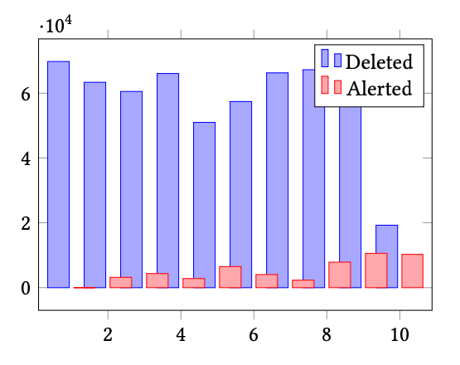
Alerts sent
Running LEMMINGS for 10-month period
587.778 domains have been deleted
106 million MX queries analysed
Filtering removed 75% of MX queries
Average daily MX queries for domain drops from 4.7 to 1.2
54.410 alerts have been sent (9.2%)
Deleted and Alerted during LEMMINSG period
Risk category | Alerts | Percentage
Low | 44.701 | 82.15%
Medium | 8.080 | 14.85%
High | 4.639 | 8.53%

Slide 13
MX Query Filters
Filter name | Queries removed | Percentage
ASN | 47.177.603 | 44.4%
High Nxdomain | 38.125.287 | 35.7%
Time | 18.675.125 | 17.6%
Newly Seen IP | 16.759.368 | 15.8%
Spamhaus | 4.228.491 | 4.0%
Country | 3.733.279 | 3.5%
Resolver Stability | 2.675.135 | 2.5%
IP Address | 2.552.351 | 2.4%
Open Resolver | 742.604 | 0.7%
No Mail | 731.991 | 0.7%
Sinkhole | 14.166 | 0.0%
APWG | 1.650 | 0.0%

Slide 14
How Effective is LEMMINGS?
Impossible to directly measure prevented data leaks
We use the increased usage of the registry cancel-delete request as a proxy for preventing potential data leaks
Calculated cancel-delete request baseline for the 12-month period before using LEMMINGS
0.13% over 627.285 domains
Compared to cancel-delete ratio seen during LEMMINGS period
Risk category | Cancel-delete | Percentage | Increase
Low | 237 | 0.53% | 4x
Medium | 38 | 0.84% | 6.5x
High | 50 | 1.08% | 8.3x

Slide 15
Registrant Survey (1)

Slide 16
Registrant Survey (2)

Slide 17
Future Work?
Impact of Qname Minimisation
Improve DNS filters (ML?)

Slide 18
Conclusion
Difficult to measure the effect of LEMMINGS
Reaction (mostly) positive
Low number of registrant/registrar complains about the alerts
Positive response Dutch internet community
Notes:
Het voorkomen van 1 data lek zou al de moeiet waard lkunne zijn.

Slide 19
Questions?
SIDN.nl
@SIDN
SIDN
www.sidnlabs.nl | stats.sidnlabs.nl

