Slide 1
Client side DNS observability
DNSWatch, Meta’s DNS snooping utility
Balint Csergo
Production engineer

Slide 2
Agenda
Introduction
DNS observability at scale
Our solution
Demo time

Slide 3
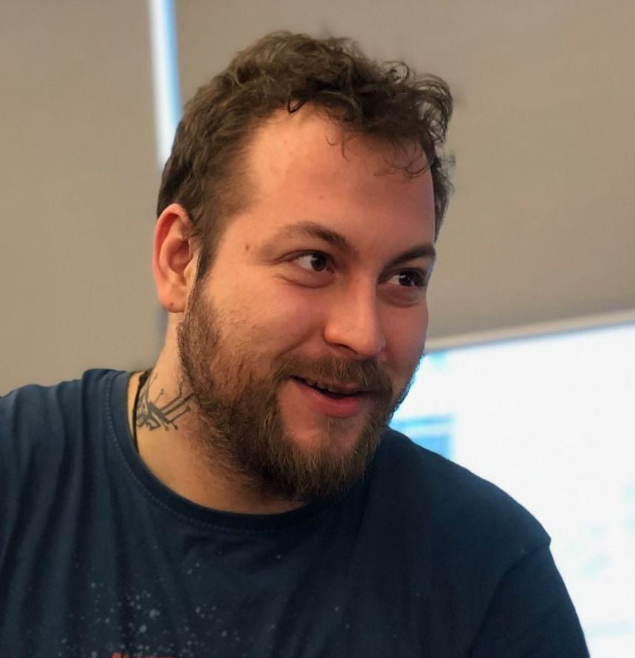
Balint Csergo
(deathowl)
PE @ Meta (Since 2019)
Working on all things DNS and Network Time
Golang, Python
Introduction

Slide 4
02 DNS Observability at scale

Slide 5
The problems we’re facing regarding DNS observability
02 DNS Observability at Scale
Monitoring production DNS service from the client side is troublesome.
Notes:
Client success % and response times are our SLOs.
Synthetic queries from an agent on each host were the best we had, but it’s not a real substitute for sampled user query data

Slide 6
The problems we’re facing regarding DNS observability
02 DNS Observability at Scale
Detecting anomalous behaviour from the server side logs is limited and delayed, data is heavily sampled

Slide 7
The problems we’re facing regarding DNS observability
02 DNS Observability at Scale
You found an offending host, but getting in depth and real-time information about every DNS query / process is nontrivial
Notes:
Dnswatch detailed

Slide 8
03 Our Solution

Slide 9
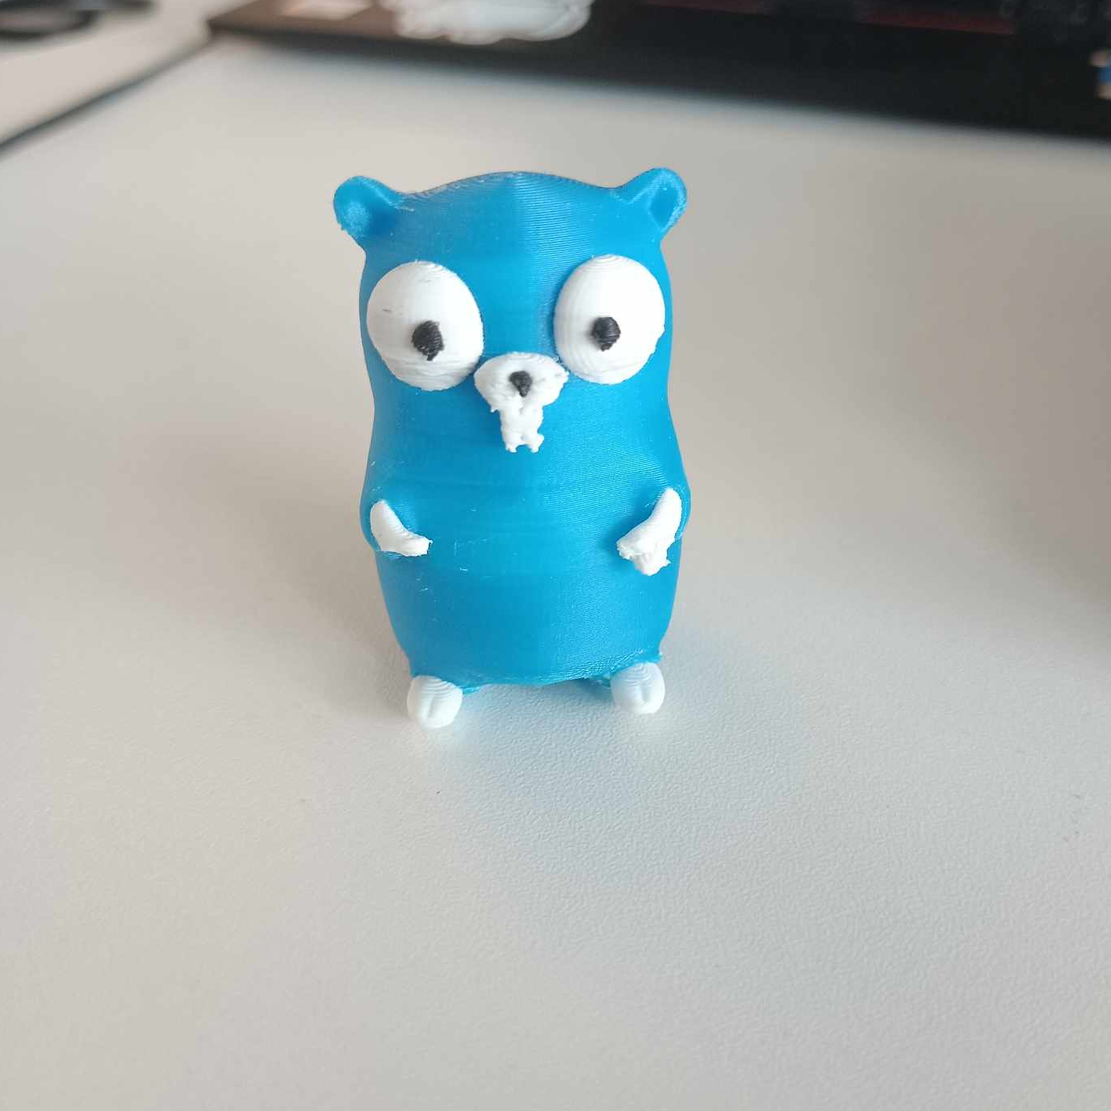
DNSWatch
03 Our Solution

Slide 10
Reusable BPF code
03 Our Solution
CO-RE (Compile Once – Run Everywhere)
Uses Fentry/Fexit for performance reasons
Kernel space capture of DNS traffic
Returned struct is easy to parse in the userspace
Kprobes can still be used in fallback mode.

Slide 11
Go code in the userspace
03 Our Solution
Well tested thanks to how amazing Go is
Easy to build and distribute for all our machines
Userspace parsing and filtering of DNS packets captured by our eBPF code
We use the same amazing miekg/dns as in DNSRocks

Slide 12
04 Demo Time
Using DNSWatch to detect DNS Data Exfiltration

Slide 13
Let’s look at this from the attacker’s perspective
04 Demo Time

Slide 14
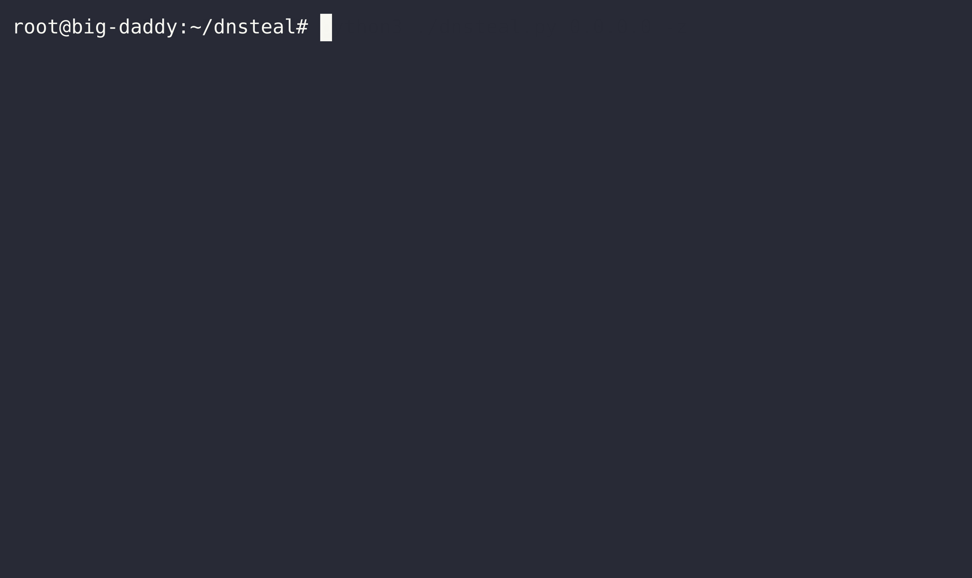
04 Demo Time

Slide 15
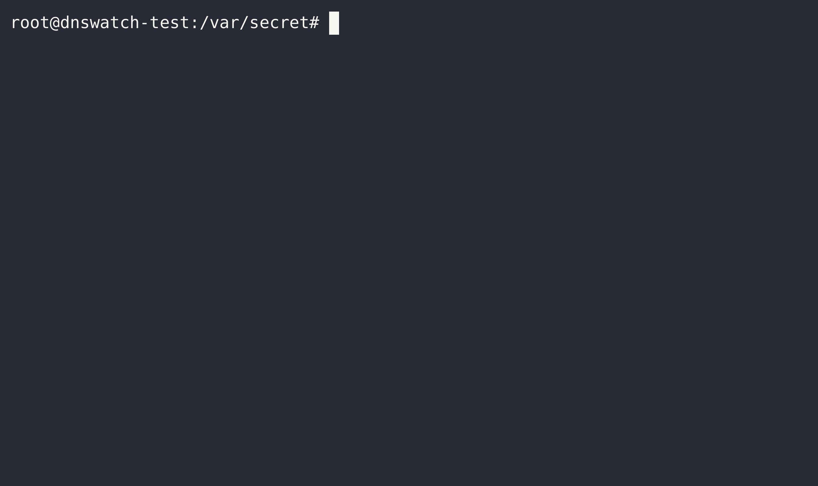
04 Demo Time

Slide 16
04 Demo Time

Slide 17
Detecting anomalous behaviour using DNSWatch
04 Demo Time

Slide 18
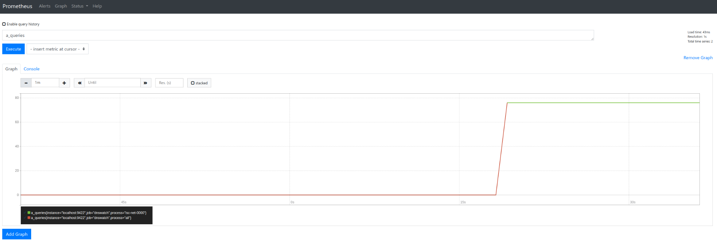
04 Demo Time

Slide 19
Diving deeper into what actually happens on the host
04 Demo Time

Slide 20
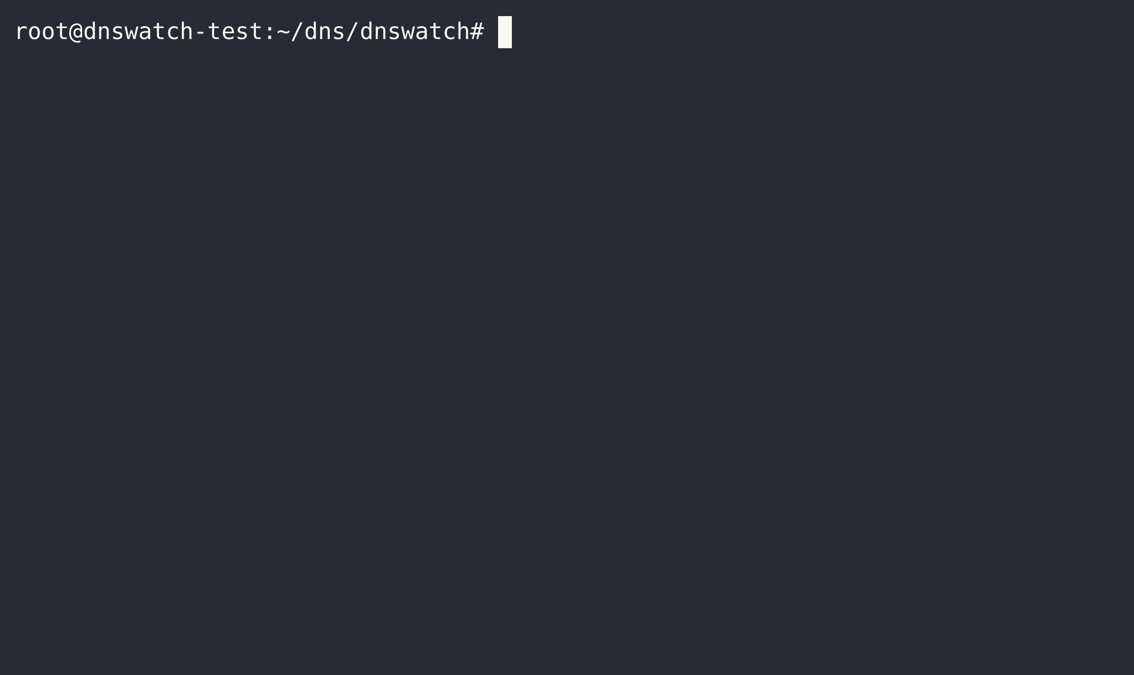
04 Demo Time

Slide 21
It’s open source
05 The best part

Slide 22
https://github.com/facebook/dns
05 The best part

Slide 23
THX
05 The best part

Slide 24
06 THX
Yaroslav Kolomiiets (@yarikk)
Oleg Obleukhov (@leoleovich)
Alex Bulimov (@abulimov)
Pablo Mazzini (@pmazzini)
Patrick Cullen (@t3lurid3)
Vadim Fedorenko (@vvfedorenko)
Vlad Mihailescu

