Slide 1
Intercept and Inject: DNS Response Manipulation in the Wild
Yevheniya Nosyk ¹, Qasim Lone ⁴, Yury Zhauniarovich ², Carlos H. Gañán ^{2,5}, Emile Aben ⁴, Giovane C. M. Moura ^{2,3}, Samaneh Tajalizadehkhoob ⁵, Andrzej Duda ¹, and Maciej Korczyński ¹
¹ Université Grenoble Alpes ² TU Delft ³ SIDN Labs ⁴ RIPE NCC ⁵ ICANN
OARC 41 (Da Nang, Vietnam)
6th September 2023

Slide 2
DNS resolution

Slide 3
DNS Root Servers

Slide 4
November 2021 k-root event
Source: https://lists.dns-oarc.net/pipermail/dns-operations/2021-November/021437.html

Slide 5
November 2021 k-root event: RIPE Atlas View

Slide 6
November 2021 k-root event: BGP route leak

Slide 7
To what extent the local Guangzhou instance of the k-root is reachable from the outside?

Slide 8
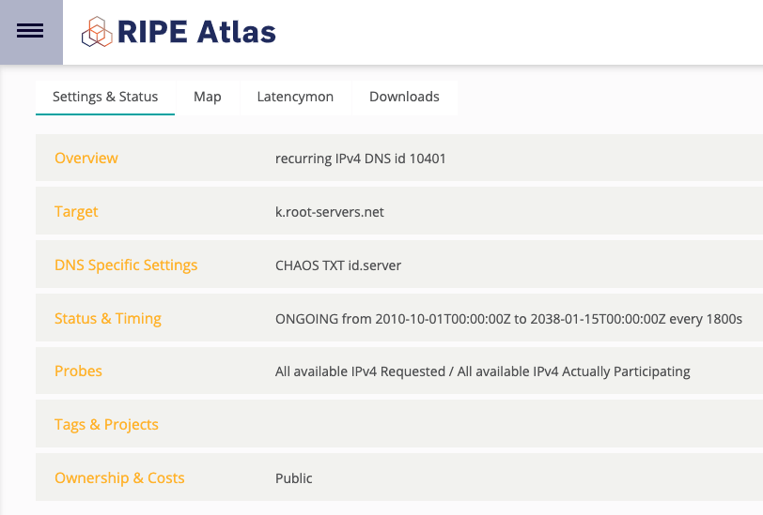
RIPE Atlas: built-in measurements
More than 11k active probes at a time
Instance reachable at least 2 month before being reported from 57 probes in 15 countries (AU, UA, CO, HK, LK, CH, FR, US, KR, DK, MX, ZM, BE, GB, NP, KE)
Instance occasionally reachable the following 9 months after the fix from 12 probes in 5 countries, but over IPv6 (RU, IL, MX, DK, HK)
11 probes receiving bogus responses for facebook.com (IPs of Dropbox and Twitter)

Slide 9
To what extent queries to DNS root servers experience manipulation?

Slide 10
RIPE Atlas : custom measurements
1b measurements (312 queries sent every 12h)
February – October 2022
NSID option for identification
14.3k RIPE Atlas probes (177 countries and 4,132 ASes)

Slide 11
Two types of responses
Non-injected (99.18% or 1b measurements):
{"measurement_id": 34848600, "probe_id": 53005, "executed": "2022-01-18 22:36:26+00:00", "response_nsid": ["ns2.nl-ams.k.ripe.net"], "answers": []}
{"measurement_id": 39032627, "probe_id": 27793, "executed": "2022-02-24 15:27:42+00:00", "response_nsid": ["M-ORY-1"], "answers": []}
Injected (0.82% or 9m measurements):
{"measurement_id": 34848596, "probe_id": 2147, "executed": "2022-01-18 23:28:34+00:00", "response_nsid": ["CleanBrowsing v1.6a - dns-edge-europe-frankfurt-c"], "answers": [{"Name": "google.com.", "Type": "A", "Class": "IN", "TTL": 90, "RDlength": 4, "Address": "142.250.180.238"}]}
{"measurement_id": 34848610, "probe_id": 34903, "executed": "2022-06-29 02:05:38+00:00", "response_nsid": [], "answers": [{"Name": "facebook.com.", "Type": "A", "Class": "IN", "TTL": 600, "RDlength": 4, "Address": "199.59.149.244"}]}

Slide 12
Injected responses (1/5)
Type A
7m responses out of 11m
2,419 unique IPs
49% of facebook.com and 89.6% of google.com responses were valid
{
"Name": "google.com.",
"Type": "A",
"Class": "IN",
"TTL": 235,
"RDlength": 4,
"Address": "216.58.208.142"
}

Slide 13
Injected responses (2/5)
Type AAAA
4m responses out of 11m
3,221 unique IPs
64.4% of facebook.com and 98.3% of google.com responses were valid
{
"Name": "google.com.",
"Type": "AAAA",
"Class": "IN",
"TTL": 174,
"RDlength": 16,
"Address": "2607:f8b0:4007:80a:0:0:0:200e"
}

Slide 14
Injected responses (3/5)
Type URI
42.5k responses out of 11m
Received by 15 probes from Iran
“0a2224” Rdata for facebook.com and “ef2678” Rdata for google.com
{
"Name": ".",
"Type": 256,
"Class": 256,
"TTL": 107008,
"RDlength": 1034,
"Rdata": "0a2224"
}

Slide 15
Injected responses (4/5)
Type SOA
6.7k responses out of 11m
Received by 1 probe from the USA
{
"Name": "facebook.com.",
"Type": "SOA",
"Class": "IN",
"TTL": 30,
"RDlength": 62,
"MasterServerName": "dns1.dnsfilter.com.",
"MaintainerName": "dadmin.dnsfilter.com.",
"Serial": 1,
"Refresh": 30,
"Retry": 30,
"Expire": 30,
"NegativeTtl": 30
}

Slide 16
Injected responses (5/5)
Type CNAME
4.5k responses out of 11m
Always google.com to forcesafesearch.google.com
Received by 6 probes from the USA, Spain, the Netherlands, and Russia.
{
"Name": "google.com.",
"Type": "CNAME",
"Class": "IN",
"TTL": 49919,
"RDlength": 18,
"Target": "forcesafesearch.google.com."
}
{
"Name": "forcesafesearch.google.com.",
"Type": "A",
"Class": "IN",
"TTL": 65939,
"RDlength": 4,
"Address": "216.239.38.120"
}

Slide 17
NSIDs of injected responses
do not contain NSIDs of root servers
78% empty
public resolvers (CloudflareDNS, OpenDNS, Quad9, Google DNS)
filtering services (CleanBrowsing)
unclassified

Slide 18
Persistence

Slide 19
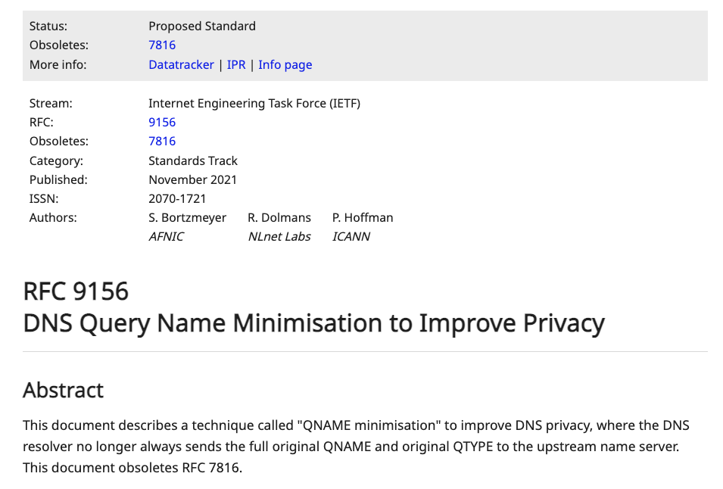
Countermeasures
BGP communities ¹
QNAME minimization
Encrypted DNS
DNSSEC
¹ Zhihao Li, Dave Levin, Neil Spring, and Bobby Bhattacharjee. 2018. Internet anycast: performance, problems, & potential. In Proceedings of the 2018 Conference of the ACM Special Interest Group on Data Communication (SIGCOMM '18). Association for Computing Machinery, New York, NY, USA, 59–73. https://doi.org/10.1145/3230543.3230547

Slide 20
Key takeaways
DNS root queries are manipulated
7% of RIPE Atlas probes from 66 countries are affected
Injected data is not always bogus
Transparent to end users
May introduce collateral damage
BGP leaks stay unnoticed

Slide 21
Thank you!
yevheniya.nosyk@univ-grenoble-alpes.fr

