Slide 1
A view of NXDOMAIN and DNSSEC from public DNS (cloudflare)
Geoff Huston, Joao Damas, George Michaelson

Slide 2
We have some summaries over cloudflare 1.1.1.1
Our collaborative research agreement with Cloudflare over 1.1.1.0/24 includes a feed as 1-in-n of their query strings seen
We’ve been able to construct a view updated daily, of two qualities in this feed
What level of NXDOMAIN query is seen down in the public DNS distinct from at the root?
What level of DNSSEC domain capability is there, in the actual domains visited, not the sum of domains signed in any TLD?

Slide 3
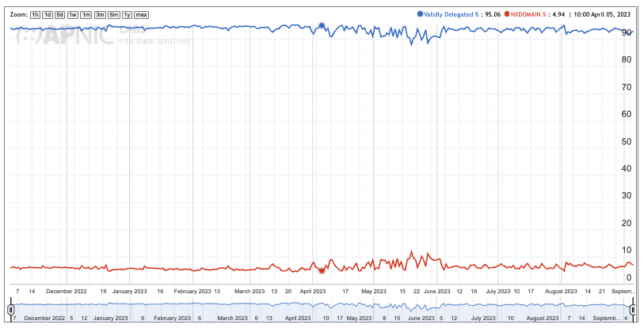
Delegated and NXDOMAIN requests through Cloudflare DNS
https://stats.labs.apnic.net/cfnxdata

Slide 4
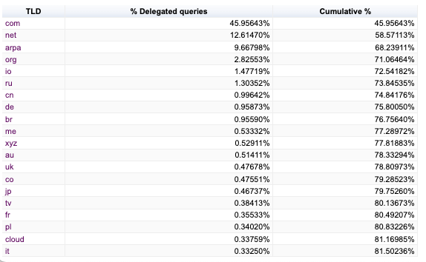
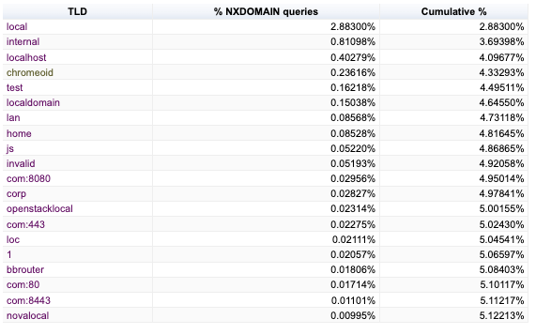
Delegated vs undelegated TLD query loads
Notice .js in undelegated. It’s the non-ISO3166 “jersey” domain but really here, is Javascript fetch leaks

Slide 5
“Chromeoid” –chrome DGA string persists
https://stats.labs.apnic.net/cfnxdata/?d=chromeoid&w=1

Slide 6
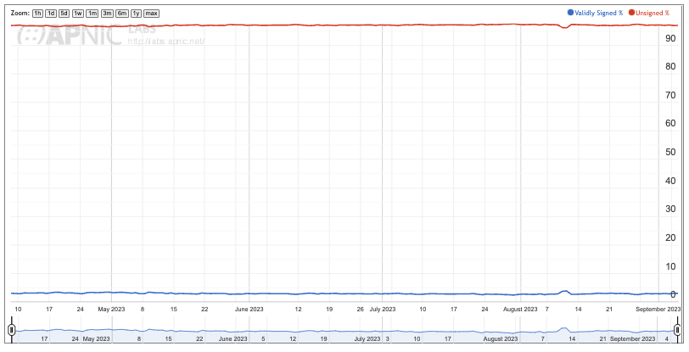
Signed and Unsigned requests through Cloudflare DNS
https://stats.labs.apnic.net/cfdnssecdata/?w=1&a=1

Slide 7
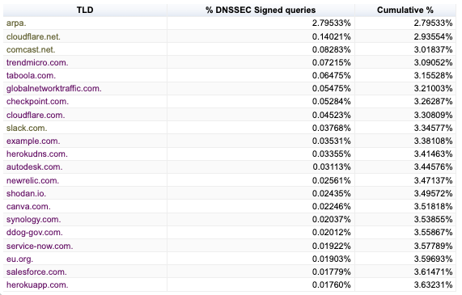
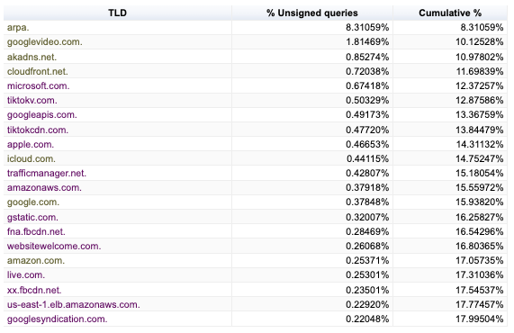
Top signed/unsigned query burdens
ARPA on both sides, because actual delegation into DNSSEC signed subdelegations in in-addr.arpa and ip6.arpa vary considerably, about 3:1 more unsigned than DNSSEC signed

