Slide 1
DNS-OARC 42 - Resolver Capability Testing

Slide 2
What is the DNS Research Federation?
A UK non profit
Mission: to advance the understanding of the Domain Name System's impact on cybersecurity, policy and technical standards.
Achieving our mission through:
Education and research
Improving access to data
Engagement in technical standards

Slide 3
Motivation
Ongoing desire / requirement to measure capabilities of resolvers in the wild
Builds on precedent work undertaken by APNIC over the last decade

Slide 4
Overview
Open source testing framework using standard Open Source DNS / Web servers - Commissioned by ICANN OCTO
Allows organisations to perform private testing using their own customer base
Facilitates selective sharing of data for the benefit of the wider community

Slide 5
Testing Scope
“Out of the Box” tests
IPv6 transport
QNAME minimisation
Aggressive NSEC
Minimum TTL allowed
TCP fallback
DNSSEC validation
Extensible architecture allows for custom user defined tests

Slide 6
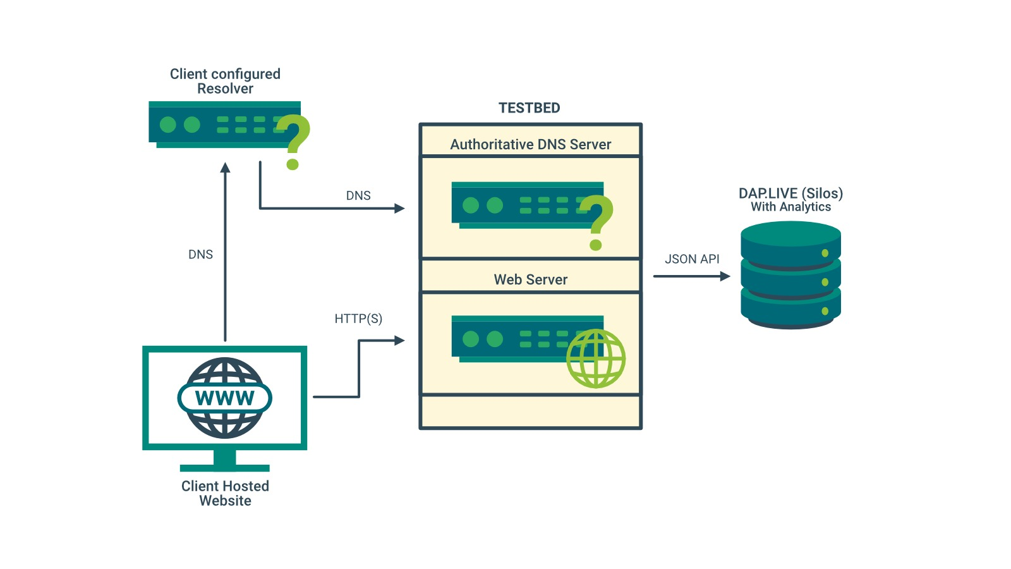
Architecture Summary

Slide 7
Components
Server Side Configuration and Reporting Toolkit (SSCRT)
CLI tool + Logging Cron - installed on Linux server, utilises BIND and Apache
Client Side Website Toolkit (CSWT)
Javascript library - Installed on testing website

Slide 8
Server Side Configuration and Reporting Toolkit (SSCRT)

Slide 9
CLI for installation and management of test instances
Configures BIND / Apache for a given test type using pre-registered test domains
Provides access to test logs in standard CSV, JSON and JSONL formats
Logging Cron
Processes BIND / Apache logs to generate test logs and optional automated reporting to DAP.LIVE
Server Side Configuration and Reporting Toolkit (SSCRT)

Slide 10
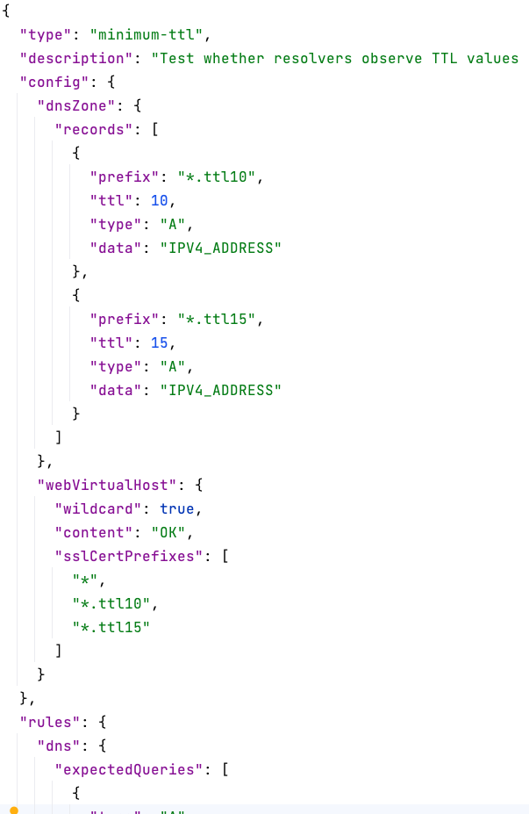
Server Side Configuration and Reporting Toolkit (SSCRT)
Test types defined using JSON schema -
encodes DNS/Web server config and expectation rules
User defined test types can be installed as JSON files

Slide 11
Server Side Configuration and Reporting Toolkit (SSCRT)
Test logs incorporate all expected DNS and HTTP requests for test run with indication of PASS / FAIL for the test
Logging level can be adjusted to prevent logging of personally identifiable info (IP addresses)

Slide 12
Client Side Website Toolkit (CSWT)

Slide 13
Client Side Website Toolkit (CSWT)
Installed as standard ES6 Javascript library on testing website
Triggers tests using background AJAX requests for test domains as configured on the SSCRT

Slide 14
Client Side Website Toolkit (CSWT)
Simple Javascript API for triggering one or more tests on page load for built in test types.
Custom triggers using simple Javascript interface for user defined tests.

Slide 15
LIVE DEMO

Slide 16
Please get involved
Beta testers
Data sharing
Some support and development packages available

Slide 17
Any Questions

