Slide 1
Wrap-Up

Slide 2


Slide 3



Thank you to our Sponsors and Patrons

Slide 4
Special thanks
Rebecca Petro (@rbcapetro) for running things in the shadow
Cathy Almond (@cathy-a) for the constant stream of #OARC42 updates on social media!

Slide 5
Don’t forget!
Workshop evaluation survey
https://www.surveyhero.com/c/oarc42
Sign up to our Mattermost platform if you haven’t already done so
https://chat.dns-oarc.net/

Slide 6
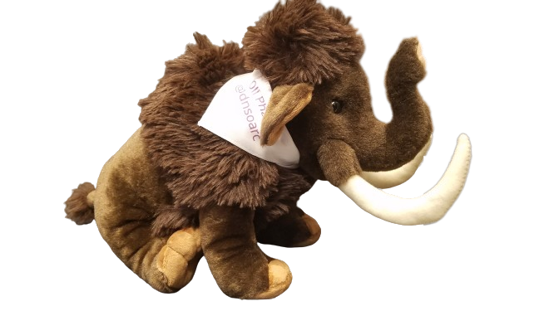
MastoDNS!
https://mastodns.net
Follow @dnsoarc@mastodns.net
Follow @oliphaunt@mastodns.net
OliPhaunt

Slide 7
Future events
OARC 43
  To be co-located with ICANN IDS
  Date and location: We’ll publish this info as soon as we can.
Please consider supporting an OARC workshop via Sponsorship, Patronage, or a donation:
https://www.dns-oarc.net/workshop/patronage-sponsorship

Slide 8
Last words
OARC Members, wider community
Programme Committee, Board & Exec
All our speakers
The various meeting operations teams
THANK YOU!

