Slide 1
Welcome & Information
Phil Regnauld
DNS-OARC

Slide 2


Slide 3

2024 Workshops Patron

Slide 4

OARC 42 DELUXE+ Sponsor

Slide 5
OARC 42 DELUXE Sponsor

Slide 6
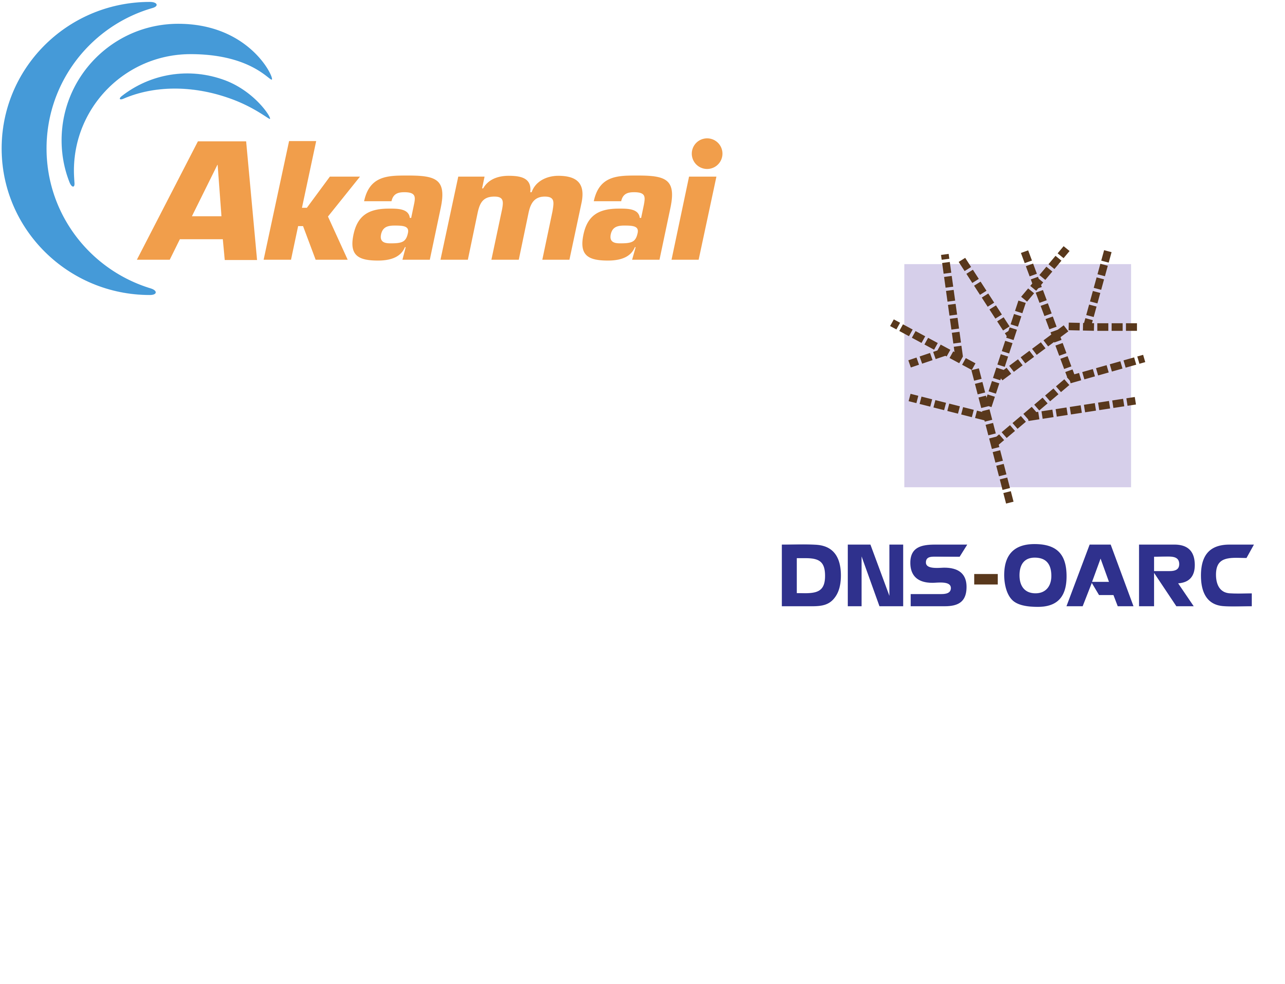
OARC 42 Social Event Sponsors

Slide 7
Hybrid Event
DNS-OARC Conduct Policy
  https://www.dns-oarc.net/oarc/policies/conduct
Workshop is being recorded
  OARC 42 Privacy Policy https://www.dns-oarc.net/oarc42
  YouTube: @DNSOARC
Social media hashtags
#LoveDNS #OARC42 #LifeUniverseandDNS

Slide 8
On-site Information
Wi-Fi: SSID DNS-OARC
      Password OARC-Workshop
Food & Drink
Toilet locations
Emergency procedures

Slide 9

COVID-19 Precautions
Pay attention to other Participants’ color code for contact
If you feel unwell
  Let staff know
  Isolate
  Attend remotely (remote attendance link will be provided)

Slide 10
Mattermost Chat
Access / sign-up https://chat.dns-oarc.net/
Petr will give more details on remote participation

Slide 11
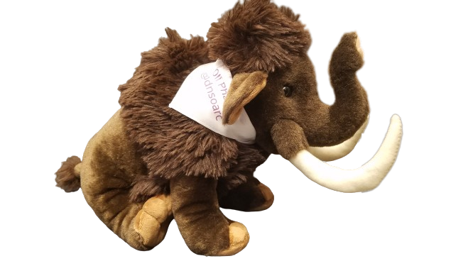
MastoDNS!
https://mastodns.net
Follow @dnsoarc@mastodns.net
Follow @oliphaunt@mastodns.net
OliPhaunt

Slide 12
Sponsor presentation
Will be at 1:45 PM today
During last 1/3rd of the Lunch Break

Slide 13
OARC Team @ OARC 42
In Charlotte
  Staff: Phil, Denesh, Jerry, Mike, Steve
  PC: Petr, Suzanne, Ben, Puneet
  Board: Joao, Ray, Shumon
Online
  Staff: @rbcapetro
  PC: @hazelesque, @cathy-a, @jtodd, @r.sommese, @tijay
  Board: @Benno, @Jabley, @jake.zack

Slide 14
In-person Social
Will be held at Fahrenheit – one block away from this venue
Time: 6 PM – 8:30 PM
Registration is required, and please wear your badge!

Slide 15
OARC Update

Slide 16
OARC’s Mission Statement
The Domain Name System Operations Analysis and Research Center (DNS-OARC) is a nonprofit, membership organization that seeks to improve the security, stability, and understanding of the Internet's DNS infrastructure.

Slide 17
OARC’s Mission Statement
Promote and conduct research with operational relevance through data collection and analysis
Offer useful services and tools
Build relationships among its community of members
Facilitate an environment where information can be shared responsibly
Enable knowledge transfer by organizing open workshops
Increase public awareness of the DNS's significance

Slide 18
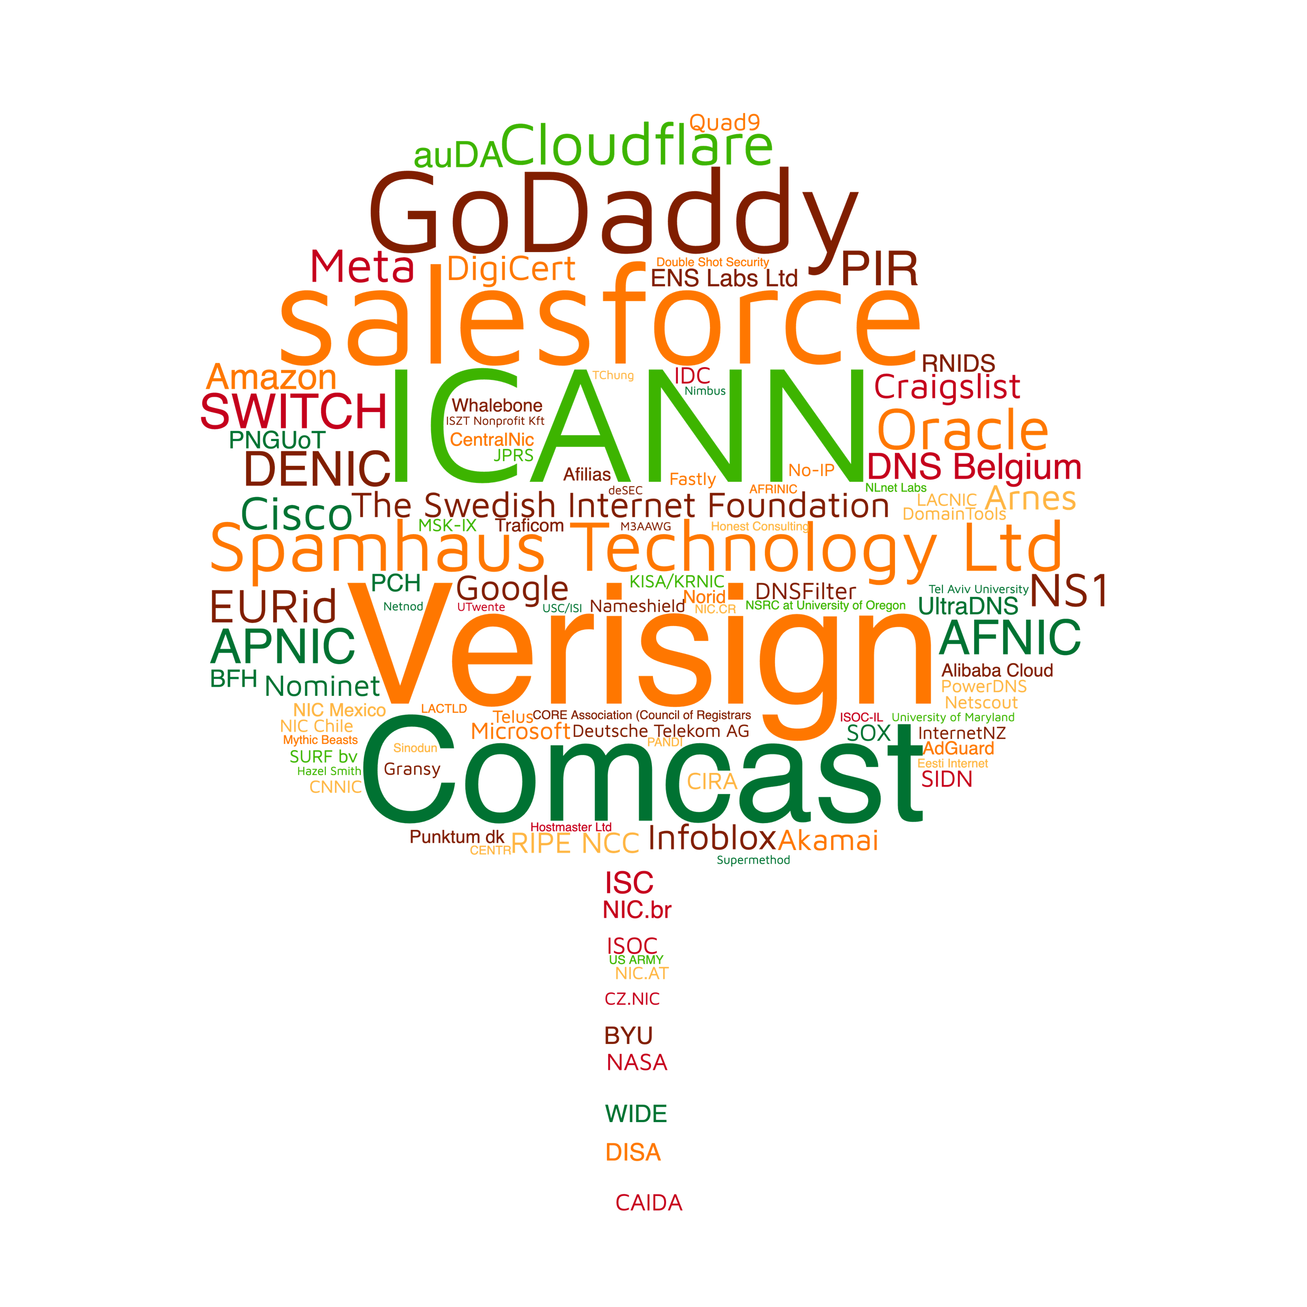
OARC’s Members

Slide 19
Since OARC 41…
Leadership transition: new President
Thanks to Keith Mitchell for 17 years of service!
New Board and Programme Committee

Slide 20
Since OARC 41…
Initiated the DITL data explorer project (thanks to Verisign)
Ongoing migration of OARC data sets to the new cluster
  Over 750 TB

Slide 21
Since OARC 41…
New releases of OARC maintained tools (dsc, dnsperf, dnscap,..)
Ongoing improvements to our Member Portal
AS112 website automation and re-vamp, funded by ARIN
Finalized replacement of our main Fremont site router
  No more IPv6 reachability issues for dnsviz (among others)

Slide 22
Future events
OARC 43
  To be co-located with ICANN IDS
  Date and location yet to be announced
  Very likely not Europe or North America
Please consider supporting an OARC workshop via Sponsorship, Patronage, or a donation:
https://www.dns-oarc.net/workshop/patronage-sponsorship

Slide 23
2023 – 2024 Board
  João Damas (Chair)
  Joe Abley (Treasurer)
  Ray Bellis (PC Liaison)
  Shumon Huque
  Benno Overeinder
  Jake Zack

Slide 24
2024 Programme Committee
  Petr Špaček (Chair)
  Hazel Smith (co-Chair)
  Ben Schwartz
  Cathy Almond
  John Todd
  Puneet Sood
  Raffaele Sommese
  Suzanne Woolf
  Tijay Chung

Slide 25
Why Become an OARC Member?
Access to and participation in the world's premier community of DNS technical experts
Influence development of open tools and services to support your infrastructure operations
Ability to share and analyze a unique dataset perspective into global DNS operations
Use of community co-ordination resources to respond to incidents and threats
Support a trusted neutral party free of vested interests in the DNS space

Slide 26
OARC’s Value Proposition
“I would attend DNS-OARC conferences for the hallway track alone. Not because of the coffee, but because of all the super welcoming peers who are always willing to help me with their insights and
knowledge.”
“OARC is a unique venue that brings together DNS vendors, operators of DNS services and researchers -the workshops provide a unique and valuable insight into the current state of the art of the DNS”

Slide 27
Wrap up
Help newcomers feel welcome and understand what makes OARC the great community it is!
To our OARC Members and Supporters, 2024 Workshop Patron Verisign, Programme Committee, Speakers, and all of you who signed up to attend, in person or remotely:
THANK YOU!

Slide 28
Denesh Bhabuta

Slide 29









Let’s chat, collaborate, and listen
Staff, PC, Board, Mentors
Share your opinions and questions
Connect with people you meet
Follow the OARC blog, and social media
#LoveDNS #OARC42 #LifeUniversandDNS

Slide 30
Petr Špaček

Slide 31
OARC 42 Participation
Mattermost Workshops channel https://chat.dns-oarc.net/
  Q&A
  Talk rating polls 👍 😐 👎
  General discussion
Q&A – Name and affiliation
  Microphone
  Mattermost #questions – Q&A Monitor asks on your behalf

Slide 32
Lightning Talks
30-40 minutes in the final session Friday 9th February
  5-10 minutes per talk. No Q&A
Abstract submissions close 17:00 EST TODAY (8th February)
  Call for Presentations @ https://www.dns-oarc.net/oarc42
  PC will select and notify speakers

