Slide 1
Using DNS to solve the latency challenge

Slide 2
DNS does its job well
DNS in its purest form does one thing: answer queries and serve up IP addresses, 24/7 without a break (at least that’s what we all here try to ensure)
It’s done this for now over 40 years, and that’s why DNS remains a crucial part of the internet’s core infrastructure.
DNS-OARC is living proof of how resilient, reliable and impactful DNS is…

Slide 3
Latency, the ignored KPI
One of the biggest issues that business faces in today's internet is latency. A study conducted by Shopify and Amazon revealed that 100ms of additional latency on an e-commerce website means 7% of lost revenue.
In Amazon’s case that equals to $4B each month
The problem: When you ask a company if they know what their cost caused by latency is, you get empty looks.
Notes:
End to End latency measurement is rare

Slide 4
Questions we started asking ourselves
Does DNS introduce latency?
Can DNS help to improve latency?
What can we do?

Slide 5
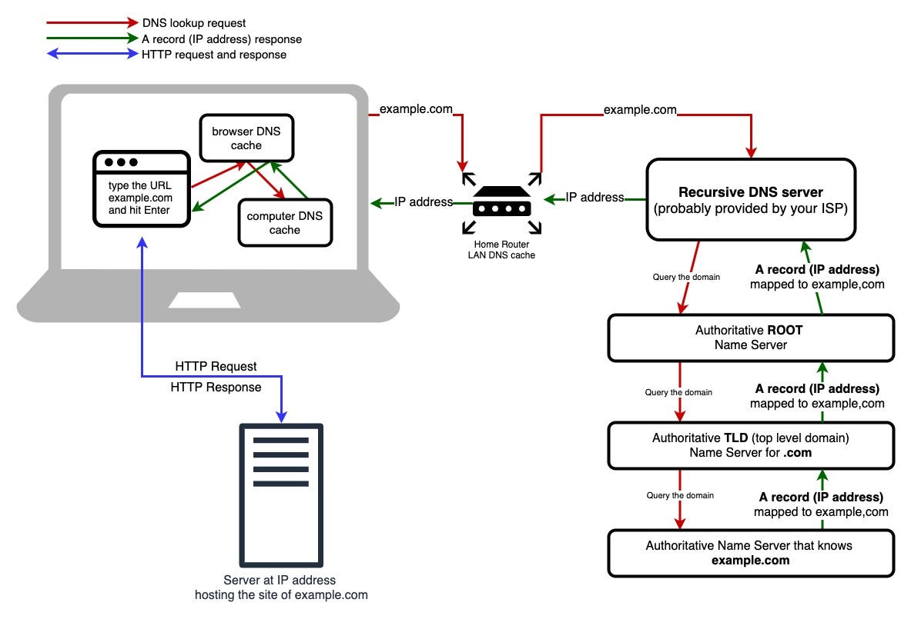
Does DNS play a role in latency?
ISP 1
A ocsp.r2m02.amazontrust.com OK IP 124.9ms
A fls-na.amazon.ca OK CNAME 294.0ms
A completion.amazon.ca OK CNAME 45.3ms
A unagi.amazon.ca OK CNAME 196.6ms
A completion.amazon.com OK IP 244.1ms
A m.media-amazon.com OK CNAME 229.1ms
A (...)ssl-images-amazon.com OK CNAME 290.7ms
A www.amazon.ca OK CNAME 122.5ms
----------------------------------------------------
1 547.2 ms
ISP 2
A ocsp.r2m02.amazontrust.com OK IP 92.1ms
A fls-na.amazon.ca OK CNAME 129.9ms
A completion.amazon.ca OK CNAME 25.5ms
A unagi.amazon.ca OK CNAME 83.2ms
A completion.amazon.com OK IP 89.6ms
A m.media-amazon.com OK CNAME 119.3ms
A (...)ssl-images-amazon.com OK CNAME 212.3ms
A www.amazon.ca OK CNAME 46.8ms
----------------------------------------------------
798.7 ms

Slide 6
Double down on some questions
Where is the bottleneck and how is it measured?
Can DNS help to improve latency?
What can we do?

Slide 7
Where is the bottleneck?
Their Datacenter
Their HUB
Carrier Networks
Datacenter Load balancer
Server Node

Slide 8
Where is the bottleneck?
Their Datacenter
Their HUB
Carrier Networks
My ISP HUB
Datacenter Load balancer
Server Node

Slide 9
Where is the bottleneck?
Their Datacenter
Their HUB
Carrier Networks
My ISP HUB
ISP Neighbourhood Node
Datacenter Load balancer
Home Router
Server Node
Home Computer

Slide 10
Where is latency measured
Their Datacenter
Their HUB
Carrier Networks
My ISP HUB
ISP Neighbourhood Node
Datacenter Load balancer
Home Router
Traditional Load Balancers
Server Node
Home Computer

Slide 11
Where is latency measured
Their Datacenter
Their HUB
Carrier Networks
My ISP HUB
ISP Neighbourhood Node
3rd Party Measurement Node
My ISP Datacenter
Datacenter Load balancer
Home Router
3rd Party Measurement Node
Traditional Load Balancers
Server Node
Home Computer

Slide 12
Where is latency measured
Their Datacenter
Their HUB
Carrier Networks
My ISP HUB
ISP Neighbourhood Node
3rd Party Measurement Node
My ISP Datacenter
Datacenter Load balancer
Home Router
3rd Party Measurement Node
WAF or WPM
Traditional Load Balancers
Server Node
Home Computer

Slide 13
Where is latency measured
Their Datacenter
Their HUB
Carrier Networks
My ISP HUB
ISP Neighbourhood Node
3rd Party Measurement Node
My ISP Datacenter
Datacenter Load balancer
Home Router
3rd Party Measurement Node
WAF or WPM
Traditional Load Balancers
Server Node
Home Computer
Real User Measurements

Slide 14
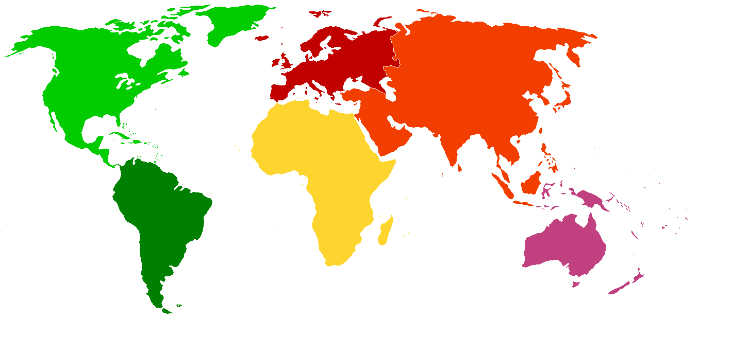
Where to go?

Slide 15
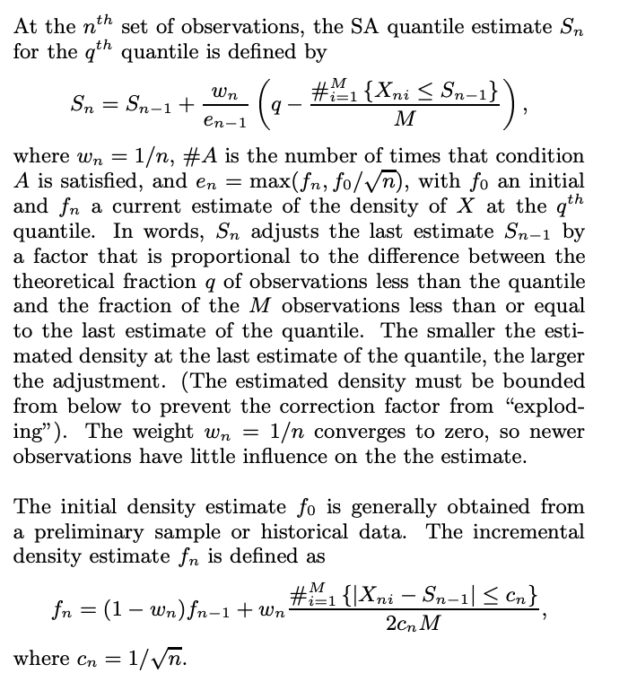
The Math
Incremental Quantile Estimation for Massive Tracking
Diane Lambert
Data is coming down a pipe at a ferocious rate, and we need to monitor statistics of the data. There is no reason to think that the data are normally distributed, so quantiles of the data are important to watch. The probe attached to the pipe has only limited memory, though, so it is impossible to compute the quantiles by sorting the data. The only possibility is to incrementally estimate the quantiles as the data fly by.
It resembles an exponentially weighted moving average in form, processing and memory requirements, but it is based on stochastic approximation.

Slide 16
What do we see when measure TTLB?

Slide 17
Where to go?

Slide 18
What do we see when measure TTLB?

Slide 19
“This isn’t a job for DNS” Perhaps, but what else can get the job done? In-band solutions can’t deal with latency in “last mile” connections because they don’t have visibility BGP-based solutions can’t deal with latency because BGP isn’t really managed DNS is a more obvious choice. It’s built for resilience, and has the agility to work around a wide variety of latency challenges (traffic congestion, underwater cables sliced, etc.)

Slide 20
What do we mean by the “best” connection?
Users will have different definitions of what “best” means.
Performance: Fastest/lowest latency connection
Resilience: Most available/least degraded connection
Cost: Least expensive connection or connection that maximizes contract spend levels
At any given moment, the mix of these factors may vary to produce the “best” connection.

Slide 21
We need your feedback Operational challenge How can we measure “last mile” performance in a consistent way when internet traffic is inherently inconsistent? Cities/densely populated areas produce a representative sample of data, but areas with low population are harder to gauge Potential risks What are the potential risks/problems of this approach to GSLB from a DNS perspective?

