Slide 1
From DNS to Inbox: Exploiting dangling DNS for malicious email
DNS-OARC 43 October 26-27, 2024

Slide 2
Meet the speaker
Carel Bitter
Head of Data, Spamhaus

Slide 3
What we’ll cover
What is dangling DNS?
Introduction to SubDoMailing?
A Case Study: SubDoMailing
What are they mailing?
Recommendations

Slide 4
25 years
in the industry

Slide 5
What is dangling DNS?
“Misconfigured DNS records that point to non-existent or expired services.”

Slide 6
Exploiting dangling DNS records
Leaving DNS records in a zone that is no longer used leaves domain name owners vulnerable to various forms of abuse
Common with CNAME records
Due to decommissioned external services (and typos)
Zone files often seem to be a one way street ;)

Slide 7
CNAMES and TEXT records
CNAMEs are used to point one domain to another e.g. prague.dns-oarc.net -> oarc43.dns-oarc.org
By adding a TXT record to the target instead of an A record, you can publish a SPF record….
…..and use the origin to authenticate emails!

Slide 8
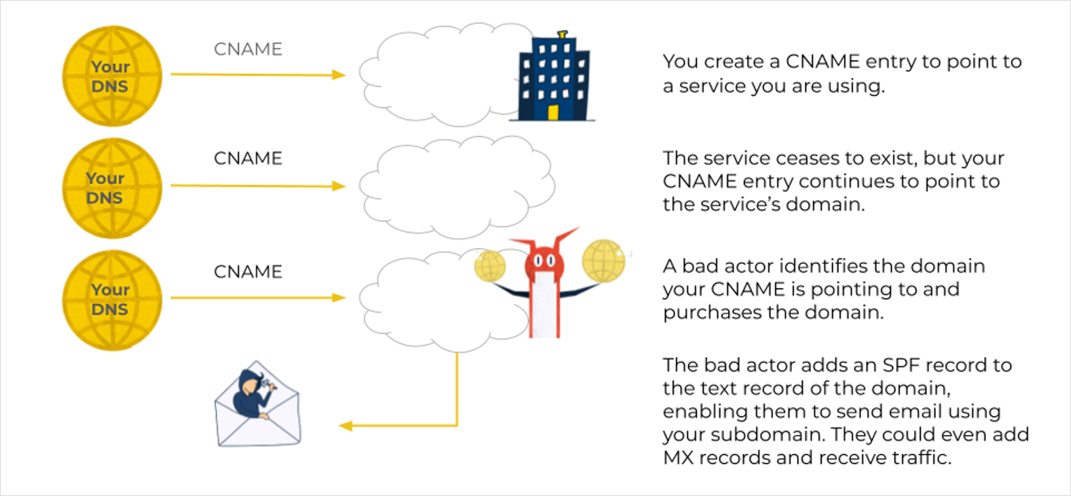
Dangling DNS for email
Notes:
When legitimate (good reputation) domain names have dangling CNAMEs, attackers can add SPF records through the domains the CNAMEs point to.
An attacker can pick up an unregistered domain name, publish their own SPF record, while exploiting the origin domain’s reputation.
Reasonably well-known method, discussed previously (aka SubdoMailing).

Slide 9
25 years
in the industry

Slide 10
SubDoMailing | Classes of domains
Victims (dangling CNAME)
CNAME target domains
SPF include domains
Infrastructure domains
Body/payload domains

Slide 11
1 | Victim domain (dangling CNAME)
Owned by ‘innocent bystanders’
Zone contains CNAME pointing to another domain that no longer exists
Dangling DNS names enable abuse by third parties
If fixed by the domain owner….the scheme falls apart
High profile domain owners at greater risk

Slide 12
2 | CNAME target domain
Domain that the dangling CNAME (victim domain) points to.
Actual name & TLD of target domains determined by the dangling entries, so limited options!
Two main variants:
External services expired domains (e.g. discontinued products)
Typos of legitimate targets

Slide 13
Example | CNAME target domain
victim-domain.example.com 3600 IN CNAME a3erp-nominacloud.com
a3erp-nominacloud.com. 172800 IN NS 054.a3erp-nominacloud.com a3erp-nominacloud.com. 172800 IN NS 372.a3erp-nominacloud.com
054.a3erp-nominacloud.com. 3600 IN A 216.22.11.204
372.a3erp-nominacloud.com. 3600 IN A 66.63.160.161

Slide 14
3 | SPF include domain
Included in CNAME target domains to:
expand the available space in SPF records
to make management easier
Observed containing the live infrastructure (sending IPs) of attackers
Great for active reconnaissance

Slide 15
Example | SPF include domain
Example: a3erp-nominacloud.com
"v=spf1 include:nicefood.us.com include:jobfinder.us.com include:healthy.de.com include:basket.de.com include:business2.me include:2ad.me -all"
Same for: 1paket.net galasport.net ipv4-brasil.com m2imb.com martizcx.com ntgmail.net

Slide 16
4 | Infrastructure domain
Any other domains used by attacker to conduct campaigns
rDNS for sending IPs
DKIM signing (d=)

Slide 17
Example | Infrastructure domains
Example rDNS domains used/owned by actor: 74.48.156.67 cytivalifesciences.me 74.48.156.68 grow4.me 74.48.156.69 larrysherwood.me 74.48.156.70 karabakh.me 74.48.161.103 canyoututor.me 74.48.161.104 profitability.me 74.48.161.105 tossing.me
But also: 74.48.151.242 only-slocate.iodesign.me 74.48.151.243 cordial-cdpd.iodesign.me 74.48.151.244 demerit-dod.iodesign.me 74.48.151.245 iodesign.me

Slide 18
5 | Payload domain
Included in the body/payload of emails
Can be third party owned
Can be an abused resource

Slide 19
25 years
in the industry

Slide 20
SubDoMailing Campaign
Victim domain autorigoldi.it.
CNAME skoda.autorigoldi.it. 3600 IN CNAME hub.dealerskoda.com. hub.dealerskoda.com. 3600 IN CNAME dealerskoda.com.
CNAME target dealerskoda.com. 3600 IN TXT "v=spf1 include:nicefood.us.com include:jobfinder.us.com include:healthy.de.com include:basket.de.com -all"

Slide 21
SubDoMailing campaign
SPF payload domain
nicefood.us.com. 3600 IN TXT "v=spf1 ip4:194.54.184.139 ip4:194.54.184.140 ip4:194.54.184.141 ip4:194.54.184.142 ip4:194.54.184.143 ip4:194.54.184.152 ip4:194.54.184.153 ip4:198.27.110.66 ip4:198.27.110.75 ip4:149.56.204.126 ip4:198.27.110.69 ip4:198.27.110.72 ip4:198.27.110.74 ip4:83" ".136.49.57 ip4:83.136.49.59 ip4:83.136.49.61 ip4:83.136.49.62 ip4:83.136.49.36 ip4:83.136.49.38 ip4:148.135.102.5 ip4:148.135.102.7 ip4:148.135.102.8 ip4:148.135.102.9 ip4:148.135.102.10 ip4:148.135.50.135 ip4:148.135.50.153 ip4:148.135.50.154 ip4:148.135" ".50.156 ip4:148.135.50.157 ip4:148.135.50.158 ip4:148.135.50.160 ip4:61.97.250.130 ip4:61.97.250.141 ip4:61.97.250.142 ip4:61.97.250.144 ip4:61.97.250.153 ip4:61.97.250.154 ip4:61.97.250.155 ip4:74.208.165.47 ip4:74.208.211.170 ip4:74.208.235.197 ip4:194." "54.184.90 ip4:194.54.184.92 ip4:194.54.184.93 ip4:194.54.184.94 ip4:194.54.184.95 ip4:185.112.82.80 ip4:185.112.82.81 ip4:185.112.82.82 ip4:185.112.82.83 ip4:185.112.82.84 ip4:69.61.104.64 ip4:69.61.104.65 ip4:69.61.104.66 ip4:69.61.104.67 ip4:69.61.104.6" "8 ip4:81.7.3.72 ip4:81.7.3.222 ip4:81.7.3.223 ip4:81.7.3.224 ip4:81.7.3.226 ip4:148.135.33.58 ip4:148.135.33.59 ip4:148.135.33.60 ip4:148.135.33.61 ip4:148.135.33.62 -all"

Slide 22
25 years
in the industry

Slide 23
What are they mailing?
Car insurance spam!

Slide 24
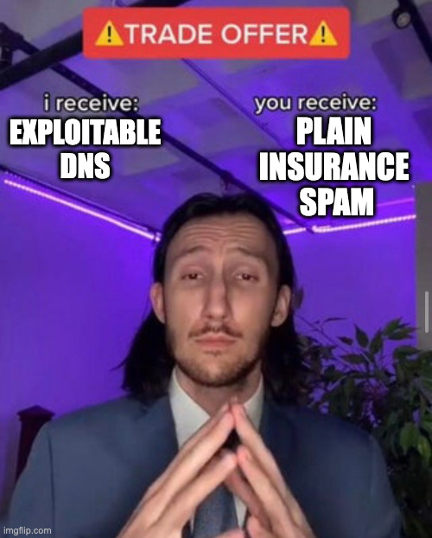
What are they mailing?
I feel cheated…

Slide 25
I feel cheated…
Not a cool malspam campaign…
Or a super targeted phishing…
Or an attack targeting the business that owns the exploited domain, but…

Slide 26
…..this may still have happened!

Slide 27
25 years
in the industry

Slide 28
What can we do?
Delete deprecated entries from DNS zone files.
DKIM alignment is a good idea.
Watch this closely - it’s a TTP, so not limited to a single actor.

Slide 29
Learn more - get in contact
Carel Bitter
Head of Data, Spamhaus
carel@spamhaus.com
https://www.linkedin.com/in/carelb/
https://www.spamhaus.org

