Slide 1
Generative AI and DNS
Own the Narrative
Pallavi Aras-Mathai

Slide 2
Agenda
Generative AI and DNS
Context setting
Experiment using Gen AI tools
Own the Narrative
Conclusion
Proposed Solution
Notes:
DNS knowledge is focused within the DNS community and sort of thins out as you move outwards from the community.

Slide 3
DNS protocol knowledge
IETF RFC documents
Blogs like Cloudflare
Mailing lists
DNS Subject Matter Experts (SME)
Notes:
DNS knowledge is focused within the DNS community and sort of thins out as you move outwards from the community.

Slide 4
Use cases for non-SME using DNS
Service Owners add CNAME or TXT
Domain ownership proof
Google Sites
Cert issuance
Domain control validation (DVC)
Service Owners add MX records to setup emails
Notes:
Various service owners require knowledge of DNS to prove domain ownership for cert issuance or use functionalities for example Stripe verify domain ownership for websites associated with a stripe payment account. Google sites requires knowledge of DNS to create custom domain feature etc.

Slide 5
Where do non-SMEs find DNS information?
Notes:
Previously Google but now Generative AI tools like ChatGPT

Slide 6
Where do non-SMEs find DNS information?
Notes:
Previously Google but now Generative AI tools like ChatGPT

Slide 7
Generative (Gen) Artificial Intelligence (AI)
Generative AI is the kind of AI you can use to create new text, visual, and audio content.^{[1]}

Slide 8
Do GEN AI tools answer correctly???

Slide 9
Generative AI research experiment
Ask Gen AI tool, DNS related questions of increasing difficulty.
Verify answers against real world

Slide 10
Gen AI tools used in the research
Chat GPT
Meta AI

Slide 11
Gen AI research experiment
Questions -
Can CNAME be added to zone apex?
How do wildcards resolve a DNS query?
How do you specify CAA for wildcard FQDN?

Slide 12
Question 1
Can CNAME be added to zone apex?

Slide 13
Can CNAME be added to zone apex?
ChatGPT is Correct
Notes:
Screenshots from the tools ( audience will be asked to focus on highlighted.)

Slide 14
Can CNAME be added to zone apex?
Meta AI is Correct

Slide 15
Can CNAME be added to zone apex? - Reality
Correct answer
CNAME cannot be created at zone apex.
AI tools answered correctly

Slide 16
Question 2
How do wildcards resolve a DNS query?

Slide 17
How do wildcards resolve a DNS query?
Chat GPT is WRONG

Slide 18
How do wildcards resolve a DNS query?
AI tools answers are WRONG
Meta AI is WRONG

Slide 19
How do wildcards resolve a DNS query? - Reality
% dig '*.pallavitest.com.' +short
testgoogle.pallavitest.com.
8.8.8.8
% dig 'label.pallavitest.com.' +short
testgoogle.pallavitest.com.
8.8.8.8
% dig 'label3.label2.label.pallavitest.com.' +short
testgoogle.pallavitest.com.
8.8.8.8

Slide 20
How do wildcards resolve a DNS query? - Reality
Correct answer:
Wildcard DNS record can resolve multi-label subdomains.
AI tools answers are WRONG

Slide 21
Question 3
How do you specify CAA for wildcard FQDN?

Slide 22
How do you specify CAA for wildcard FQDN?
Chat GPT is WRONG

Slide 23
How do you specify CAA for wildcard FQDN?
AI tools answers are WRONG
Meta AI is WRONG

Slide 24
How do you specify CAA for wildcard FQDN? - Reality
RFC 8659 - DNS Certification Authority Authorization (CAA) Resource Record
Given a request for a specific FQDN X or a request for a Wildcard Domain Name *.X, the Relevant RRset RelevantCAASet(X)
AI tools answers are WRONG

Slide 25
Conclusion of the experiment
Responses of GenAI tools, cannot be trusted

Slide 26
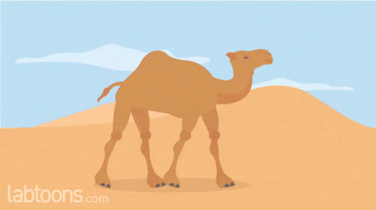
Proposed Solution
DNSchat tool using Retrieval Augmented Generation (RAG)

Slide 27
Retrieval Augmented Generation (RAG)
Retrieval Augmented Generation (RAG) is an architecture that augments the capabilities of a Large Language Model (LLM) like ChatGPT by adding an information retrieval system that provides grounding data. ^{[2]}

Slide 28
DNSchat tool - Proof of Concept (PoC)
Used Azure Open AI for the POC
Create Azure AI service
Upload RFC 8659 to the AI service
Create Open AI Chatbot linking to the AI service

Slide 29
Question 3
How do you specify CAA for wildcard FQDN?

Slide 30
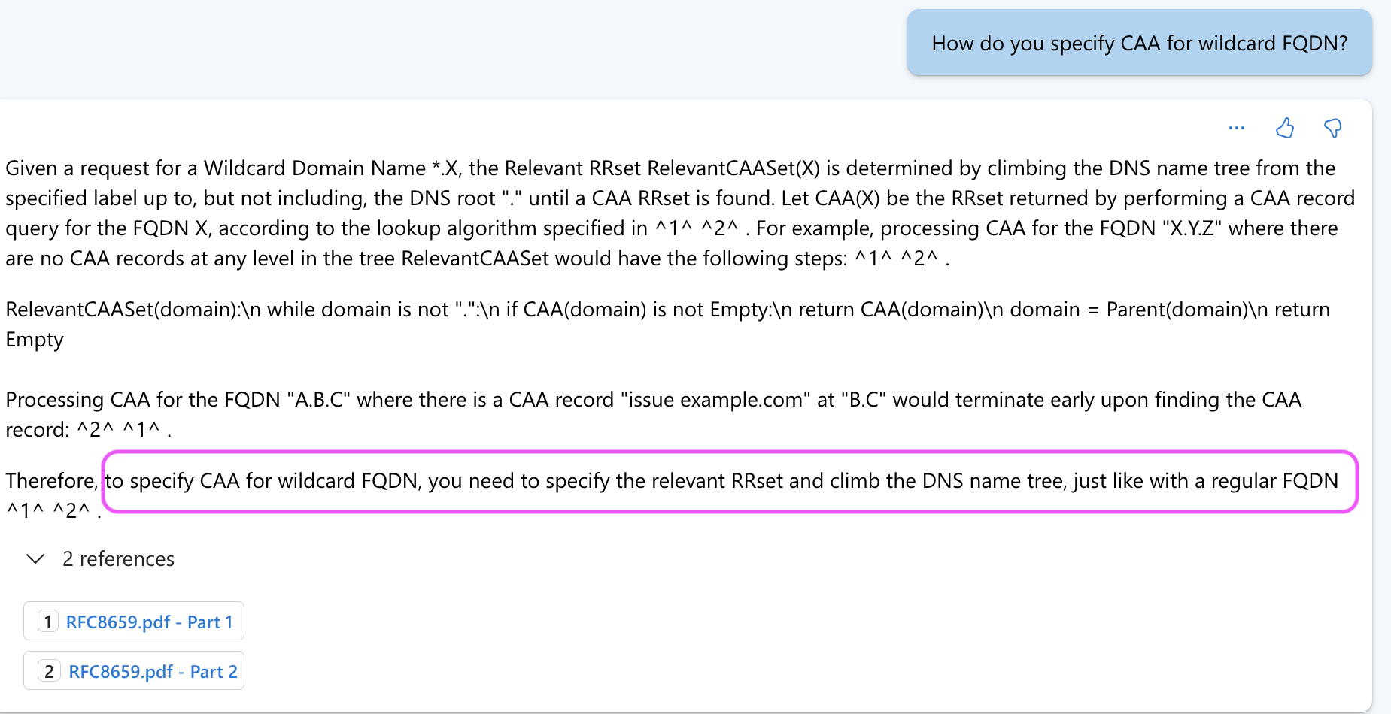
DnsChat tool - POC

Slide 31
Next Steps - Own the narrative
DNSchat tool ….
Collaboration with DNS-OARC
Managed and verified by DNS community
Trustworthy to give correct information

Slide 33
Reference
[1] https://appian.com/learn/topics/enterprise-ai/what-is-generative-ai#:~:text=Generative%20AI%20is%20the%20kind,speed%20up%20content%20creation%20tasks.
[2]
https://learn.microsoft.com/en-us/azure/search/retrieval-augmented-generation-overview

Slide 34
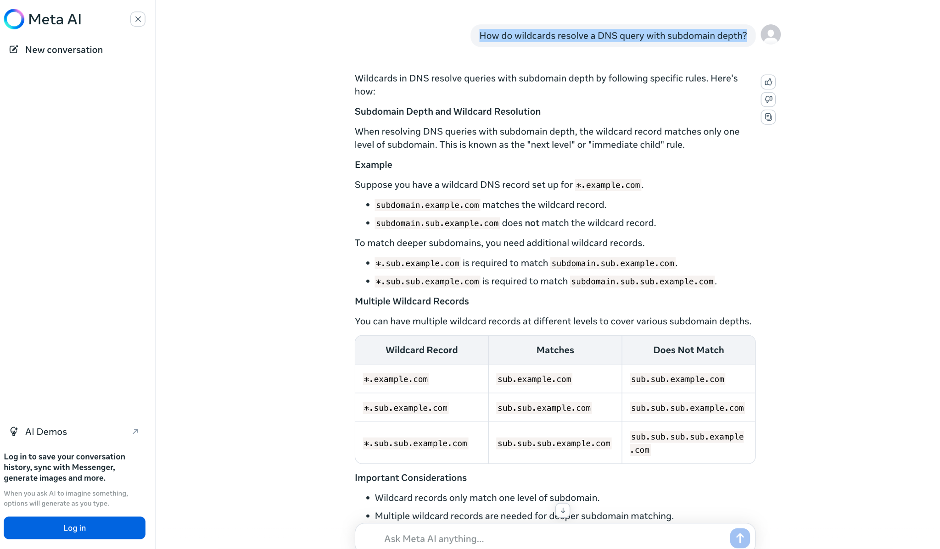

Slide 35
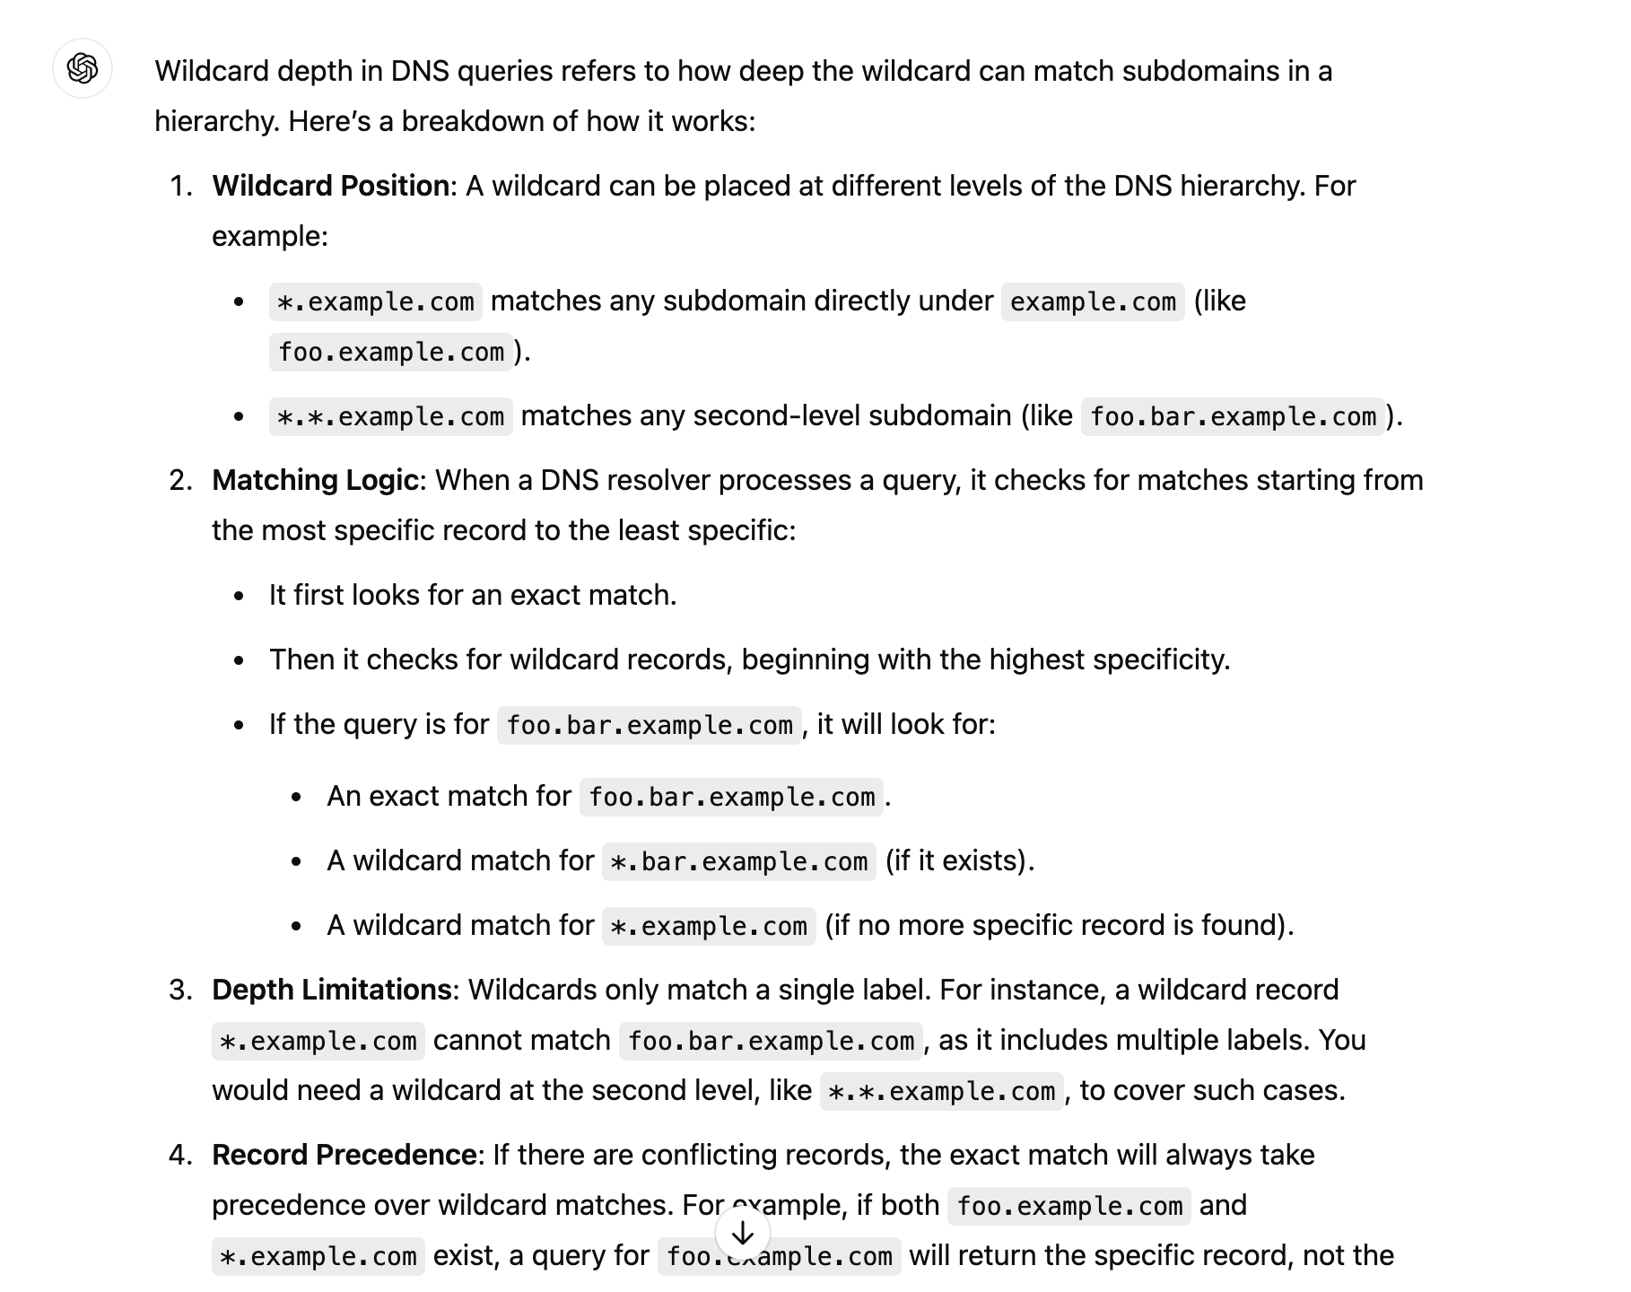

Slide 36
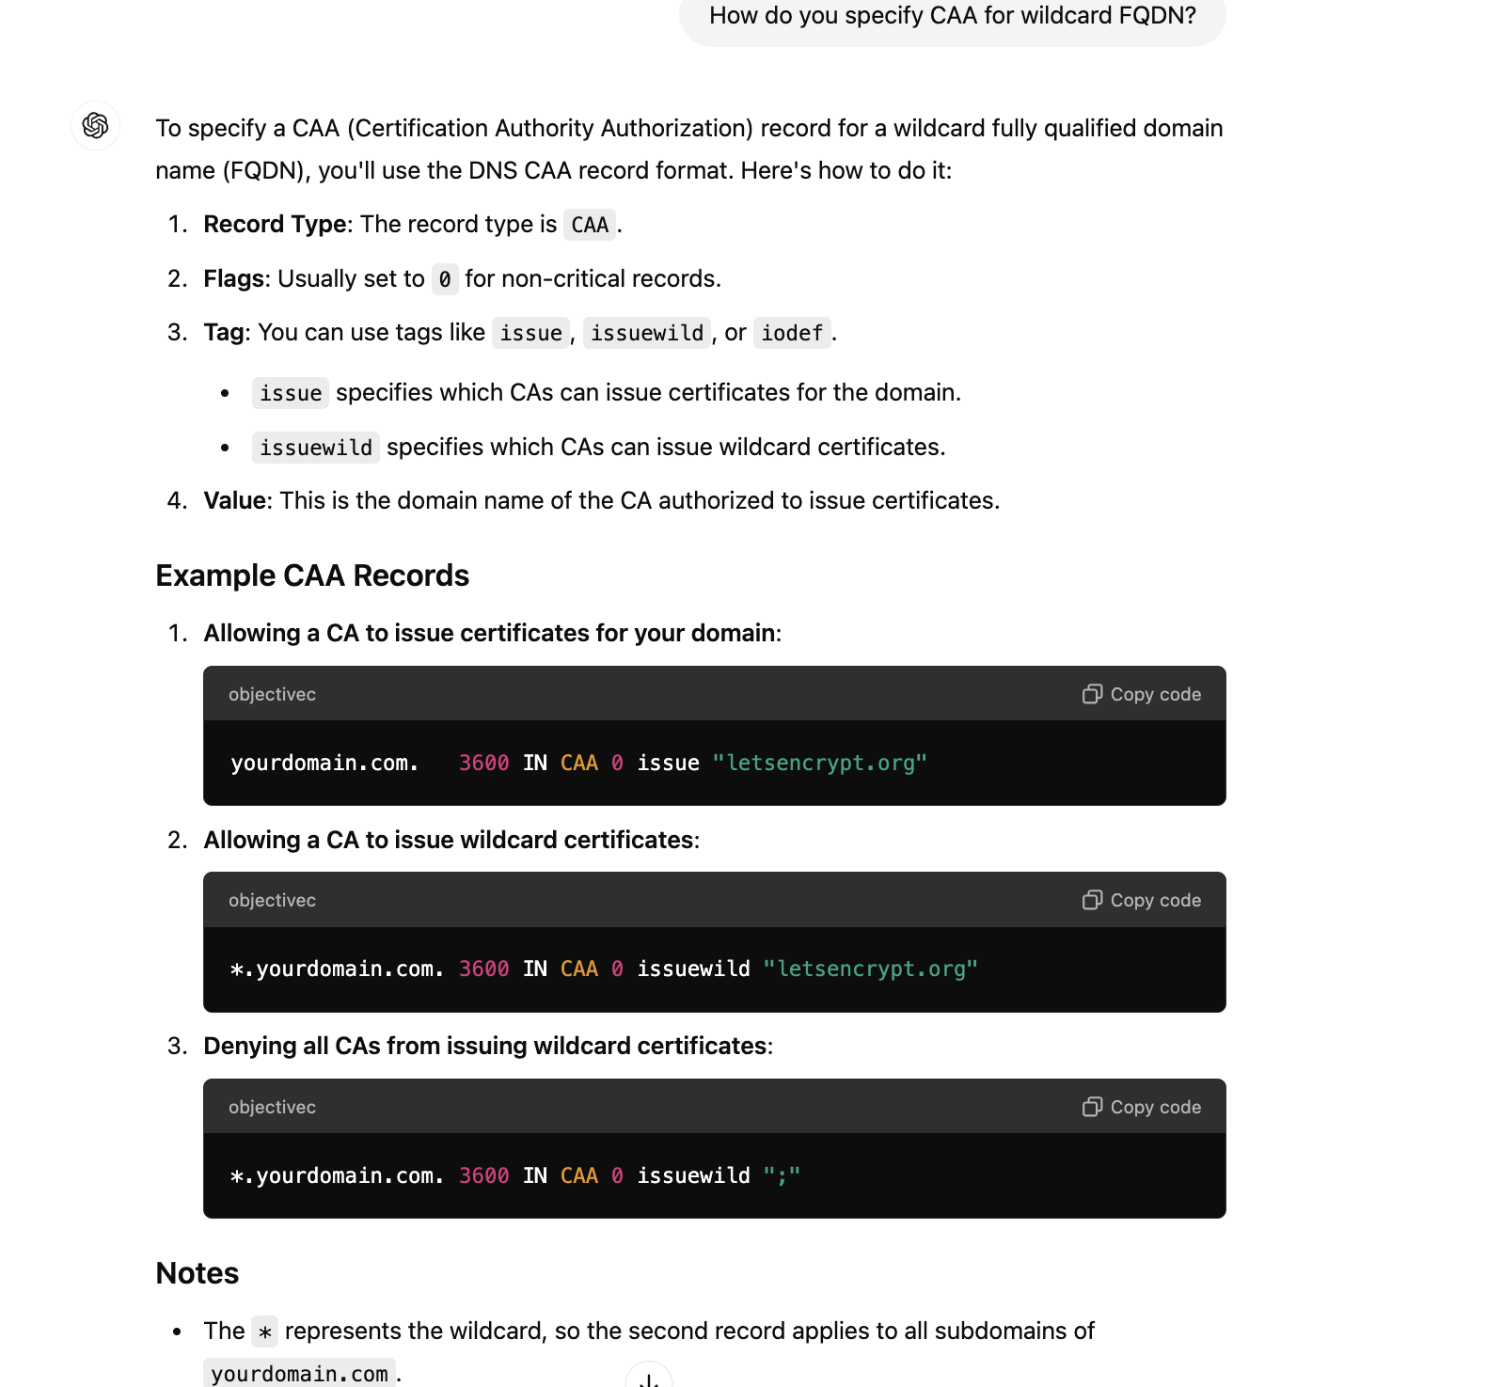

Slide 37
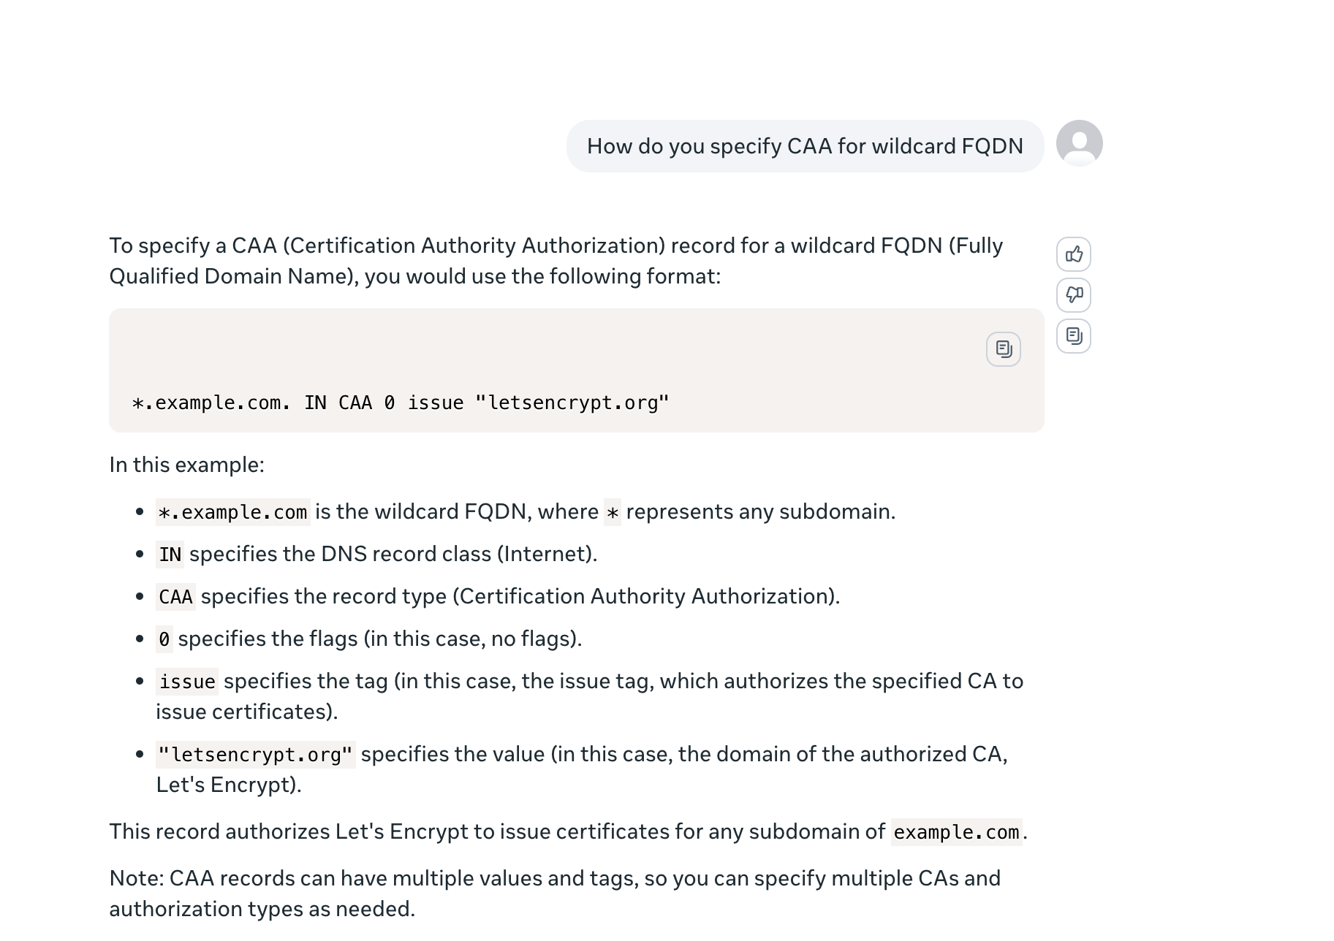

Slide 38
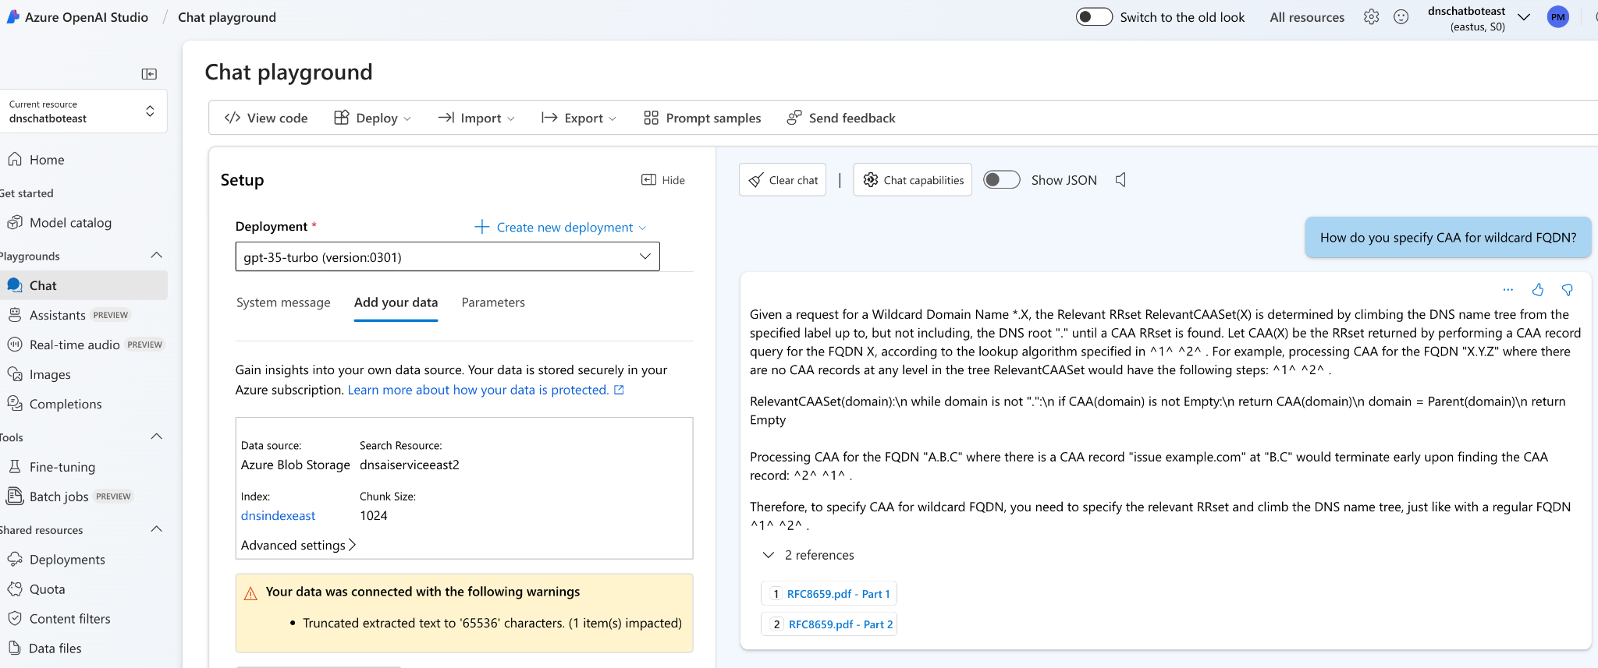
Azure Open AI

