Slide 1
CVSS scoring often does not work well for DNS
Cathy Almond
2024-10-27
https://www.isc.org

Slide 2

What are we doing?
Why do we issue Security Advisories?
What do consumers of Advisories
  really need to know?
What’s actually worthwhile
  for us to be doing?
Photo by iSawRed on Unsplash

Slide 3

Happy Birthday CVE Program!
(25 on 22nd October 2024!)
Photo by Nick Stephenson on Unsplash
https://www.cve.org/Media/News/item/blog/2024/10/22/CVE-Program-Celebrates-25-Years

Slide 4
Who are the consumers of DNS Security Advisories?
Product users (large-scale DNS operators as well as smaller organisation system administrators)
OS/Platform distributors and packagers
Cyber Security Incident Response Teams (CSIRTs and similar wide-scope organisations)
Security researchers
The “bad guys” 👺

Slide 5
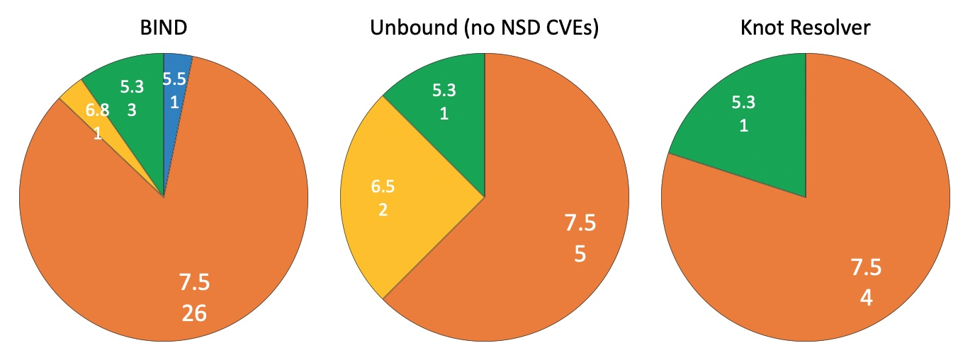
CVSS 3.1 Base scores - BIND, Unbound and Knot since January 2022
Counts of CVEs
for each product
grouped
by CVSS
score
Source kb.isc.org
Source https://www.nlnetlabs.nl/projects/unbound/security-advisories/
Source https://www.cvedetails.com/vulnerability-list/vendor_id-20536/NIC.html

Slide 6
KeyTrap, DNSBomb and NXNS
KeyTrap CVE-2023-50387: CVSS 7.5
DNSBomb CVE-2024-33655: CVSS 7.5
NXNS
  BIND CVE-2020-8616 CVSS: 8.6 (base)
  Unbound CVE-2020-12662 CVSS: 7.5
  Knot Resolver CVE-2020-12667 CVSS: 7.5
  PowerDNS CVE-2020-10995 CVSS: 7.5

Slide 7
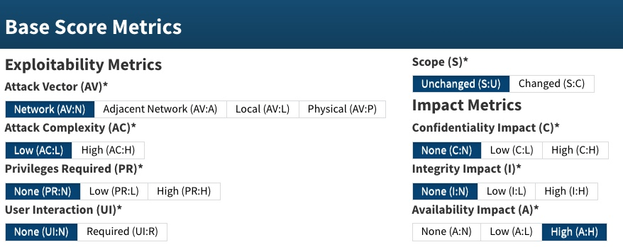
Why CVSS 7.5?
Source: https://nvd.nist.gov/vuln-metrics/cvss/v3-calculator?vector=AV:N/AC:L/PR:N/UI:N/S:U/C:N/I:N/A:H&version=3.1

Slide 8
Which metrics sometimes change?
Source: https://nvd.nist.gov/vuln-metrics/cvss/v3-calculator?vector=AV:N/AC:L/PR:N/UI:N/S:U/C:N/I:N/A:H&version=3.1

Slide 9

Will CVSS 4.0 make a useful difference?
Photo by Dylan Hunter on Unsplash

Slide 10
What types of question do we receive?
Does this affect authoritative or recursive operation?
When/how does the vulnerability take effect?
How likely is it that we might be affected?
Is there a configuration or operational workaround?
How can we mitigate this vulnerability until we can upgrade our servers?
How quickly do we need to upgrade?
Is my <EOL version of product> affected by this?
Almost no-one asks us about the actual CVSS score!

Slide 11
Does identifying the CWE help?
CWE = “Common Weakness Enumeration”
https://cwe.mitre.org/about/new_to_cwe.html
Probably not?
    CWE is a community-developed list of common software and hardware weakness types that could have security ramifications. A “weakness” is a condition in a software, firmware, hardware, or service component that, under certain circumstances, could contribute to the introduction of vulnerabilities. Weakness conditions are in many cases introduced by the developer during development of the product.

Slide 12
KeyTrap, DNSBomb and NXNS
KeyTrap CVE-2023-50387 CVSS 7.5 CWE-770 “Allocation of Resources without Limits or Throttling.”
DNSBomb CVE-2024-33655 CVSS 7.5 CWE-400 “Uncontrolled Resource Consumption.”
NXNS CWE-400 “Uncontrolled Resource Consumption.”
  BIND CVE-2020-8616 CVSS 8.0
  Unbound CVE-2020-12662 CVSS 7.5
  Knot Resolver CVE-2020-12667 CVSS 7.5
  PowerDNS CVE-2020-10995 CVSS 7.5
Source of CWE tags: https://nvd.nist.gov/vuln

Slide 13
Does identifying the CWE help?
CWE = “Common Weakness Enumeration”
https://cwe.mitre.org/about/new_to_cwe.html
Probably not?
    CWE is a community-developed list of common software and hardware weakness types that could have security ramifications. A “weakness” is a condition in a software, firmware, hardware, or service component that, under certain circumstances, could contribute to the introduction of vulnerabilities. Weakness conditions are in many cases introduced by the developer during development of the product.
CWEs appear to be more useful for researchers and software developers than for operators?

Slide 14
Will EPSS scores help?
EPSS = “Exploit Prediction Scoring System”
https://www.first.org/epss/model
Maybe, maybe not?
    “… the output of EPSS is a probability. All we can say about vulnerability exploitation is that some of the vulnerabilities are more likely to be exploited than others, that's it, that's all EPSS is saying. EPSS is trying to provide information to practitioners that hopefully gives them an edge, that ability to play the odds and hopefully make proactive moves against attackers before they make those moves. Be careful not to compare any predictive system against perfection, instead compare against alternatives. While it'd be great to be perfect, in reality we need to identify the best strategy available to us and then try trusting it for a while.”

Slide 15
KeyTrap, DNSBomb and NXNS
KeyTrap CVE-2023-50387 CVSS 7.5
  EPSS 5.00% (Probability of exploitation activity in the next 30 days)
  ~93% Percentile (the proportion of vulnerabilities that are scored at or less).
DNSBomb CVE-2024-33655 CVSS 7.5
  EPSS 0.05% (Probability of exploitation activity in the next 30 days)
  ~14% Percentile (the proportion of vulnerabilities that are scored at or less).
NXNS (no EPSS data)
  BIND CVE-2020-8616 CVSS 8.0
  Unbound CVE-2020-12662 CVSS 7.5
  Knot Resolver CVE-2020-12667 CVSS 7.5
  PowerDNS CVE-2020-10995 CVSS 7.5
Source of EPSS data: https://www.first.org/epss/data_stats
(via https://www.cvedetails.com/ )

Slide 16
Will EPSS scores help?
EPSS = “Exploit Prediction Scoring System”
https://www.first.org/epss/model
Maybe, maybe not?
    “… the output of EPSS is a probability. All we can say about vulnerability exploitation is that some of the vulnerabilities are more likely to be exploited than others, that's it, that's all EPSS is saying. EPSS is trying to provide information to practitioners that hopefully gives them an edge, that ability to play the odds and hopefully make proactive moves against attackers before they make those moves. Be careful not to compare any predictive system against perfection, instead compare against alternatives. While it'd be great to be perfect, in reality we need to identify the best strategy available to us and then try trusting it for a while.”
EPSS scores are (supposedly) dynamic; but only as ‘good’ as the data available about/from the CVEs:
https://arxiv.org/pdf/2302.14172

Slide 17
Or there’s the “just upgrade” stance?
https://www.youtube.com/watch?v=Rg_VPMT0XXw
If it’s a bug that might be a security issue then always give it a CVE number (but not a CVSS score, although NIST may score it for you anyway)
Guarantee backward compatibility with new releases
Recommend always upgrade in order to be protected
https://lore.kernel.org/linux-cve-announce/
That’s a lot of CVEs!

Slide 18
Or there’s the “just upgrade” stance?
But sometimes it’s necessary to make potentially ‘breaking’ changes such as introducing new limits (for CVE-2024-1737 for example)
https://www.youtube.com/watch?v=Rg_VPMT0XXw
If it’s a bug that might be a security issue then always give it a CVE number (but not a CVSS score, although NIST may score it for you anyway)
Guarantee backward compatibility with new releases
Recommend always upgrade in order to be protected
https://lore.kernel.org/linux-cve-announce/
That’s a lot of CVEs!

Slide 19
Multi-vendor DNS CVEs
If a single vulnerability affects multiple products then DNS software providers will try to coordinate their security releases
DNS-OARC Mattermost has been a very useful tool - it facilitates secure/private channels for each multi-vendor issue with representation from affected product providers (and if appropriate, researchers/reporters of issues)
Multi-vendor security issues always don’t always have the same CVE reference or CVSS score from all software providers
Coordinated security releases are not without special challenges!

Slide 20

Recap: What are we doing?
Why do we issue Security Advisories?
What do consumers of CVEs
  really need to know?
What’s actually worthwhile
  for us to be doing?
Photo by Paul Volostnov 🇺🇦 on Unsplash

Slide 21

Discussion time …
Photo by Hans-Peter Gauster on Unsplash

Slide 22
Thank you!
Main website: https://www.isc.org
Software downloads: https://www.isc.org/download or https://downloads.isc.org
Presentations: https://www.isc.org/presentations
Main GitLab: https://gitlab.isc.org

