Slide 1
Characterizing the DDoS Amplification Power of Open DNS Resolvers to Facilitate Prioritized Mitigation
Ramin Yazdani
DNS-OARC 43
27 October 2024
Prague

Slide 2
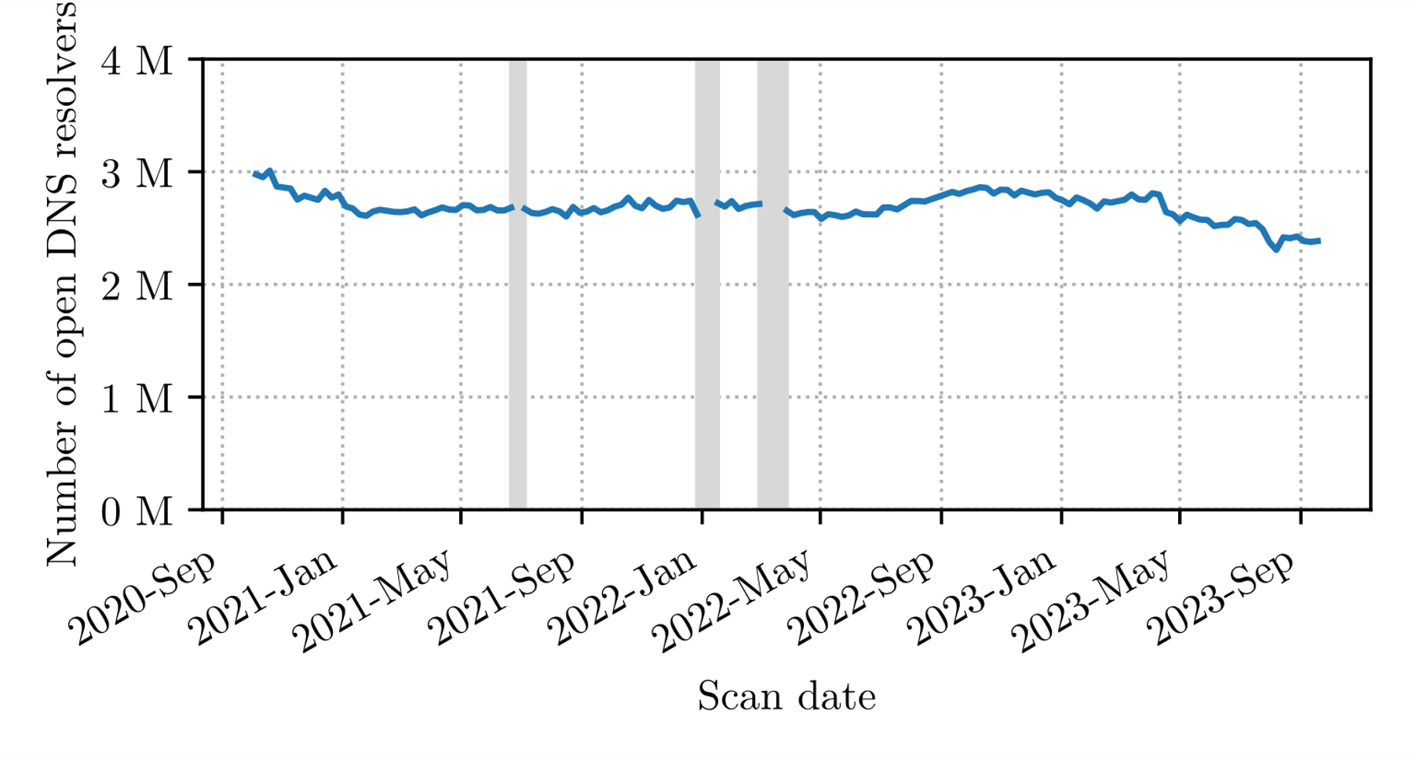
An Old but Persistent Problem
Reflection-based DDoS attacks continue to disrupt networks and services to date
Attacker
Victim
Botnet
Reflectors

Slide 3
From Mirai to Meris to Mantis
Thousands of servers and virtual machines
2022
Tens of thousands of Mikrotik routers
2021
Multiple hundred thousands of IoT devices
2016

Slide 4
Our Motivation
Reflectors are not in possession of an equal power either.
We can make our defense efforts more efficient by focusing on the most potent reflectors.
While attackers are cherry picking the bots to misuse, nothing stops them from doing the same with reflectors.

Slide 5
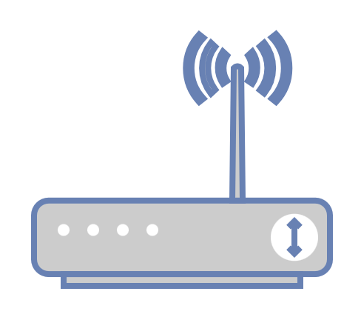
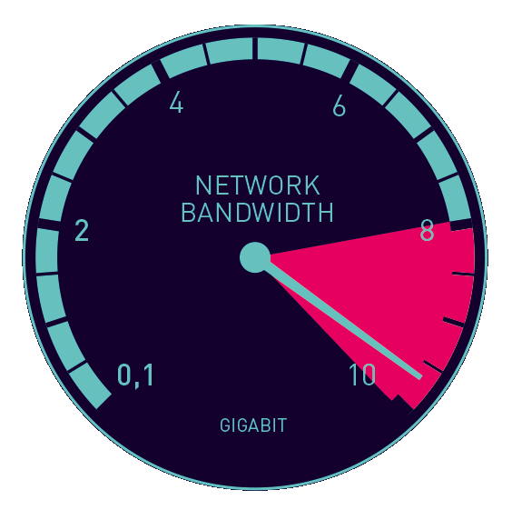
Aspects that we Study
Network connectivity
Bandwidth Amplification
Packet Amplification

Slide 6
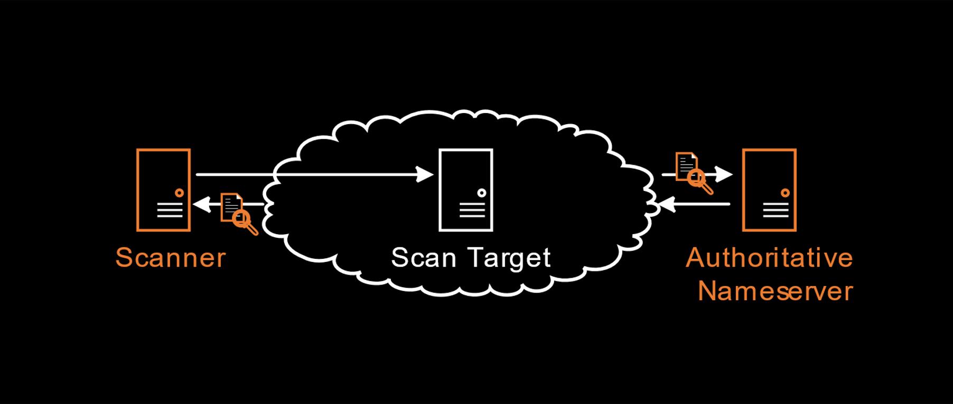
Measurement Setup

Slide 7
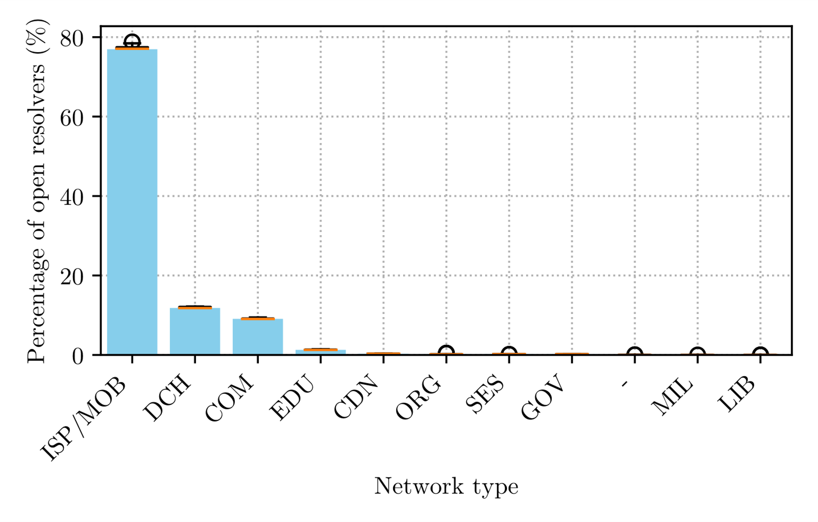
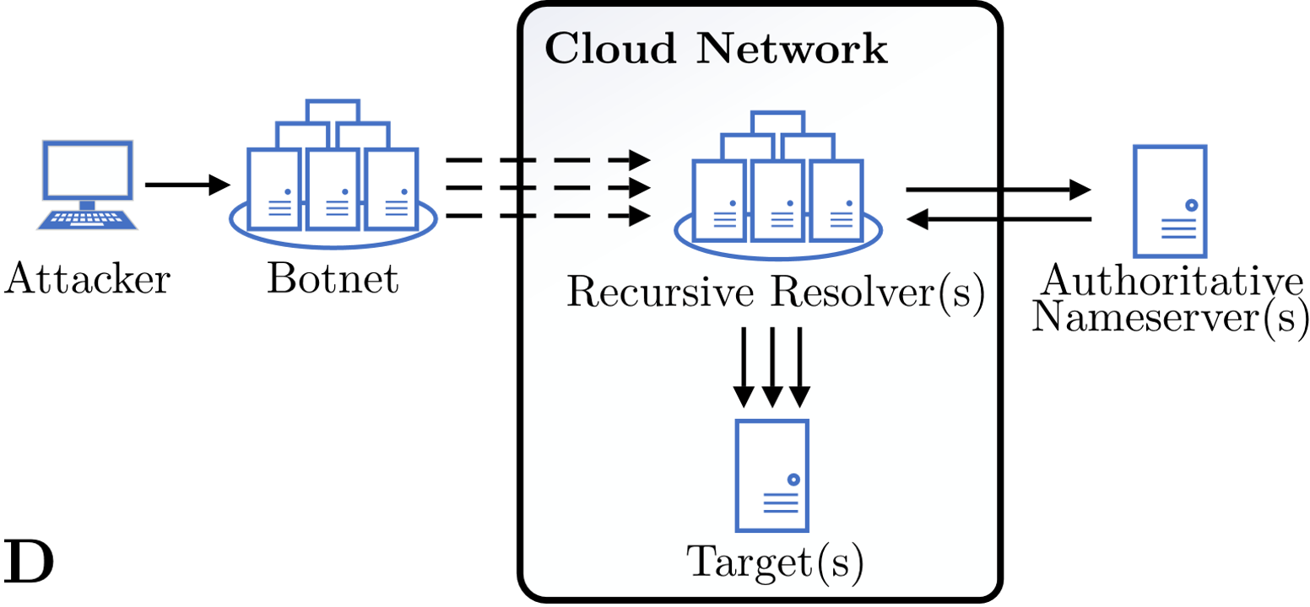
Key Findings (Network Connectivity)
A non-negligible share of reflectors are hosted in datacenters/clouds.
Some cloud providers expose their infrastructure to reflection-based DDoS attacks.
[1] R. Yazdani et al., Mirrors in the Sky: On the Potential of Clouds in DNS Reflection-based Denial-of-Service Attacks, RAID’22.

Slide 8
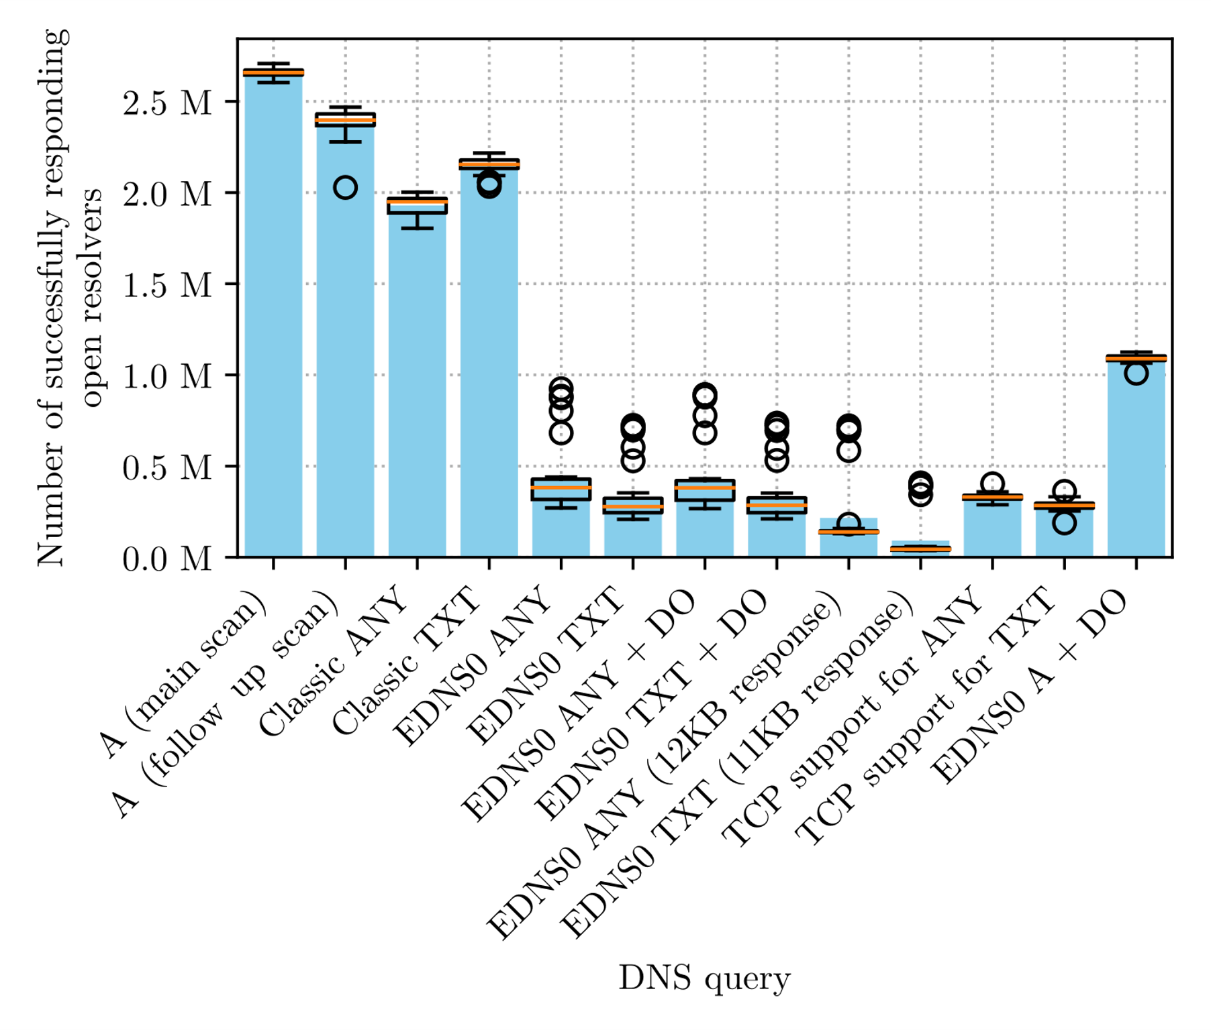
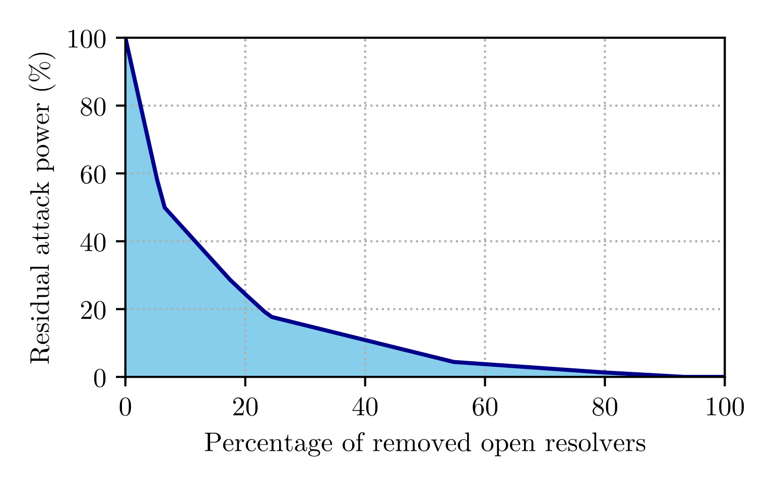
Key Findings (Bandwidth Amplification)
A large group of open resolvers lack DNSSEC support. This stands to substantially limit attackers when misusing DNSSEC.
By focusing on just the 20% most potent amplifiers, we can reduce the Internet-wide DNS-reflection attack potential by up to 80%.
[2] R. Yazdani et al., A Matter of Degree: Characterizing the Amplification Power of Open DNS Resolvers, PAM’22.

Slide 9
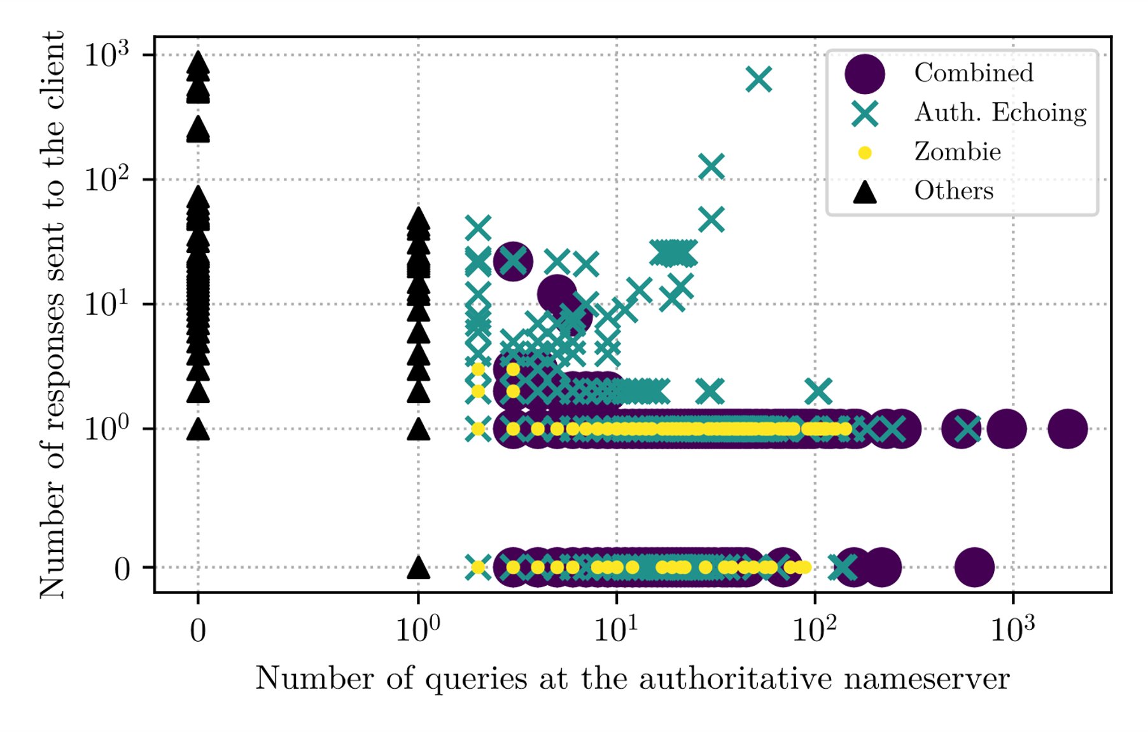
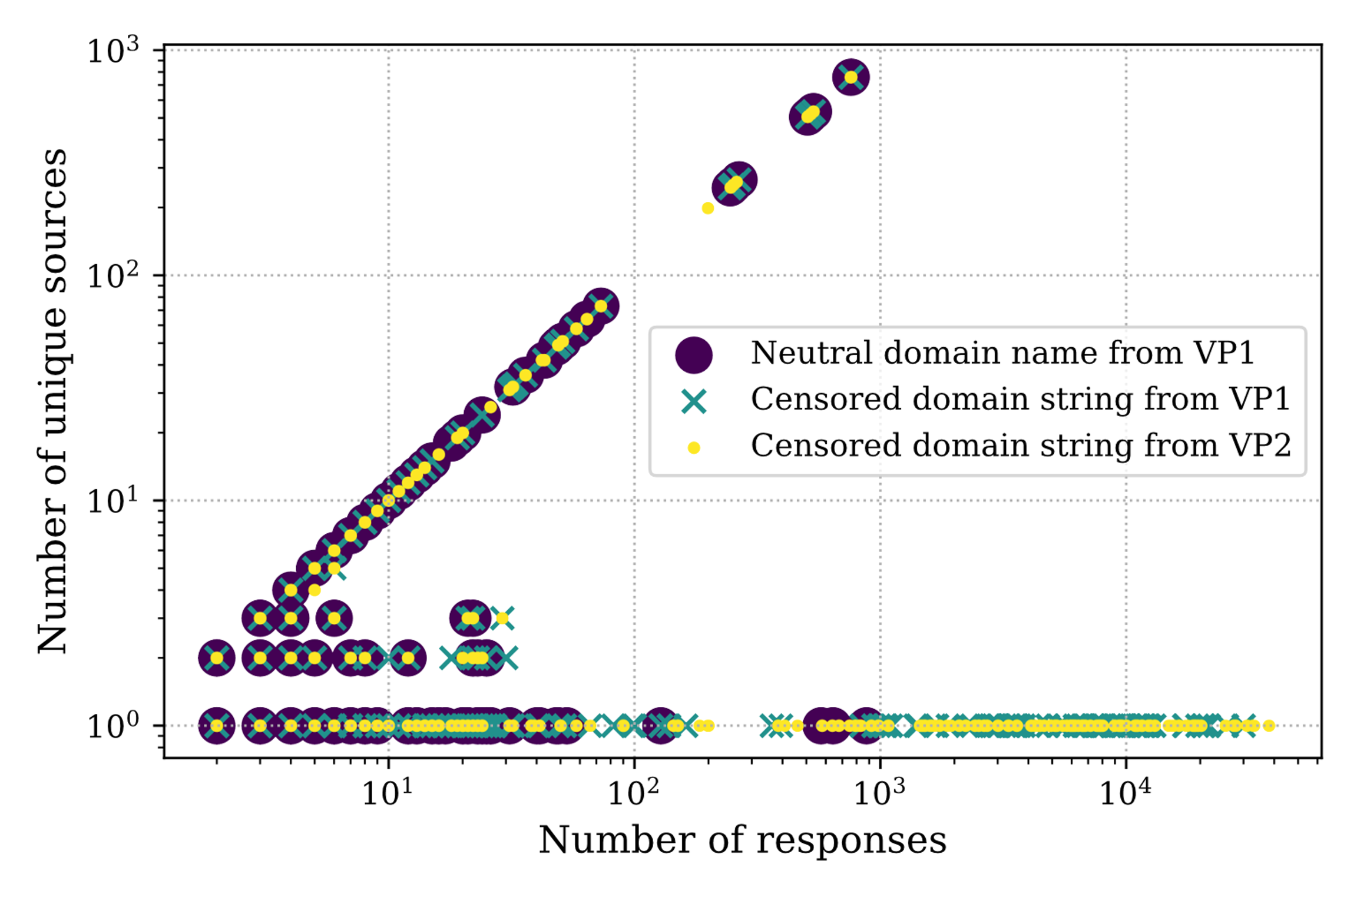
Key Findings (Packet Amplification)
Packet amplification happens both on the client end as well as the authoritative nameserver end.
DNS middleboxes can be triggered to send tens of thousands of responses, hence increasing their abuse potential in DDoS attacks.
[3] R. Yazdani et al., Hazardous Echoes: The DNS Resolvers that Should Be Put on Mute, TMA’23.

Slide 10
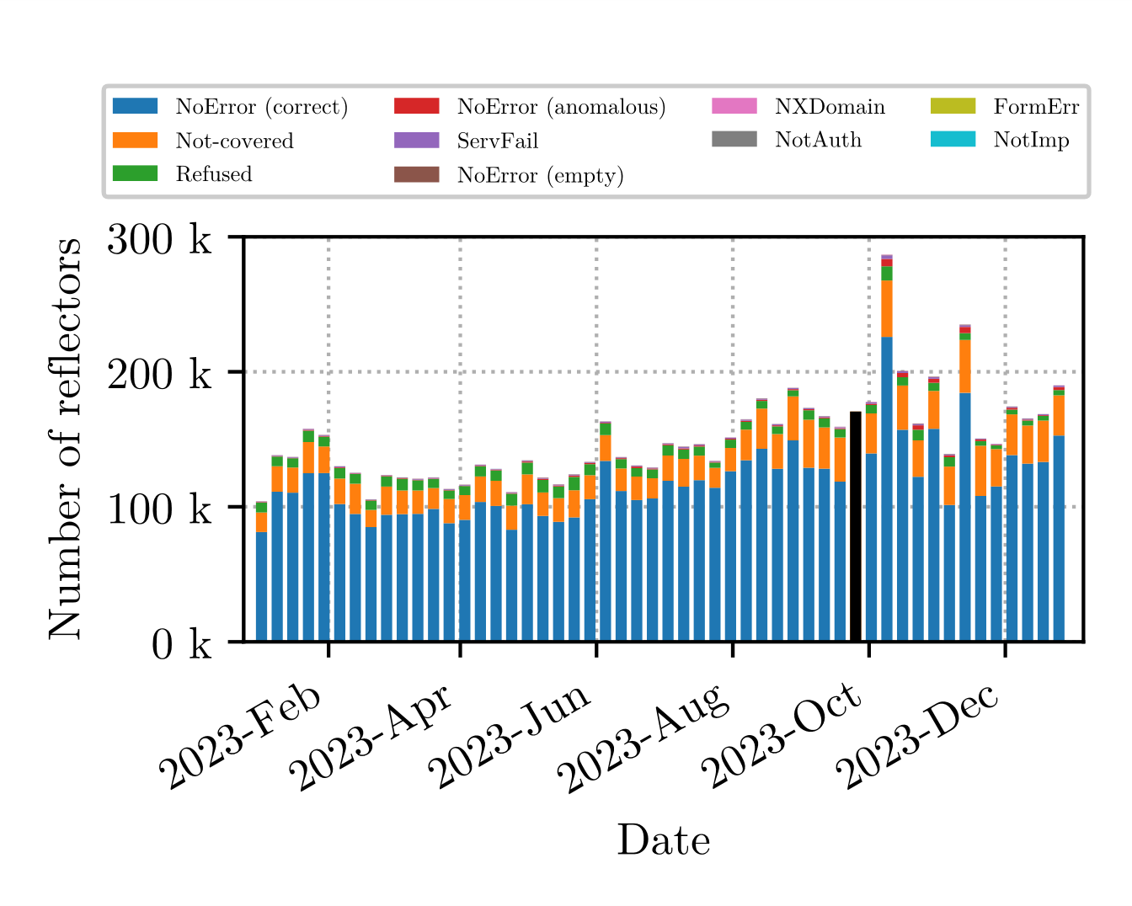
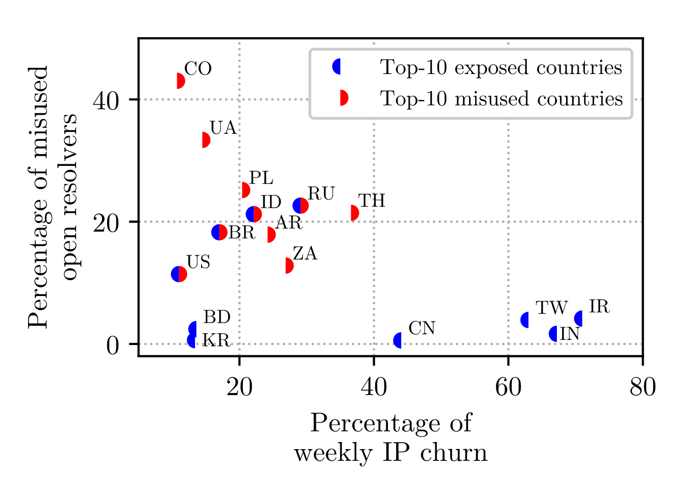
Key Findings (Reflectors in Attacks)
Open recursive resolvers are not the only contributors to DNS-based DDoS attacks.
Open resolvers with a higher IP churn are involved less in DDoS attacks.
[4] R. Yazdani et al., Glossy Mirrors: On the Role of Open DNS Resolvers in Reflection and Amplification DDoS Attacks, CNSM’24.

Slide 11
Conclusions
The number of exposed open resolvers is much higher than what attackers typically misuse.
Our characterization shows differences in the amplification power of open resolvers that can be leveraged for a prioritized mitigation.
Attackers do not yet fully leverage the diversity among open resolvers, meaning that we can expect the intensity of DNS-based DDoS attacks to grow if we do not take action.
Thanks!
Ramin Yazdani
r.yazdani@utwente.nl
linkedin.com/in/ramin-yazdani

