Slide 1
DNS is a Primary Vector for DDoS
Richard Meeus, Director Security Technology & Strategy
DNS OARC 43 Prague, Czechia
Oct 26/27

Slide 2
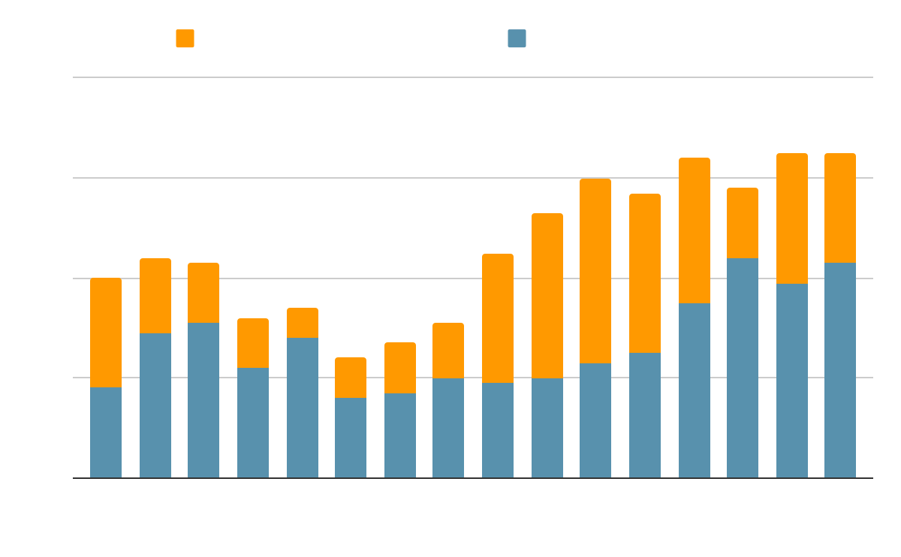
65% of Q3 DDoS attacks leverage DNS
Notes:
DNS is the preferred route
resource exhaustion being the most prevalent

Slide 3
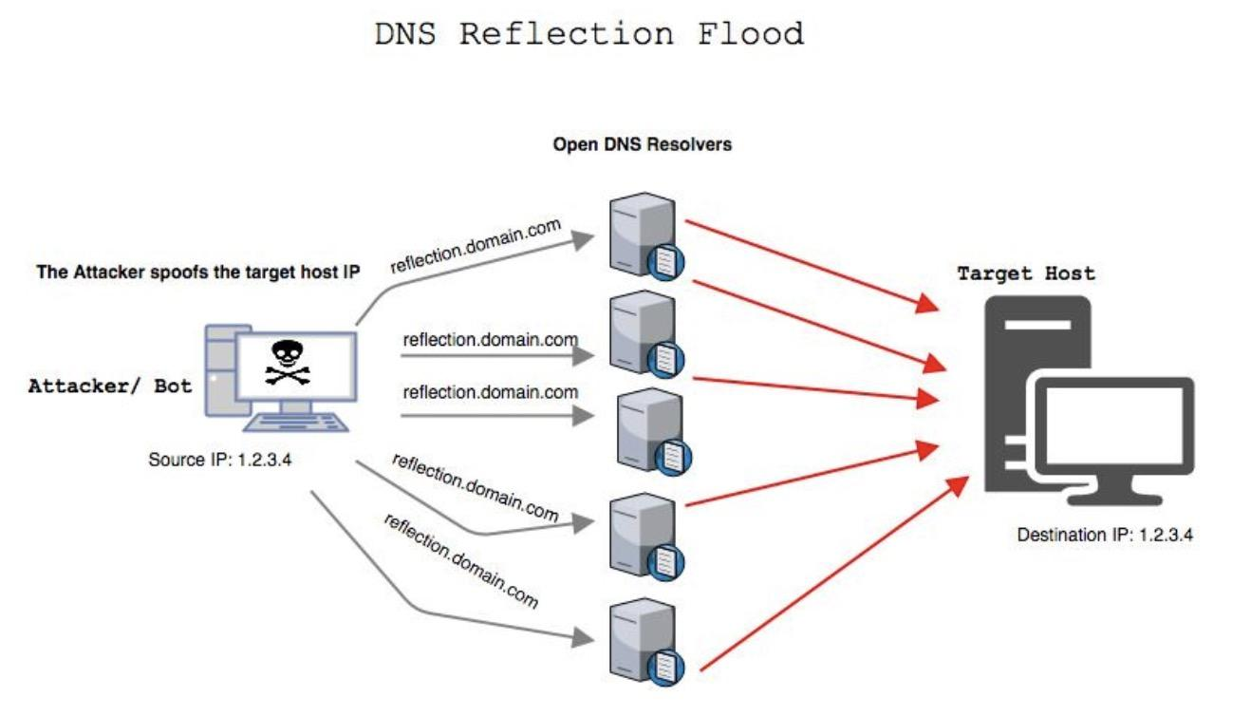
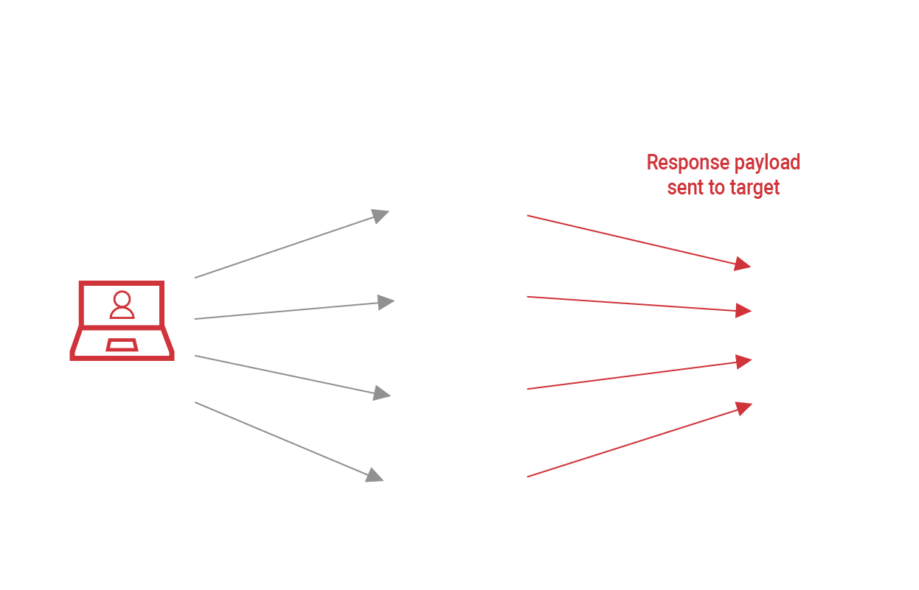
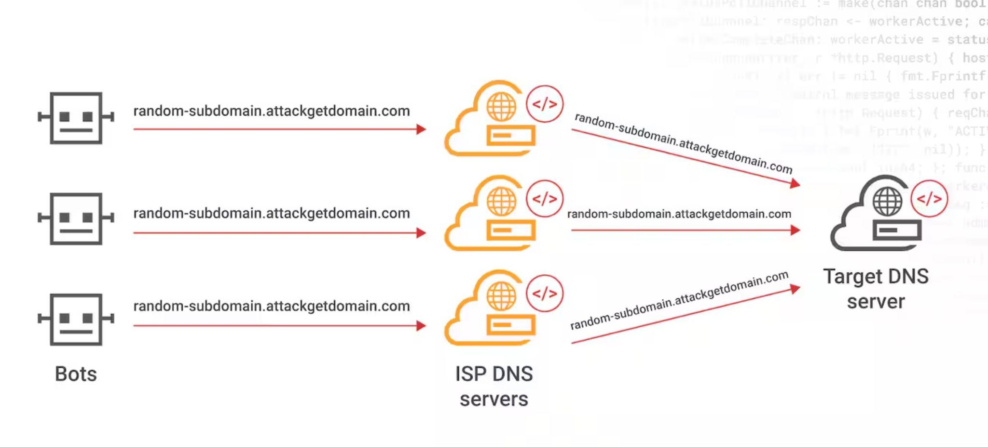
The newly trending DDoS target: DNS - part 1
Notes:
Dig into reflection attacks
5 in the chart of recent attacks were reflection
UDP
Using the internet against itself

Slide 4
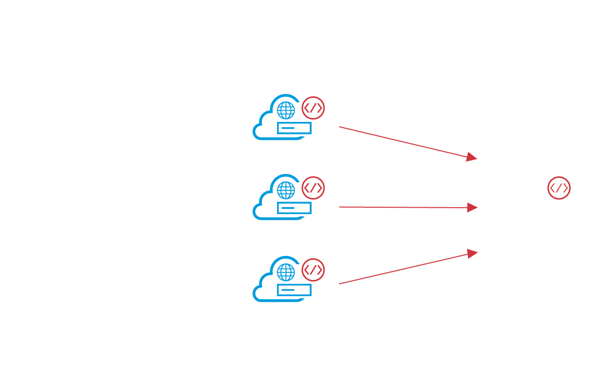
The newly trending DDoS target: DNS part 2
Notes:
Richard
DNS is a popular target for DDoS attacks because of the impact malicious traffic can have on this critical and foundational service.
A DNS DDoS attack compromises DNS servers with spoofed requests, causing an overwhelming response of payloads to the target

Slide 5
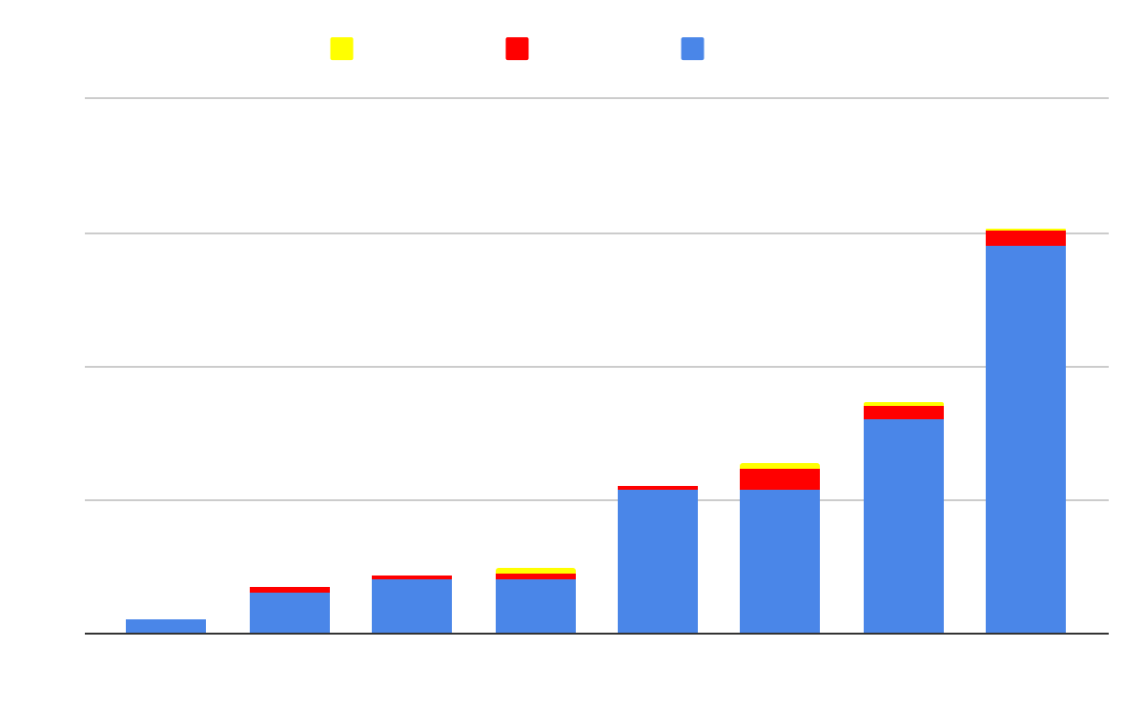
High Packets per Second Attacks

Slide 6
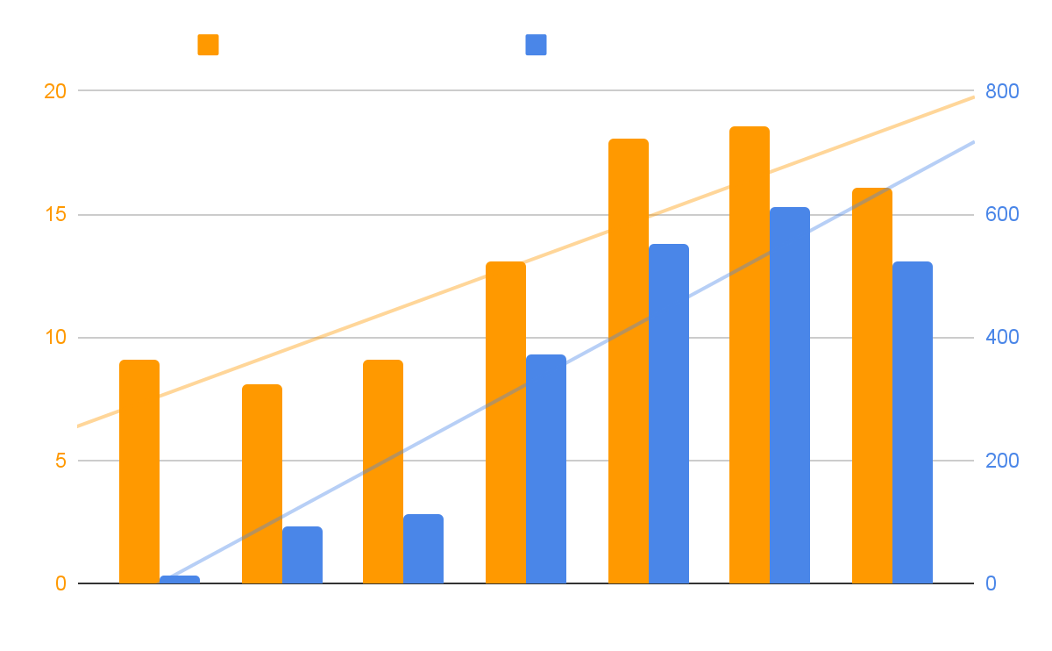
Attacks Are Getting Longer

Slide 7
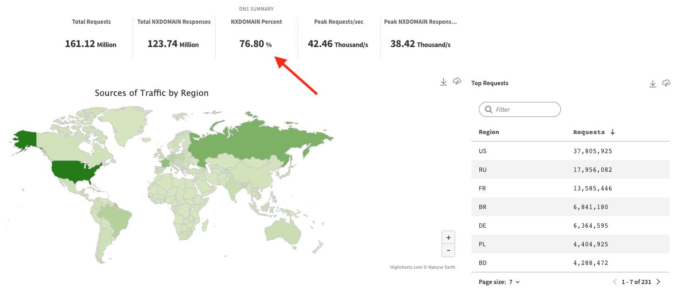
Major Sports League

Slide 8
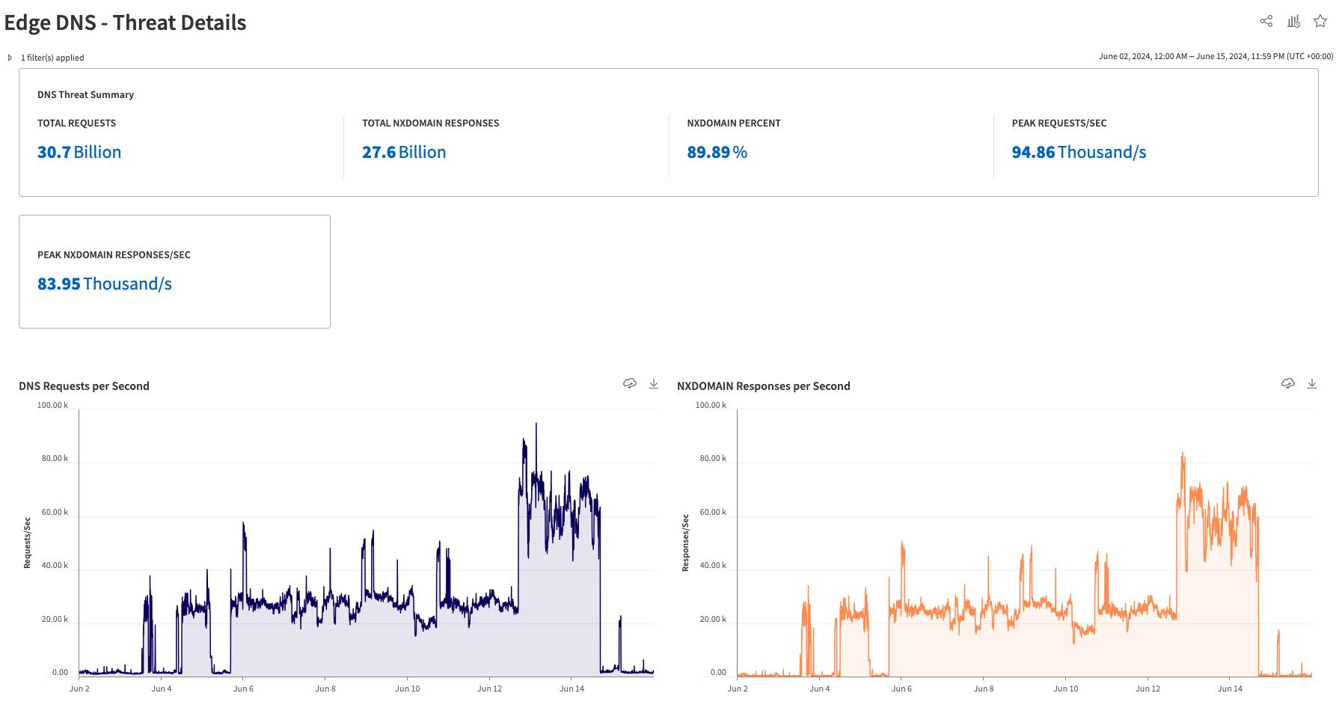
Major Sports League

Slide 9
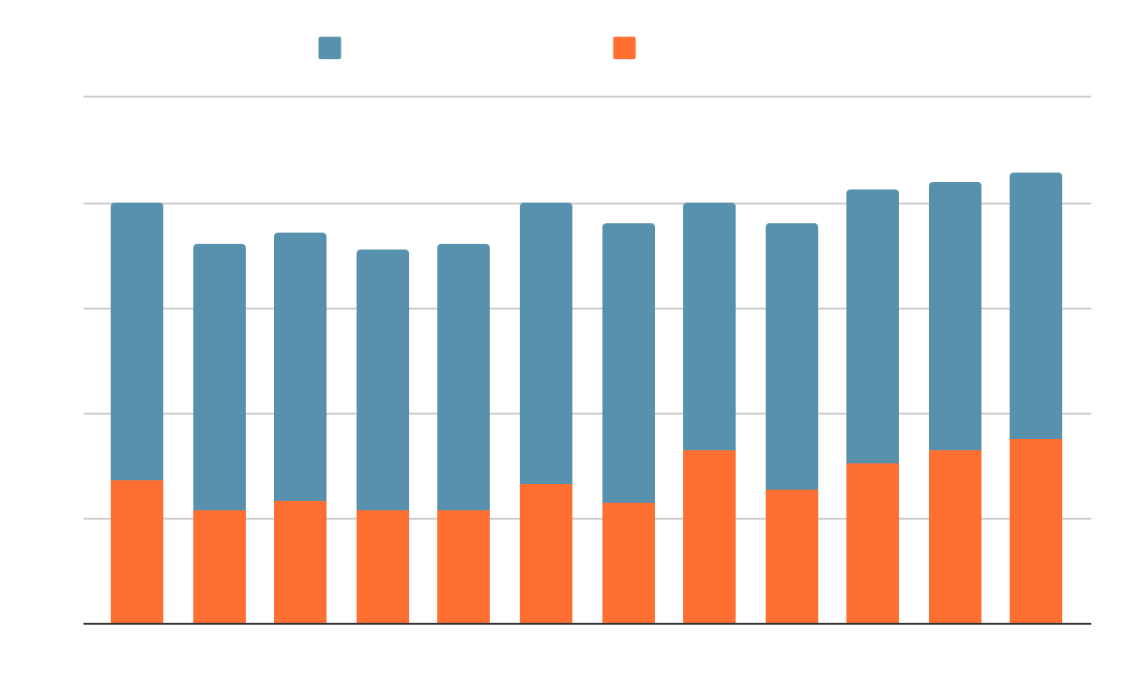
NX Domain Impact
NXDOMAIN trends across cloud authoritative infrastructure

Slide 10
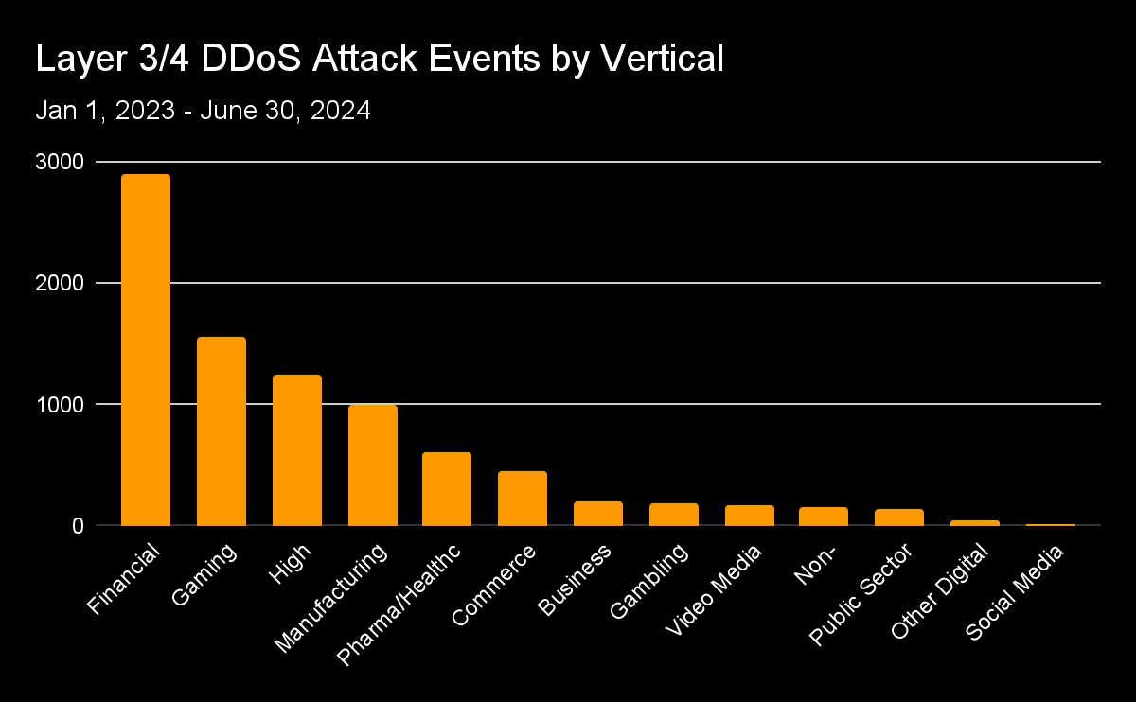
Layers 3 and 4 DDoS attack events by industry
Financial services remains the most frequently attacked industry by Layers 3 and 4 DDoS attack events

Slide 11
Mitigation and Protection
Fortify authoritative infrastructure
Use “traditional” DDoS defences
Deploy authoritative proxies

