Slide 1
Cross the Zone:
Toward a Covert Domain Hijacking via Shared DNS Infrastructure
Yunyi Zhang, Mingming Zhang, Baojun Liu, Zhan Liu, Jia Zhang, Haixin Duan, Min Zhang, Fan Shi, Chengxi Xu
October 26, 2024
Notes:
Hello, everyone.
I am Yunyi Zhang, a Ph.D. student from Tsinghua University.
It is a great honor to have the opportunity to present our research findings,
The title of my talk is “Cross the Zone: Toward a Covert Domain Hijacking via Shared DNS Infrastructure”

Slide 2
Brief Summary
We uncover a prevalent covert DNS infrastructure deployment practice: shared nameservers infrastructure.
The XDAuth attack exploits well-known DNS hosting platforms to take over the domain names of enterprises.
Notes:
First, I give a brief summary for our work.
We uncover a prevalent covert DNS infrastructure deployment practice: shared nameservers infrastructure.
Moreover, we propose the new XDAuth attack. It can exploit well-known DNS hosting platforms to take over the domain names of enterprises.

Slide 3
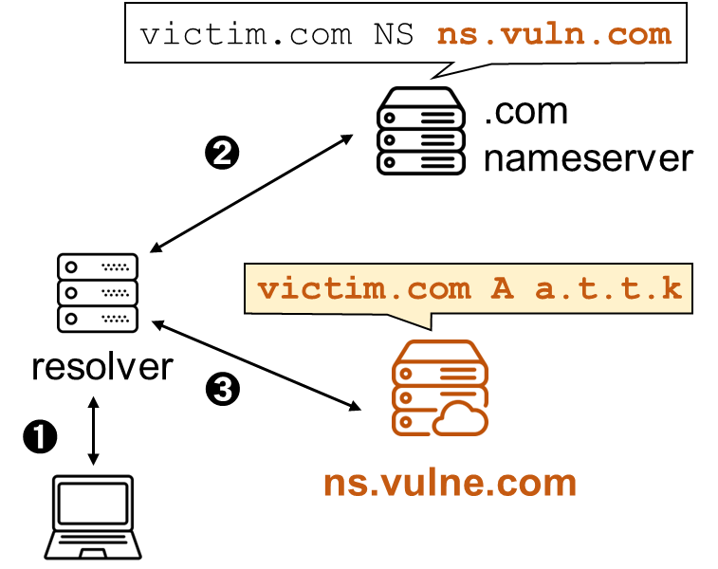
XDAuth Attack
What is the XDAuth attack
A new practical and powerful domain hijacking attack
break the authoritative boundaries of the domain
Exploiting authoritative nameserver infrastructure flaws
shared nameserver lacking data isolation
Published in USENIX Security 2024
Stale NS
Notes:
Since everyone present here is an expert in the field of DNS,
and the previous reports have already mentioned the background of DNS, I will directly introduce our research content.
What is the XDAuth attack?
It is a new practical and powerful domain hijacking attack, breaking the authoritative boundaries of the domain zone.
It exploits authoritative nameserver infrastructure flaws.
Below are two figure illustrating traditional domain hijacking attacks and XDAuth attacks.
In traditional domain hijacking attacks, attackers directly target the vulnerable authoritative server of the target domain, such as ns.vnlue.com.

Slide 4
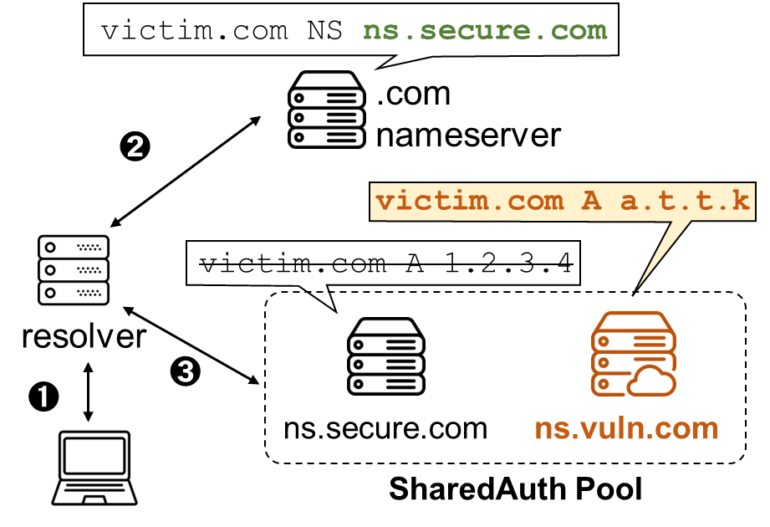
XDAuth Attack
What is the XDAuth attack
A new practical and powerful domain hijacking attack
break the authoritative boundaries of the domain
Exploiting authoritative nameserver infrastructure flaws
shared nameserver lacking data isolation
Published in USENIX Security 2024
Stale NS
XDAuth
Notes:
However, in XDAuth, we assume that the authoritative server of the target domain is secure and cannot be directly controlled by attackers.
At this point, attackers exploit the shared nature of the authoritative server to bypass security measures and indirectly manipulate the resource records of the target domain.

Slide 5
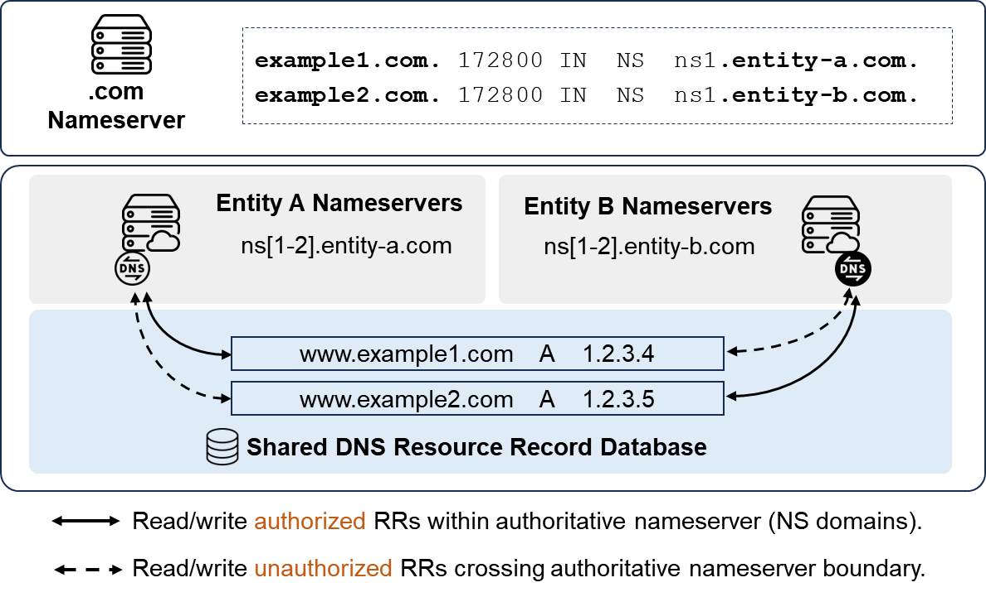
XDAuth Attack
Shared nameserver
Different NS domain names rely on the same underlying infrastructure
Entities: DNS host provider, Registrar, and other enterprises, e.g., BBC, Nike
Notes:
Let's first understand shared authoritative servers.
In simple terms, different NS domain names rely on the same NS IPs. As shown in the figure on the right, ns1.entity-a.com and ns1.entity-b.com rely on a shared DNS resource record storage.
The underlying infrastructure lacks operational isolation. As depicted by the dashed lines in the figure, even though ns1.entity-b.com is not the authoritative server for example1.com, it can still manipulate the domain's resource records.
Entities here can be any type of organization, including DNS hosting service providers, registrars, as well as well-known enterprises such as the BBC.

Slide 6
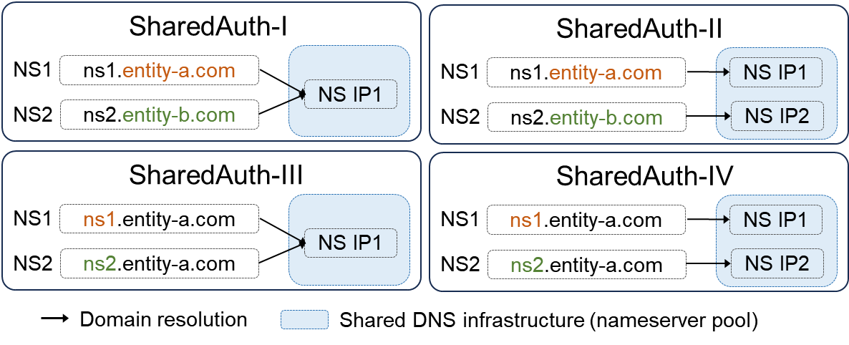
XDAuth Attack
Shared nameserver
Different NS domain names rely on the same underlying infrastructure
Entities: DNS host provider, Registrar, and other enterprises, e.g., BBC, Nike
Types of SharedAuth
Different IPs (ShareAuth-II and IV)
Same IPs (ShareAuth-I and III)
Notes:
Based on the characteristics of shared authoritative servers, we have categorized them into four types.
The most significant difference among them is whether they share the same IP address.

Slide 7
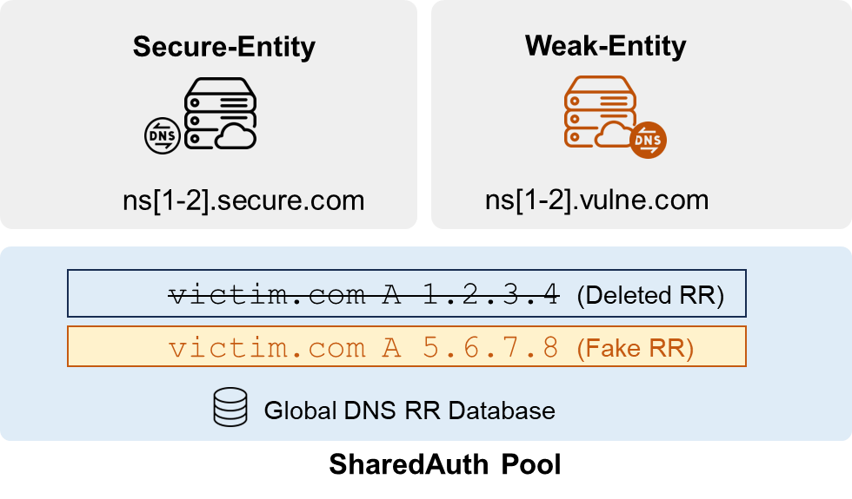
XDAuth Attack
Threat model
Conditions
delegated to shared nameserver
canceled the service
false sense of safety
Notes:
In our threat model, the condition for the victim domain is that its authoritative servers are shared and have been cancelled. The controlled NS domain gives them a false sense of security.

Slide 8
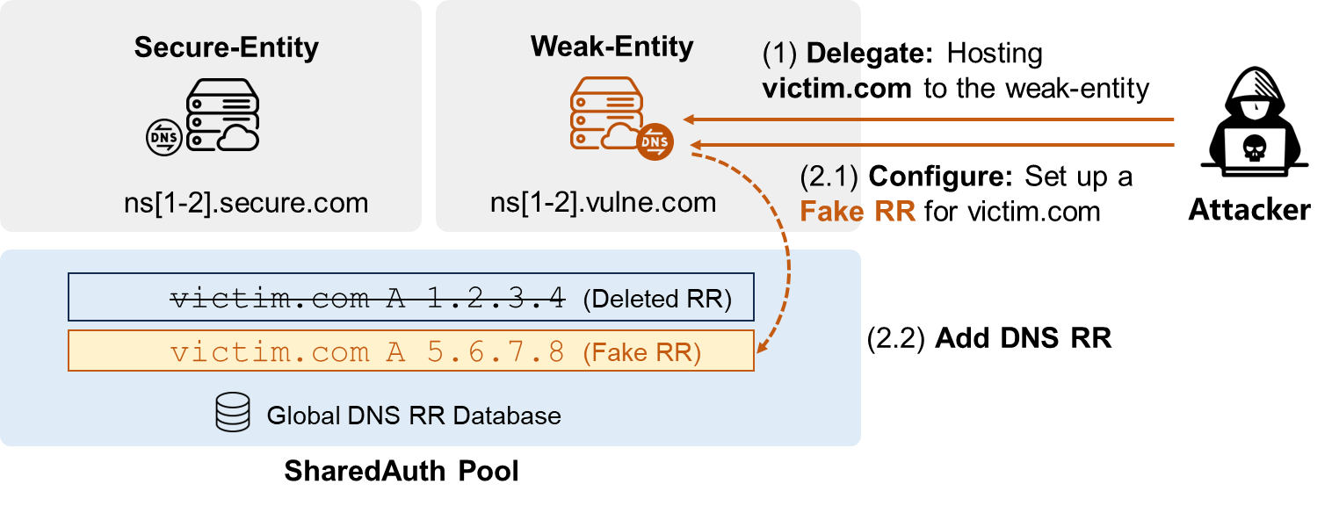
XDAuth Attack
Threat model
Conditions
Target
delegated to shared nameserver
break the boundary of nameserver
canceled the service
hijack domain by shared nameserver
false sense of safety
hijack private domain
Notes:
Attackers aim to exploit the shared authoritative servers to bypass security defenses and take over domains that are hosted on secure authoritative servers, particularly those belonging to well-known enterprises.
For example, the attacker hosts the target domain on a weak-entity, whose nameserver is shared with the secure-entity.

Slide 9
XDAuth Attack
Threat model
Conditions
Target
delegated to shared nameserver
break the boundary of nameserver
canceled the service
hijack domain by shared nameserver
false sense of safety
hijack private domain
Notes:
Finally, when a client access the target domain, it get the fake resource record injected by the attacker.

Slide 10
Question
How to discover the shared nameservers hidden behind the services?
Notes:
How can we discover the shared authoritative servers hidden behind the services?

Slide 11
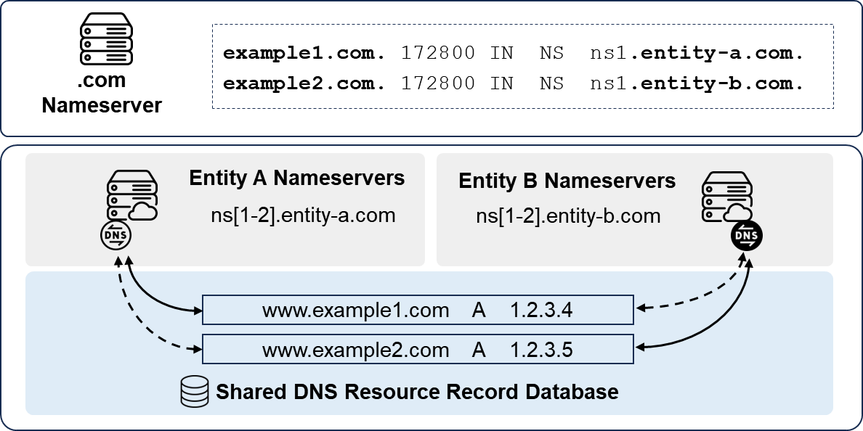
XDAuthChecker
Response from shard nameservers
nameservers respond with the correct response, outside of the delegation
ns1.entity-a.com respond the query of domain www.example2.com
query www.example2.com
client
response www.example2.com
A 1.2.3.5
cross-resolution verification
Notes:
Let's revisit the concept of shared authoritative servers.
Even without a delegation relationship, as long as they are part of the same shared nameserver group, the authoritative nameserver can return correct responses for domain names without a delegation relationship.
This means that outside of the delegation relationship, the authoritative server can respond with the correct responses.
As illustrated in the figure, ns1.entity-a.com is not the nameserver for www.example2.com, yet it can respond with normal results.
Leveraging this characteristic of shared authoritative servers, we have designed a method for discovering shared authoritative servers based on cross-resolution verification.

Slide 12
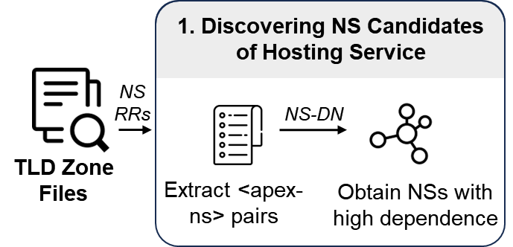
XDAuthChecker
Step 1: Discovering NS Candidates of Hosting Service
72
10,90
Research Report
TLD zonefile
25,310 NS seeds
Notes:
Below, I will introduce the process of our method.
Our detection starts by discovering the NS domains of public hosting providers to uncover shared nameserver pools, as these domains serve as public entry points for accessing and modifying DNS settings in shared nameservers.
First, we collected 72 popular hosting providers from research and blogs over the past five years.
Next, we systematically analyzed the zone files of 1090 TLDs, extracting representative NS.
Finally, we gathered 25,310 NS candidates.

Slide 13
XDAuthChecker
Step 2: Uncovering Shared Nameservers
cross-resolution verification
domain1
NS1
domain1
NS1
domain2
NS2
domain2
NS2
Notes:
Then, we utilized cross-resolution verification to discover shared nameservers.
We first conduct a Cartesian product cross-mapping on our NS candidates.

Slide 14
XDAuthChecker
Step 2: Uncovering Shared Nameservers
cross-resolution verification
1.9B
domain1
NS1
domain1
NS1
domain2
NS2
domain2
NS2
Notes:
Despite having carefully curated our set of NS candidates, the scale of testing at this point still reaches 1.9 billion, and we need to further reduce the scale of testing.

Slide 15
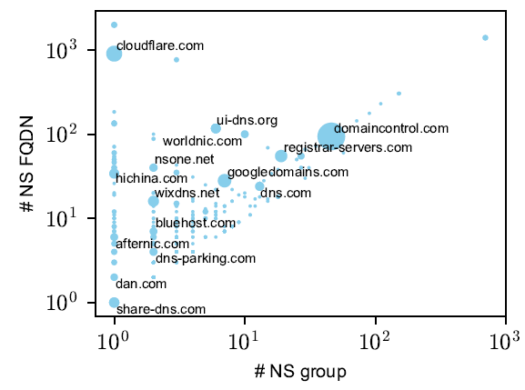
XDAuthChecker
Step 2: Uncovering Shared Nameservers
cross-resolution verification
1.9B
Resolution-task reduction
domain1
NS1
Grouped within providers
domain1
NS1
domain2
NS2
Same IP
domain2
NS2
0.3B
Unusual resolution behaviors
HiChina
dns1.hichina.com
dns2.hichina.com
GoDaddy
ns01.domaincontrol.com
ns02.domaincontrol.com
Notes:
We employ a pruning strategy to reduce resolution tasks.
Our pruning strategy includes three aspects:
Firstly, we found that a group of NS from some service providers are inherently shared, like the HiChina in the figure, so we grouped the NS candidates from the perspective of the providers.
Secondly, we discovered that authoritative servers with the same IP always have the same response, so we reduced requests for different NS domains but with the same IP.
Finally, we filtered out NS with abnormal responses, such as those that perform recursive operations.

Slide 16
XDAuthChecker
Step 3: Identifying Vulnerable Entities
Nameserver owner identification
Cross-entity inspection
WHOIS, HTTP, domain
free or trial public hosting services
Notes:
Next, we identify the vulnerable entities (i.e., providers or organizations) deploying the shared nameservers.
We first use WHOIS, HTTP responses, and domain name strings to determine the owner of the NS domains.
Then, we manually conduct cross-verification to confirm the exploitable service providers and the victims.

Slide 17
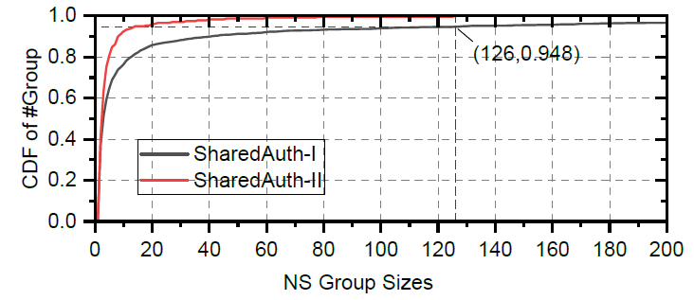
Shared nameservers are prevalent
64,415 shared nameservers
2,134 SharedAuth-I groups
238 SharedAuth-II groups
SharedAuth-I displaying larger NS group sizes
Notes:
Next, let me introduce our findings.
Our experimental results demonstrate that shared nameservers are prevalent.
We have discovered a total of 64,415 shared authoritative nameservers.
The following figure illustrates the sizes of different shared groups.
SharedAuth-I displays larger NS group sizes than SharedAuth-II.

Slide 18
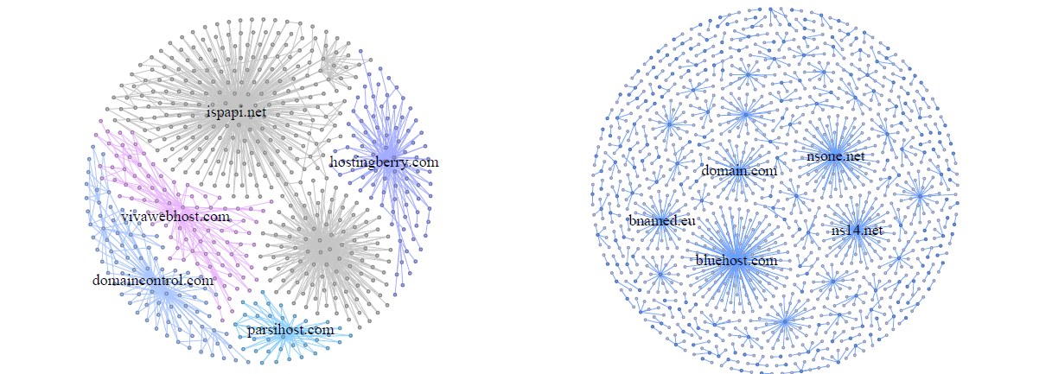
Different entity tend to share nameserver
Clusters of shared nameservers
if any nameserver is vulnerable, it affects all other entities in that group
ispapi.net
nsone.net
domaincontrol.com
SharedAuth-I
SharedAuth-II
Notes:
We also found that a shared group may include many different types of enterprises. These shared infrastructures are often concentrated in a few large service providers.
This figure shows the relationship between authoritative nameservers within different shared groups, and it is evident that the central nodes are a few large service providers.
Note that if any nameserver in the shared group is vulnerable, it affects all other entities in that group

Slide 19
Different entity tend to share nameserver
Clusters of shared nameservers
Common scenarios of shared nameservers
service subscription
Different services within a single corporation
infrastructures migration
Company mergers and acquisitions
Enterprises use public hosting services
Corporate mergers and acquisitions
Notes:
Through our analysis, we have identified four scenarios of shared authoritative servers.
service subscription
Different services within a single corporation
infrastructures migration
Company mergers and acquisitions
Taking corporate mergers and acquisitions as an example, when a DNS hosting service provider is acquired, unlike other business that can be quickly switched, the historical authoritative nameservers must remain online, leading to the coexistence of new and old services. For instance, the example shown here illustrates the situation with Digicert DNS and DNSMadeEasy.

Slide 20
Vulnerable Entities
12 mainstream DNS hosting providers
125,124 domains of well-known enterprises/organizations
Notes:
Through extensive analysis, we have confirmed that 12 major DNS hosting service providers have been affected by XDAuth, including Amazon Route 53, NSONE, and others.
Furthermore, we have identified 125,124 affected enterprise domain names of well-known companies, involving brands such as Nike, Canon, Porsche, BBC, etc.

Slide 21
Disclosure & Mitigation
Disclosure
Some providers have confirmed and fixed the issues, like NSONE
McKesson and Nike has confirmed the issue and is working on fix
Mitigation
Improve existing NS allocation strategy
Implementing discontinuation constraints
Maintaining a global status of domain hosting
Performing domain ownership verification by other information
Notes:
We have responsibly disclosed the vulnerabilities.
As of now, three hosting service providers have acknowledged and fixed the issue.
McKesson has thanked us for our report and is currently in the process of fix.
In light of the potential trade-offs between availability and security, and following the analysis of well-managed providers, we provide a series of effective mitigation suggestions for hosting providers and domain owners:
Improve existing NS allocation strategy
Implementing discontinuation constraints
Maintaining a global status of domain hosting
Performing domain ownership verification by other information, like registration information

Slide 22
Conclusion
New attack surface
uncover a new attack surface in the DNS infrastructure: shared nameservers infrastructure
Novel methodology and findings
shared authoritative nameservers are prevalent
a novel approach to discovering shared nameserver threats
demonstrate the risk existing in many DNS hosting provider and enterprises
Notes:
Finally, I summarize our work.
We disclosed a new attack surface in DNS infrastructure: the shared nameserver infrastructure.
We designed a new method to discover shared authoritative servers hidden behind the services.
Our experimental results have shown that shared authoritative servers are very prevalent, but their security threats have not been disclosed before.
Through large-scale experimental analysis, we have demonstrated the impact of the XDAuth attack in real-world scenarios, identifying a large number of affected hosting service providers and well-known enterprise domain names.

Slide 23
Thanks for listening!
Any question?
Yunyi Zhang
Email: zhangyyzyy@nudt.edu.cn

