Slide 1
Ongoing Issues and Anomalies in Existent and Non-Existent Top-Level Query Names
Duane Wessels, Verisign
DNS-OARC 43 – October 27, 2024

Slide 2
What is this talk about?
Queries to root name servers!
Mostly for queries with top-level domains that don’t exist.
Data comes from two sources:
A-root & J-root daily summaries
DNS-OARC “Day In The Life” (DITL) annual collections*
This is similar to ICANN’s DNS Magnitude data.
Note: here rank is based on query volume, not magnitude.

Slide 3
Get ready to see some graphs
Two ways of looking at long-term changes in query traffic patterns:
rate – queries per day
rank – popularity

Slide 4
Sample
A-root
Data points from DITL
Query rate data from Verisign
J-Root
Query rate ranking from Verisign

Slide 5
TLDs That Exist

Slide 6
.com

Slide 7
.arpa
Recent increase coming
from the same large
cloud services provider.
Spike around the start of
2023 from a large cloud
services provider.

Slide 8
.
Priming queries from
resolver software
running on large US
cable ISP customer
premise equipment.
Over IPv6!

Slide 9
Of the top 20 most-queried TLDs, 12 are not delegated.
Rank | TLD
1 | com
2 | arpa
3 | net
4 | local
5 | .
6 | test
7 | ir
8 | home
9 | cn
10 | localhost
Rank | TLD
11 | org
12 | internal
13 | lan
14 | ctc
15 | invalid
16 | dhcp
17 | io
18 | js
19 | coms
20 | wifi
Rank based on query volume. Data from A-root and J-root during August 2024.

Slide 10
Special Use TLDs

Slide 11
.local
RFC 6762 – Multicast DNS
Caching DNS servers SHOULD recognize these names as special and
SHOULD NOT attempt to look up NS records for them, or otherwise
query authoritative DNS servers in an attempt to resolve these names.
Instead, caching DNS servers SHOULD generate immediate
NXDOMAIN responses for all such queries they may receive (from
misbehaving name resolver libraries). This is to avoid unnecessary
load on the root name servers and other name servers.

Slide 12
.test
RFC 6761 – Special-Use Domain Names
Caching DNS servers SHOULD recognize test names as special and
SHOULD NOT, by default, attempt to look up NS records for them, ...
This is to avoid unnecessary load on the root name servers and other
name servers.

Slide 13
.localhost

Slide 14
.invalid

Slide 15
.internal*
*not (yet?) a special-use TLD
Queries leaking from large cloud services provider. Decreased after Verisign outreach.

Slide 16
Networking Related

Slide 17
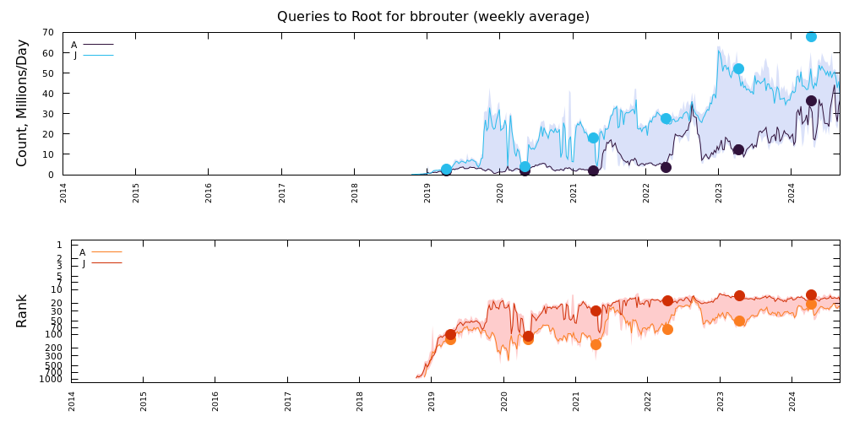
.bbrouter

Slide 18
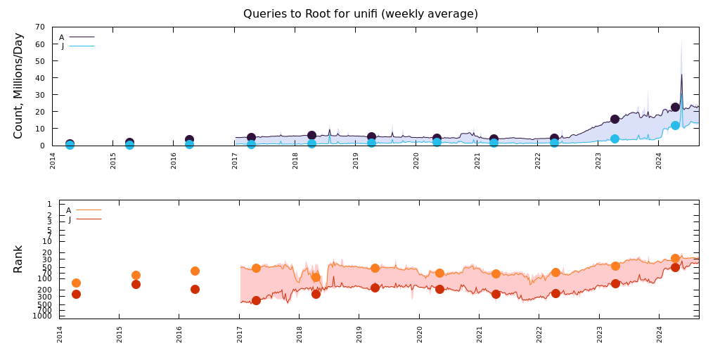
.unifi

Slide 19
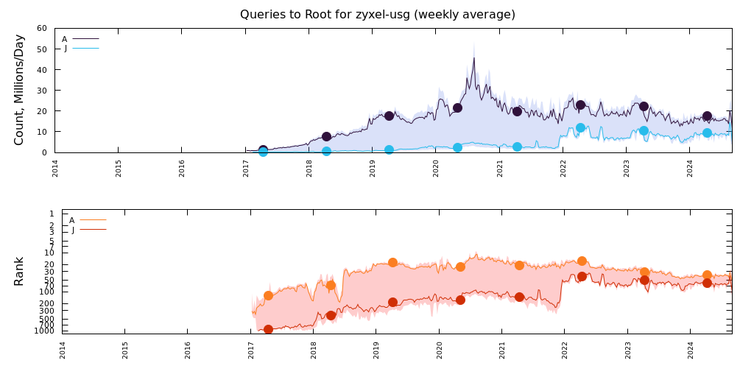
.zyxel-usg

Slide 20
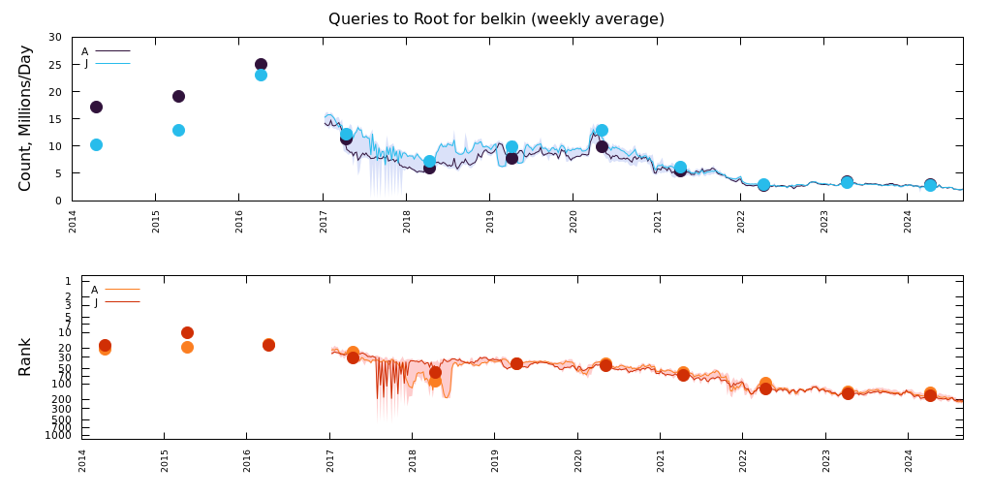
.belkin

Slide 21
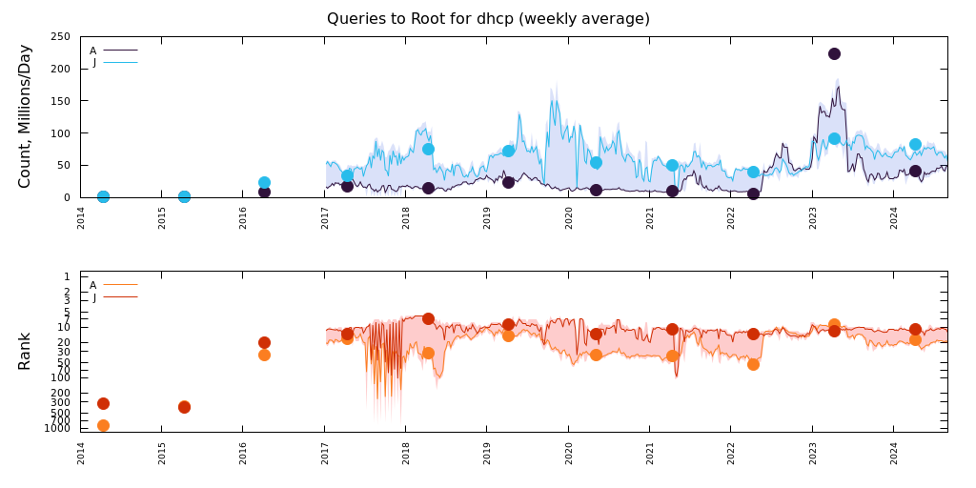
.dhcp

Slide 22
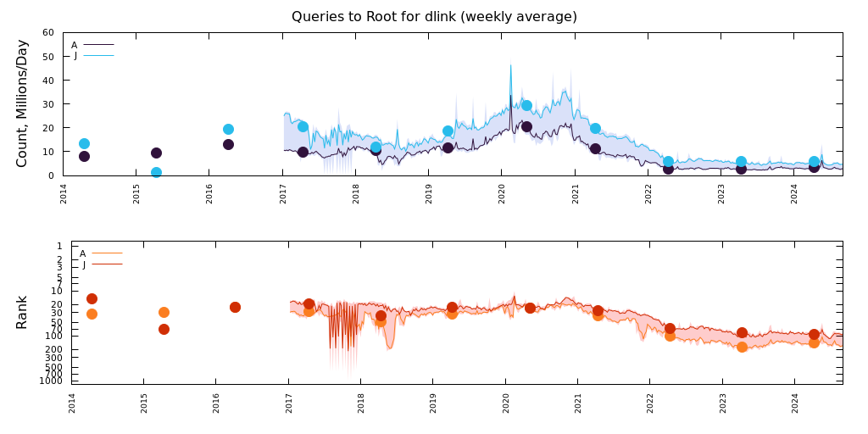
.dlink

Slide 23
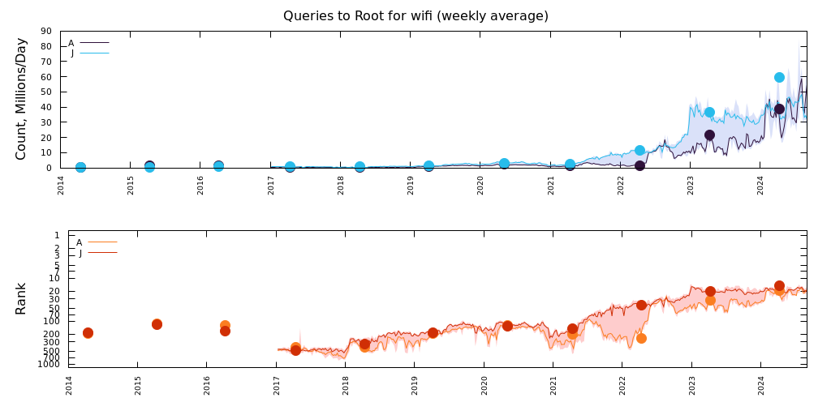
.wifi

Slide 24
Cloud Related

Slide 25
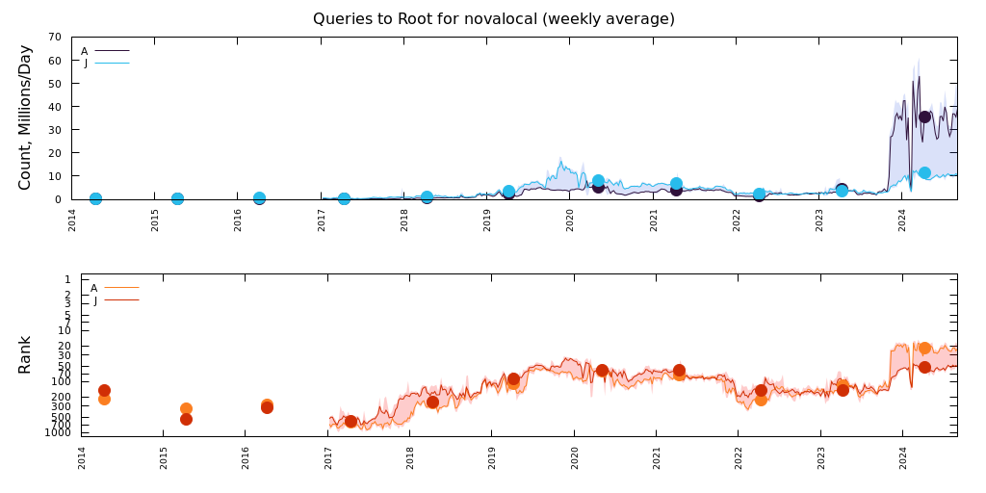
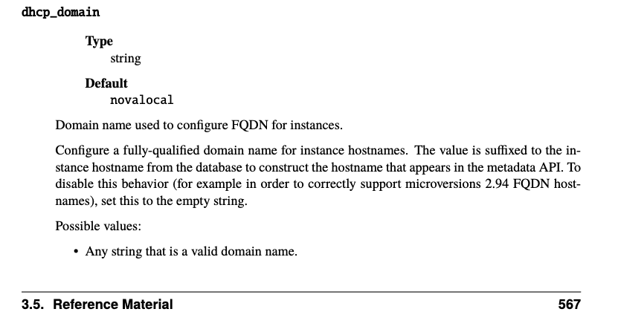
.novalocal

Slide 26
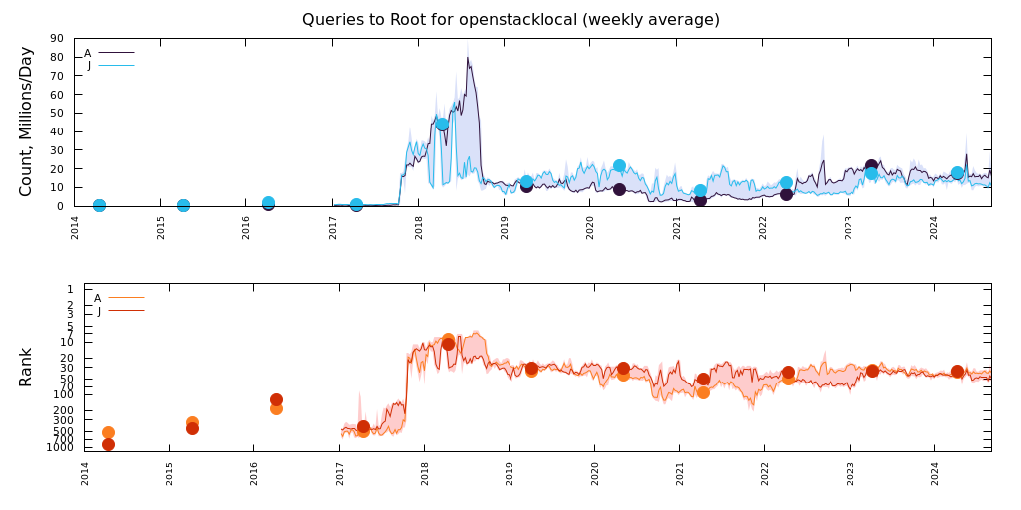
.openstacklocal

Slide 27
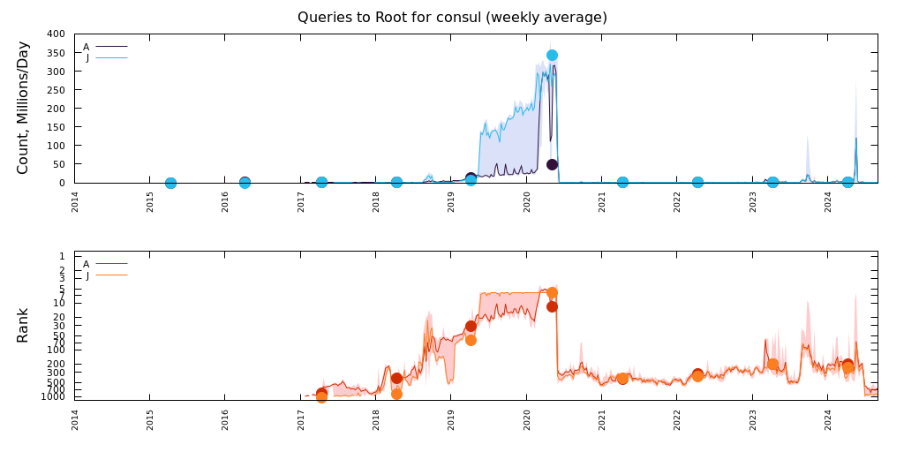
.consul
2019/2020 increase coming
from a single large recursive DNS provider. Stopped after Verisign outreach.
Recent increase coming
from a single large cloud services provider. Stopped after Verisign outreach.

Slide 28
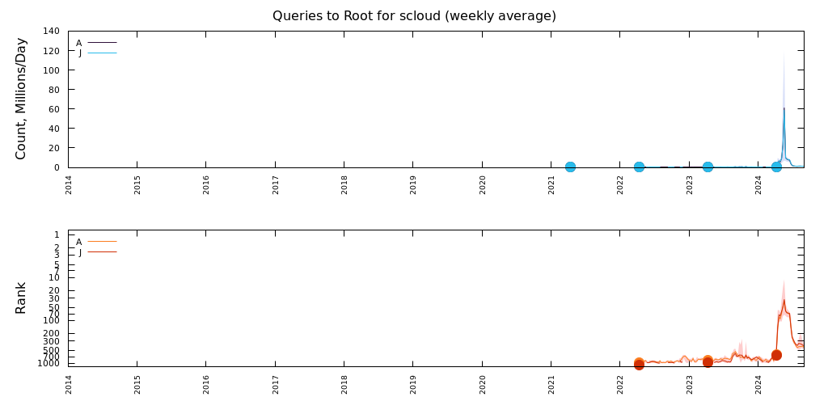
.scloud
Recent increase coming from a single large cloud services provider. Brought to my attention by Roy Arends. Stopped after ICANN & Verisign outreach.

Slide 29
Software Related

Slide 30
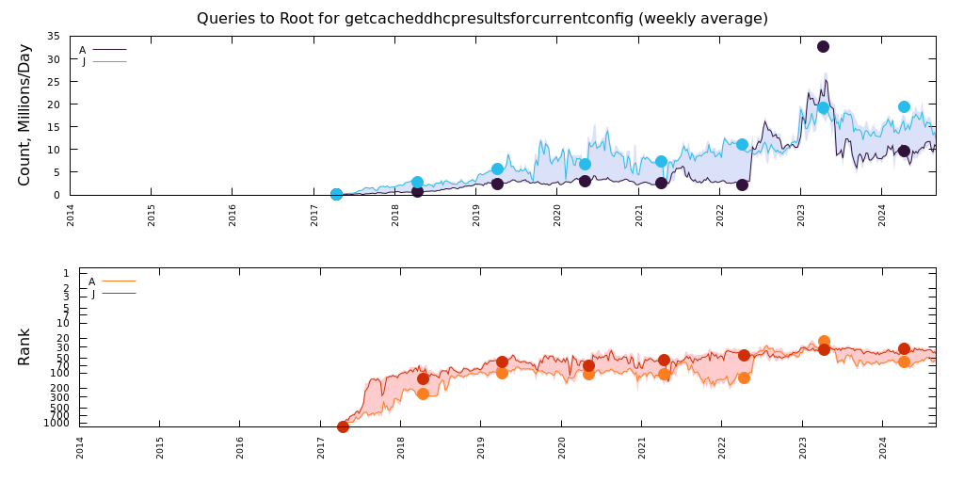
.getcacheddhcpresultsforcurrentconfig
Discussed on dns-operations thread by Roy Arends from December 2018
Attributed to Android code base
if (dhcpResults != null) {
WifiStateMachine.this.stopIpClient();
dhcpResults.domains = "getCachedDhcpResultsForCurrentConfig";
”Already factored out” according to Warren Kumari
Yet query volume and rank increasing since 2018

Slide 31
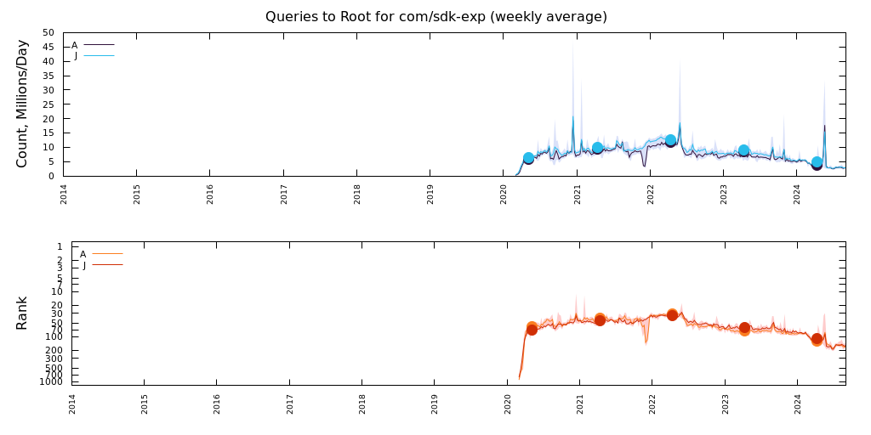
.com/sdk-exp

Slide 32
What Should Happen Instead?
This has been a known problem for at least 20 years.*
Why does it keep happening?
Products that need to have a default domain should not use non-existent, non-standardized TLDs.
Use a name under your own namespace instead!
Or, don’t emit queries using default / example values – force users to change the defaults.
Would the community be receptive to an RFC providing guidance for product default domain names?
* “Wow, That’s a Lot of Packets,” Passive and Active Measurement Workshop (PAM), April 2003

