Slide 1
IS BIG DNS TAKING OVER?
Digitalmedusa.org
Funded by Digital Infrastructure Insights (Ford Foundation, Sloan, Omidyar, and Schmidt Futures)

Slide 2
Preliminary report
In short
Based on APNIC LAB data, Since 2022, the use of public DNS services has halved in many regions.
Study seeking to learn reasons for this drop in usage and global regulatory tracker of government requests to block domain name resolution. It also aims to explore whether there are any kinds of correlation between specific political incidents and changes in the use of public DNS resolvers

Slide 3
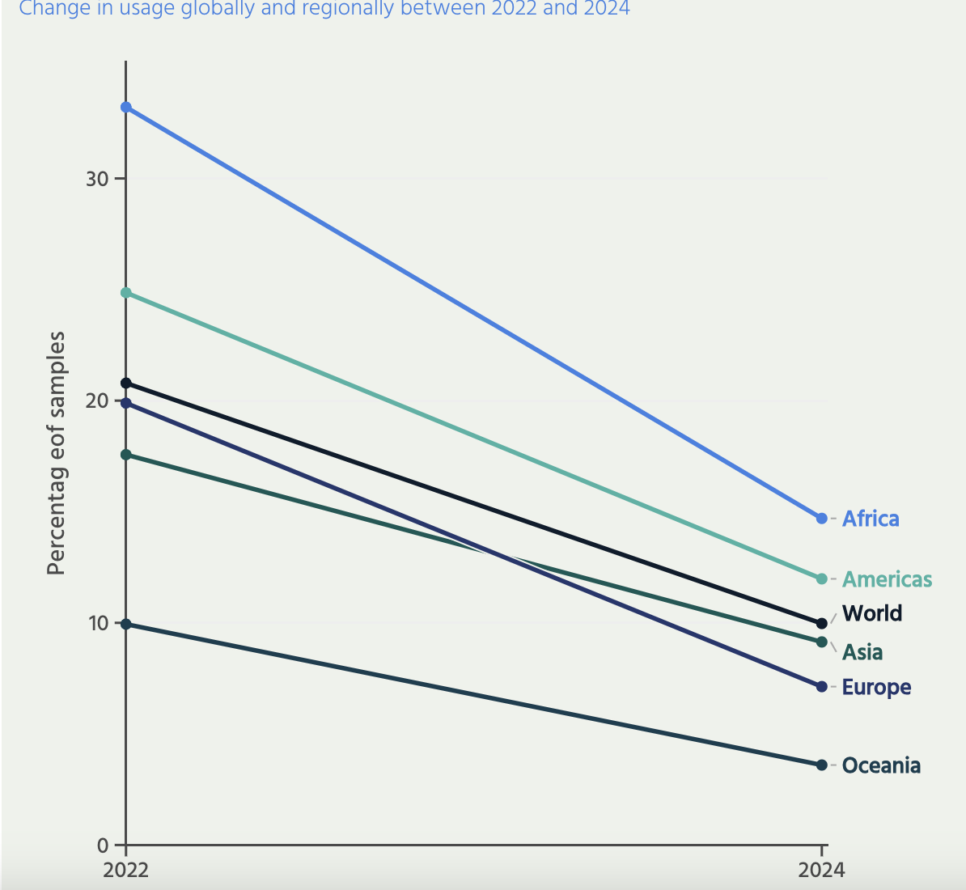

Slide 4
Low Internet and Press Freedoms, Higher usage of DNS resolvers
We identified a high percentage of Internet users in regions with low Internet and Press freedoms, including Central Asia and Middle and West Africa, still using public DNS resolvers.

Slide 5
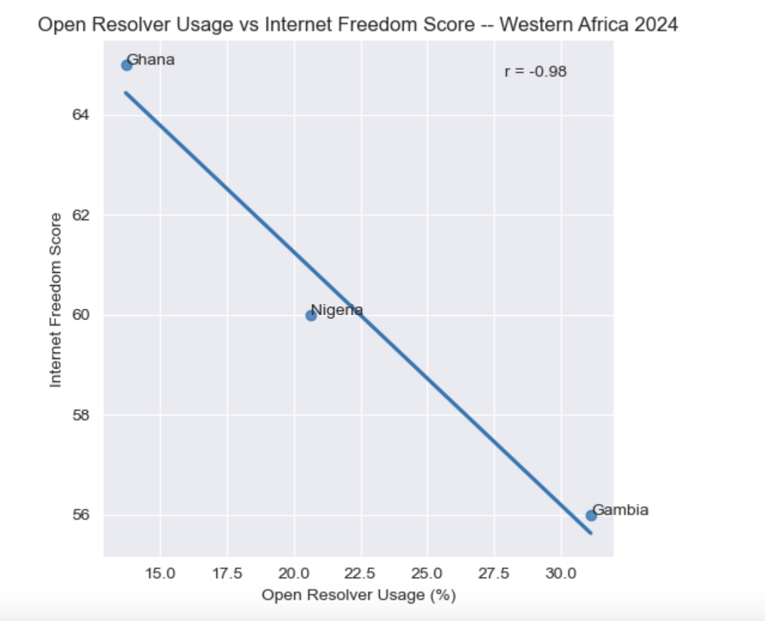
Correlation: Western Africa
There was a negative correlation between Internet freedom index and usage of open resolvers in Western Africa. Where there was lower Internet freedom, there was a higher usage of public resolvers.

Slide 6
Hypothesis
Our preliminary analysis shows a sharp decline in the use of public DNS resolvers globally. A hypothesis for this drop is an increase in regulatory pressures and content moderation requirements by the governments. While such requests might not directly order domain name blocking at the DNS resolver level, ISPs might find it easier and less costly to follow the blocking order through the DNS resolver.

Slide 7
Next steps
Source other data on the use of public resolvers
Work on the Blocking Global Tracker
Explore whether there are any correlations between the use of public resolvers and political incidents
Consider correlation between the size of the ISPs and public DNS resolver adoption

Slide 8
Questions
What other data sources can we use to explore this issue further?
What factors contributes to the public resolver usage trend?

Slide 9
Link to the report

