Slide 1
Protocol Vulnerabilities panel
Petr Špaček
Raffaele Sommese

Slide 2
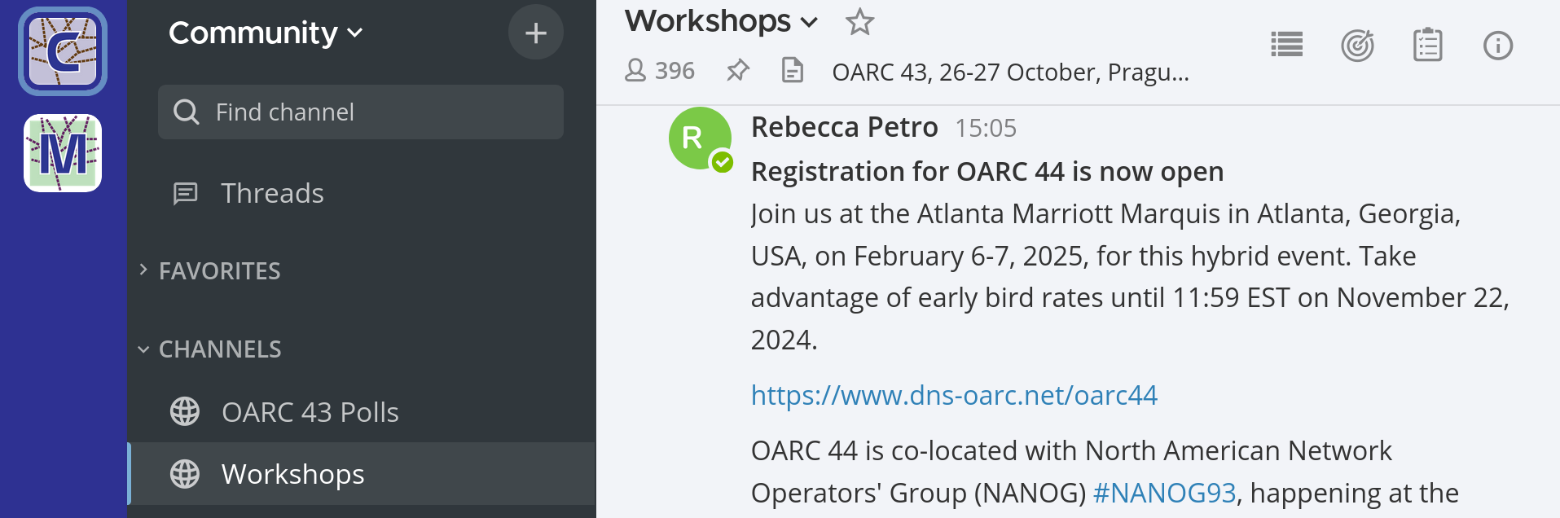
OARC 43 Participation
Mattermost Workshops channel
https://chat.dns-oarc.net/community/channels/workshops
1
2

Slide 3
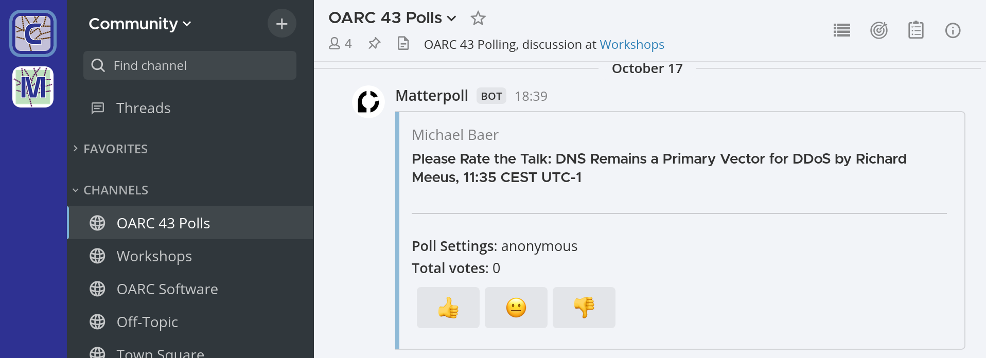
OARC 43 Talk rating
Mattermost OARC 43 Polls channel
https://chat.dns-oarc.net/community/channels/oarc-43-polls
1
2
3

Slide 4
Lightning Talks
20 minutes in during Session 3, Day 2
  5 minutes per talk. No Q&A
Abstract submissions close at 5:00 PM CEST (15:00 UTC)
Call for Presentations @ https://www.dns-oarc.net/oarc43
  PC will select and notify speakers

Slide 5
Protocol Vulnerabilities panel discussion
Moderated discussion
20 minutes
After all presenters finish
Microphone – state your Name and Affiliation
Mattermost – prefix #questions

Slide 6
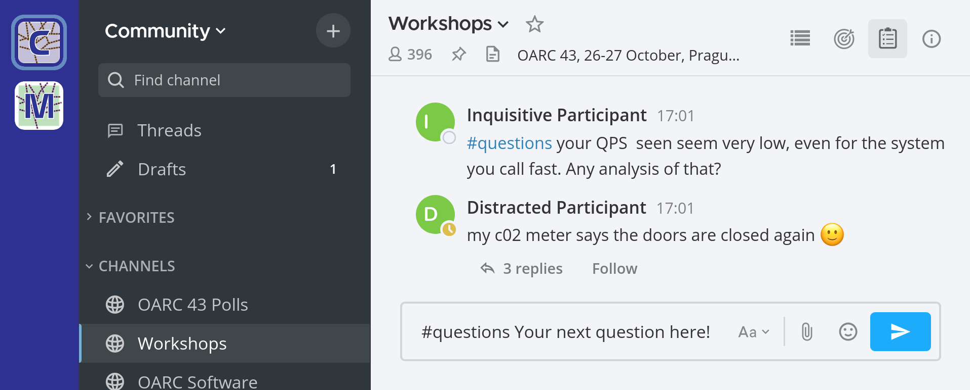
OARC 43 Questions
Microphone – state your Name and Affiliation
1
3
2

Slide 7
Protocol Vulnerabilities panelists
Richard Meeus, Akamai
Xiang Li, Nankai University
  Yunyi Zhang, Tsingua University
Huayi Duan, ETH Zurich
Elias Heftrig, ATHENE, Goethe-Universität Frankfurt
Yehuda Afek, Tel-Aviv University

