Slide 1
DNS Anycast Stack Virtual vs Bare Metal
Denic eG Dr. Benjamin Schönbach
Team DNS Jens Finkhäuser Patrick Fedick Jürgen Geinitz Sven Wefels Marco Prause Frank Ulbricht Riyad Islam Manuel Stausberg Daniel Brandtner

Slide 2
Anycast Stack (AS)
AS
„… the basic runtime environment of a nameserver (NS) and its (sub)processes upon OS-level including observer and other subsystems (i.e monitoring, networking).“
Virtual
Multiple NS processes within isolated namespaces (aka containers)
isolated path resolution, PID, UID and network stack
restricted compute resources
Bare Metal
Multiple NS processes within isolated chroot(s) (aka filesystem)
isolated path resolution only
shared compute ressources

Slide 3
Requirements & Motivation
Why stacking?
Cloud computing era leads to more flexibility, less system administration but also managed restriction by providers
Node redundancy vs. DNS traffic vs. Marketing → more nodes with complex routing and high customer awareness
Increasing geopolitical crises impacting global network and node infrastructure
Data science & AI with BIG hunger on DNS related data
Whats needed?
Easy & fast setup
one click install & teardown
Flex routing
many IXP connects
hard vs. soft routing
Adaptive platform
on-prem, cloud, hybrid
Multi-Tenancy
traffic isolation
high scalability

Slide 4
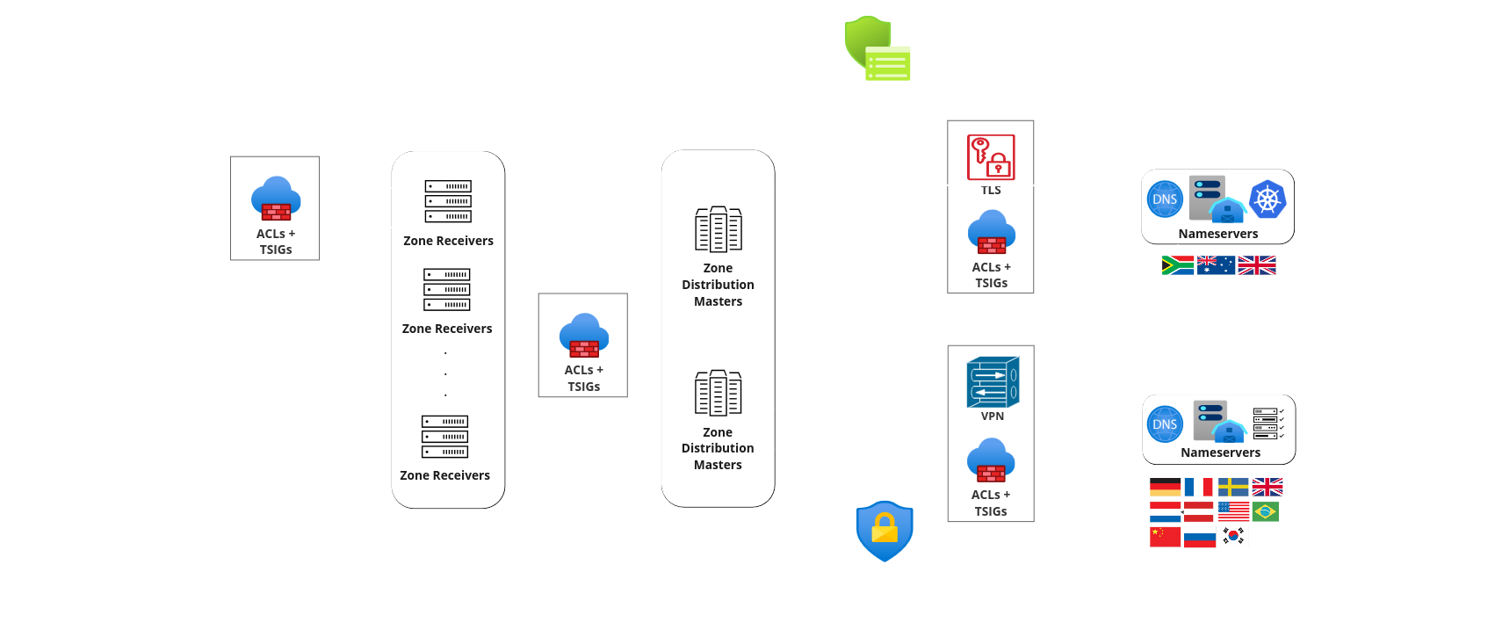
Big Picture

Slide 5
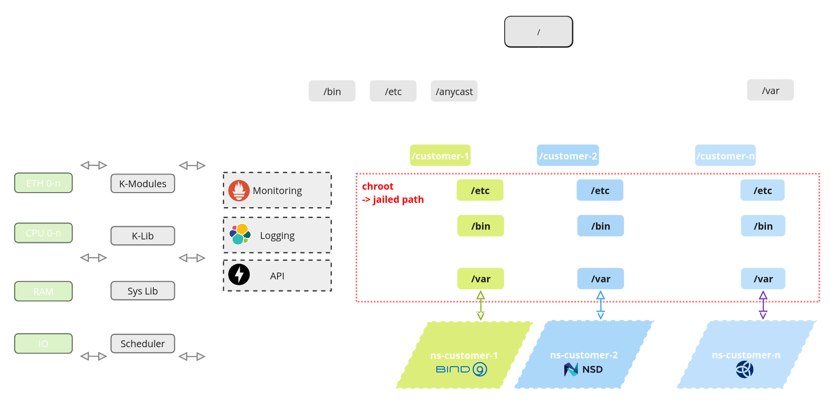
Bare Metal

Slide 6
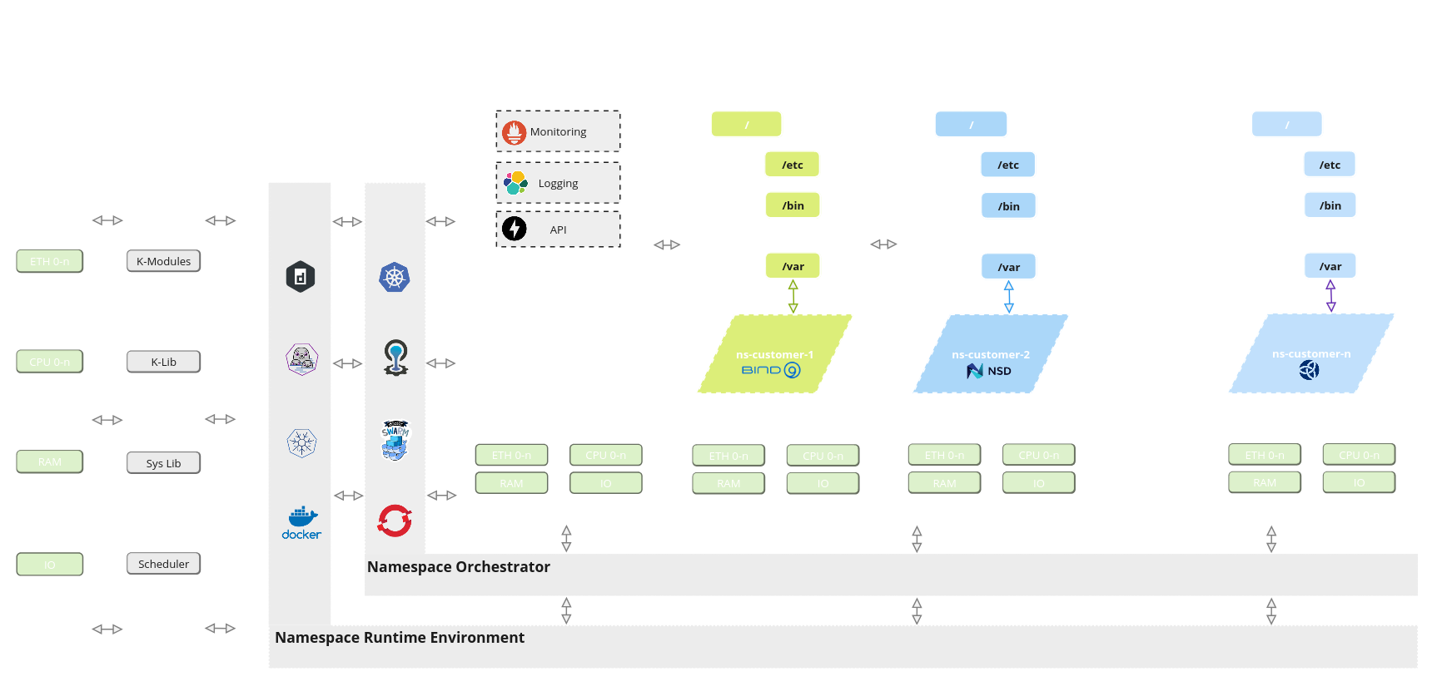
Virtual

Slide 7
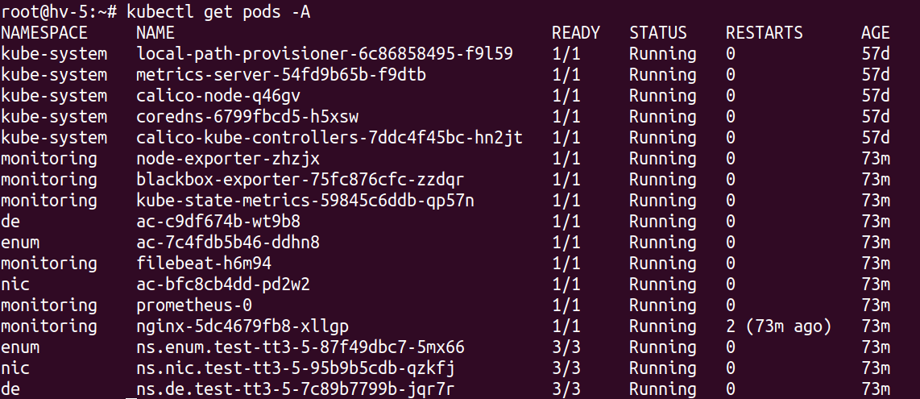
Demo Time :)
Lets setup a virtual anycast stack in less than 5 minutes with……..
Orchestrator
k3s
Dual network stack (ipv4/6)
calico (bird)
3 customers
de, nic ,enum

Slide 8
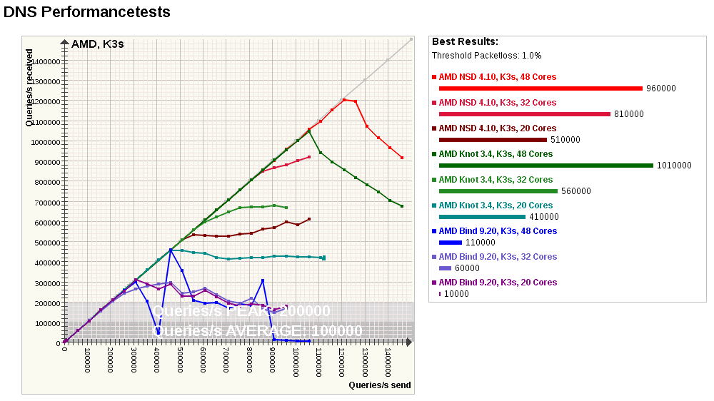
Virtual

Slide 9
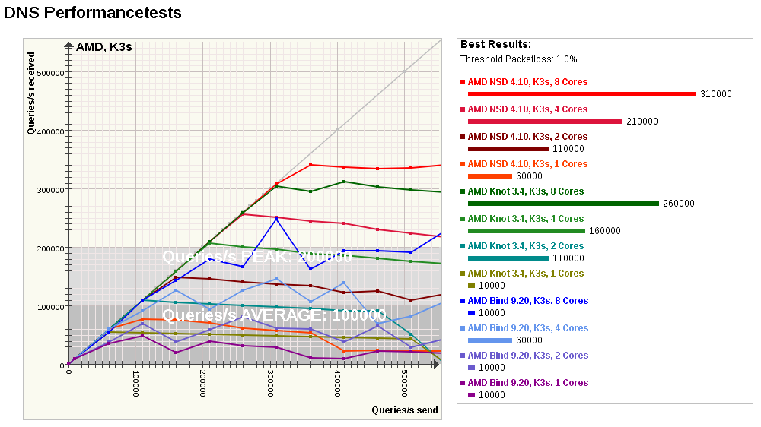
Virtual

Slide 10
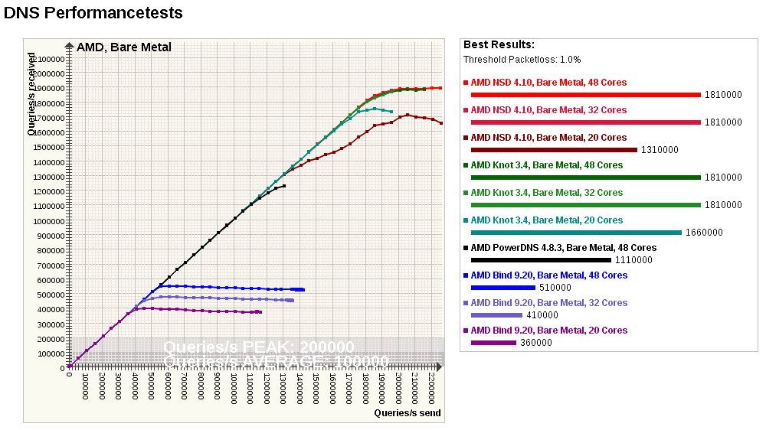
Bare Metal

Slide 11
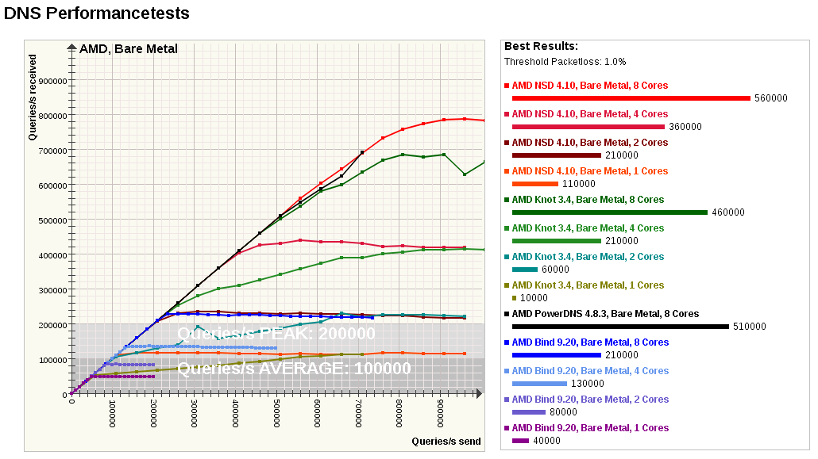
Bare Metal

Slide 12
Conclusion
Which stack fits better?
Trade off between….
query performance
administration effort
customer scalability
fast setup
OS portability
Which stack to choose?
High performance & scalability → Bare Metal
huge number of customers on same node
High portability & less administration → Virtual
easy setup and strong OS adaptiveness
Capability | Stack
 | Bare Metal | Virtual
Performance | ☺☺☺ | ☺
Administration | ☺ | ☺☺☺
Scalability | ☺☺☺ | ☺☺
Setup | ☺☺☺ | ☺☺☺
Portability | ☺ | ☺☺☺

Slide 13
Q&A

Slide 14
ThanK You!

