Slide 1
Zone Transfer Performance
Bill Snow, Digicert UltraDNS
2025-02-06

Slide 2
What about it?
testing zone transfer performance is complicated
there are data distribution choices
how do we move data around?
how do we test for capacity?

Slide 3
Motivation
Managed DNS and
Large installations

Slide 4
Alternatives
source of truth might be a webapp db, or external primaries
database replication is a good choice, except
head of line problem
monolithic scaling
maybe consider zone transfers

Slide 5
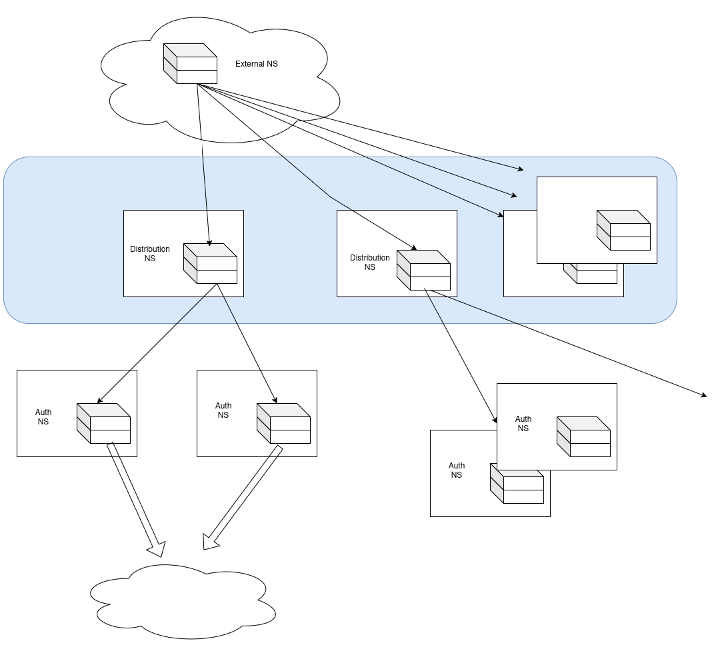
Multi-tiered Installations
multi-tiered propagation system
TLDs
distributor servers transfer in+out
global distribution in ~5s

Slide 6
Methodology
How are we going to test capacity

Slide 7
Capacity testing
how do you make a lot of zone transfers at once?
the state machine is annoying
notify, soa, transfer messages – what to measure?
satisfy ourselves with cold start time - it's not a bad upper bound
someone else must do this...

Slide 8
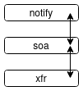
Concurrent sessions
how do you make a lot of zone transfers at once?
the state machine is annoying
notify, soa, transfer messages – what to measure?
satisfy ourselves with cold start time - it's not a bad upper bound
someone else must do this
the webapp people have lots of state machines
ab -c <concurrency>

Slide 9
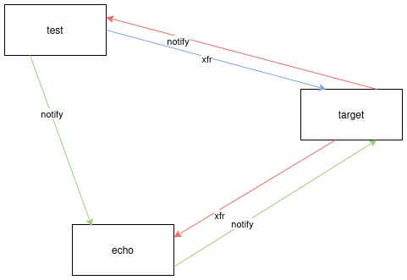
Test setup
just send a bunch of notifies
how many transfers come back?
how long do the transfers take?

Slide 10
Echo server
not exactly an echo server
answers every AXFR request with the same 30 record template
...and IXFR
also-notifies
soa serial number is always the current time in ms
quick enough. Still hard to make it as quick as knot!
use long refresh times
test generates notify load on the echo server
every soa request is out-of-date

Slide 11
What's on the target host?
bind
knot
nsd
powerdns with postgresql
catalog zones

Slide 12
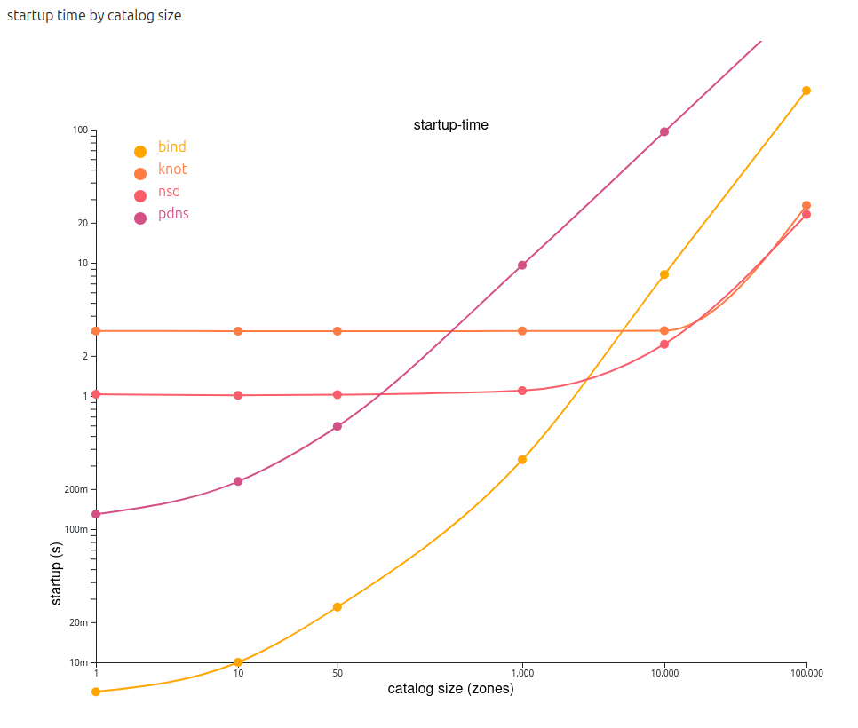
Benchmark start times
they're all pretty fast up to 10k
knot & nsd unbothered for a while
test setup seems to work
sanity –

Slide 13
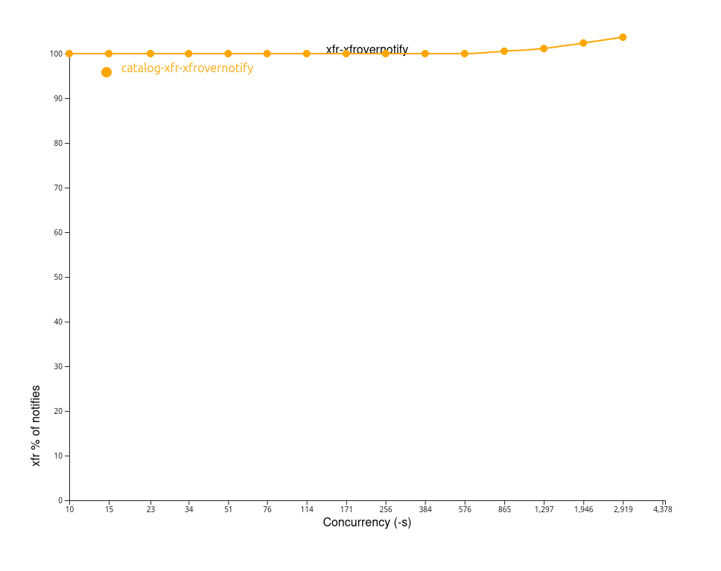
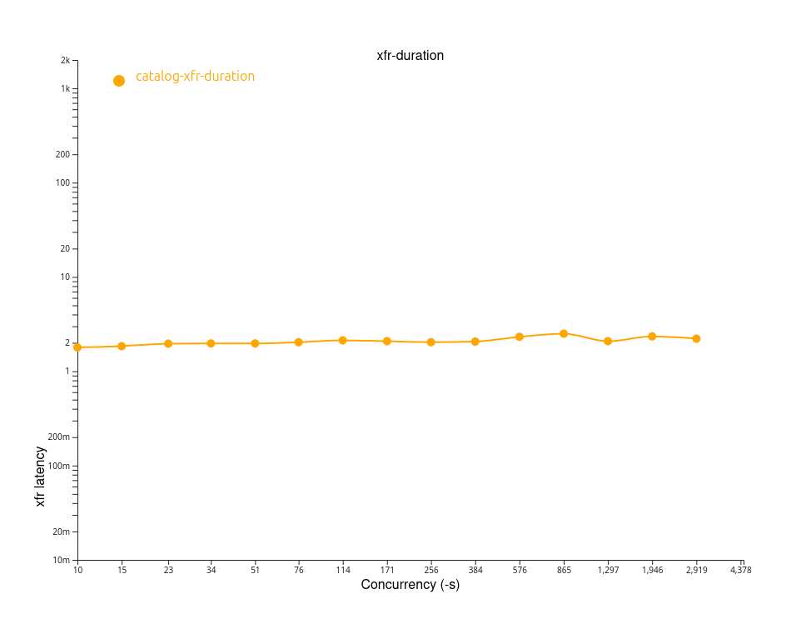
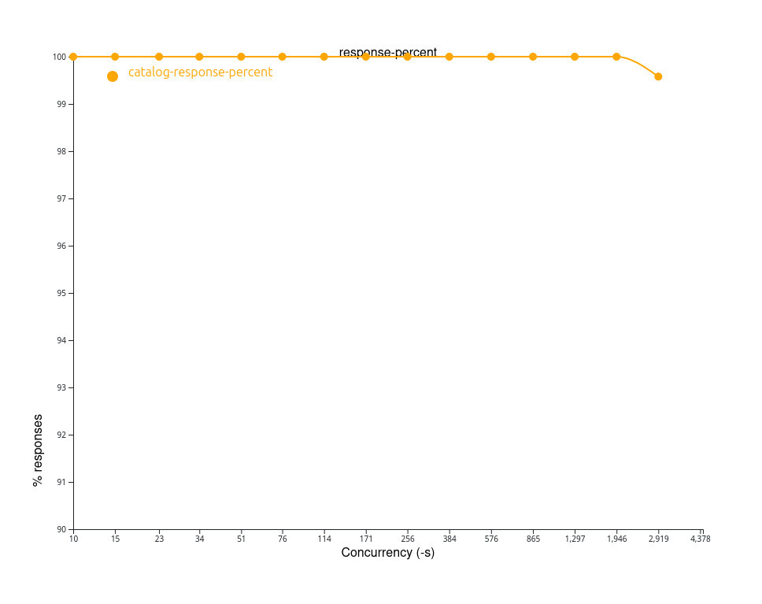
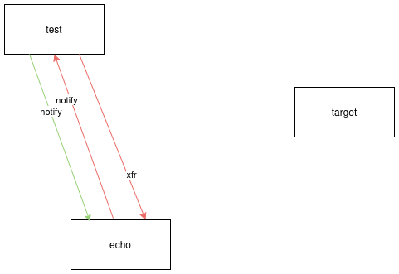
Benchmark the echo server
around ~3k notifies/s
everything is normal up to 576
think about that as xfr latency (time to respond)
sanity –

Slide 14
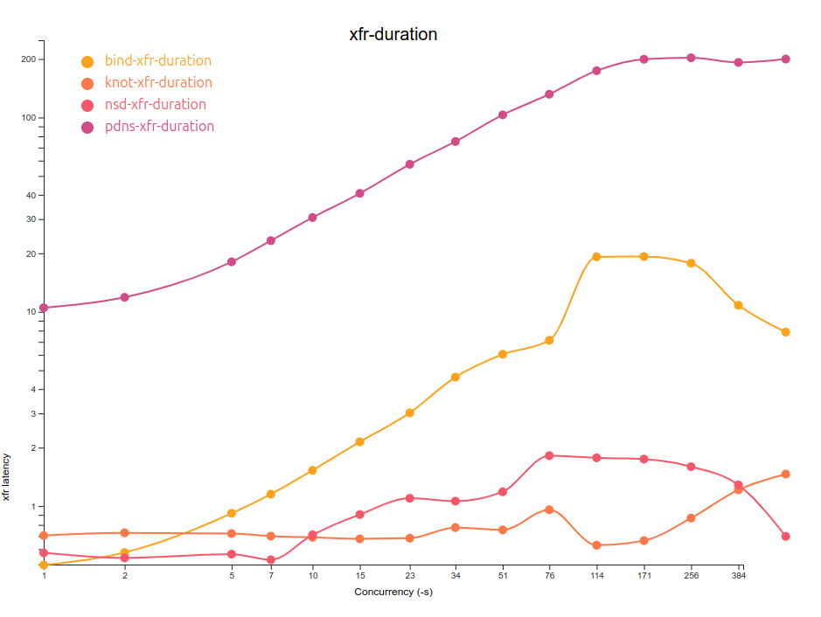
Finally some test results
total 3k notifies
pretty fast
concurrent sessions
qps <1000 (more later)
but this is the response time of the target to the xfr request

Slide 15
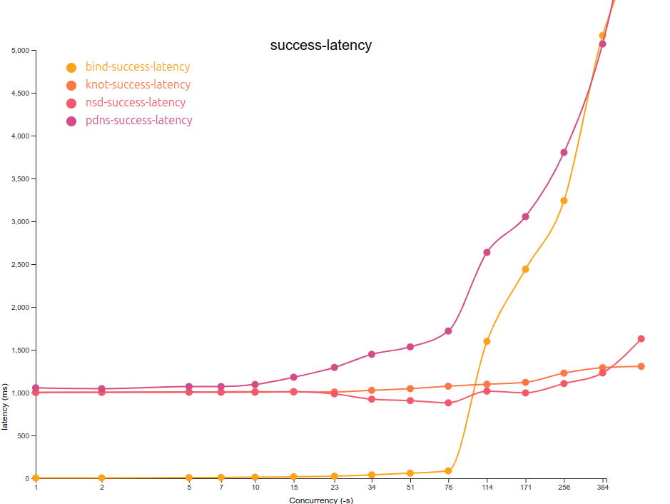
Average time to transfer
how long does it take from notify time to test xfr completion
echo server ms timestamp trick
kind of nice up to 76

Slide 16
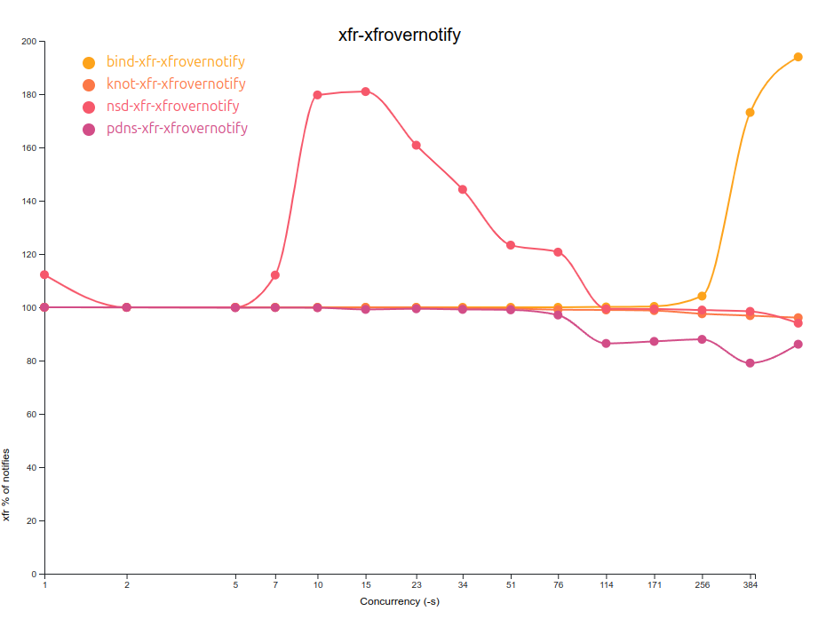
XFR transactions per notify
how many xfrs do we get per notify?
nsd is a bit wild in this data
refresh timers are difficult
effects of concurrency are sensible (otherwise)

Slide 17
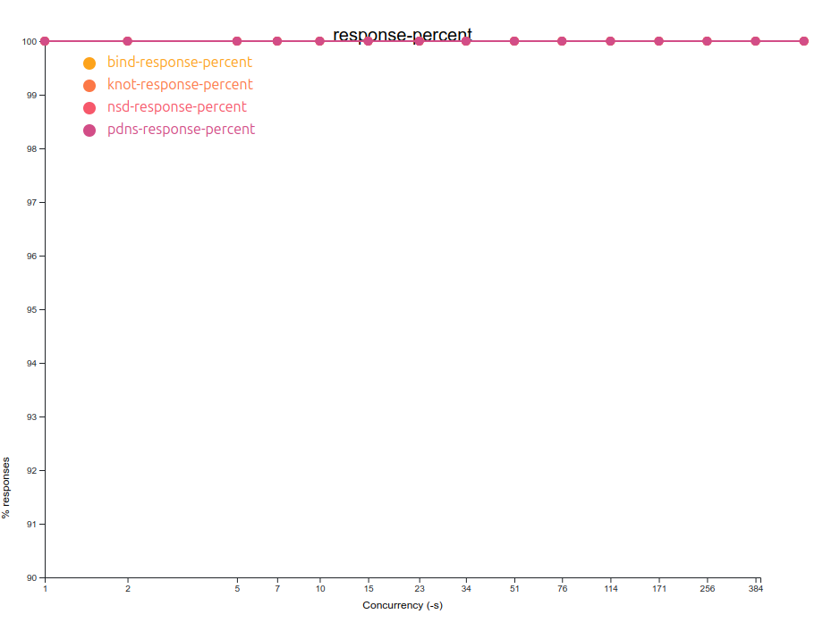
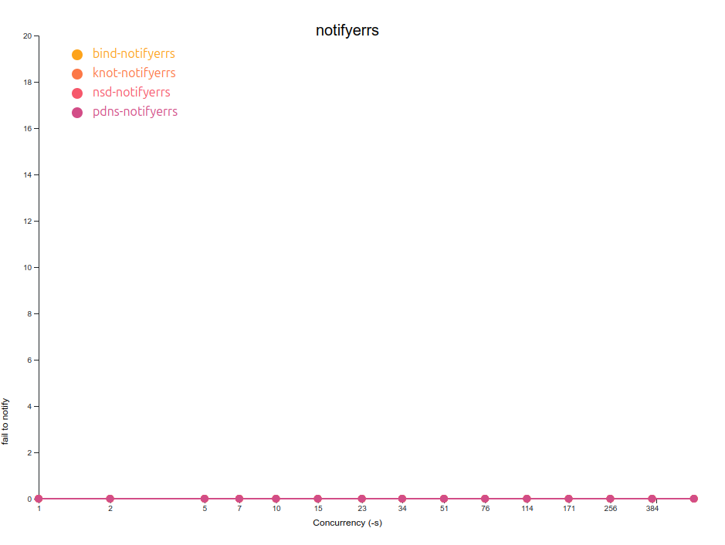
Losing transfers
validated the test environment
match up log lines to stats
100% forwarded notifies
receiving no notify errors
receiving no xfr errors
no nameserver error log lines!

Slide 18
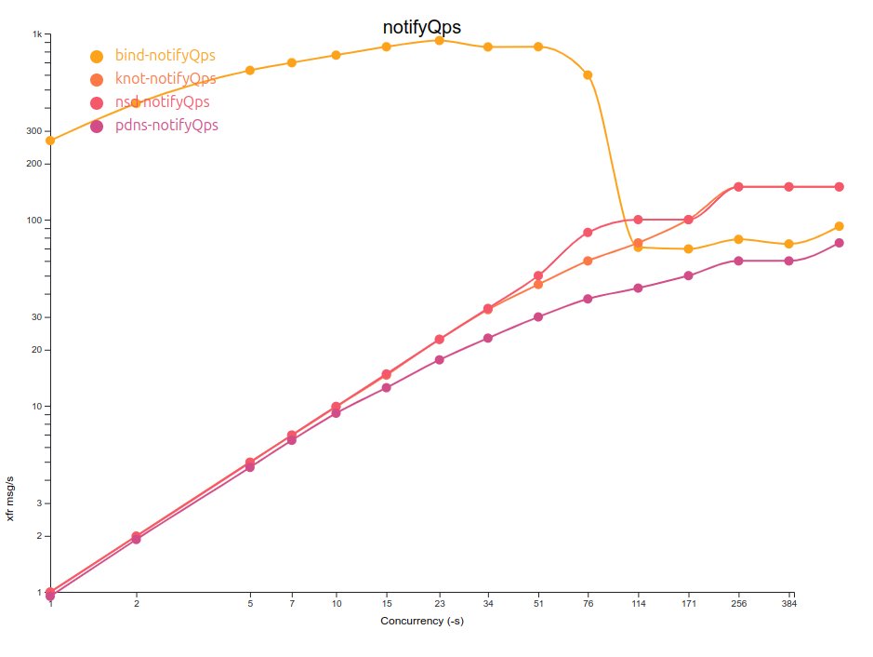
Rate limiting in action
the nameservers other than bind will only do 1 transfer/second per zone

Slide 19
Catalog Zone Updates
Add and remove zones

Slide 20
What happens when we add and remove zones?
this is a more complicated state machine – what to include?
for simplicity – just the catalog for now
Why are you doing this? Why???

Slide 21
What happens when we add and remove zones?
tweak the echo server
needs a few zones named after the timestamp
send notify traffic
The previous install isn't going to work, because there is only one catalog
nsd doesn't do multiple catalogs

Slide 22
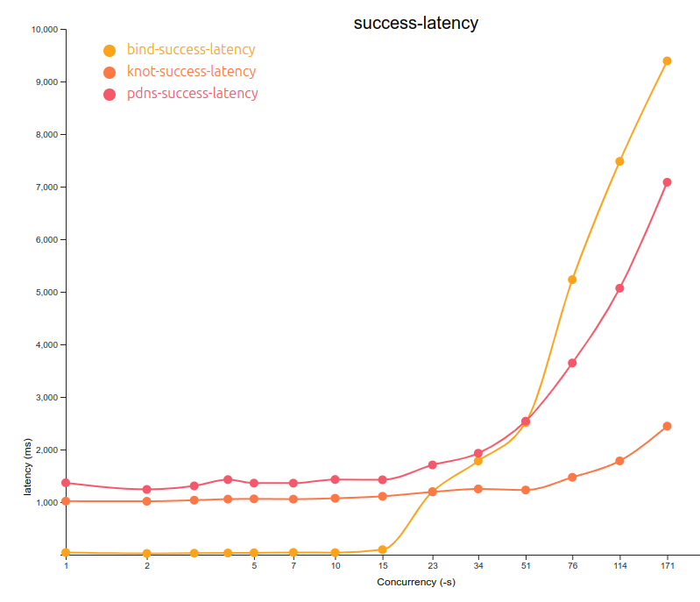
Catalog update performance
time from notify to transfer out of the catalog zone (only)
not as performant as zone updates
testable!

Slide 23
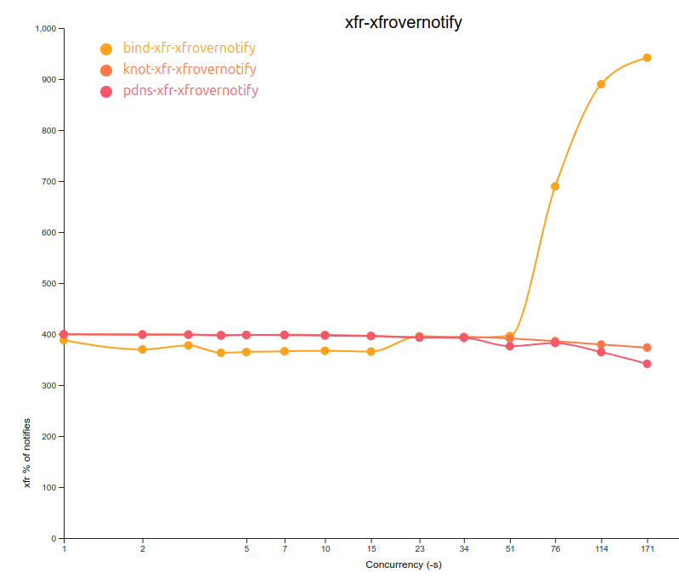
Catalog update performance
ideally 4:1 notify:transfer
each catalog has 3 members

Slide 24
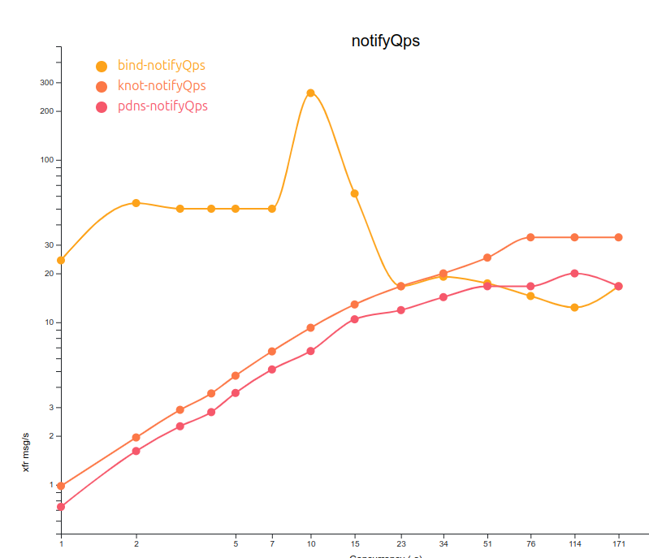
Catalog update performance
average rate to complete 1k catalog updates
what's up with bind?

Slide 25
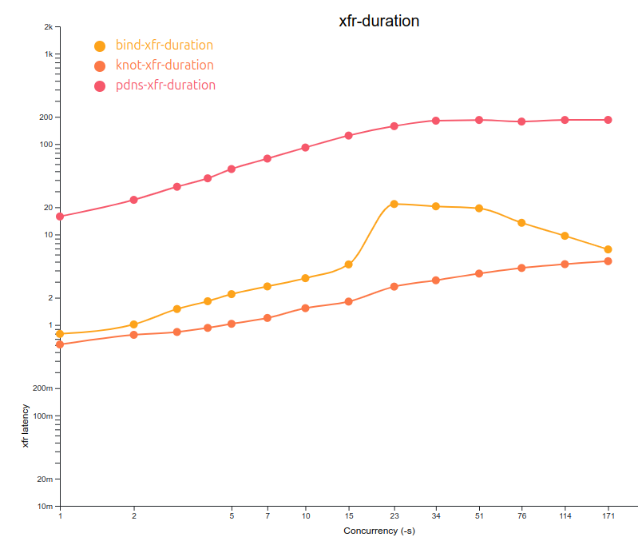
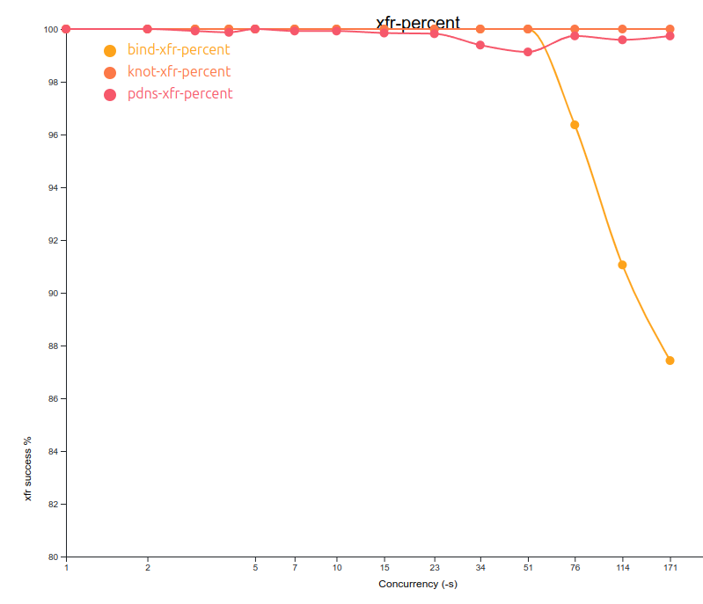
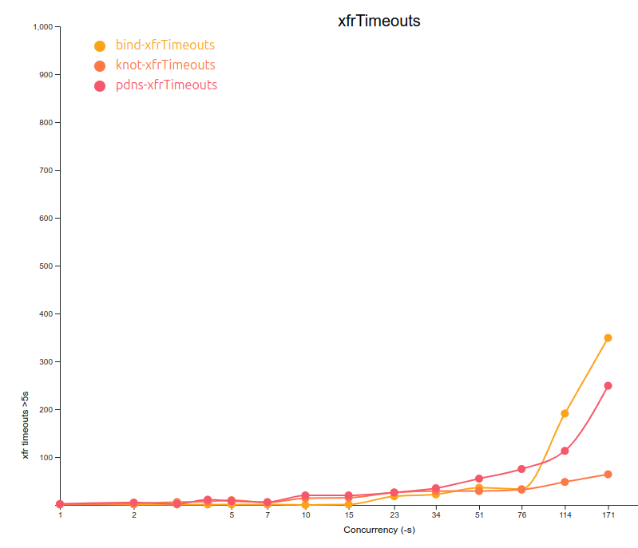
Catalog update performance
more than expected transaction timeouts
xfr time was as expected

Slide 26
Conclusions
Do we like zone transfers?

Slide 27
It depends
this all seems a lot more complicated than db replication
on purpose!
maybe that's what you need in your installation, or not
installation-specific tuning is important

Slide 28
Future work
need to deal with the refresh time by caching serial numbers
multi-primary tests, failure scenarios
simulated network latency
more detail in the catalog updates, including member transfer time
improved test performance

Slide 29
Thanks
This was fun

