Slide 1
Detection, Analysis and Measurement of DNS Tunneling Techniques Master's Thesis Research
Speaker: Damianos Christos Nikou
SIDN Supervisor: Moritz Müller

Slide 2
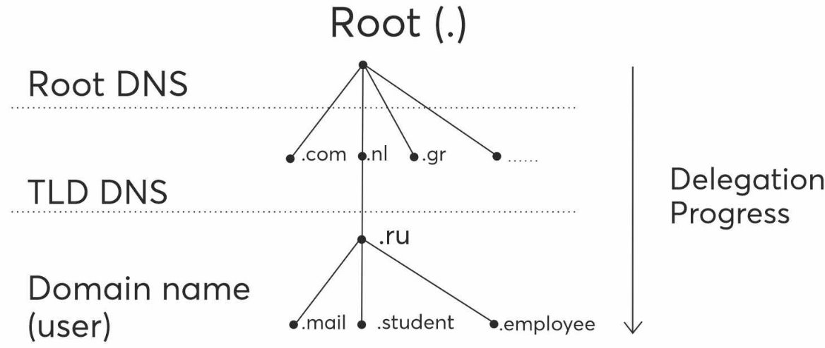
Research Purpose
Target:
.nl ccTLD
Detection of DNS tunneling techniques
Analysis of DNS tunneling queries
Validation of DNS tunneling queries
Measurement of DNS tunneling queries
Implementation:
SIDN's authoritative name servers
ENTRADA Tool

Slide 3
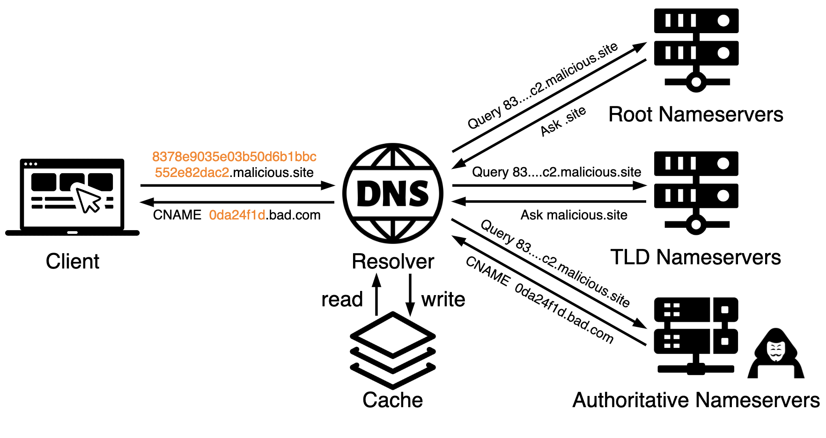
DNS Tunneling
Embedded data into DNS queries and responses
Covert communication between server and client
Bypass network protection
Hidden into legitimate DNS traffic
Modified authoritative name servers to process exfiltrated data
Transmit data in restricted environments

Slide 4
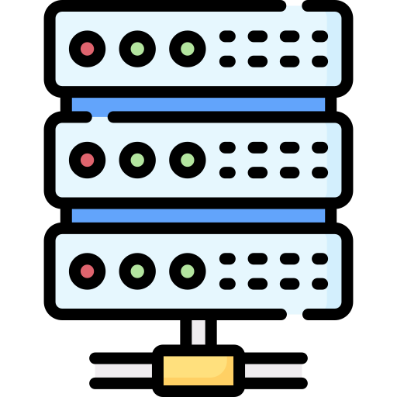
DNS Tunneling Tools
Client Side
Installed on user machine
Acts as stub resolver
Search the server on DNS hierarchy
Server Side
Resides on C2 server
Masquerades as authoritative name server
DNS Tunnels Types:
Over UDP
Over TCP

Slide 5
Detection of DNS Tunneling
Traffic Analysis
Volume of DNS Traffic per IP Address
Number of Hostnames per Domain
Volume of NXDOMAIN Responses
Payload Analysis
Size of Request
Entropy of Subdomains
Uncommon Records Types
Implementation Environments
DNS Testbed
ENTRADA Tool

Slide 6
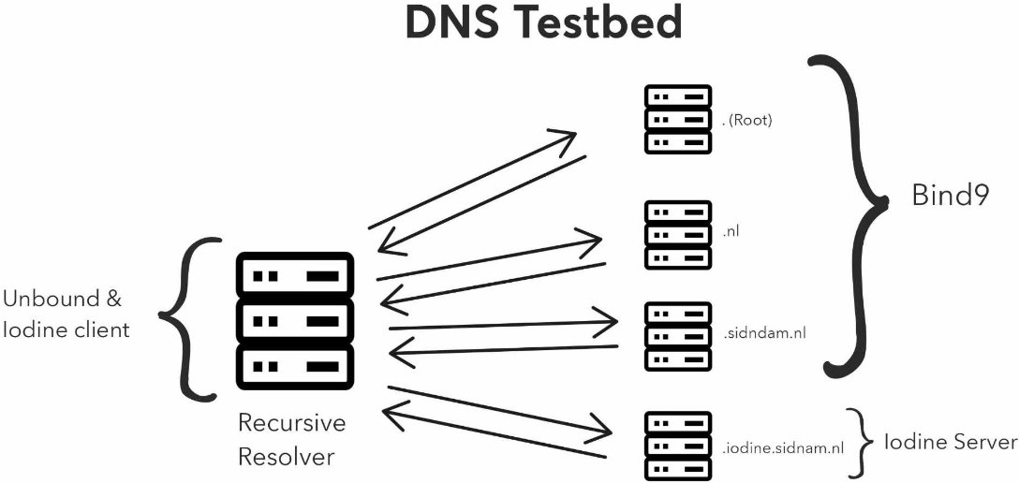
DNS Testbed Environment

Slide 7
ENTRADA Tool Environment
Capabilities
Open-Source Tool
Daily DNS traffic of .nl
Data more than a year
DNS queries in human-readable format
DNS queries captured as PCAP files
Select specific datasets of .nl traffic
Data Processing
Custom rules on SQL Queries on DNS queries
Drop queries that are unlikely caused by DNS tunneling
Select potential DNS tunneling queries
Application of detection rules on DNS queries
Scripts for analysis of DNS packets
ENTRADA: https://entrada.sidnlabs.nl/

Slide 8
Custom Detection Rules
Rule 1: Entropy > 3.8 of query names per label
Rule 2: "Base32", "Base64", "Hex", and "NetBIOS" encoding per label
Rule 3: Uncommon RR such as "TXT", "NULL", and "PRIVATE"
Rule 4: Continuous sequences of characters and numbers
Rule 5: Characters "z" or "y" in first letter and leftmost label of query
Rule 6: Error types such as NXDOMAIN responses
qname | QUERY TYPE
y6tbwbiffzn52xyefrhcgv6ns.xi7cxcqtkfwpd6pm4cxq.*.*.nl. | TXT
aqyrybnsuih67lxpjqjcmgpxndypwira.ipg5namibkuyv7fbmscq.*.*.nl. | TXT
These Rules based on observations of DNS testbed and literature analysis.

Slide 9
Validation of DNS Tunneling
Develop a scoring system based on detection rules.
Weights of score based on literature and DNS testbed.
Score on DNS queries assign the likelihood of DNS tunneling.
Real User Validation
Genuine user utilizes Iodine DNS tunneling tool.
Custom detection rules for DNS tunneling queries.
Detection of DNS tunneling query.
User verification of IP and validation of findings.

Slide 10
Validation of DNS Tunneling
qname | ERROR | ERRORTYPE | Total Score | Query Type
yrbbb0.*.*.nl. | True | NXDOMAIN | 5 | NULL
Score Distribution:​
NULL RR: 1 point​
Leftmost label "y": 1 point​
Continuous patterns: 2 points​
NXDOMAIN error: 1 point​
​

Slide 11
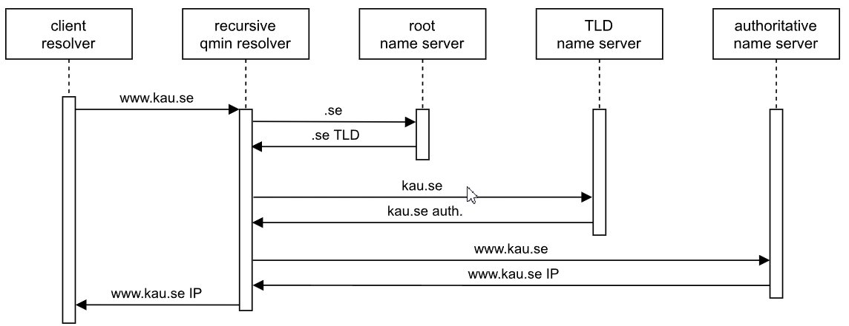
Limitations
QNAME Minimization
Enabled on DNS resolvers for privacy and security
Minimizes amount of information leaked
https://www.sidnlabs.nl/en/news-and-blogs/taking-another-look-at-query-name-minimization-in-the-dns
Only DNS queries
Investigation based only DNS quries
Unique DNS data to operation of .nl ccTLD
Hard to validate our results

Slide 12
Measurements on .nl traffic
DNS Tunneling Measurements
Over several months
Over a specific date
Over a single domain name
Attributes
Frequency by origin country
RR of DNS queries
Unique IP addresses
Number of DNS queries

Slide 13
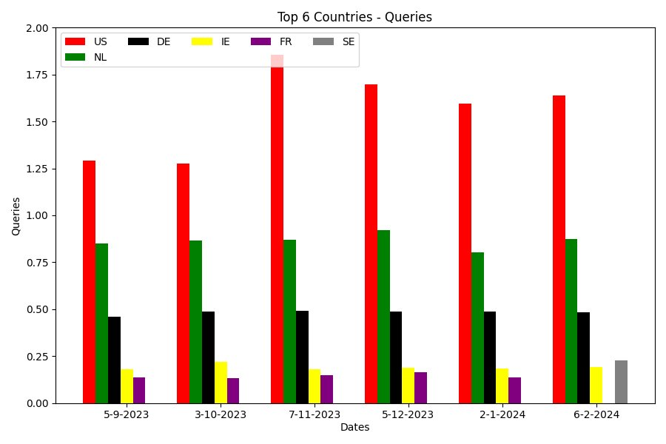
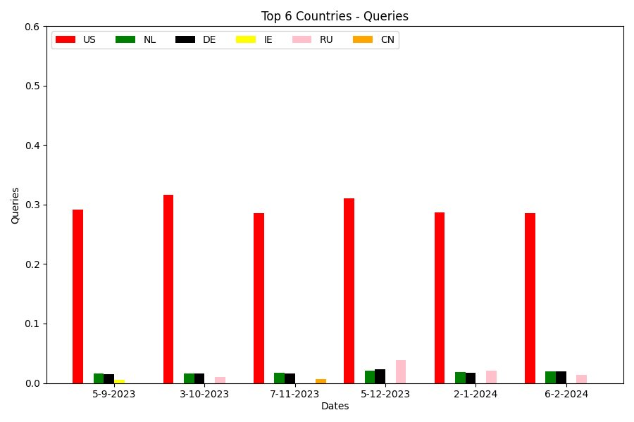
Measurements on several months
TOTAL DATA
FILTERED DATA

Slide 14
Conclusion
DNS Tunneling is being used in the wild and can be detected in ccTLD traffic
DNS query features like high entropy, encoded types, Uncommon RR, and NXDOMAIN.
Highest ratio observed from U.S in .nl traffic.
Russia included on the top 6 ratio in potential DNS tunneling queries in .nl traffic.
Detection almost 3000 unique domains remain in a specific day.
Universal detection techniques apply in all DNS hierarchy.
Common usage of DNS tunneling in daily traffic.

Slide 15
Future Work
DNS Tunneling with QNAME Minimization
More in-depth analysis of identified queries
Custom Rules on ccTLDs
Custom Rules on Root DNS Servers
Machine Learning Detection of DNS tunneling

Slide 16
Damianos Christos Nikou
Graduate Student at Radboud University
LinkedIn: https://www.linkedin.com/in/damianos-christos-nikou/
Thesis: https://www.sidnlabs.nl/en/news-and-blogs/detection-analysis-and-measurement-of-dns-tunnelling-techniques
Thank You For Your Attention!

Slide 17
QUESTIONS?

