Slide 1
OARC 44
Welcome & Information
#ItsAlwaysDNS

Slide 2
Housekeeping
DNS-OARC Conduct Policy
https://www.dns-oarc.net/oarc/policies/conduct
Workshop is being recorded
YouTube: @DNSOARC

Slide 3
On Site Information
Wi-Fi: SSID DNS-OARC
Password OARC-Workshop
Food & Drink
Toilet locations
Emergency procedures

Slide 4
Let’s chat, collaborate, and listen
Staff, PC, Board, Mentors
Share your opinions and questions
Connect with people you meet
Follow the OARC blog, and social media
#LoveDNS #OARC44 #ItsAlwaysDNS

Slide 5
Sponsors and Patrons
2025 Workshops Patron
Deluxe Sponsor

Slide 6
OARC 44 Participation
Mattermost Workshops channel on https://chat.dns-oarc.net/
Q&A
Talk rating polls 👍 😐 👎
General discussion - Public channels are open to anyone
Talk to us if you need some assistance on getting signed up
Q&A – Name and affiliation
Microphone
Mattermost #questions – Q&A Monitor asks on your behalf

Slide 7
OARC Team @ OARC 44
In Atlanta
Staff: Phil, Denesh, Jerry, Mike, Matt, Steve
PC: Cathy, Tijay, Merike, Marcelo, Raffaele, Puneet,
Board: Joao, Ray, Mauricio
Remote
Staff: @rbcapetro
PC: @willem
Board: @benno, @jabley, @jake.zack

Slide 8
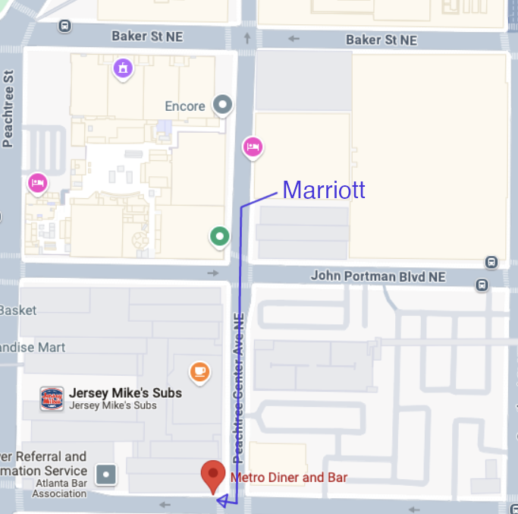
In-person Social TONIGHT
It's not too late to register!
When: Thursday, February 6th, 2025, 18:00 - 20:00
Where: Metro Diner & Bar (just around the corner)
Delegate badge will be required to enter the OARC social event and any +1s (and +2s) / guests will need to arrive with the OARC 44 attendee
Come and hang out for snacks, drinks and karaoke!
Will be held at Fahrenheit – one block away from this venue
Time: 6 PM – 8:30 PM
Registration is required, and please wear your badge!

Slide 9
DNS-OARC Update

Slide 10
OARC Mission Statement
DNS Operations Analysis and Research Center
a nonprofit, membership organization
improve the security, stability, and understanding of the Internet's DNS infrastructure

Slide 11
OARC Mission Statement
Promote & conduct research with operational relevance through data collection and analysis
Offer useful services and tools
Build relationships among its community of members
Facilitate an environment where information can be shared responsibly
Enable knowledge transfer by organizing open workshops
Increase public awareness of the DNS's significance

Slide 12
Why Become an OARC Member?
Be part of the premier community of DNS technical experts
Help support the development of software tools and services
Access and analyze a unique dataset collected on DNS infrastructure across the globe
Coordinated incident response with trusted peers
Keep OARC neutral and free of operator and vendor influence

Slide 13
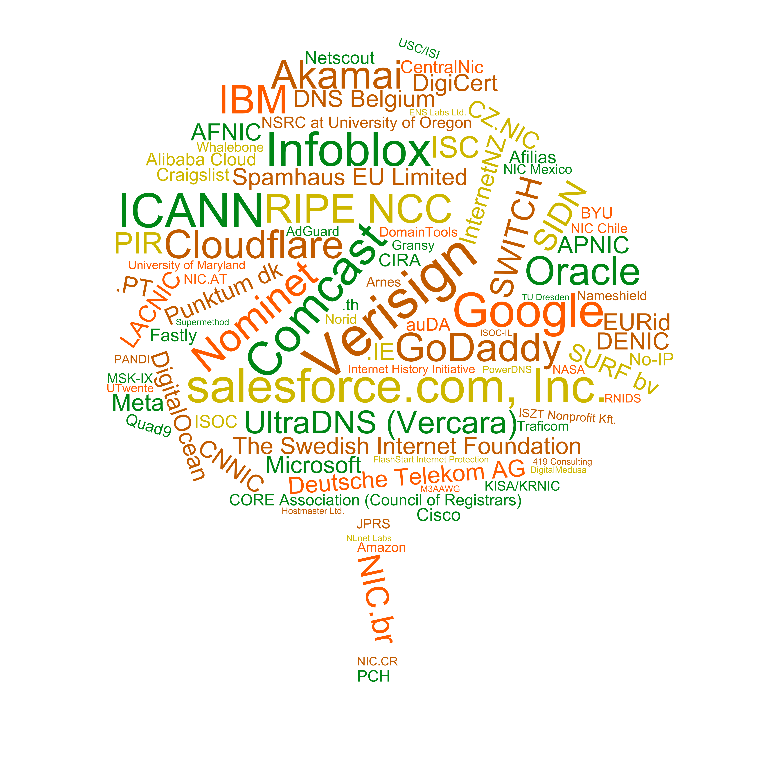
OARC Members

Slide 14
What's new since OARC 43?
OARC initiatives: DNS BCP @ OARC
Making the O in OARC more prominent
BCP Panel discussion this afternoon:
Should the OARC community have a role in identifying and promoting DNS Best Current Practices?

Slide 15
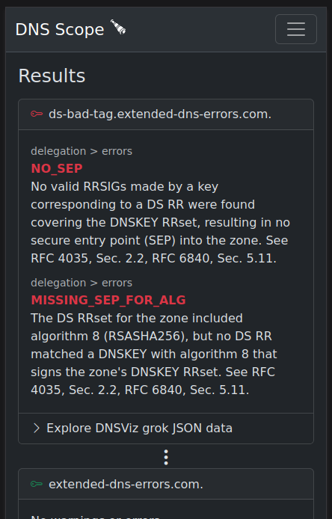
What's new since OARC 43?
OARC software and services news
DNS Scope prototype preview 2
improved UI
now mobile friendly
come test for yourself! Find Jerry
Crunchy DITL
project done - Thanks Verisign!
but work continues, next step: try and load all of DITL!
interested? Come talk to Jerry

Slide 16
What's new since OARC 43?
OARC software and services news

Slide 17
Future OARC events
We are currently scouting multiple options
We will have announcements in the coming weeks for both OARC 45 & OARC 46
Please consider supporting an OARC workshop via Sponsorship, Patronage, or a donation:
https://www.dns-oarc.net/workshop/patronage-sponsorship

Slide 18
Mentor initiative
Help newcomers feel welcome and understand what makes OARC the great community it is!
Why don't you take a second to introduce yourself to the person to either side of you (assuming you don't already know them :)

Slide 19
OARC Board Chair Update

Slide 20
Wrap up
To our OARC Members and Supporters, Programme Committee, Speakers, and all of you who signed up to attend, in person or remotely - and of course, our sponsors:
THANK YOU!

Slide 21
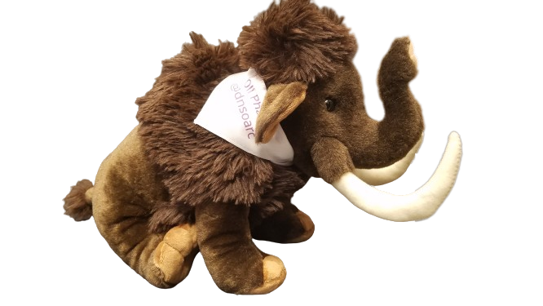
MastoDNS!
https://mastodns.net
Follow @dnsoarc@mastodns.net
Follow @oliphaunt@mastodns.net
OliPhaunt

