Slide 1
Wrap-Up

Slide 2
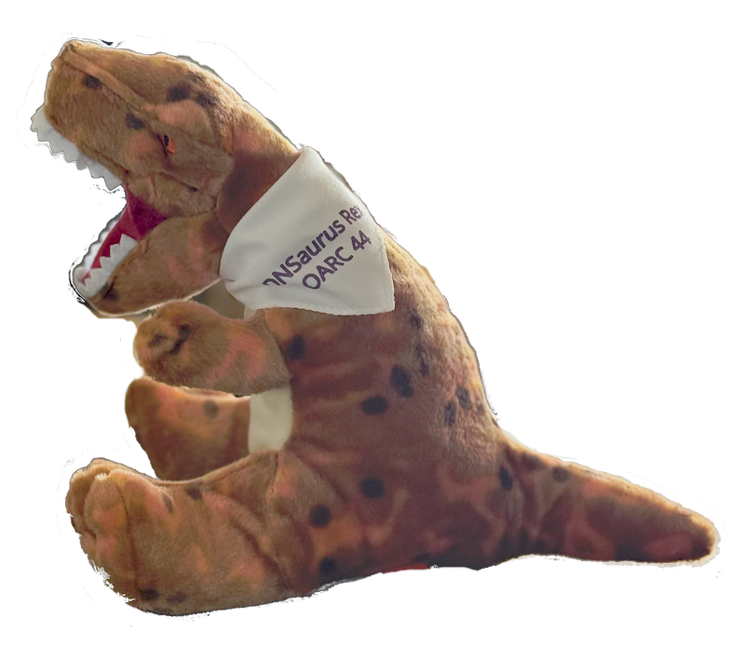

Slide 3
Thank you to our Sponsors and Patrons
2025 Workshops Patron
Deluxe Sponsor

Slide 4
Special thanks
OARC Team for making things run smoothly
OARC's Program Committee for putting together a great set of talks, shepherding the speakers through the process
The Speakers, for bringing this content to OARC - without them, we'd have no workshop!
And, of course, thanks to all participants for showing up - in person, and remotely!

Slide 5
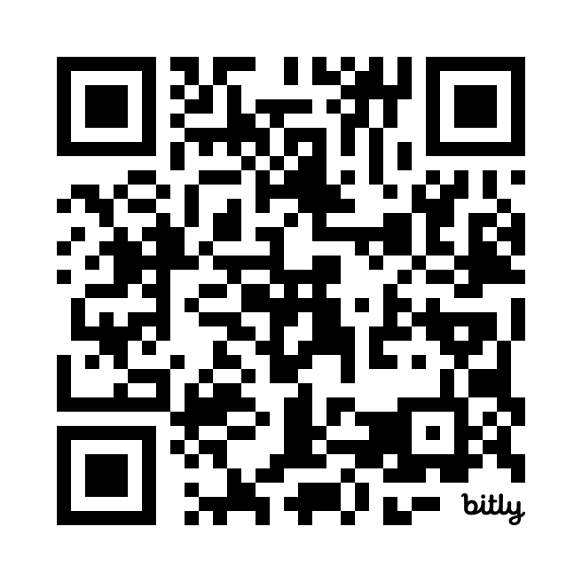
Don’t forget!
Workshop evaluation survey
https://www.surveyhero.com/c/oarc44
Sign up to our Mattermost platform if you haven’t already done so
https://chat.dns-oarc.net/

Slide 6
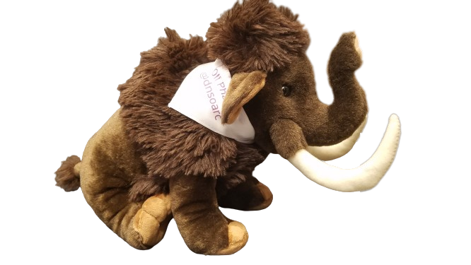
Don’t forget!
https://mastodns.net
Follow @dnsoarc@mastodns.net
Follow @oliphaunt@mastodns.net
OliPhaunt

Slide 7
Supporting OARC
Please consider supporting an OARC workshop via Sponsorship, Patronage, or a donation:
https://www.dns-oarc.net/workshop/patronage-sponsorship
Or even better - become a member! Come talk to us.

Slide 8
Future events
We are co-organizing a DNS Hackathon together with RIPE
15-16 March 2025 in Stockholm, the weekend before NETNOD Meeting
https://labs.ripe.net/author/becha/join-the-dns-hackathon-2025/
We'll be announcing our next events in the coming weeks!
See you soon!

