Slide 1

DNS Week
Welcome & Information

Slide 2




Sponsors and Patrons
2025 Workshops Patron
Deluxe Sponsors

Slide 3

Sponsors and Patrons
OARC 45 Drinks Sponsor
Special thanks to our OARC 45 Hosting Partner

Slide 4
Practical information
DNS-OARC Conduct Policy
  https://www.dns-oarc.net/oarc/policies/conduct
Workshop is being recorded
youtube.com/@DNSOARC
Social Media #LoveDNS #OARC45 #ItsAlwaysDNS

Slide 5
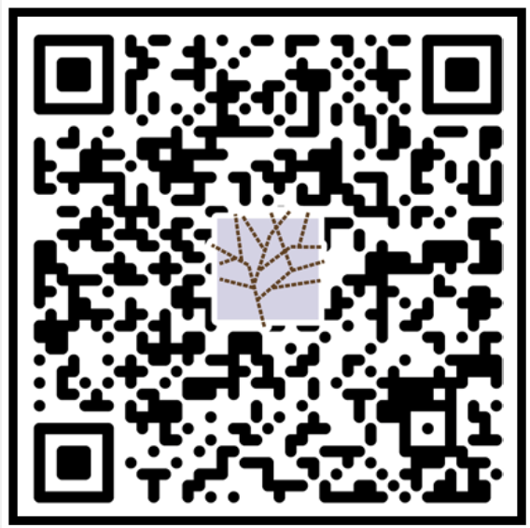
On Site Information
Wi-Fi: SSID DNS-OARC
    Password OARC-Workshop
Breaks
Toilet locations
Emergency procedures

Slide 6
OARC 45 Participation
Mattermost Workshops channel on https://chat.dns-oarc.net/
  Q&A
  Talk rating polls 👍 😐 👎 J n
  General discussion - Public channels are open to anyone
  Talk to us if you need some assistance on getting signed up
Q&A – Name and affiliation
  Microphone
  Mattermost #question – Q&A Monitor asks on your behalf

Slide 7
OARC 45 Team
Stockholm
  Staff: Steve, Matt , Jerry, Phil
  PC: Cathy, Marcelo, Raffaele, Puneet, Willem
  Board: Joao, Ray, Mauricio, Joe, Jake, Benno
  Secretary: Keith
Remote
  Staff: @rbcapetro
  PC: @tijay, @merike

Slide 8
In-person Social TONIGHT
You may still be able to register
When: Tuesday, October 7th, 2025, 18:00
Where: 11th floor (outside this door)
Badge required for attending
Collect drinks tickets for yourself & +1’s – 15:15, Reg. desk
Thank you to our sponsors!
Will be held at Fahrenheit – one block away from this venue
Time: 6 PM – 8:30 PM
Registration is required, and please wear your badge!

Slide 9
About DNS-OARC

Slide 10
DNS Operations Analysis and Research Center
a nonprofit, membership organization
improve the security, stability, and understanding of the Internet's DNS infrastructure

Slide 11
OARC Mission
Promote DNS research with operational relevance through
Data collection and analysis
Organize workshops to enable knowledge transfer
Develop and maintain services and software
Support peer network of DNS operators, developers & researchers
Facilitate a trusted environment for information sharing
Increase public awareness of the DNS's significance
Contribute to security, stability and resiliency of the DNS

Slide 12
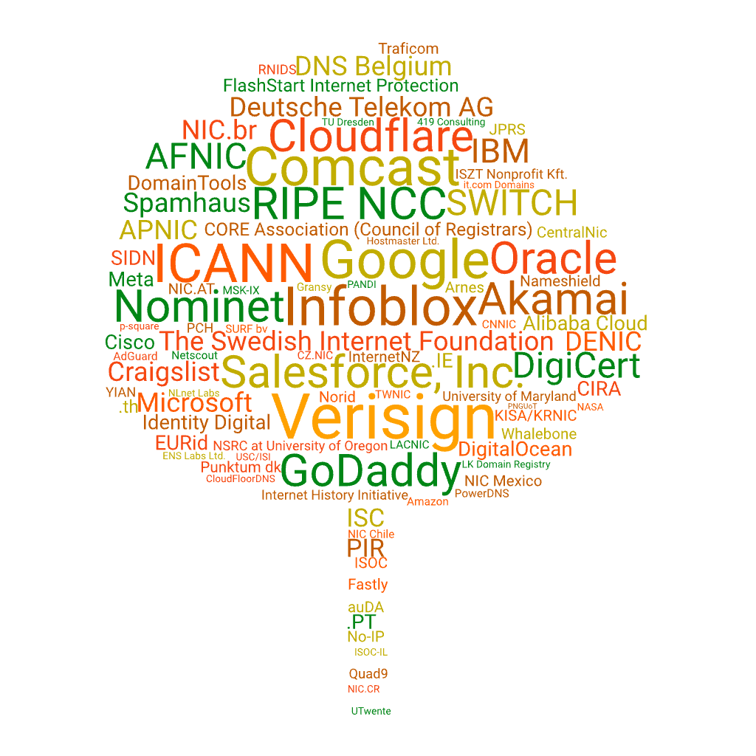
OARC Members

Slide 13
Why Become an OARC Member?
Community of DNS technical experts
Support the development of software tools and services
Share and access data, historically significant archives, DITL
Place to evaluate incidents & coordinate response with trusted peers

Slide 14
What's new since OARC 44?
All of DITL data imported until 2024 into Crunchy DITL
  Talk to Jerry and get a demo!
BCP discussion has made progress… stay tuned

Slide 15
Future OARC events
OARC 46 – May 16 & 17, 2026 - Edinburgh, Scotland, before RIPE 94
We have an RFP out for OARC 47 – soon to be announced!
Please consider supporting an OARC workshop via Sponsorship, Patronage, or a donation:
https://www.dns-oarc.net/workshop/patronage-sponsorship

Slide 16
Mentor-Mentee initiative
31 First-time attendees!
Help newcomers feel welcome and understand what makes OARC the great community it is!
Why don't you take a second to introduce yourself to the person to either side of you (assuming you don't already know them :)
Mentors, please make yourselves known

Slide 17
OARC Board Chair Welcome

Slide 18
To our OARC Members and Supporters, Programme Committee, Speakers, and all of you who signed up to attend, in person or remotely - and of course, our sponsors:
THANK YOU!

