Slide 1


Wrap Up

Slide 2




Sponsors and Patrons
2025 Workshops Patron
Deluxe Sponsors

Slide 3

Sponsors and Patrons
OARC 45 Drinks Sponsor
Special thanks to our OARC 45 Hosting Partner

Slide 4

DNS Week!
This was the first DNS Week…
It won’t be the last ☺
Thanks to
for making it possible!

Slide 5

DNS Week!
One more day to go – we hope you signed up!
https://www.netnod.se/netnod-tech-meeting-2025

Slide 6
Special thanks
OARC Team for making things run smoothly
OARC's Program Committee for putting together a great set of talks, shepherding the speakers through the process
The Speakers, for bringing this content to OARC - without them, we'd have no workshop!
And, of course, thanks to all participants for showing up - in person, and remotely!

Slide 7
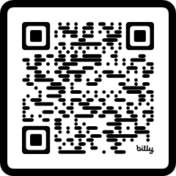
Don’t forget!
Workshop evaluation survey
https://www.surveyhero.com/c/OARC45
Sign up to our Mattermost platform if you haven’t already done so:
https://chat.dns-oarc.net/

Slide 8
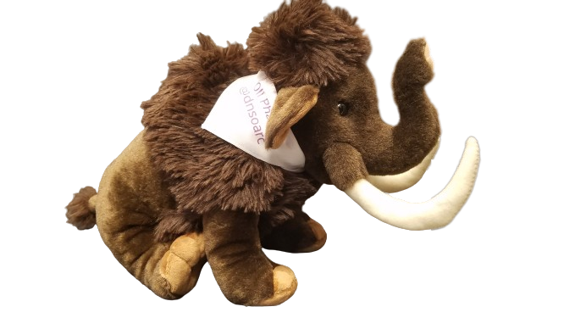
Don’t forget!
https://mastodns.net
Follow @dnsoarc@mastodns.net
Follow @oliphaunt@mastodns.net
OliPhaunt

Slide 9
Supporting OARC
Please consider supporting an OARC workshop via Sponsorship, Patronage, or a donation:
https://www.dns-oarc.net/workshop/patronage-sponsorship
Or even better - become a member! Come talk to us.

Slide 10
Future events
OARC 46 will be taking place in Edinburgh, Scotland May 17 & 18, 2026, prior to RIPE 94
We plan to announce OARC 47 in the coming weeks.
See you soon!

