Slide 1
Who do you trust? Exploring the transitive trust graph of delegated TLDs
William Carroll and Matthew Thomas

Slide 2
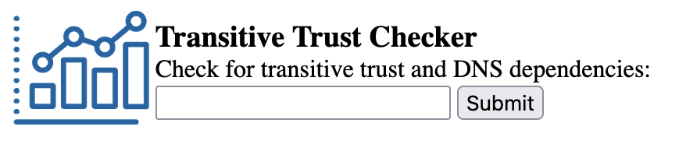
Background: Original Verisign Transitive Trust Research
2010 Verisign research by Osterweil & McPherson¹
Uses Transitive Trust concept²
Tool: trans-trust.verisignlabs.com
Focused on a single domain at a time
¹ Eric Osterweil, Danny McPherson, and Lixia Zhang, 2011. Operational Implications of the DNS Control Plane.
² Venugopalan Ramasubramanian and Emin Gün Sirer. 2005. Perils of transitive trust in the domain name system. In Proceedings of the 5th ACM SIGCOMM conference on Internet measurement (IMC '05). USENIX Association, USA, 35.
2

Slide 3
Why Transitive Trust Matters
Trusted Computing Base size affects:
  redundancy and resilience
  vulnerabilities (attack surface)
  operational cost and complexity
  performance

Slide 4
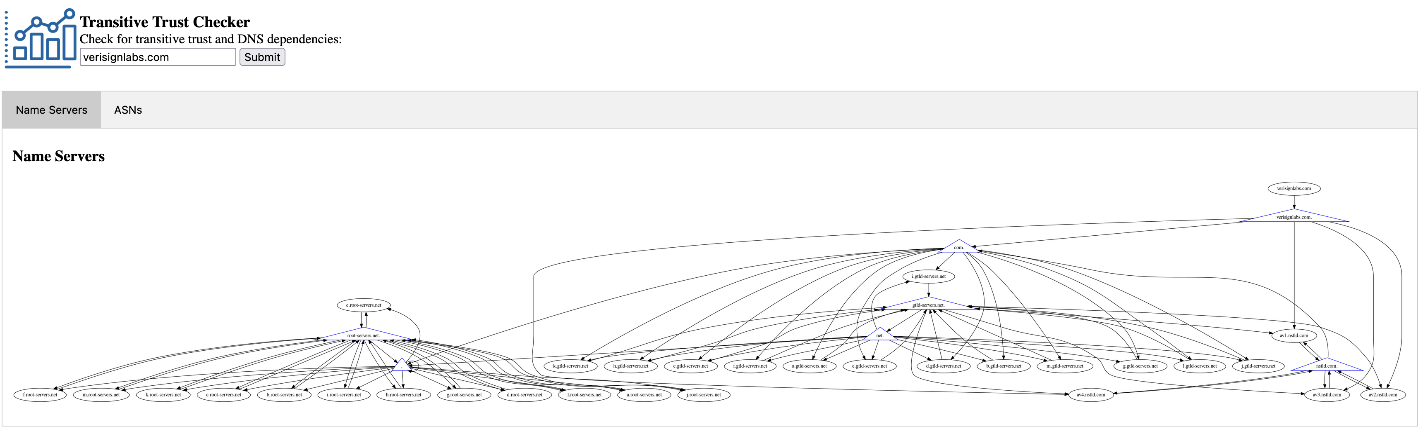
SLD Example: Transitive Trust Graph of Verisignlabs.com

Slide 5
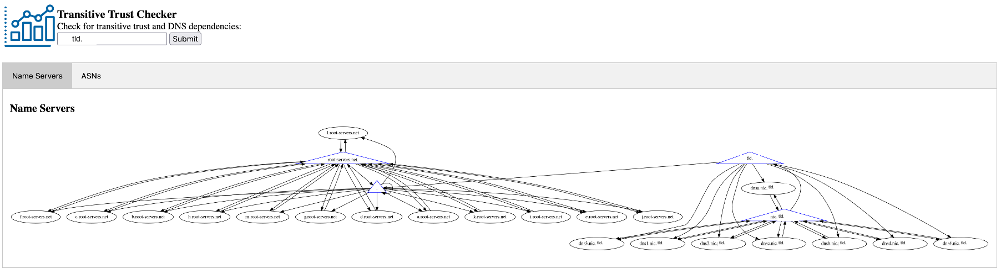
Some TLDs Have Few Dependencies
5

Slide 6
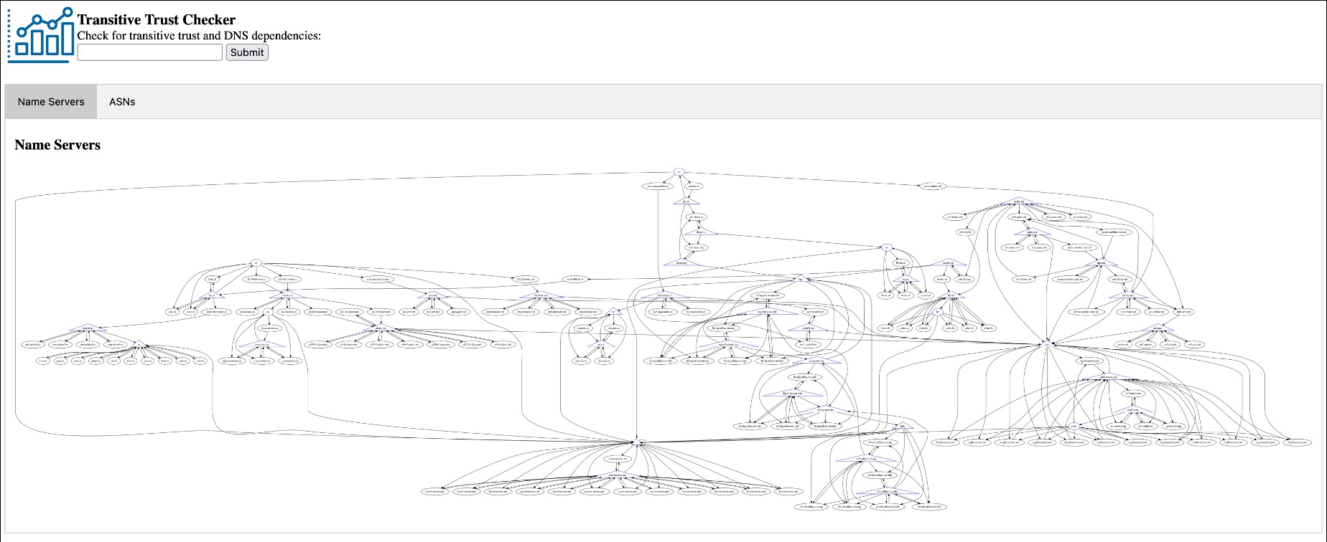
Some TLDs Have Many Dependencies
6

Slide 7
Every TLD Transitively Trusts .NET
All TLDs
ROOT-SERVERS
.NET.
NET.
Root Zone
.

Slide 8
Expanding the Scope: From One Domain to All TLDs

Slide 9
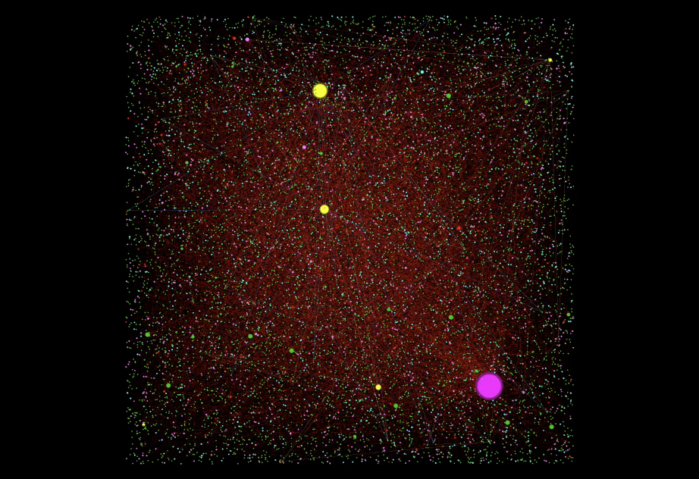

A Wholistic View of Transitive Trust at the Root
Run transitive trust lookups for every TLD in the root zone
Merge results into one single directed graph
Label nodes appropriately
Size nodes based on “degree”
nameserver
Child zone
nGTLD
ccTLD
Original TLD
Root
9

Slide 10
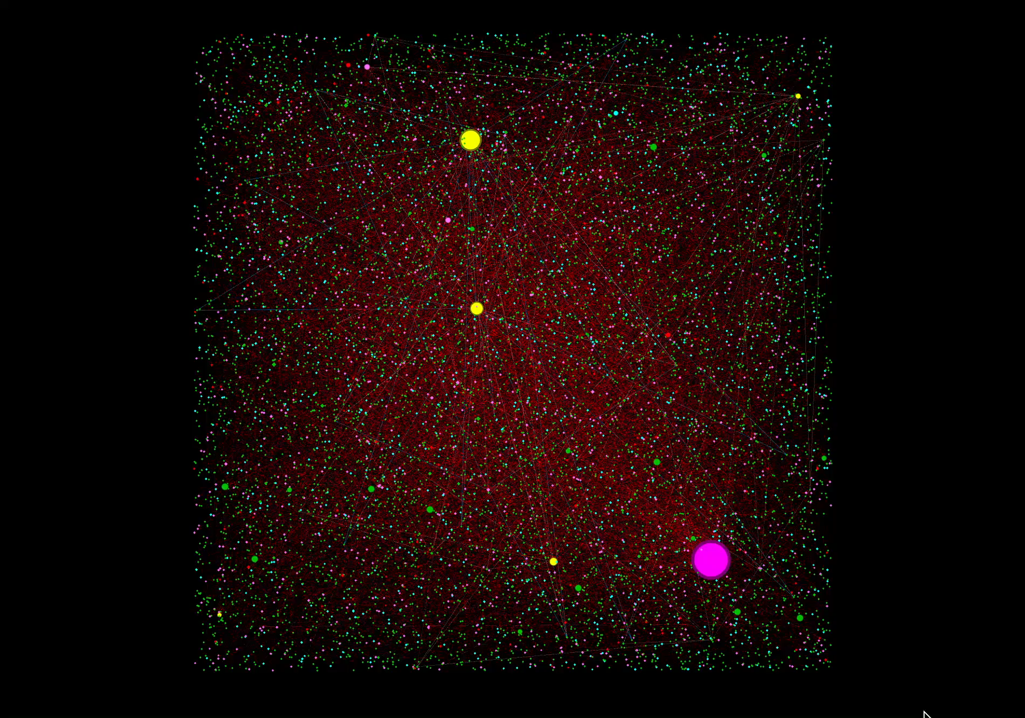
10

Slide 11
Preliminary Findings

Slide 12
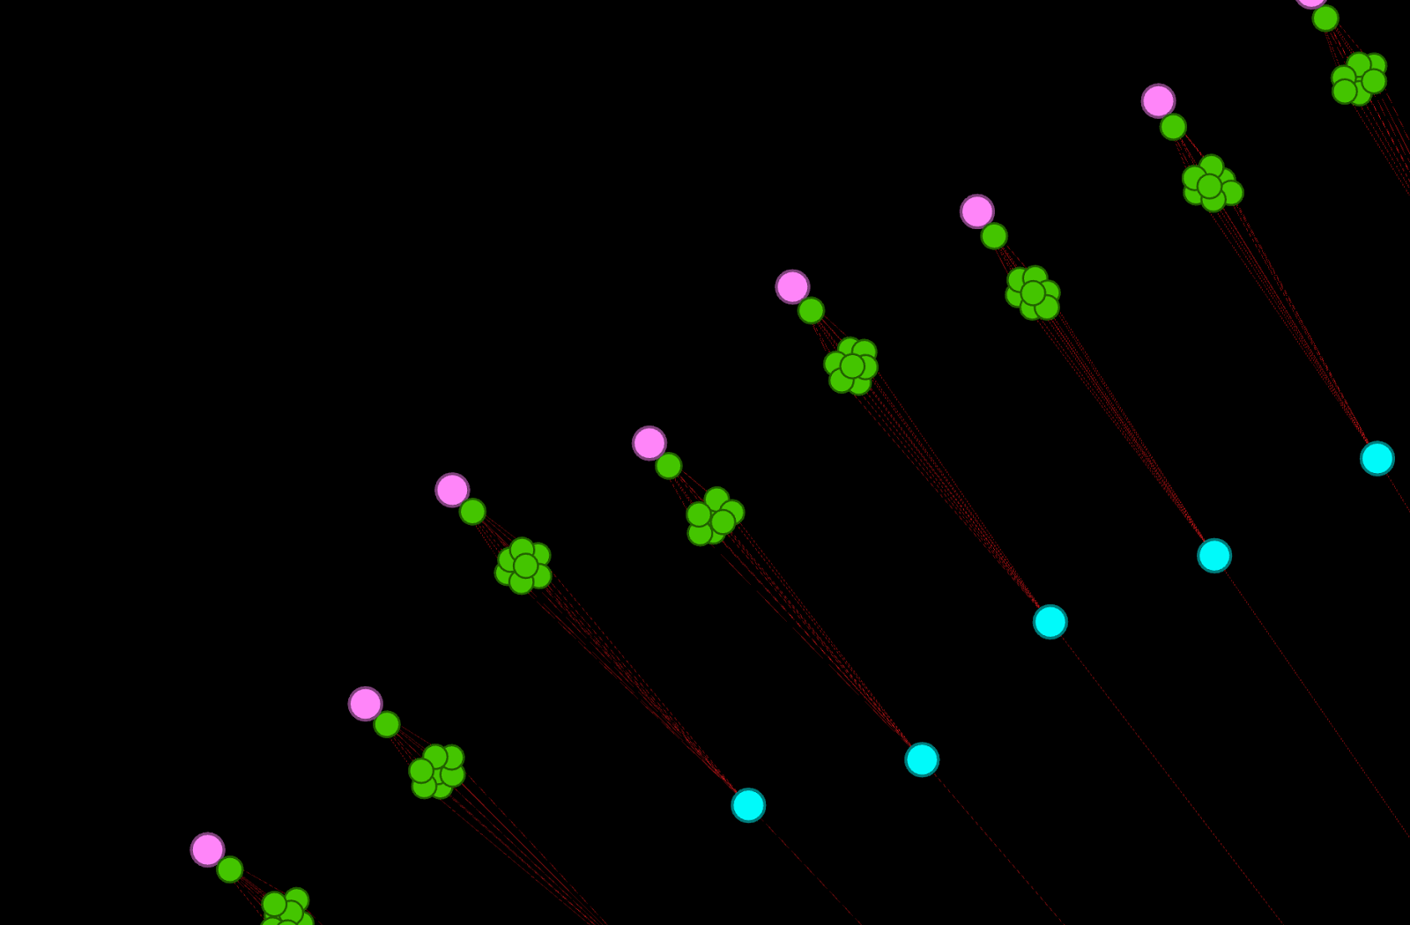


Finding #1: Significant amounts of Fully-in-bailiwick TLDs
All name dependencies exist inside the TLD’s namespace.
938 (65%) of 1,440 TLDs have no dependencies outside themselves.*
79 have only additional net SLDs only.
39 have only additional com/net SLDs only.
* excepting dependencies on gtld-servers.net.,nstld.com., and root-servers.net.
12

Slide 13
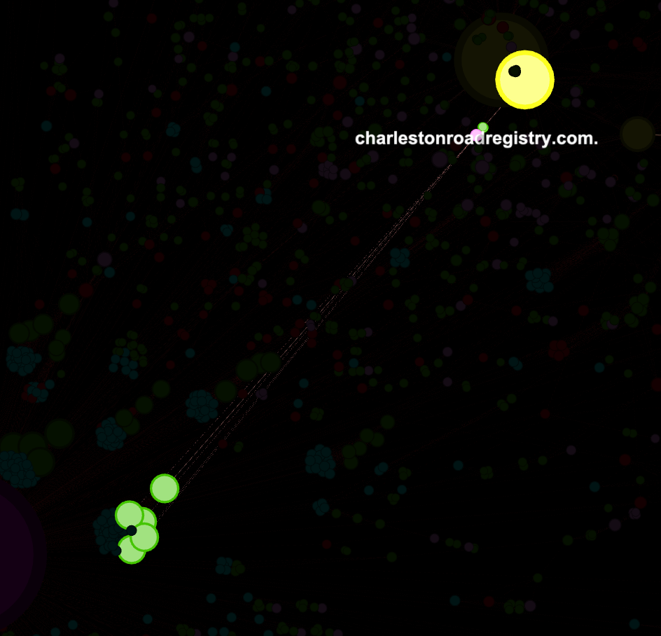
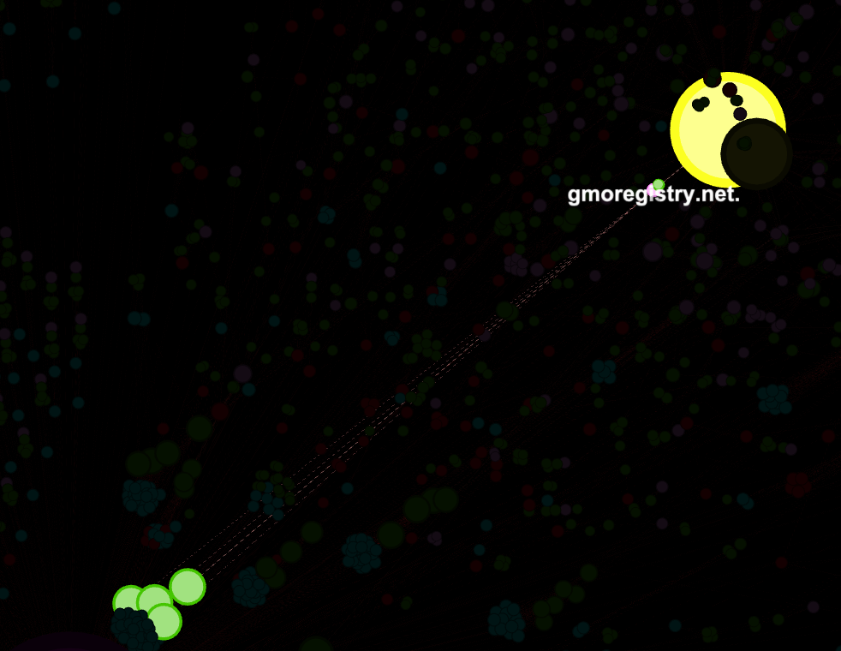
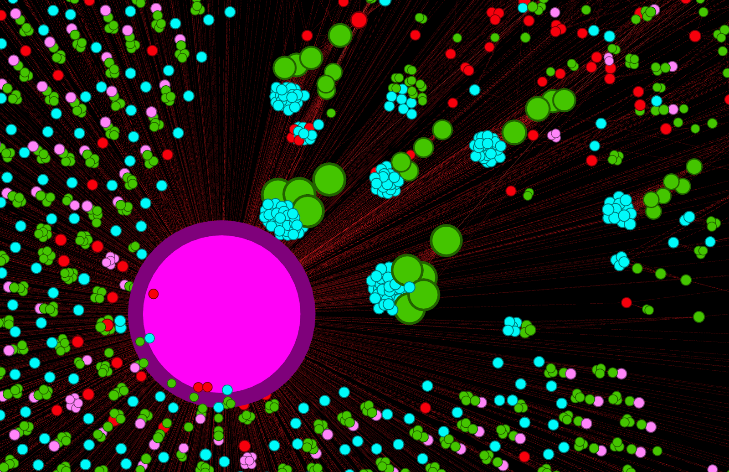
Finding #2: Consolidation of Shared NS by Registry Operators
SLD Dependencies | TLD Count
afilias-nst.info., afilias-nst.org., gtld-servers.net., nstld.com., root-servers.net., trs-dns.com., trs-dns.info., trs-dns.net., trs-dns.org. | 59
gmoregistry.net., root-servers.net. | 47
charlestonroadregistry.com., google.com., gtld-servers.net., nstld.com., root-servers.net. | 46
de.net., denic.de., denic.net., irondns.de., irondns.net., knipp.de., knipp.net., nic.de., root-servers.net. | 26
afilias-nst.info., afilias-nst.org., cernet.net., dns.cn., gtld-servers.net., gtld.biz., nstld.com., root-servers.net., zdnscloud.biz., zdnscloud.cn., zdnscloud.com., zdnscloud.info., zdnscloud.net. | 22
gtld-servers.net., nstld.com., root-servers.net. | 21
afilias-nst.info., afilias-nst.org., afrinic.net., akam.net., apnic.net., arin.net., ca-servers.ca., d-zone.ca., dns.br., dnsnode.net., lacnic.net., lactld.org., netnod.se., nic.cl., ns.se., pch.net., ripe.net., root-servers.net. | 18
nic.fr., root-servers.net. | 17
afilias-nst.info., afilias-nst.org., root-servers.net. | 10
alidns.com., aliyun.com., cernet.net., dns.cn., gtld-servers.net., hichina.com., nstld.com., root-servers.net., teleinfo.cn., teleinfoo.com. | 10
rcode0.net., root-servers.net. | 8
13

Slide 14
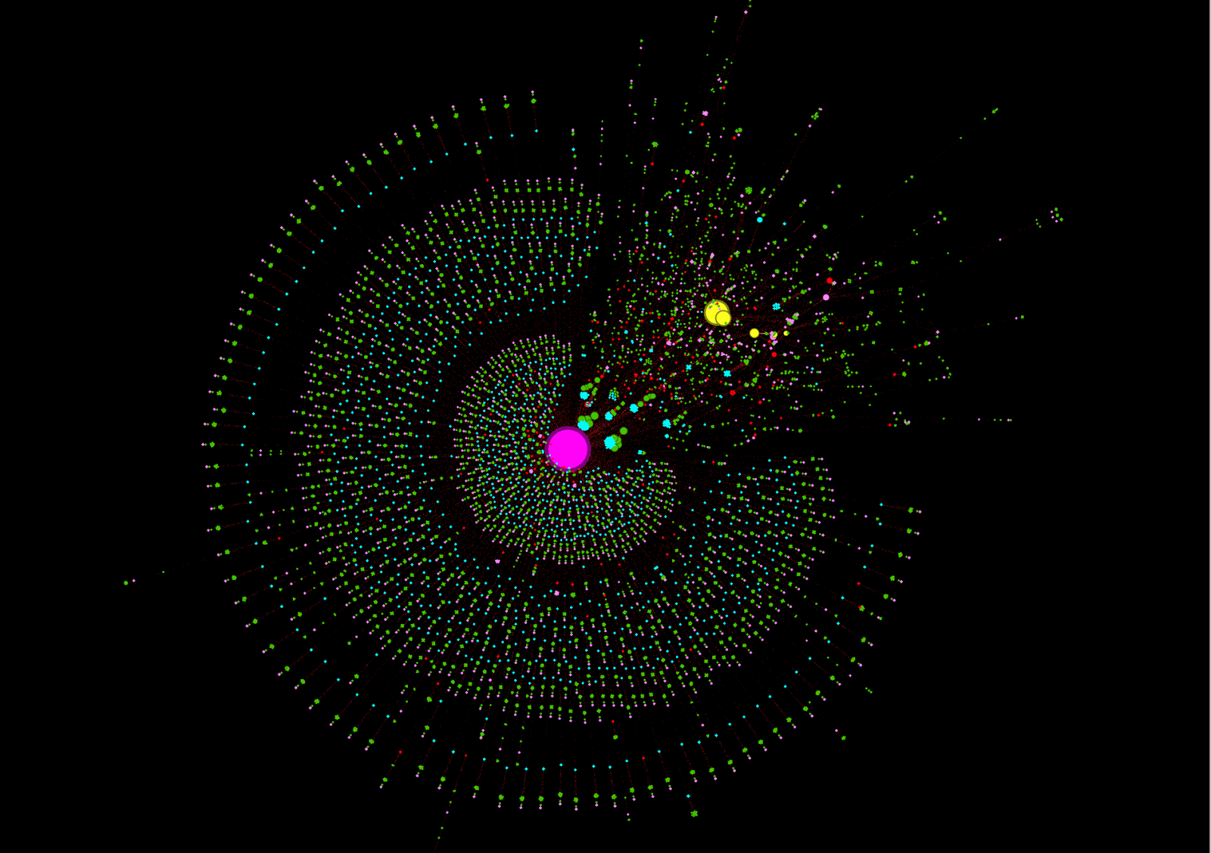
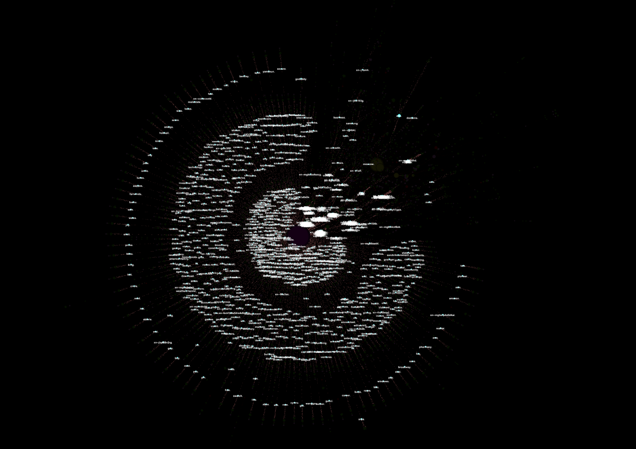
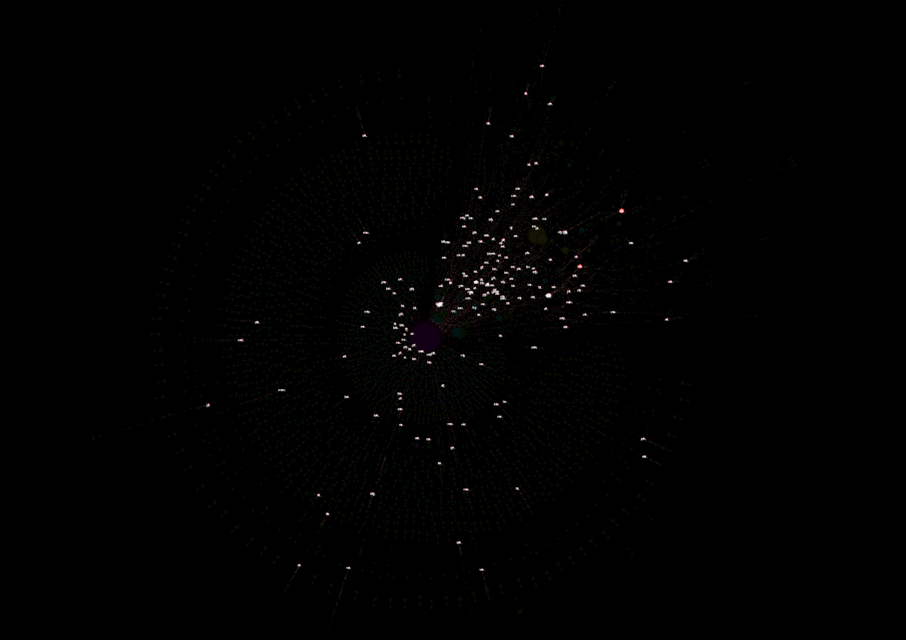
Finding #3: Legacy TLDs and ccTLDs Have Larger Trans-Trust Areas
 | ccTLD |  | Legacy gTLD |  | New gTLD |  | Total
TLD Dependencies | TLDs | % | TLDs | % | TLDs | % | TLDs | %
2 |  | 0% | 1 | 5% |  | 0% | 1 | 0%
3 | 108 | 43% | 8 | 38% | 898 | 77% | 1,014 | 70%
4 | 25 | 10% | 6 | 29% | 147 | 13% | 178 | 12%
5 | 19 | 8% | 4 | 19% | 21 | 2% | 44 | 3%
6 | 19 | 8% | 1 | 5% | 64 | 5% | 84 | 6%
7 | 7 | 3% |  | 0% | 4 | 0% | 11 | 1%
8 | 3 | 1% |  | 0% | 23 | 2% | 26 | 2%
9 | 28 | 11% |  | 0% | 1 | 0% | 29 | 2%
10 | 21 | 8% | 1 | 5% | 6 | 1% | 28 | 2%
11 | 15 | 6% |  | 0% | 4 | 0% | 19 | 1%
12 | 2 | 1% |  | 0% | 1 | 0% | 3 | 0%
13 | 2 | 1% |  | 0% |  | 0% | 2 | 0%
14 |  | 0% |  | 0% | 1 | 0% | 1 | 0%
Grand Total | 249 | 100% | 21 | 100% | 1,170 | 100% | 1,440 | 100%
14

Slide 15
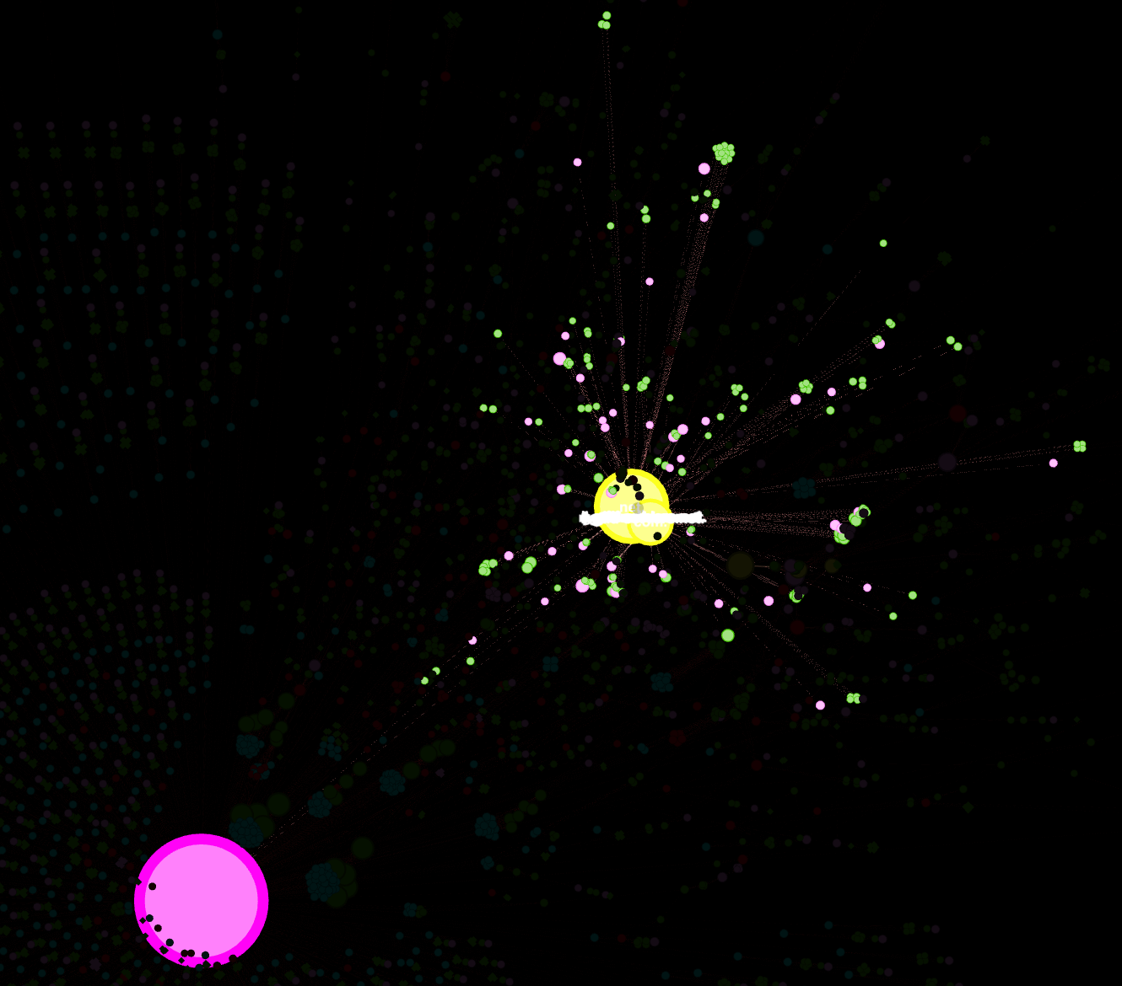
Finding #4: COM/NET are the Most Relied Upon TLDs for Additional SLD Dependencies
Additional SLD Dependency TLDs | TLDs
net | 77
com, info, net, org | 61
com | 50
de, net | 28
br, ca, cl, info, net, org, se | 26
biz, cn, com, info, net, org | 22
fr | 18
info, org | 10
cn, com, net | 10
cn, net | 8
br, ca, cl, fr, info, net, org, se | 7
uk | 7
br, ca, cl, com, edu, info, net, org, se | 6
br, ca, cl, com, info, net, org, se | 6
au | 6
com, net | 5
br | 5
Legacy gTLDs and ccTLDs remain the most relied-upon TLDs by other TLDs.
15

Slide 16
Looking Back to Prepare for the Future

Slide 17
Achieving Balance
“There is a balancing act between the complexity, overhead, and resilience of DNS' control plane, and finding an operational sweet spot is an important open research challenge.”
- Eric Osterweil, Danny McPherson, and Lixia Zhang, 2011. Operational Implications of the DNS Control Plane.
17

Slide 18
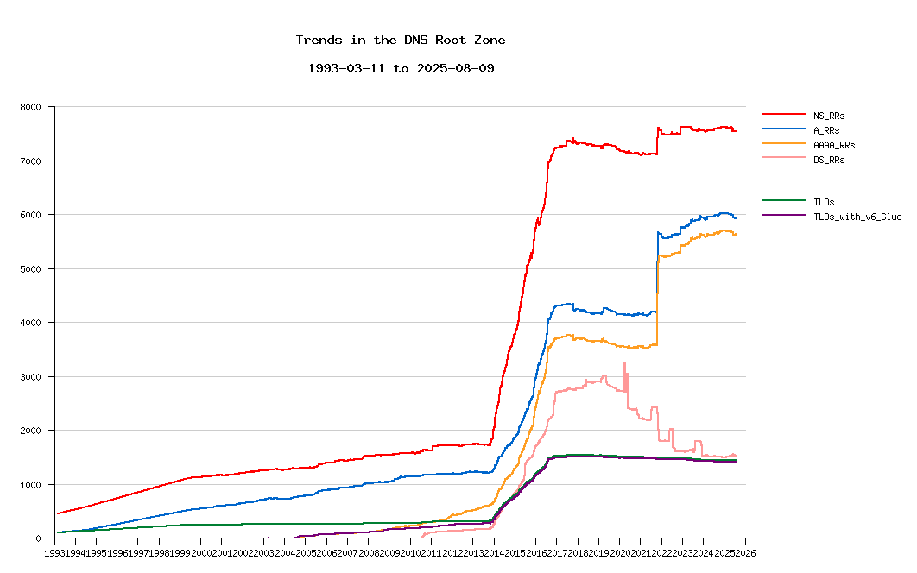
Root Zone Trends Over Time
Significant changes in root zone
  New gTLD program
  IPv6 glue deployment
  DNSSEC DS record growth
  Registry operator consolidation
Source: https://zfr.dns-oarc.net/root-zone-trends.png
18

Slide 19
Future Work
Automated daily maps (complete)
Resolver IP/network structure integration (BGP, ASN, etc.)
Resolver software/versions
Risk scoring
Monitoring and alerting
Targeted community education and awareness
19

Slide 20
Q&A

