Slide 1
Autocast: automatic anycast site optimization
Thijs van den Hout
DNS OARC | October 8, 2025

Slide 2



Anycast routing
194.0.28.53
194.0.28.53
194.0.28.53
194.0.28.53
194.0.28.53
194.0.28.53
194.0.28.53

Slide 3
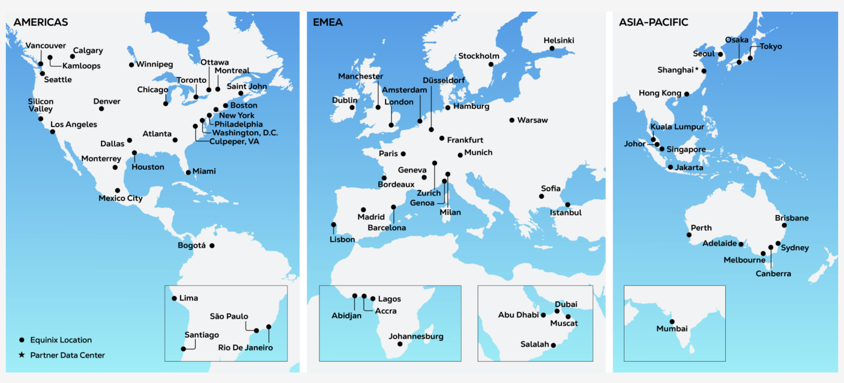
Anycast, anywhere: Equinix

Slide 4
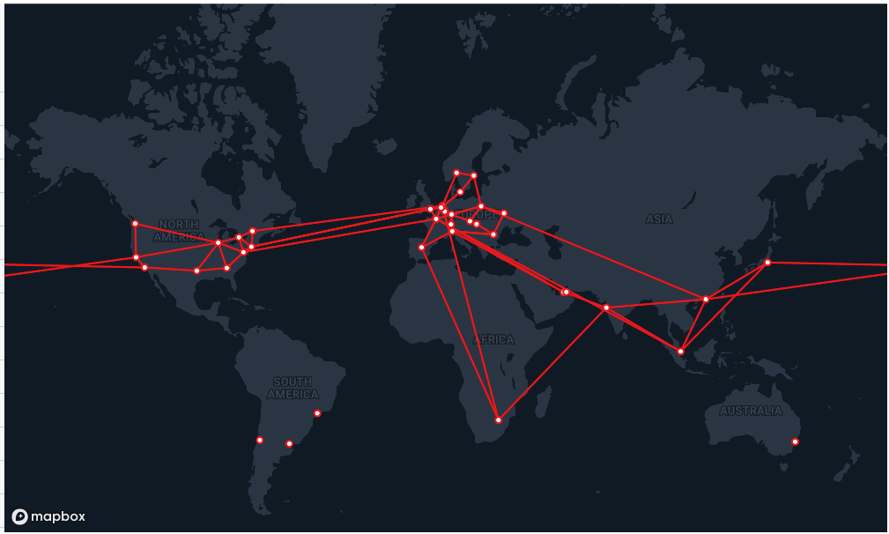
Anycast, anywhere: i3D.net

Slide 5

Anycast, anywhere: Vultr

Slide 6
Which anycast locations do we choose?
We want to: minimize latency, ensure resilience, save on costs
Best practices, literature, constant tweaking
All the locations?!
Can we do it based on measurements? Data-driven
Select 10 sites from 40 points of presence => 847M combinations
Performance of all possible anycast configurations cannot be measured

Slide 7
Autocast (automating anycast)
A measurement-based anycast site selection method to minimize client latency
Requirements:
Fast results
Accurate predictor
Rooted in operations

Slide 8
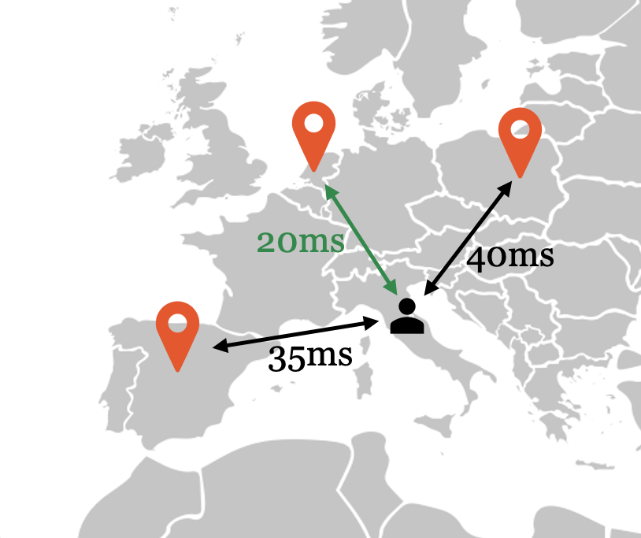
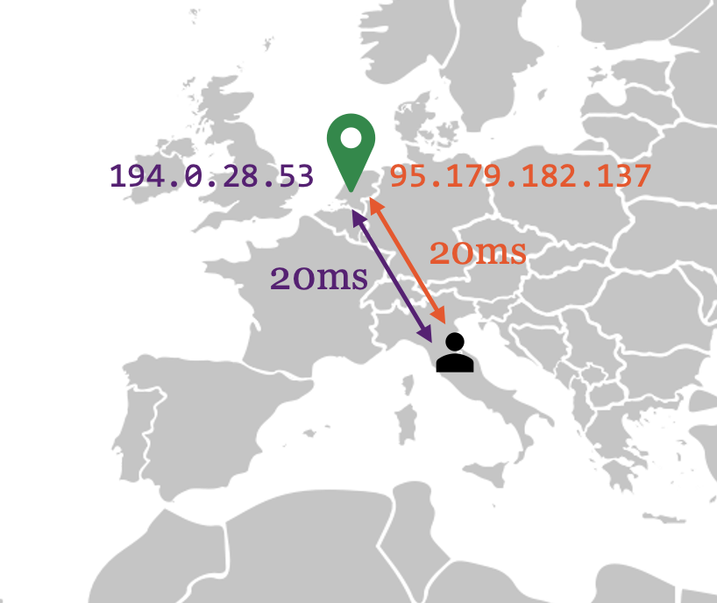
Autocast assumptions
Assumption 1: clients are routed to the anycast site with the lowest latency
Assumption 2: anycast and unicast latencies to the same anycast site are the same

Slide 9
Method: Measuring the unmeasurable
Step 1: measure the latency from all possible anycast PoPs to all clients
Ping RTT | Site A | Site B | Site C | Site D | …
Client 1 | 14.3ms | 65.6ms | 22.1ms | 6.7ms | …
Client 2 | 21.0ms | 84.1ms | 9.2ms | 26.1ms | …
Client 3 | 40.5ms | 9.3ms | 38.5ms | 31.1ms | …
… | … | .. | … | … | …

Slide 10
Measuring the unmeasurable
Step 1: measure the latency from all possible anycast PoPs to all clients
Step 2: simulate anycast site selections and compute expected latency.
Ping RTT | Site A | Site B | Site C | Site D | …
Client 1 | 14.3ms | 65.6ms | 22.1ms | 6.7ms | …
Client 2 | 21.0ms | 84.1ms | 9.2ms | 26.1ms | …
Client 3 | 40.5ms | 9.3ms | 38.5ms | 31.1ms | …
… | … | .. | … | … | …

Slide 11
Measuring the unmeasurable
Step 1: measure the latency from all possible anycast PoPs to all clients
Step 2: simulate anycast site selections and compute expected latency.
Ping RTT | Site A | Site B | Site C | Site D | …
Client 1 | 14.3ms | 65.6ms | 22.1ms | 6.7ms | …
Client 2 | 21.0ms | 84.1ms | 9.2ms | 26.1ms | …
Client 3 | 40.5ms | 9.3ms | 38.5ms | 31.1ms | …
… | … | .. | … | … | …

Slide 12
Measuring the unmeasurable
Step 1: measure the latency from all possible anycast PoPs to all clients
Step 2: simulate anycast site selections and compute expected latency.
Ping RTT | Site A | Site B | Site C | Site D | …
Client 1 | 14.3ms | 65.6ms | 22.1ms | 6.7ms | …
Client 2 | 21.0ms | 84.1ms | 9.2ms | 26.1ms | …
Client 3 | 40.5ms | 9.3ms | 38.5ms | 31.1ms | …
… | … | .. | … | … | …
A+D latency
6.7ms
21.0ms
31.1ms
…

Slide 13
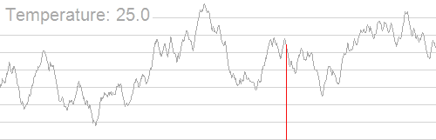
Optimization
Millions/billions of possible anycast site selections
Metric to optimize: median resolver latency weighted by nr queries
B+C latency
22.1ms
9.2ms
9.3ms
…
A+D latency
6.7ms
21.0ms
31.1ms
…
Simulated Annealing
Illustration: Wikimedia
15.3ms
21.1ms

Slide 14
Putting it to the test on Vultr
Measurement
Automatic infrastructure deployment on Vultr (32 PoPs)
Client hitlist of .nl-querying resolvers (230K IPv4 addresses and 73K IPv6)
Unicast ping measurement from all PoPs to all clients (73% response)

Slide 15
Putting it to the test
Optimization
Generate anycast deployments for 3, 5, 7, 9, 11, 13, 15, 17 sites
Run optimization algorithm for each number of sites => 8 deployments
Generate 5 random configuration for each number => 40 deployments
Deploy them with anycast and evaluate!

Slide 16
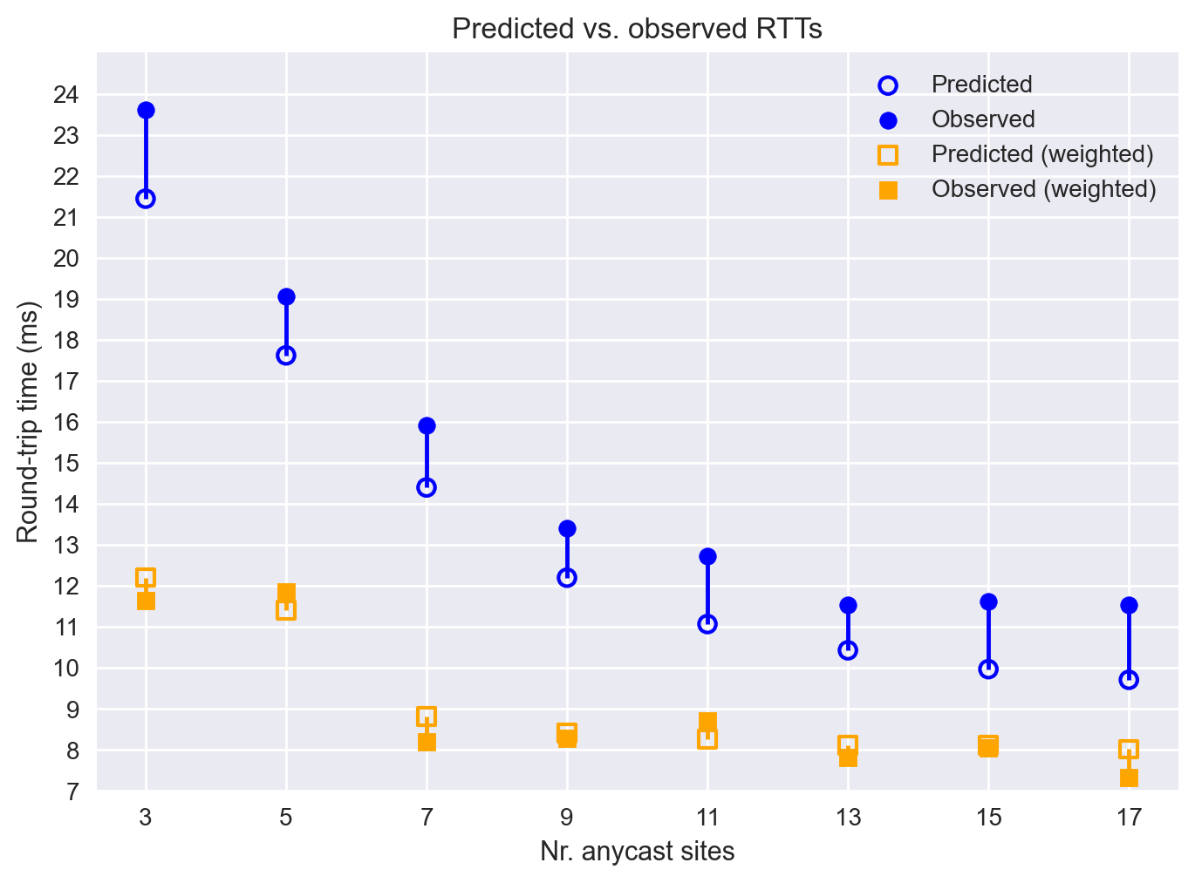
Results: Autocast-suggested configurations
Predicted vs observed latency diff: 1.57ms
Weighted by nr queries: 0.19ms

Slide 17
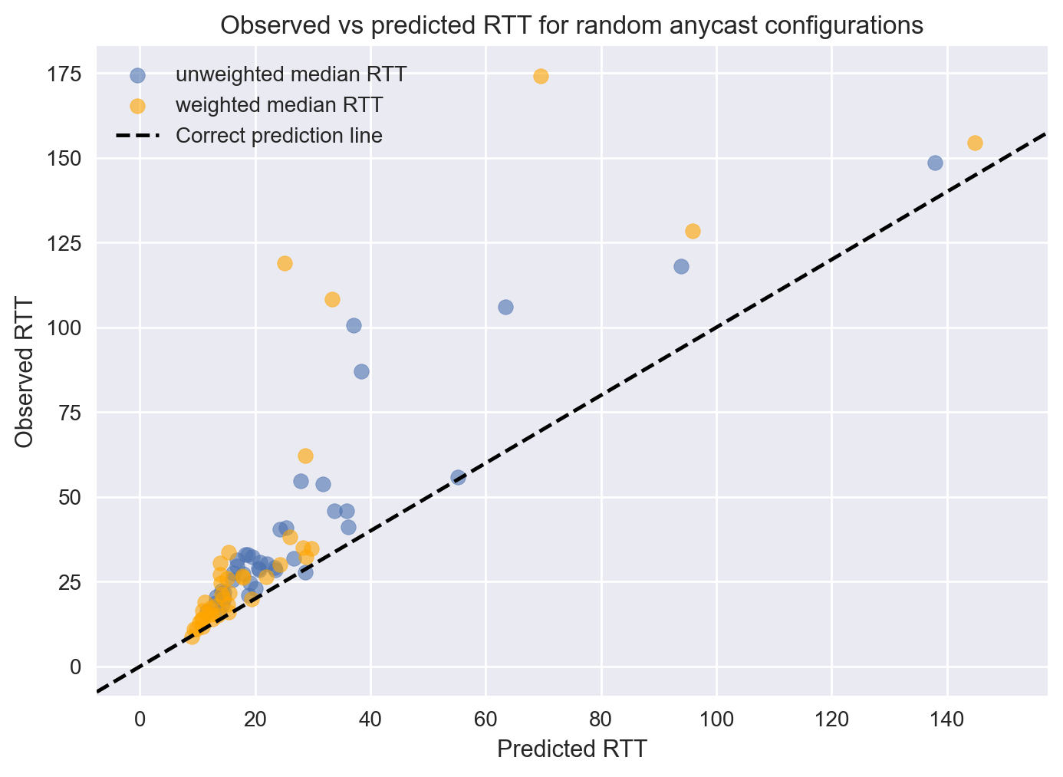
Results: random configurations

Slide 18
Re: Assumptions (or shortcuts)
Assumption 1 violations
Optimal deployment: 26.8% of clients, 11.8% of queries
Random deployment: 40.8% of clients, 34.5% of queries
Assumption 2
Median difference: 0.06ms
μ=0.29ms, σ=14.6ms, Cohen’s d=0.02, sample size of 284K

Slide 19
Conclusions
It seems to work quite well!
Assumption 1 holds well enough to predict performance
Fast results and accurate predictions
Use in production

