Slide 1


LLMs for DNS Abuse Detection:
Promising or Overhyped?
(early-stage work)
Jihye Kim
Network Security Researcher
DNS-OARC 45

Slide 2

LLMs are Everywhere!

Slide 3
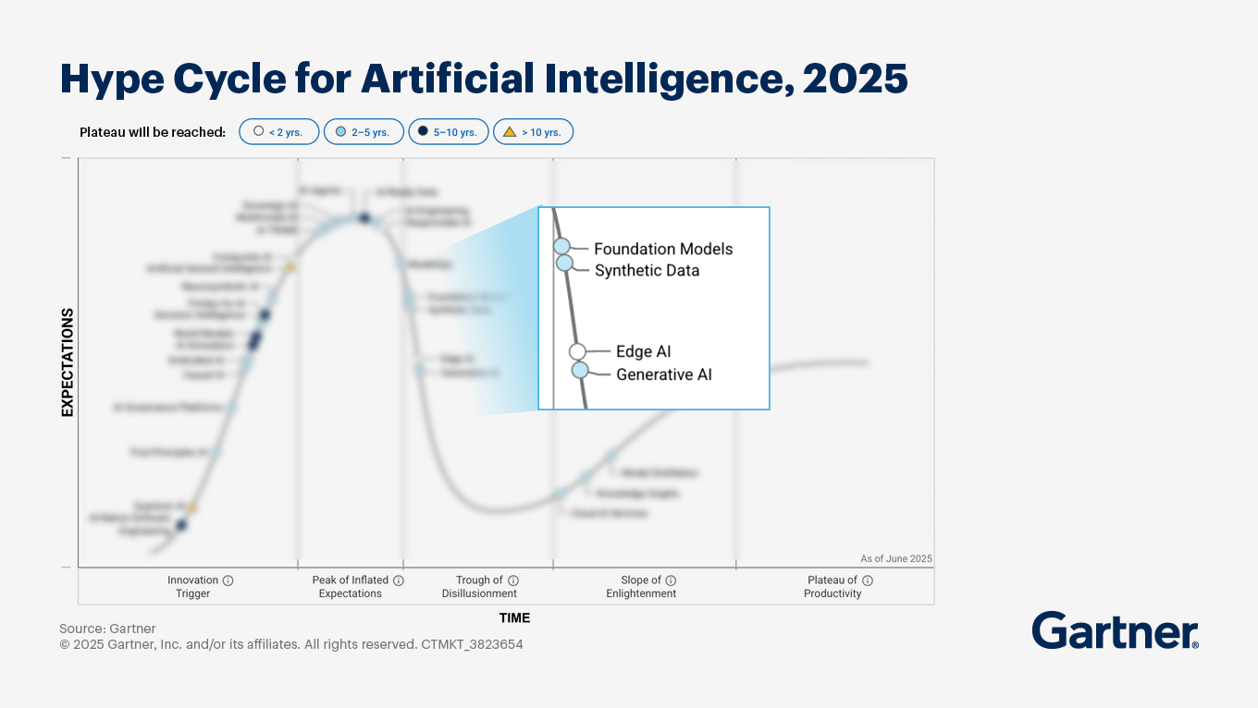
LLMs are Everywhere!

Slide 4
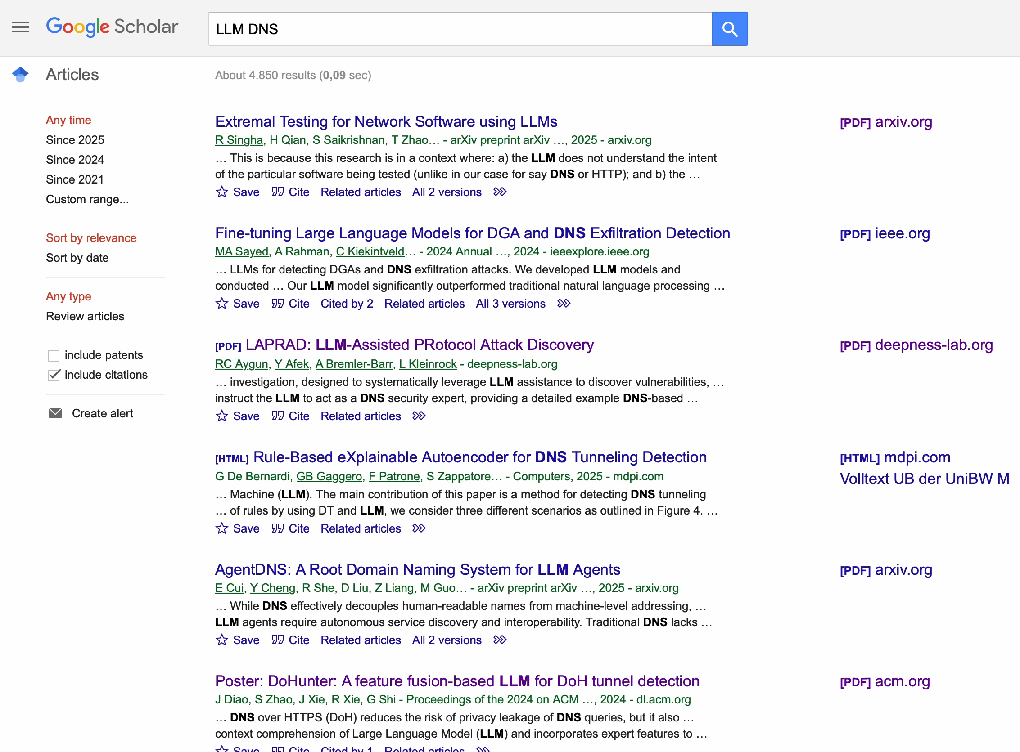


Slide 5
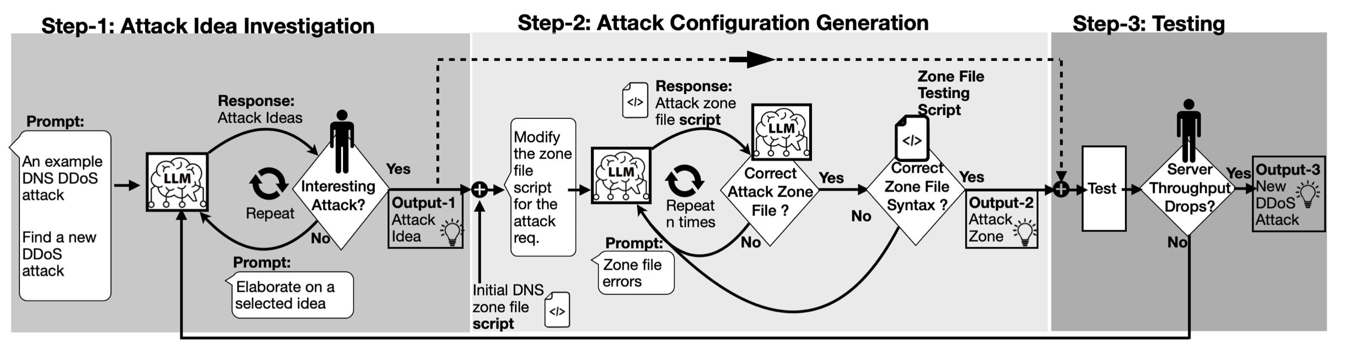
LLM-Assisted PRotocol Attack Discovery
[1] Aygun, R. Can, Yehuda Afek, Anat Bremler-Barr, and Leonard Kleinrock.
“LAPRAD: LLM-Assisted Protocol Attack Discovery,” IFIP Networking IOCRCI Workshop

Slide 6
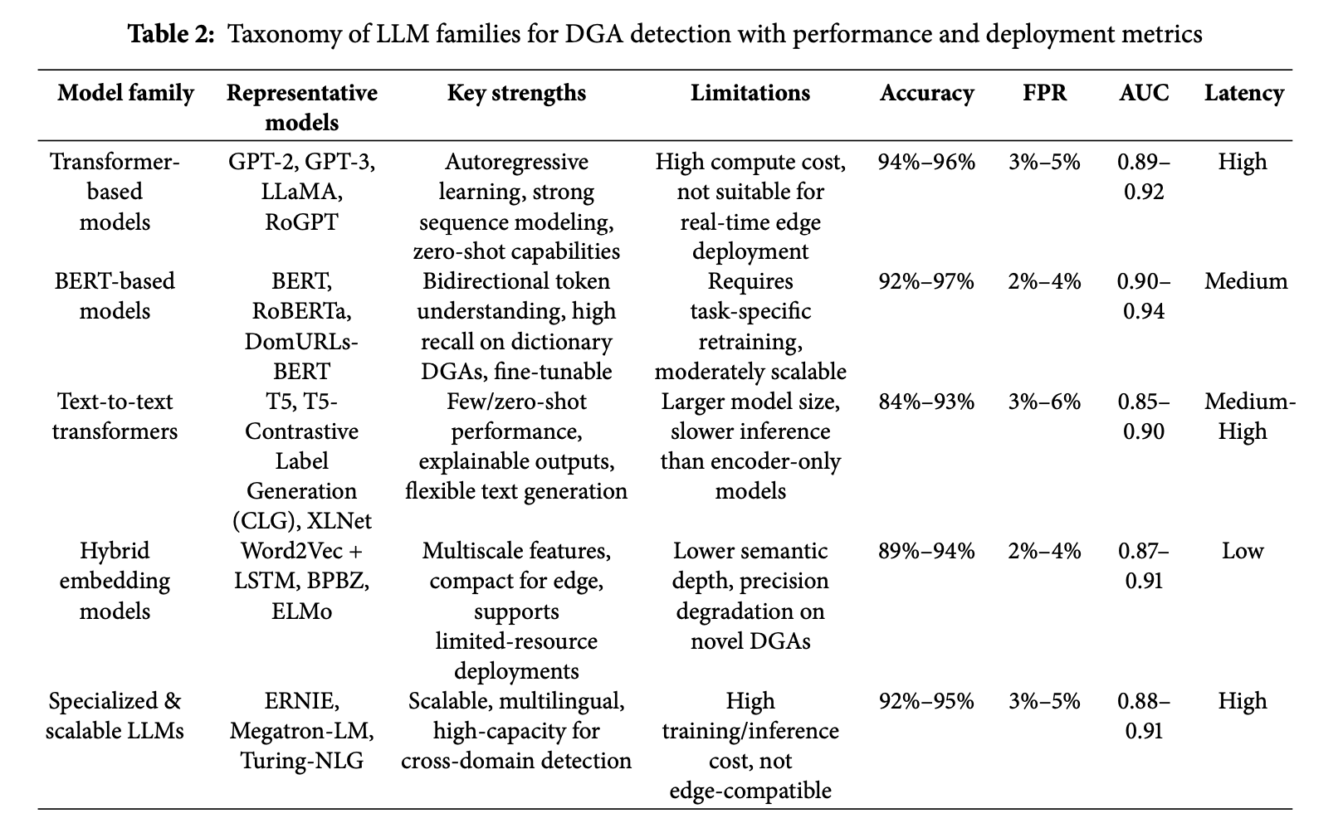
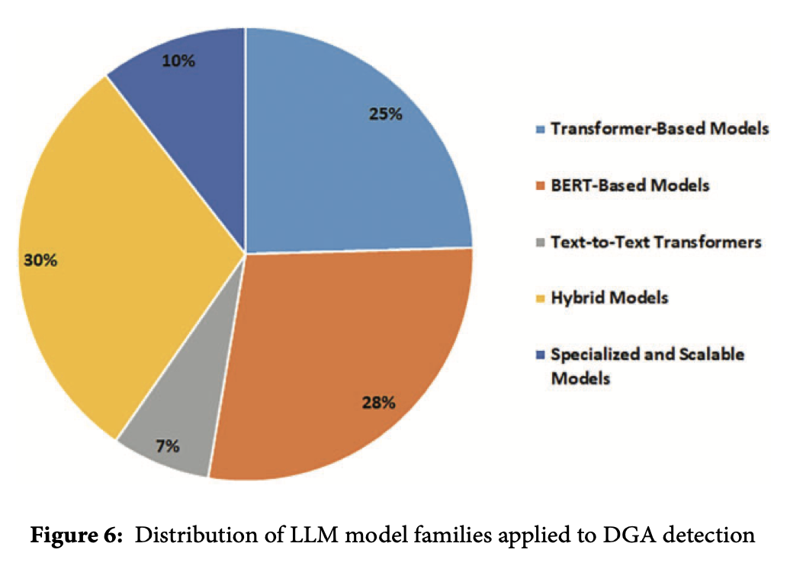
LLMs for DGA Detection
[2] Alqahtani, Hamed, and Gulshan Kumar. “Large Language Models for Effective Detection of Algorithmically Generated Domains: A Comprehensive Review.” Computer Modeling in Engineering & Sciences 144, no. 2 (2025): 1439.

Slide 7
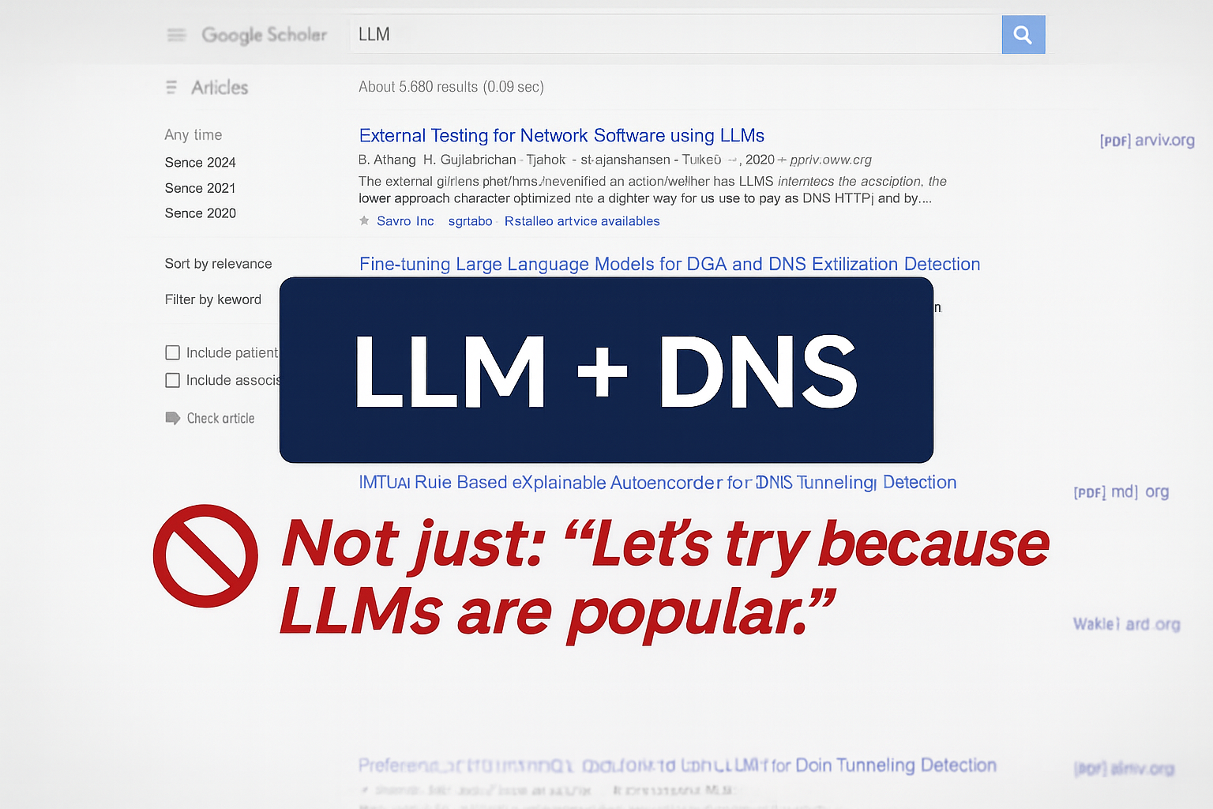

Slide 8

DNS for LLMs: Why DNS is a good input?
Symbolic and text-based: naturally fits LLM tokenization
Human-readable, structurally complex
Real-world attack surface with diverse threats
Benchmark for structured reasoning

Slide 9
DNS for LLMs: Why DNS is a good input?
Symbolic and text-based: naturally fits LLM tokenization
Human-readable, structurally complex
Real-world attack surface with diverse threats
Benchmark for structured reasoning

Slide 10
DNS for LLMs: Why DNS is a good input?
Symbolic and text-based: naturally fits LLM tokenization
Human-readable, structurally complex
Real-world attack surface with diverse threats
Benchmark for structured reasoning

Slide 11
DNS for LLMs: Why DNS is a good input?
Symbolic and text-based: naturally fits LLM tokenization
Human-readable, structurally complex
Real-world attack surface with diverse threats
Benchmark for structured reasoning

Slide 12
LLMs for DNS: Why LLMs are good for DNS?
Semantic / context detection
Prompt-based Zero / Few-shot generalization
Explainability via natural language
Actionable response generation

Slide 13
LLMs for DNS: Why LLMs are good for DNS?
Semantic / context detection
Prompt-based Zero / Few-shot generalization
Explainability via natural language
Actionable response generation

Slide 14
LLMs for DNS: Why LLMs are good for DNS?
Semantic / context detection
Prompt-based Zero / Few-shot generalization
Explainability via natural language
Actionable response generation

Slide 15
LLMs for DNS: Why LLMs are good for DNS?
Semantic / context detection
Prompt-based Zero / Few-shot generalization
Explainability via natural language
Actionable response generation

Slide 16
LLMs vs. Traditional Methods
Aspect | Traditional ML/Statistical Approach | LLM-based Approach
Hand-crafted features,
flow statsistics
Raw/semi-structured DNS sequences + features
Input
Strong in-domain;
Weaker on novel attacks
Prompt-based zero/few-shot;
adapts with minimal training
Adaptability
Limited
(scores, feature weights)
Natural-language explanations,
Human-readable reasoning
Explainability
Attack
Coverage
Good for volumetric
& known patterns
Broader: flooding, amplification, semantic abuses, policy misuses
Efficient but brittle
to unseen variants
Higher cost/latency,
adversarial risks
Weakness

Slide 17
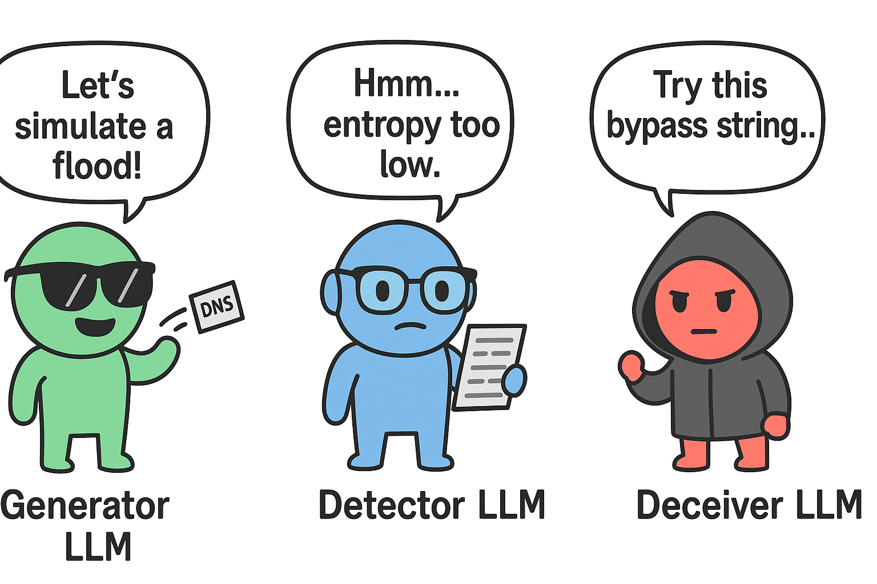
LLMs for DNS: How Can LLMs be effectively used?
Create Synthetic DNS Attack Traffic
Detect and Explain DNS Attack Traffic
Confuse Detector with Adversarial Traffic

Slide 18
LLMs for DNS: How Can LLMs be effectively used?
Create Synthetic DNS Attack Traffic
Detect and Explain DNS Attack Traffic
Confuse Detector with Adversarial Traffic

Slide 19


DNS Abuse Taxonomy
DNS as tool or target for DDoS
Flooding
Reflection / Amplification
Redirection
Subversion
DNSSEC Abuse
Attacker
Resolver
Authoritative server
Victim

Slide 20
DNS Abuse Taxonomy
Abuse Type Description Related DDoS Vector
Flooding
Reflection
/Amplification
Redirection
Subversion
DNSSEC Abuse
Sending excessive DNS queries
to exhaust server resources
Direct DDoS,
Resource exhaustion
Exploiting resolvers to reflect
and amplify traffic toward a victim
Amplification DDoS
Manipulating DNS responses to
redirect traffic (e.g., to a botnet controller)
Indirect DDoS,
Traffic Manipulation
Compromising domain registration
or zone control to manipulate traffic
Indirect DDoS,
Traffic Manipulation
Abusing DNSSEC’s large responses or misconfigurations to overwhelm systems
Amplification DDoS,
Resource exhaustion

Slide 21
DNS Abuse Taxonomy
Abuse Type Description Related DDoS Vector
Class
Subclass
Class
Subclass
DNSSEC Abuse
Query Flooding
Kaminsky Attack
Response Flooding
Redirection
DNS
Subversion
DNS Cache Poisoning
Flooding
Reflection
/Amplification
SAD DNS
NXDOMAIN Flooding
(slow drip, random subdomain)
Domain Hijacking
Resolution Failure Flooding
(domain lock-up,
phantom subdomain)
Packet Interception
DNS Tunneling
iDNS
Fast Flux
TsuNAME
DGA (Malware C2 Infra)
Unchained
DNSSEC Amplification
NXNS Attack
NSEC/NSEC3 Walking
NRDelegation Attack
Bogus DNSSEC Data Injection
Loop Attack
Algorithm Downgrade Attack

Slide 22
DNS Abuse Taxonomy
Abuse Type Description Related DDoS Vector
Class
Subclass
Class
Subclass
DNSSEC Abuse
Query Flooding
Kaminsky Attack
Response Flooding
Redirection
DNS
Subversion
DNS Cache Poisoning
Flooding
Reflection
/Amplification
SAD DNS
NXDOMAIN Flooding
(slow drip, random subdomain)
Domain Hijacking
Resolution Failure Flooding
(domain lock-up,
phantom subdomain)
Packet Interception
DNS Tunneling
iDNS
Fast Flux
TsuNAME
DGA (Malware C2 Infra)
Unchained
DNSSEC Amplification
NXNS Attack
NSEC/NSEC3 Walking
NRDelegation Attack
Bogus DNSSEC Data Injection
Loop Attack
Algorithm Downgrade Attack

Slide 23
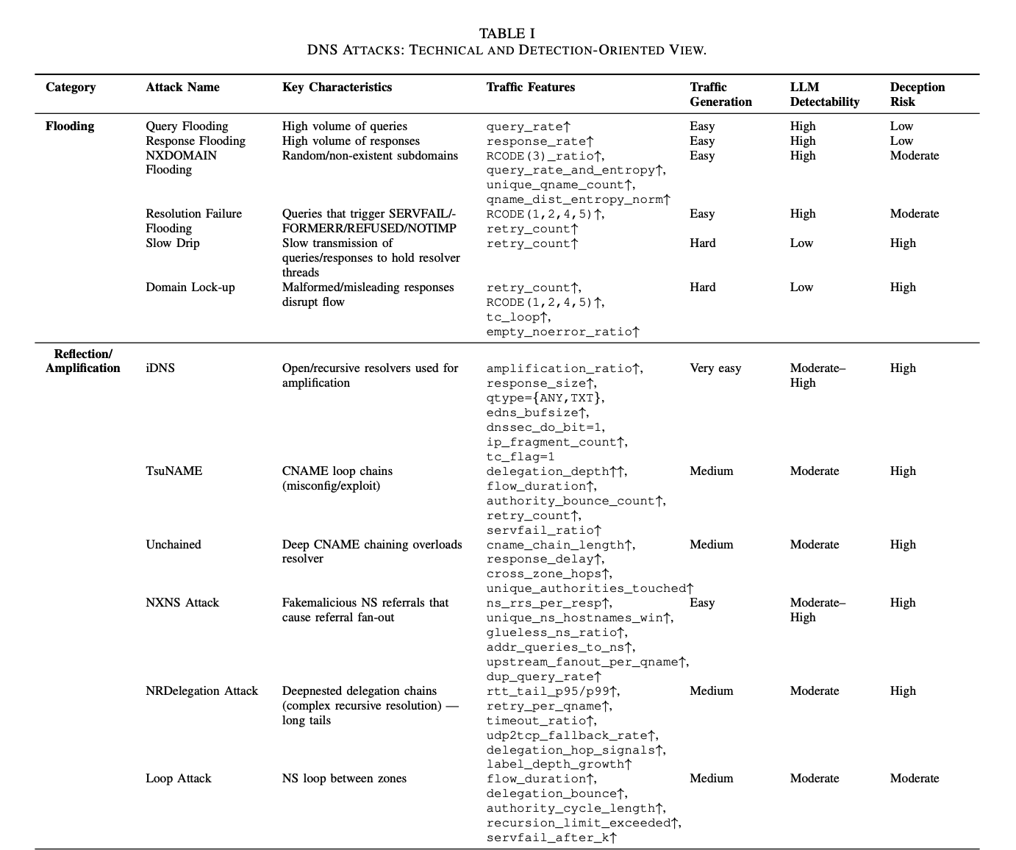
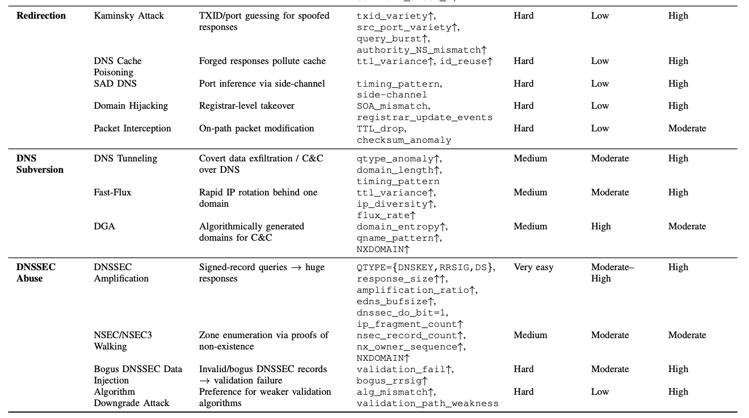
DNS Abuse Taxonomy
Attack Name Key Characteristics Traffic Features
Traffic
Generation
LLM
Detectability
Deception
Risk
Random/non-existent
Subdomains
RCODE(3)_ratio ↑
query_rate_and_entropy ↑
unique_qname_count ↑
qname_dist_entropy_norm ↑
Easy
High
Moderate
NXDOMAIN
Flooding

Slide 24

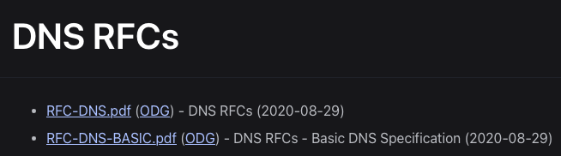
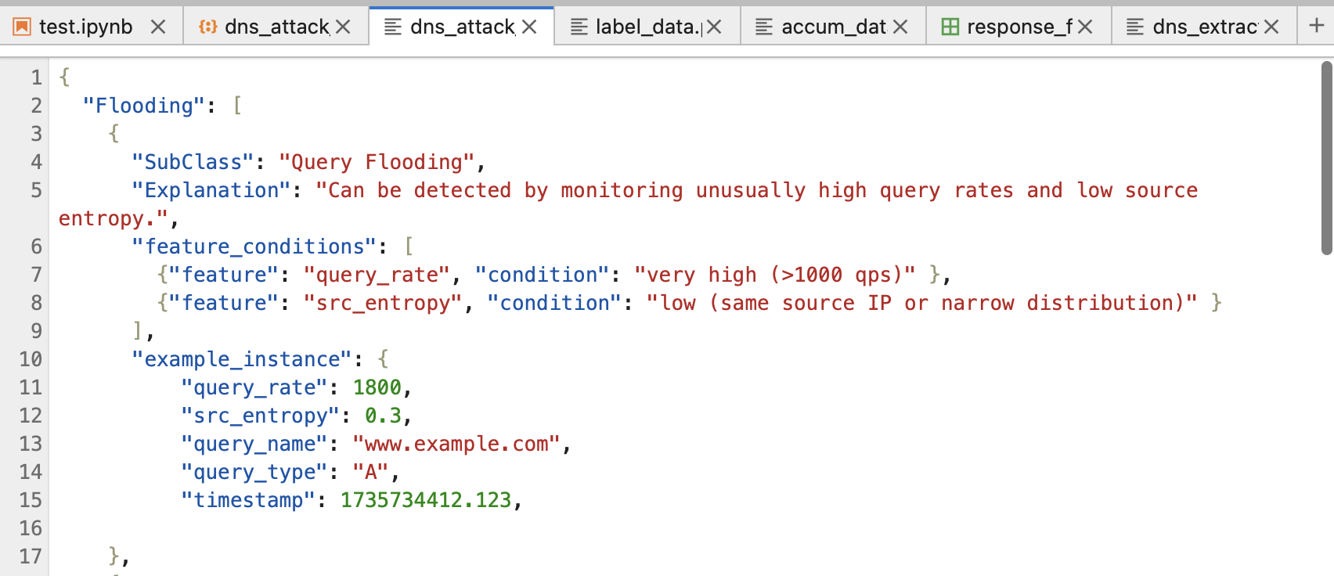

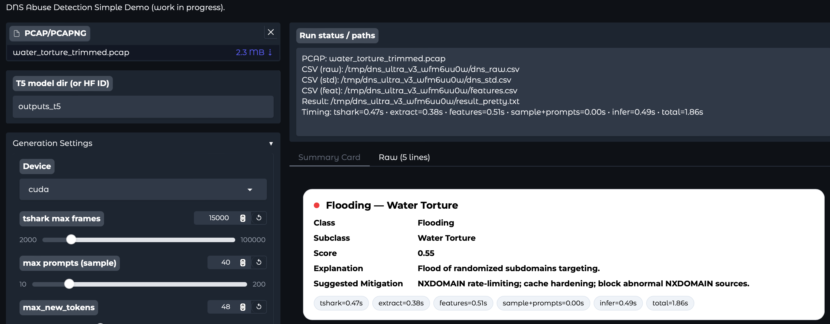
DNS Abuse Detection WorkFlow
dns_attack_taxonomy.json
Knowledge Base
(Protocol + Attack knowledge)
RAW (.pcap)
From
data
collection
…
- Class / SubClass
- Explanation
- Feature_Conditions
- Example_Instance
dns_extractor.py
compute_features.py
dns_llm_train.json
dns_llm_val.json
> input_text: prompt
> target_text:
structured JSON
cluster.py
llm_formatter.py
Gradio Web UI
train_t5.py
predict_t5.py
app_dns_t5.py
FLAN-T5
Model

Slide 25
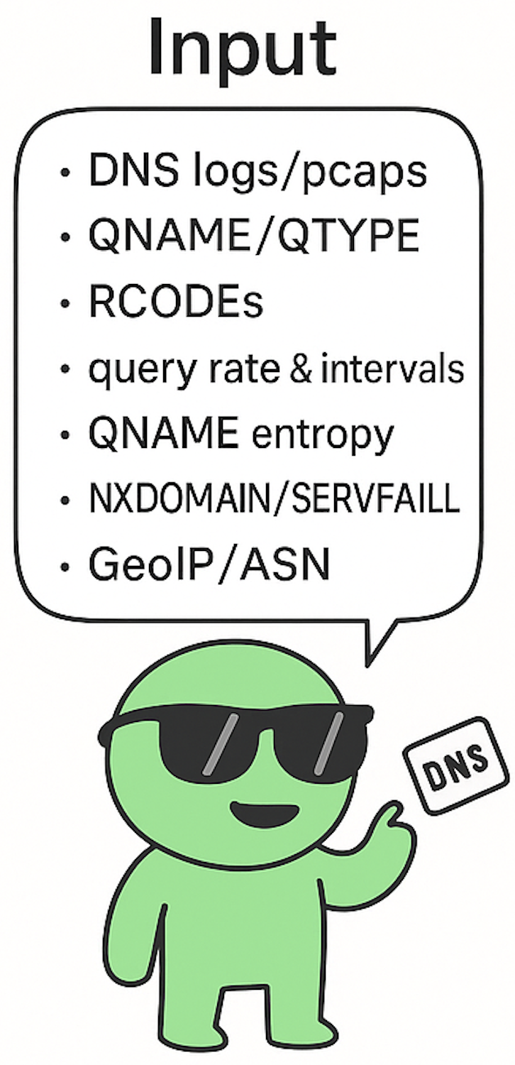
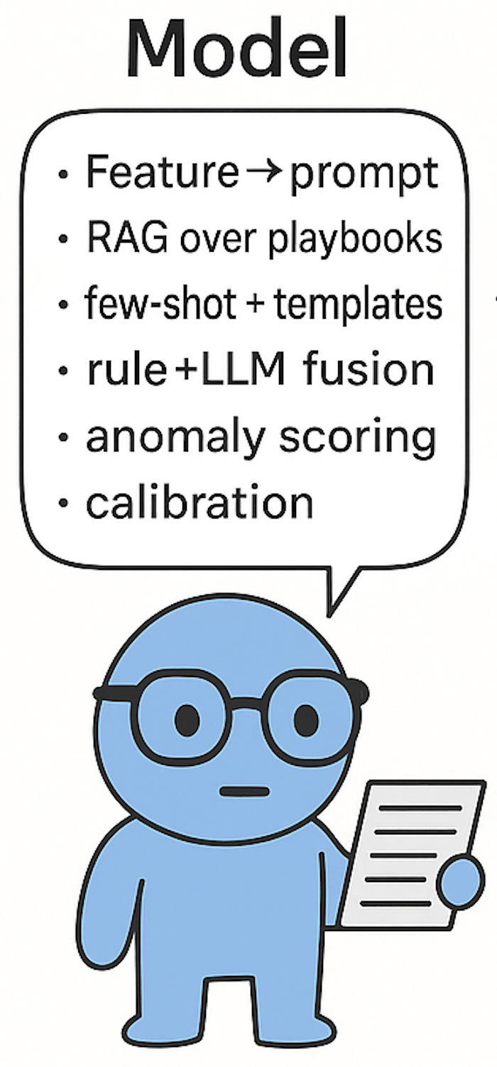
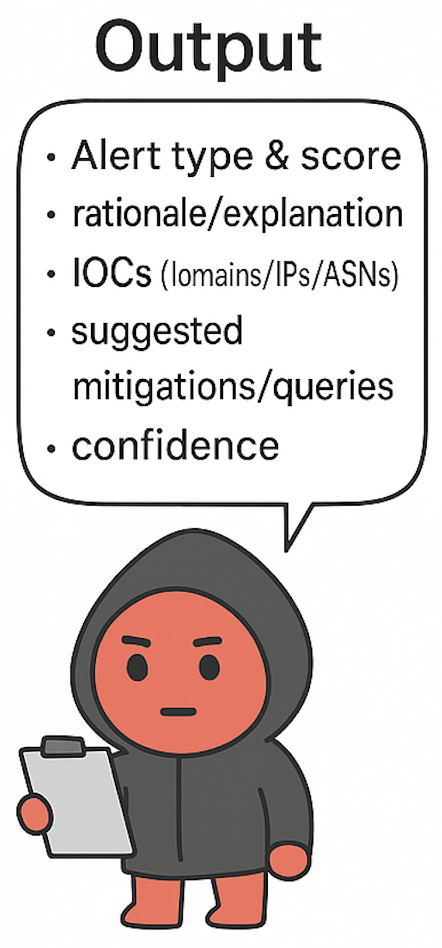
DNS Abuse Detection WorkFlow
Input
Model
Output
What you want back?
Which datasets/features?
Which LLM family/version?
How you’ll feed data?

Slide 26
Input Models
Input
Public
Datasets
- Benign traffic:
> OPENINTEL datasets (ground baseline)
- Attack traffic:
> Open-source attack datasets
DNS Server
Logs
- Traffic Generators + LLM-augmentation
> Flamethrower
> Scapy, TRex, MoonGen
Synthetic
Attack Datasets
Which datasets/features?
(Optional)
Q. Traffic logs from DNS Operators?
Adversarial
Traffic
Datasets

Slide 27
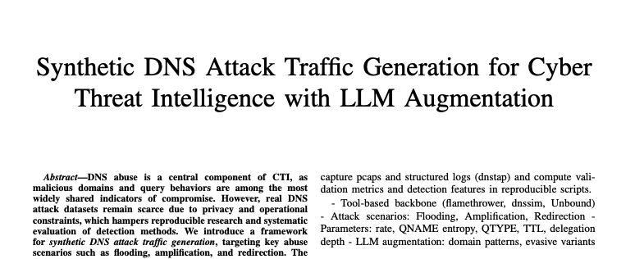
Input Models
Input
Public
Datasets
- Benign traffic:
> OPENINTEL datasets (ground baseline)
- Attack traffic:
> Open-source attack datasets
DNS Server
Logs
- Traffic Generators + LLM-augmentation
> Flamethrower
> Scapy, TRex, MoonGen
Synthetic
Attack Datasets
Which datasets/features?
(Optional)
Q. Traffic logs from DNS Operators?
Adversarial
Traffic
Datasets

Slide 28
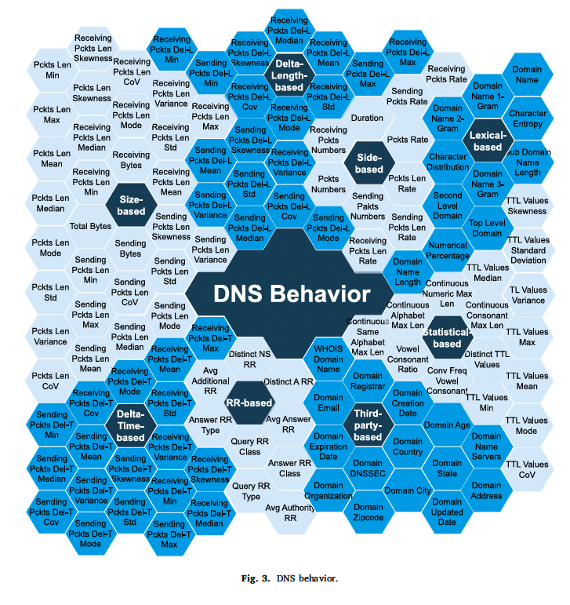
Input Models
Input
RAW (.pcap)
dns_extractor.py
compute_features.py
STD_COLS (Local Features)
llm_formatter.py
frame.time_epoch, ip.src, ipv6.src,
dns.flags.response, dns.qry.name, dns.resp.name,
dns.resp.ttl, dns.resp.len, dns.flags.rcode,
dns.count.answers, dns.count.add_rr,
udp.length, frame.len
Which datasets/features?

Slide 29
Input Models
Input
RAW (.pcap)
dns_extractor.py
Outputs for DNS analysis
and LLM prompting:
--mode packet
Fine-grained per-packet context
+ file-level aggregates
--mode window
Sliding-window aggregaton over
--window seconds;
> Per-window features
compute_features.py
llm_formatter.py
Which datasets/features?

Slide 30
Input Models
Input
RAW (.pcap)
dns_extractor.py
Converts ‘features.csv’ into JSONL
for T5 training or inference prompts
--mode infer
Build/keep ‘input_text,’
append schema suffix, and write
all prompts to ‘out_val’
--mode train
Requires ‘label’;
performs safe train/val split
Use taxonomy to build ‘target_text’
compute_features.py
llm_formatter.py
Which datasets/features?

Slide 31
LLM Models
Model
We need “ Classification + Explanation + Generation + … ”
Type | Models | Key Characteristics
Decoder-only
Encoder-only
Encoder-Decoder
GPT-Family,
LLaMA
Strong at log/query generation
Autoregressive: predicts next token sequentially
Less suitable for classification/detection tasks
High accuracy in detection/classification
Cannot generate outputs;
Limited explanatory power
BERT-,
Family
T5,
BART,
UL2
Which LLM family/version?
How you’ll feed data?
Supports detection, explanation, and generation
Larger parameter size / higher computational cost

Slide 32
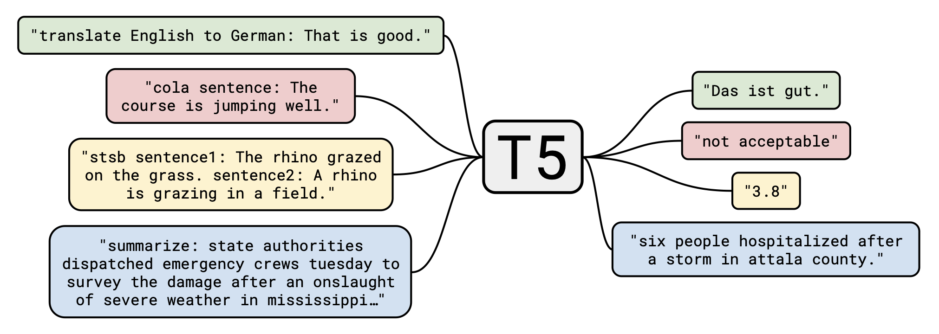
LLM Models
Model
Which LLM family/version?
How you’ll feed data?
T5: Text-to-Text Transfer Transformer

Slide 33
LLM Models
Model
FLAN-T5
Model
train_t5.py
predict_t5.py
T5 Training & Inference Scripts
train_t5.py
Fine-tunes T5 on DNS prompts/targets with robust metrics
Tokenizer/Model: AutoTokenizer, AutoModelForSeq2SeqLM
predict_t5.py
Batch-generated normalized single-line JSON per input
app_dns_t5.py
Which LLM family/version?
How you’ll feed data?

Slide 34
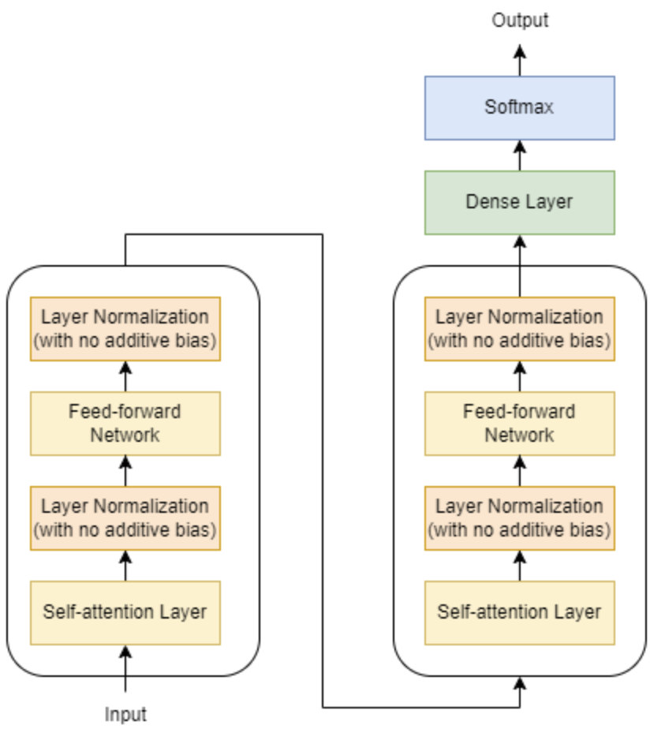
T5-Base Model
large
small
…
JSON token
sequence
LLM Models
Model
12x
Encoder
Self-attention
Which LLM family/version?
How you’ll feed data?
12x
Decoder
Cross-attention
Formmated DNS Log

Slide 35
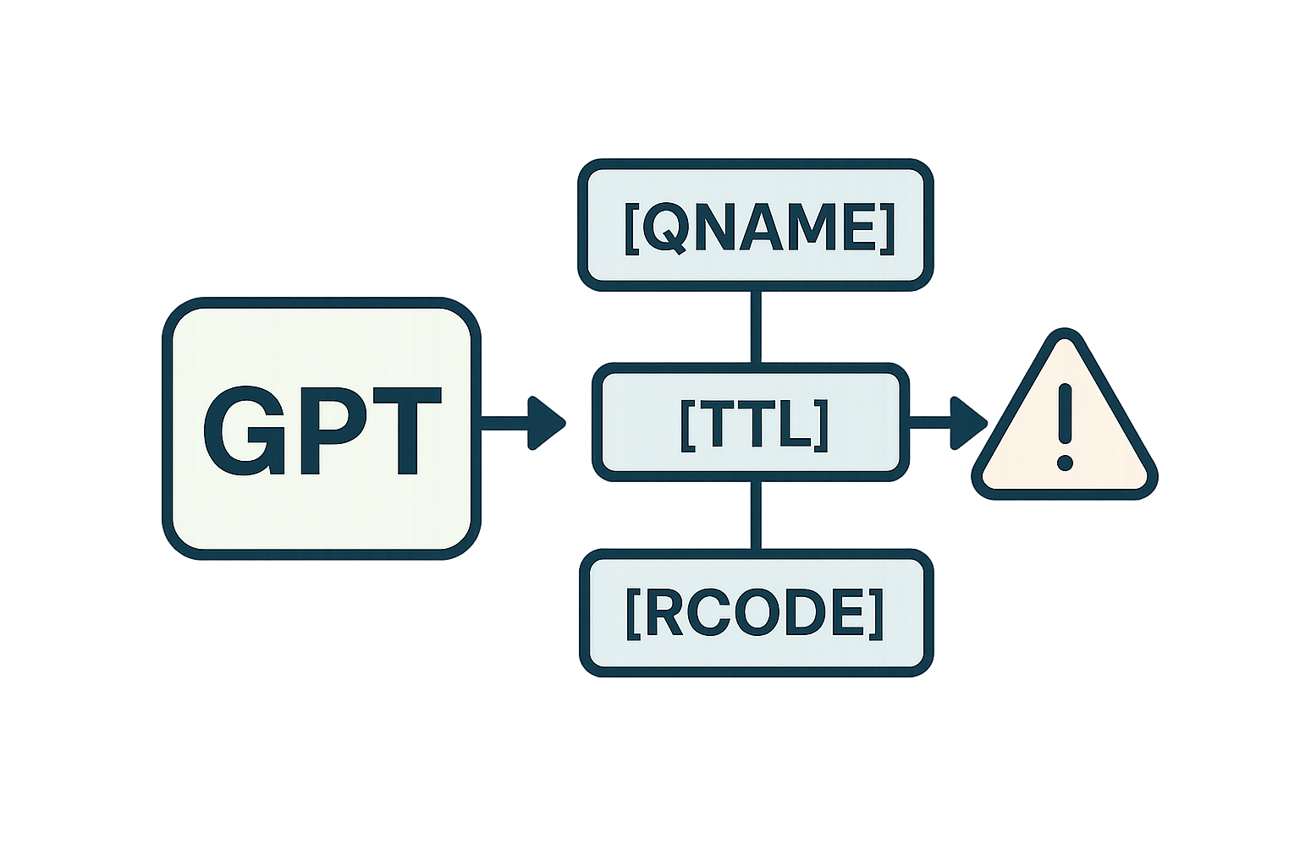
LLM Models
- DNS attack taxonomy for LLM Inference:
Model
dns_attack_
taxonomy.json
- Knowledge base as RAG:
> Up-to-date data reasoning from RFCs
and attack reports
Knowledge Base
Which LLM family/version?
How you’ll feed data?
search
kb_rfcs.json
kb_attacks.json
Flan-T5
retrieve

Slide 36
Output Models
Output
PCAP to Inference: End-to-End Demo
- Gradio Web UI
Summary Card (Gradio HTML):
- Class
- Subclass
- Score
- Explanation
- Mitigation
CSV (labelled):
per-row + final aggregated label
FLAN-T5
Model
train_t5.py
predict_t5.py
app_dns_t5.py
What you want back?

Slide 37
Output Models
Output
PCAP to Inference: End-to-End Demo
- Grafana/Prometheus
Prometheus:
- exports/metrics (port: 9108);
Grafana Panels:
- dns_pipeline_seconds
- dns_label_ratio
- dns_final_score
- dns_nxdomain_ratio …
FLAN-T5
Model
train_t5.py
predict_t5.py
app_dns_t5.py
What you want back?

Slide 38
Future Work
Short-term: Datasets, Benchmarking
> Benchmark diverse DNS datasets
> Compare across model families (Traditional MLs vs. LLMs)
Mid-term: Develop a Synthetic / Adversarial Traffic Framework
> Adversarial Robustness Testing
> Improve Trustworthiness
Long-term: Towards Operator-grade Deployment

Slide 39
Simple DEMO (3m)

