Slide 1




Web2 Woes & Web3 Warfare:
Detecting & Dissecting DNS Abuse
.eth
.cb.id
Alexander Urbelis
urbelis.eth
.base
General Counsel / CISO, ENS Labs Ltd.
.linea
.uni

Slide 2
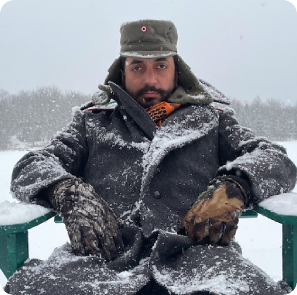

whoami
General Counsel / CISO of ENS
Former CISO of NFL
Professor of Law, King’s College, London
DNS-based cyber threat intel platform creator
Technology Advisory Board of Human Rights First
Member of the UL Security Council
Background in defense and intelligence in the US
Co-host of a Hacker-focused radio show in NY
Published in FT, CNN, The Intercept, 2600 Magazine
Was a hacker way before it was cool
Notes:
https://www.notion.so/enslabs/Marketing-Calendar-1897a8b1f0ed8000aa13d29f1869c48f?pvs=4
How should others in ENS use this resource?

Slide 3



The DNS is Dangerous

Slide 4
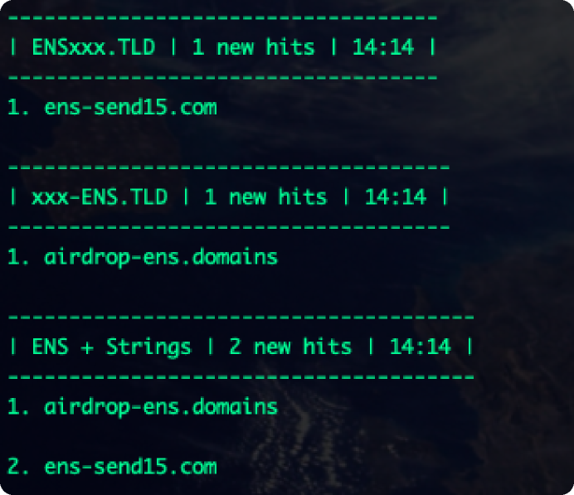
Bad Guys Abound
Created a DNS-based threat intel system
We identify malicious domains daily
Cloudflare -> Hiding the host
Attacks / fraud persist
Volume and velocity are alarming
Propelled on X / Twitter
Linktree usage is common
Wallet drainer smart contract
Attacks stood up surprisingly quickly

Slide 5
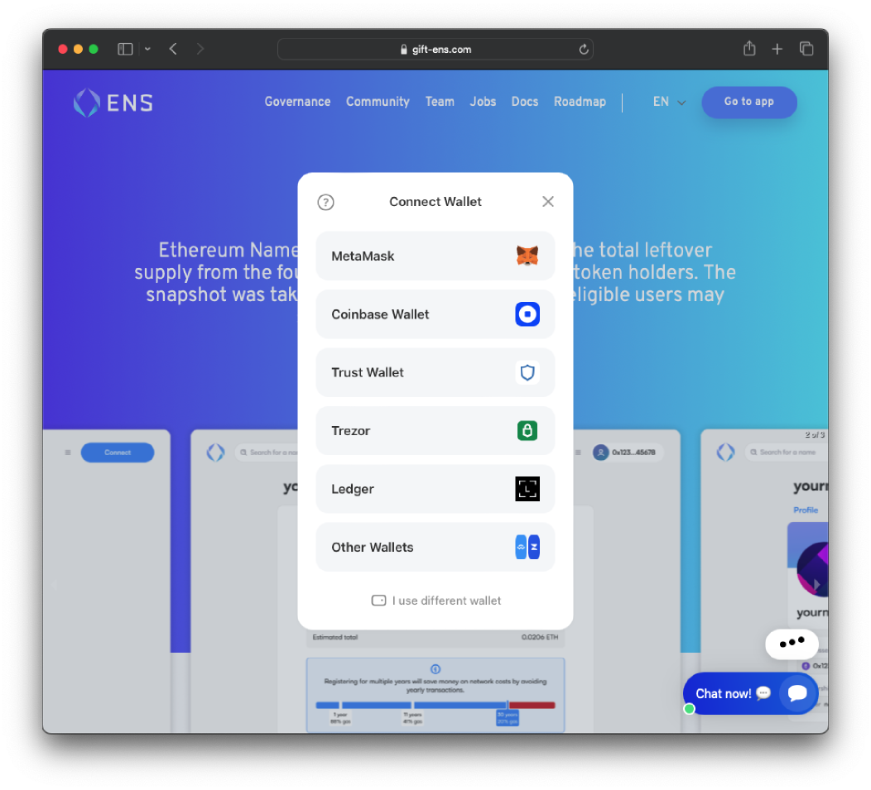
The Attacks
Pernicious and persistent
Can cause significant losses
Clear case of DNS Abuse
Chicken & egg reporting issue
Law enforcement not available
An onboarding concern for web3

Slide 6
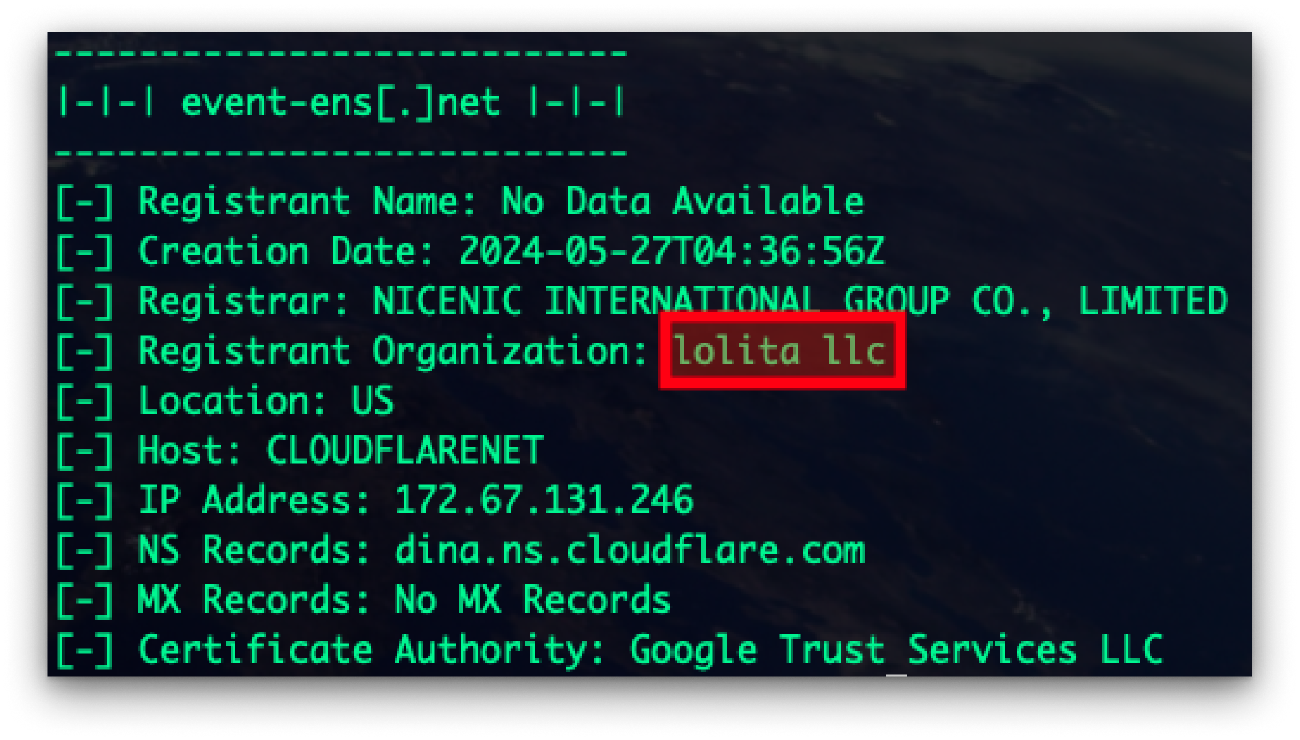
Consistent Thread

Slide 7
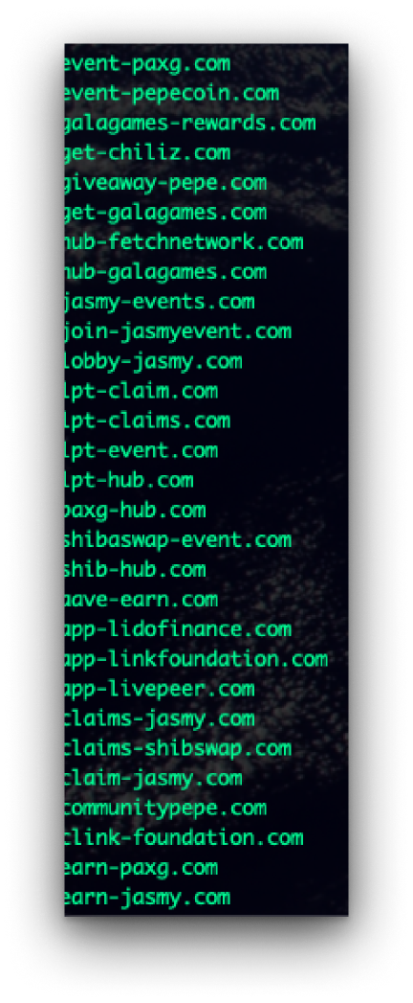
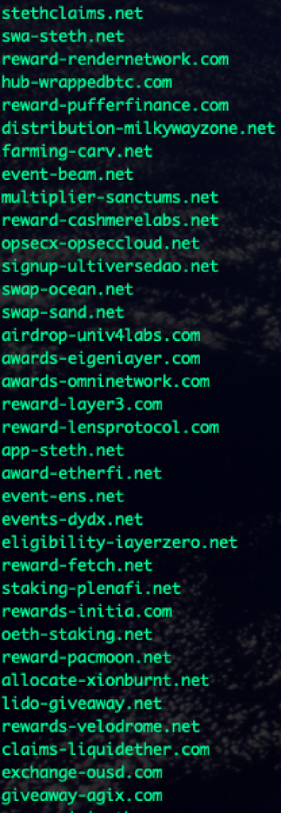
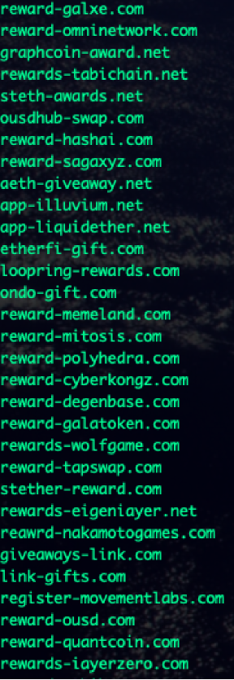
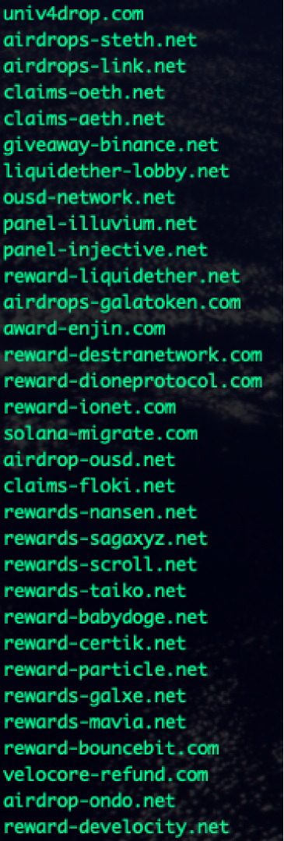
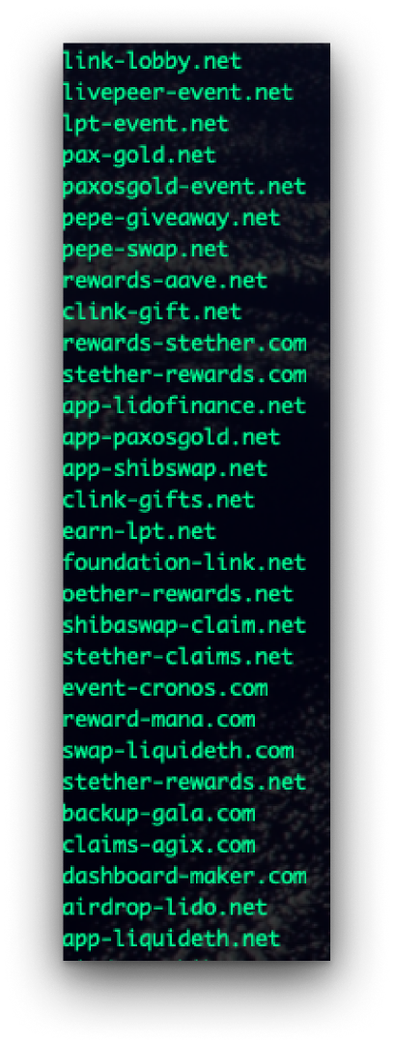
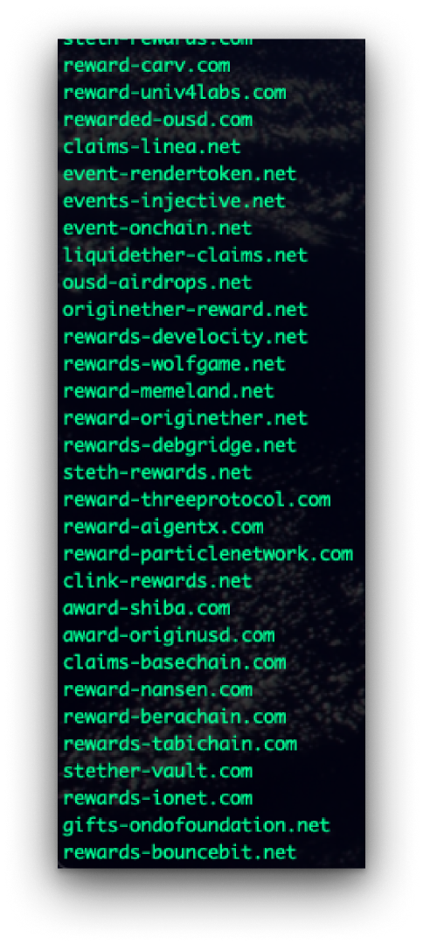
2,200+ Attacks on web3 and defi entities

Slide 8
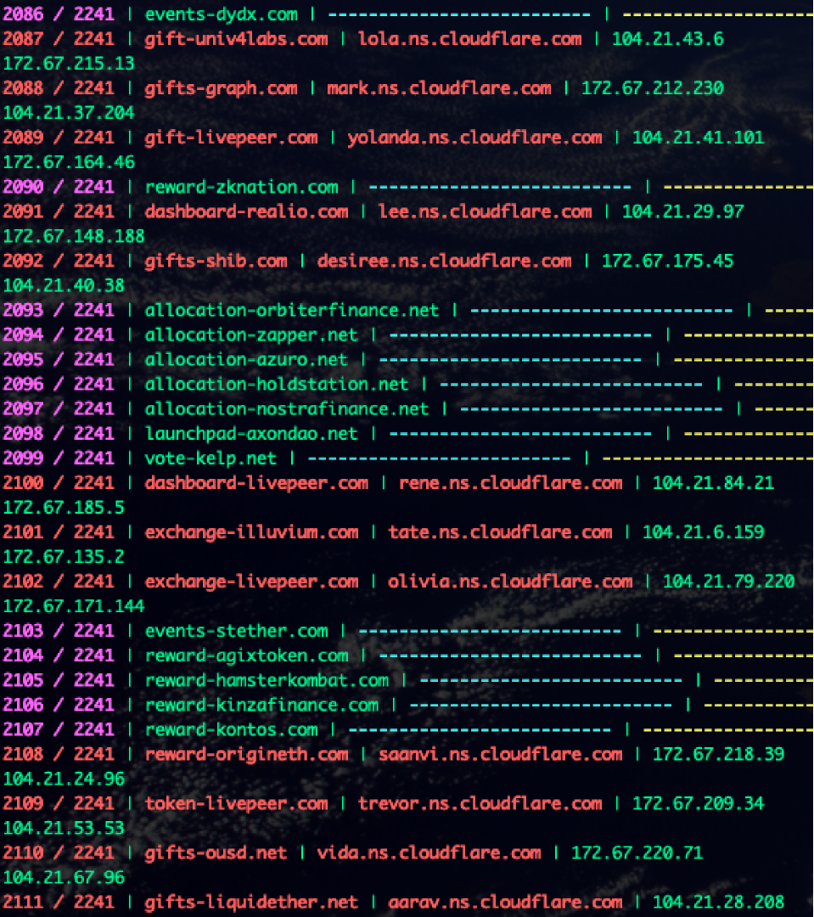
Tracking &
Threat Detection
Consistent infrastructure
Consistent DNS configuration
Wrote bash script to track NS record
changes every ten minutes
NS records -> Cloudflare = attack
wget -m [target domain]
Evidence and indicators
Reliable early warning system

Slide 9
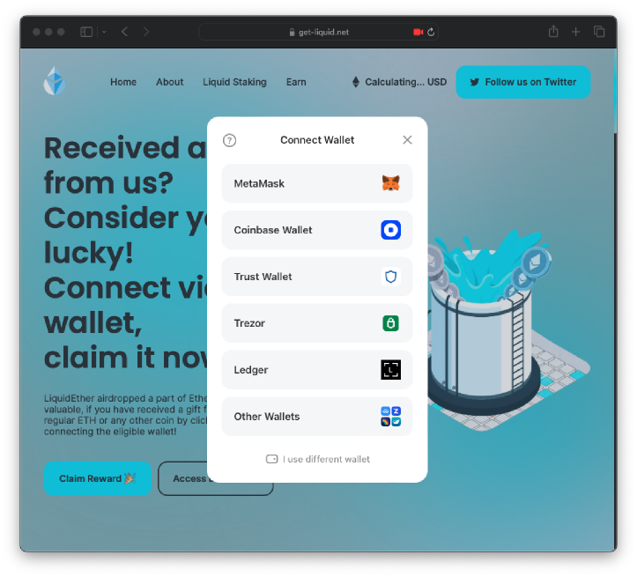
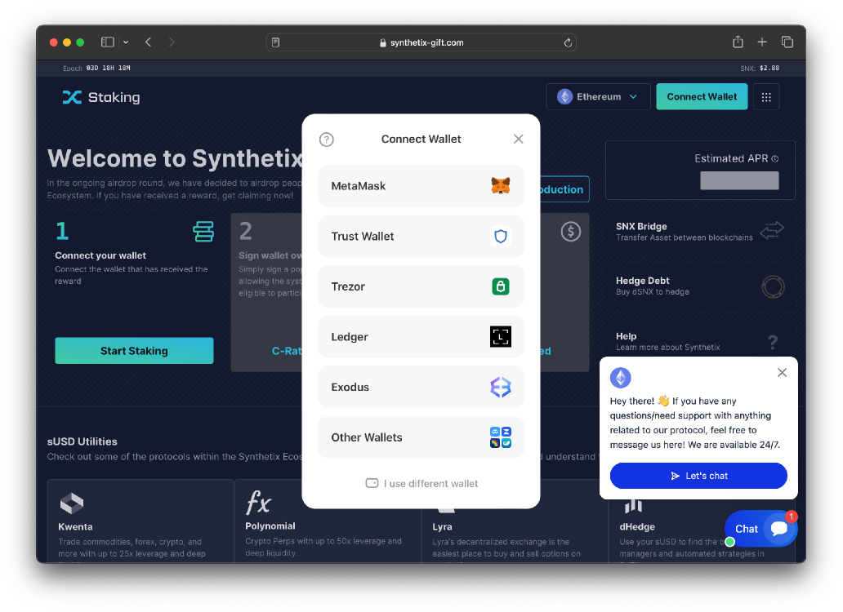
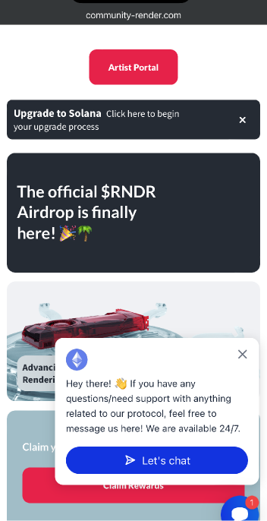
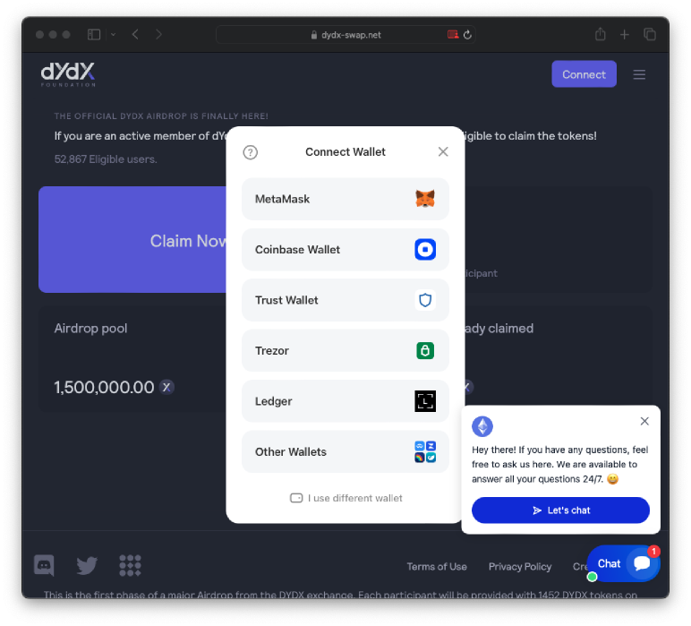
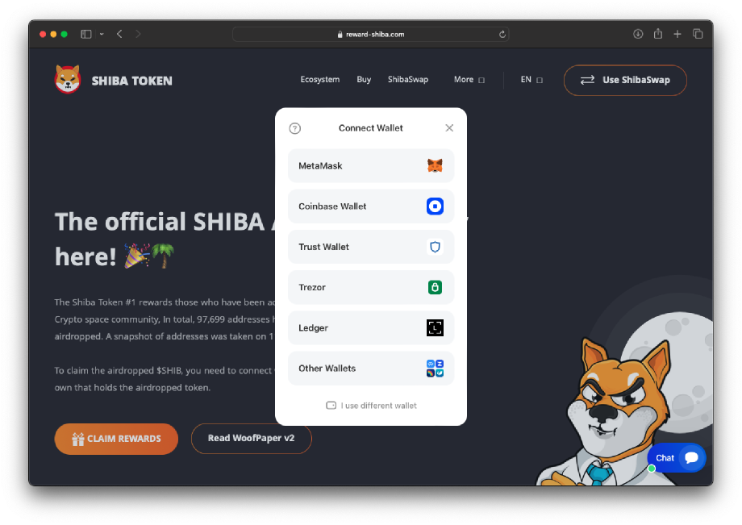
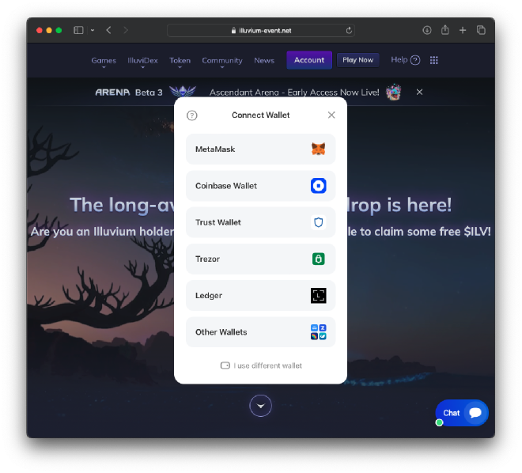
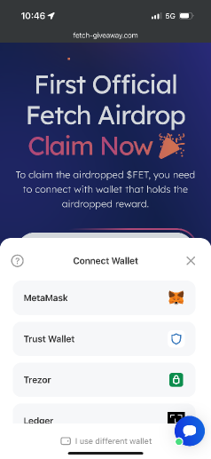
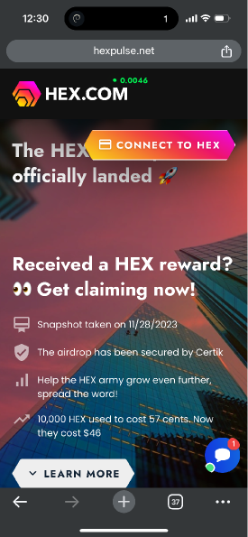
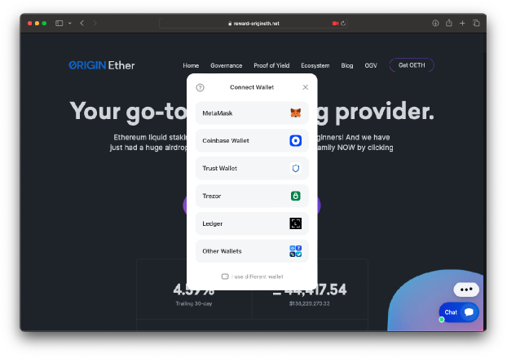

Slide 10

What to do about all this?

Slide 11
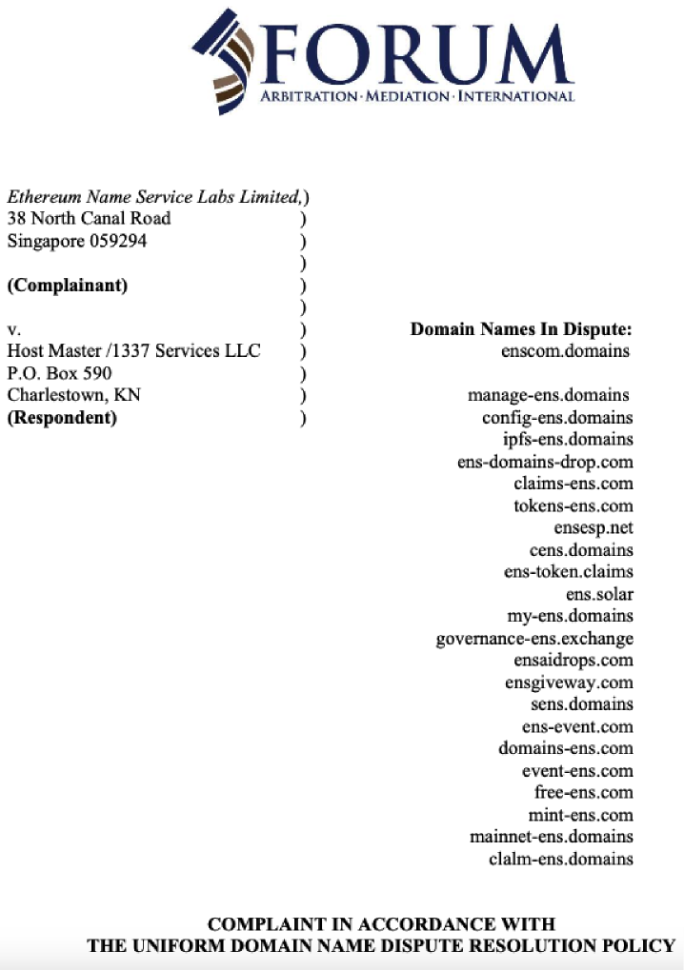
UDRPs /
Takedowns / Blocklists /
Reports /
Always reactive, always chasing
How to get ahead of the game?

Slide 12

A Modest Proposal
Share intel amongst the ecosystem
Disperse through SEAL (web3 alliance)
Prioritize abuse reporting
Reclaim domains & collect intel
Evolve the UDRP / DNS abuse process

Slide 13
Web3 on the Offense
Common grievance | Registration pattern | Same rights at issue
Come together and file the largest UDRP Complaint ever
Reclaim thousands of malicious threat actor domains
Warning shot to threat actors that we are watching
Gather intel from registrations / domains / logs
Law enforcement involvement / US interest
Evolve DNS Abuse reporting process
Community is safer together

Slide 14




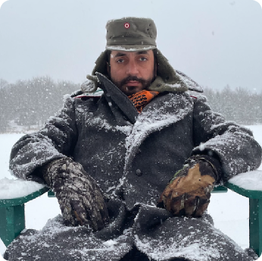
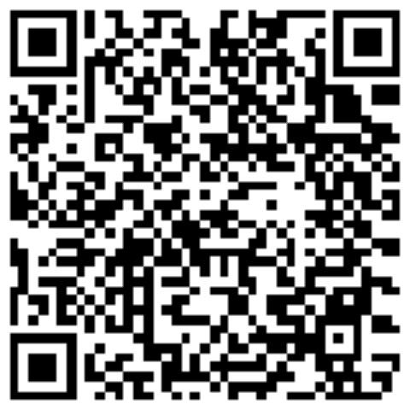
Thank You for Listening
Let’s share intel, be in touch, and connect in Dublin
Alexander Urbelis
urbelis.eth
General Counsel / CISO, ENS Labs Ltd.
alex@ens.domains
Telegram: aurbelis
X / Twitter: aurbelis
Signal: alex.8998
LinkedIn:

