Slide 1

DSC Exporter
Lightweight & Realtime Observability of DSC Data
Denic eG
B.Sc. Max Klebe
Dr. Benjamin Schönbach
Team DNS
Patrick Fedick
Jürgen Geinitz
Sven Wefels
Marco Prause
Frank Ulbricht
Riyad Islam
Manuel Stausberg
Daniel Brandtner
April John

Slide 2
DSC and its legacy
DSC
„… DSC uses distributed system for collecting, visualizing, and archiving DNS measurements...“
Collector(s)
Distributed instances for collecting and processing of DNS data
processing of captured DNS raw data into unified DSC output (.xml)
sync of processed output (.xml) towards presenter
Presenter
Centralized instance for visualization and archiving of DNS data
no DNS raw data processing
queued import of pre-processed DNS data

Slide 3
Requirements & Motivation
Why distributed?
Cloud computing era leads to high flexibility → more nodes with one click
Nodes vs. Observability vs. Cybersecurity → more nodes with complex networking and high safety & security & sustainable awareness
Easy to scale and multi-tenancy for large anycast DNS services
Since performance DNS servers upload (raw) data anyways, collection of processed DSC output adds less load
Whats needed?
Easy & fast setup
  easy install & scale
Open source stacking
  living community support
Adaptive observability & visualization
  Prometheus, Grafana etc.
Multi-Tenancy
  anycast customer isolation

Slide 4
Presenter vs. Exporter vs. Datatool
Presenter
Visualization & archiving of DSC data
integrated front-end for visualization
attached text file database for archiving (.dat)
Exporter
Real-Time export of DSC data as metrics
REST API and multiprocess based service architecture
flexible scraping and visualization by exisiting observability frameworks (i.e. prometheus + grafana)
Datatool
Collection of scripts for DSC data import/export
no front-end/api → just pure data processing
cyclic import of processed DSC data into various datasources (i.e. influxdb)

Slide 5
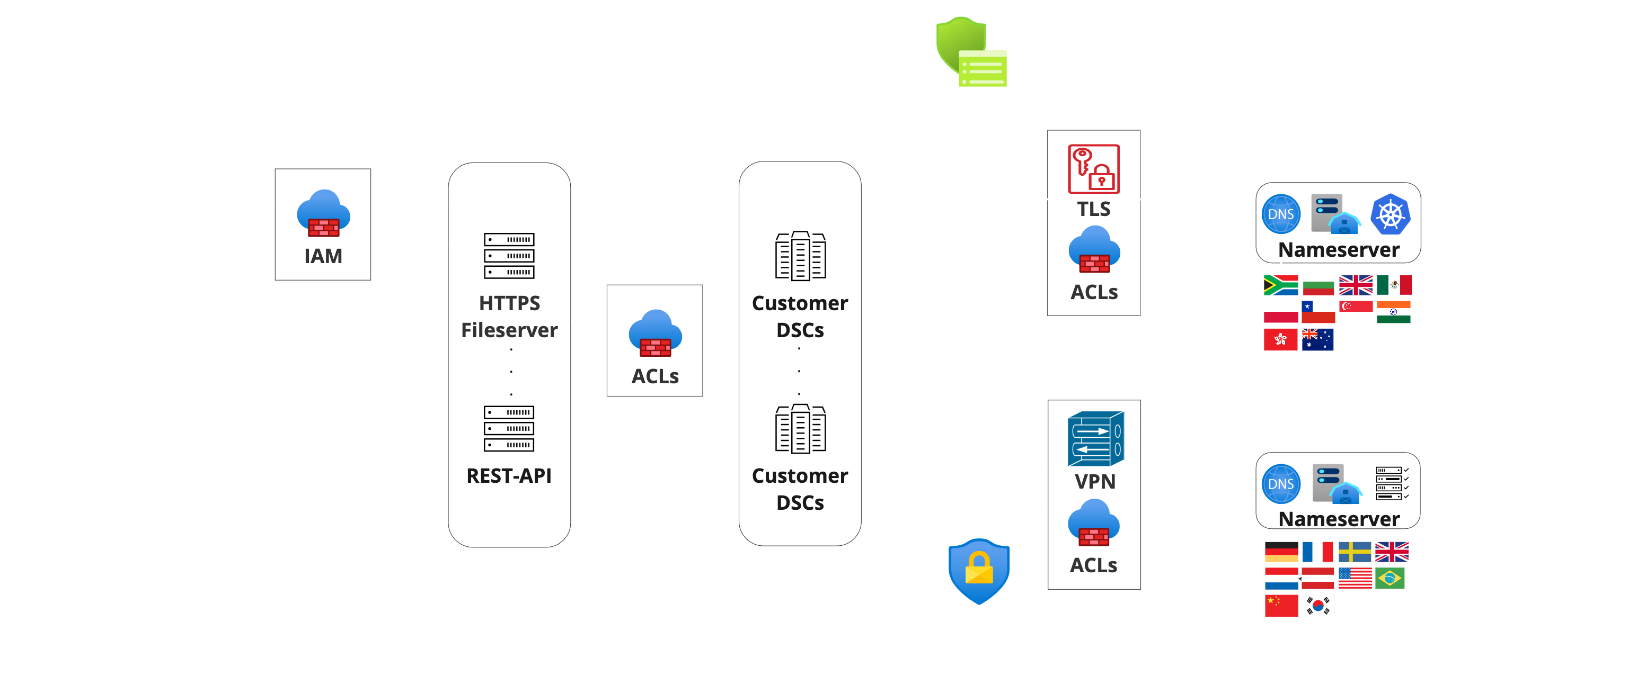
Big Picture

Slide 6
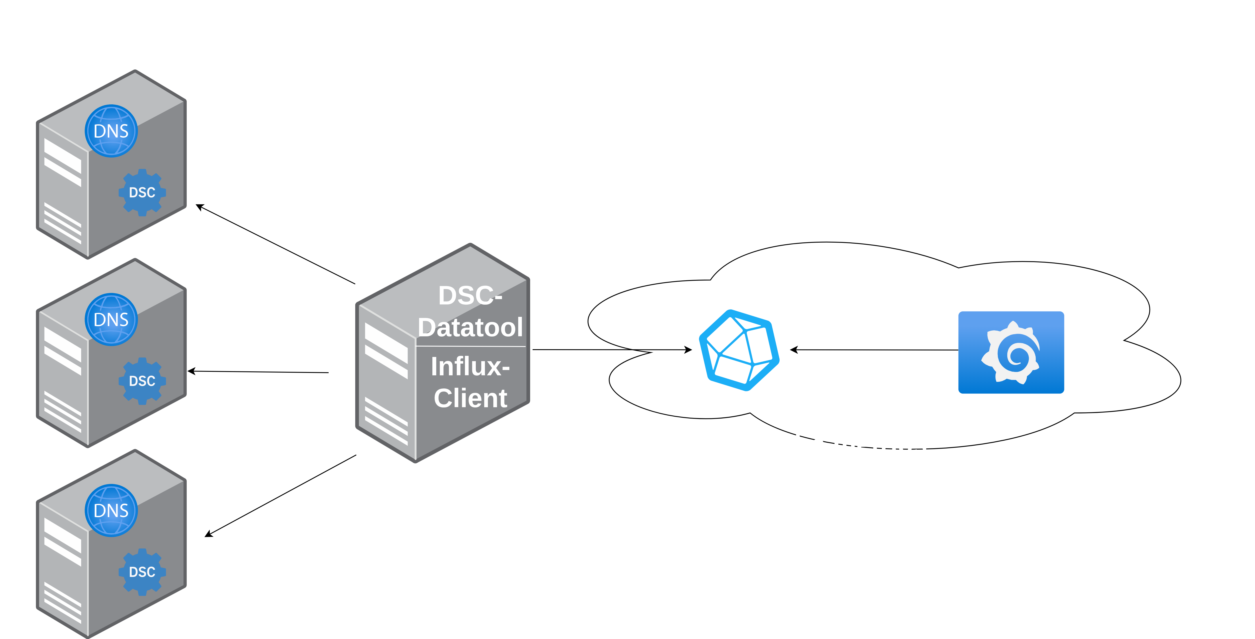
Datatool

Slide 7
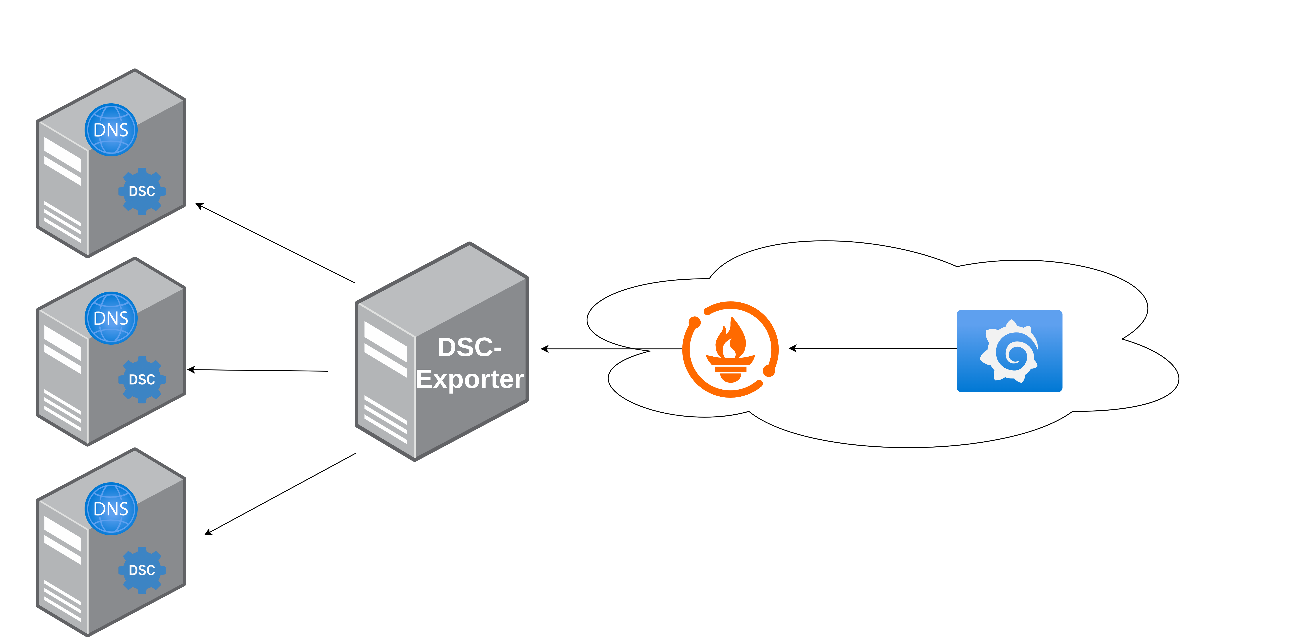
Exporter

Slide 8
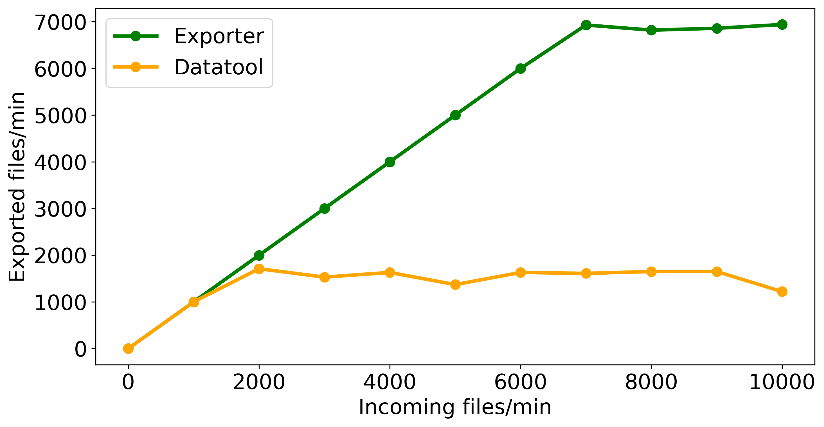
Performance

Slide 9
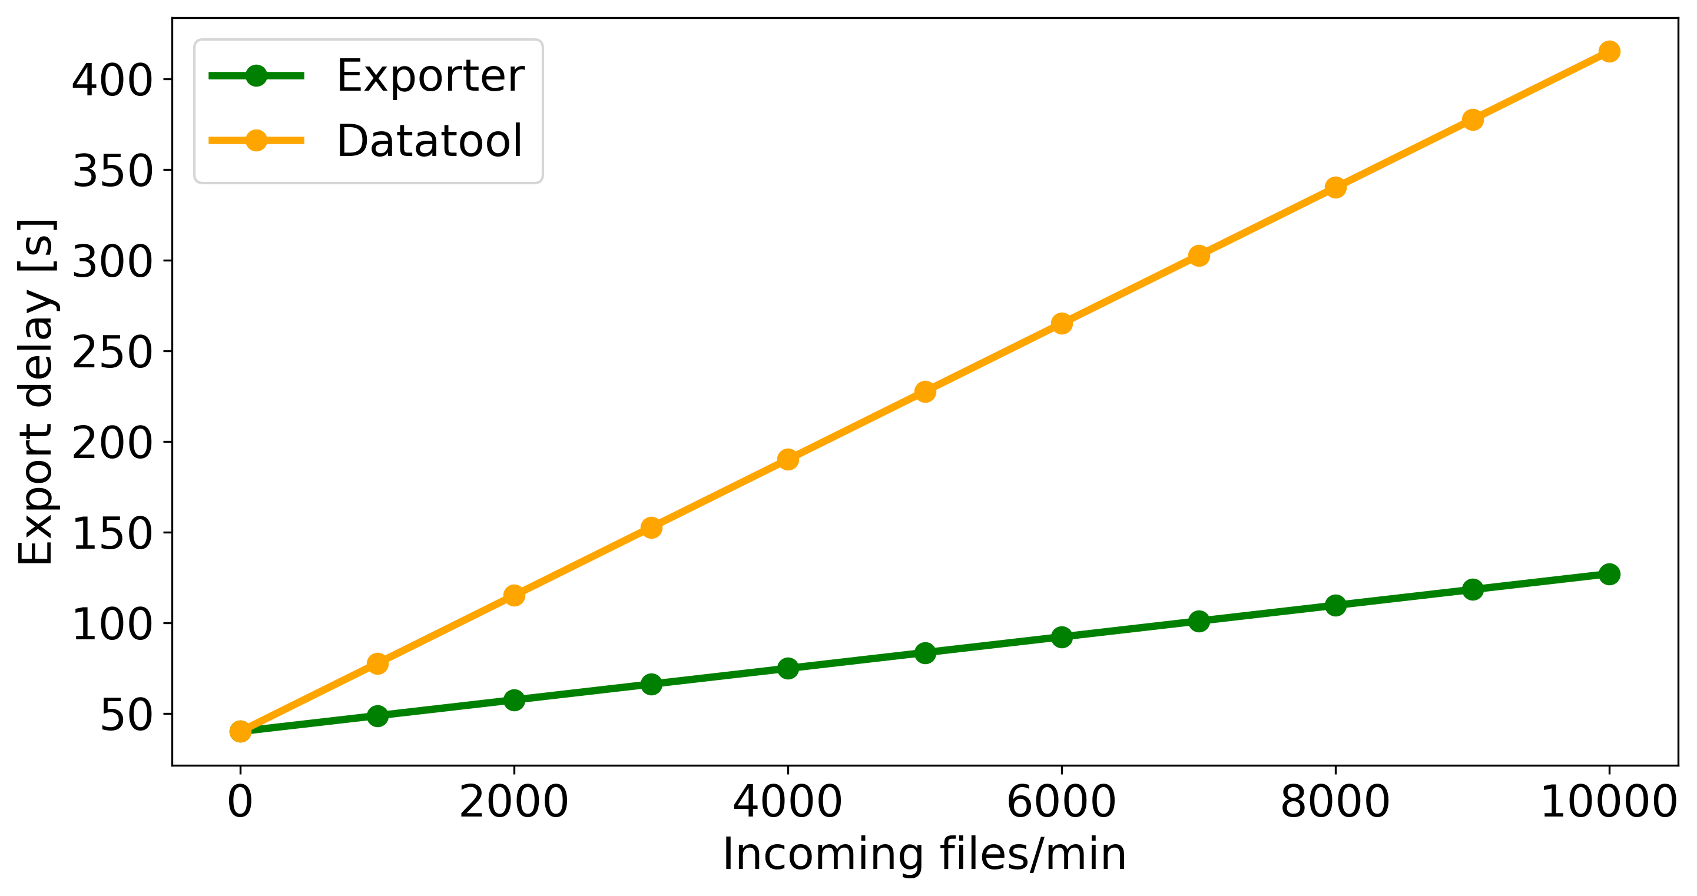
Realtime

Slide 10
Comparison
Δt : delay between collector(s) output until visualization appearance
10
9
8
7
6
5
4
3
2
1
Exporter
Datatool
Presenter
Δt (min)
1000 | 2000 | 4000 | 6000 | 8000 | 10000
Incoming files/min

Slide 11
Conclusion
Which solution fits better?
Trade off between….
  processing performance
  long term archiving
  customer scalability
  realtime analysis
  community support
Which solution to choose?
High performance & realtime capability → Exporter
  huge number of parallel DSC files from multiple nodes
High scalability & archiving → Datatool
  scalable and solid archiving
Capability | Stack
 | Presenter | Exporter | Datatool
Performance | ☺☺ | ☺☺☺ | ☺
Scalability | ☺☺ | ☺☺☺ | ☺☺☺
Realtime | ☺ | ☺☺☺ | ☺☺
Archiving | ☺☺☺ | ☺ | ☺☺☺
Open Source | ☺☺☺ | ☺☺☺ | ☺☺☺

Slide 12

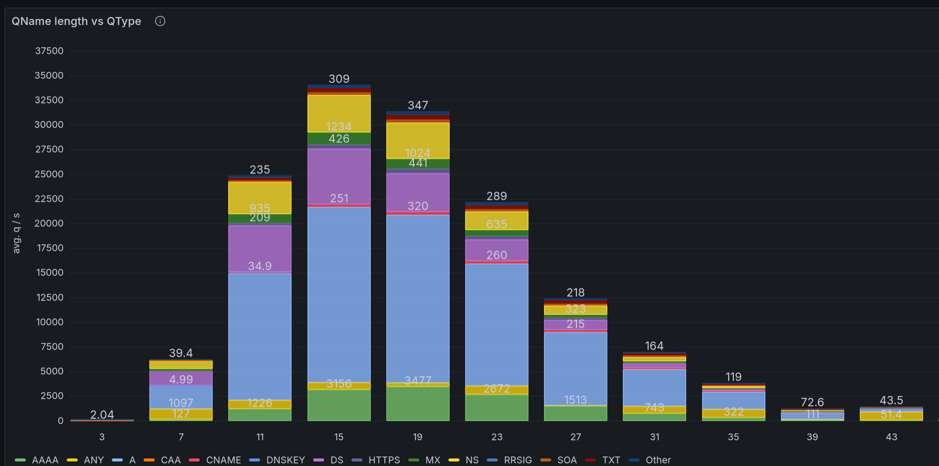

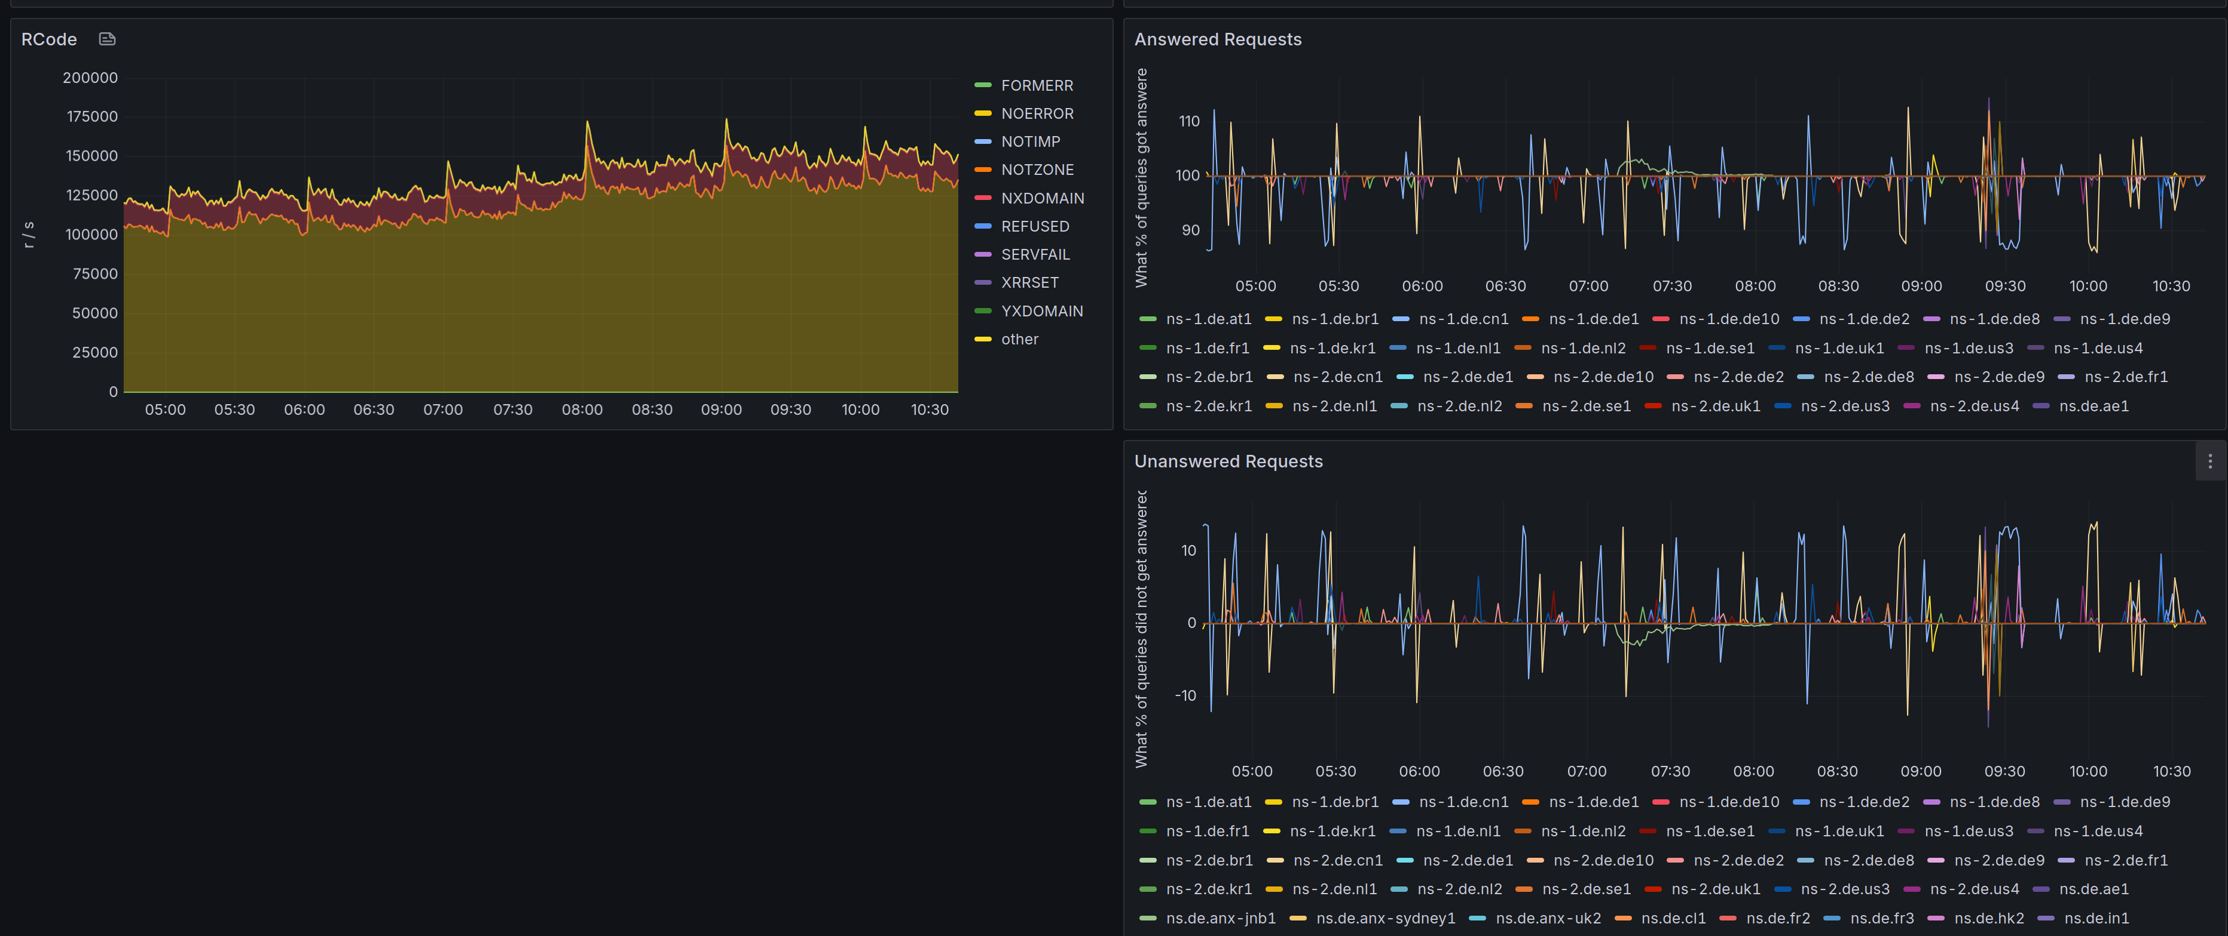
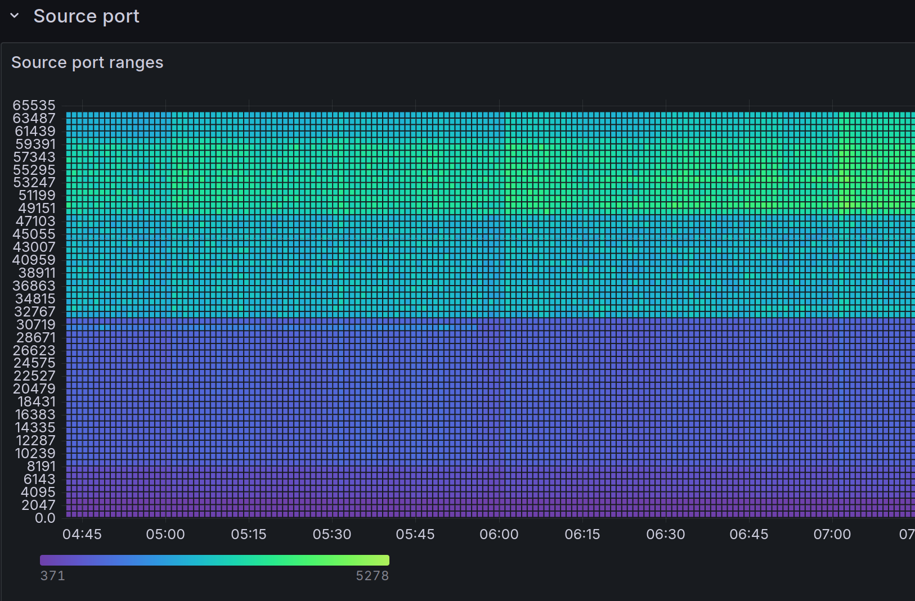
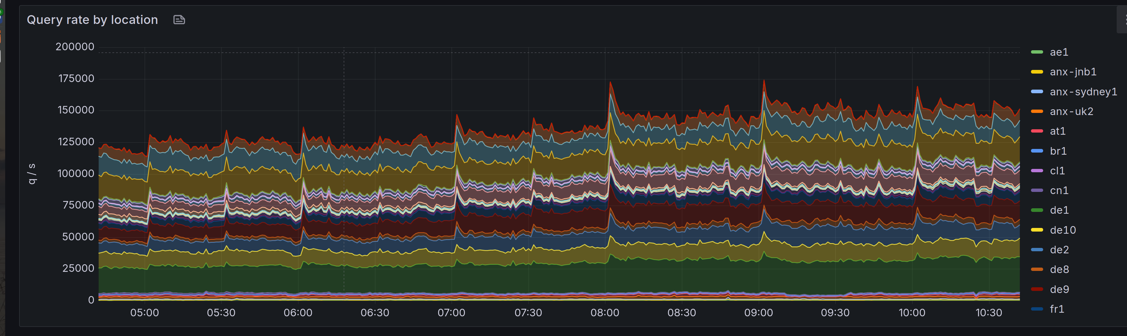
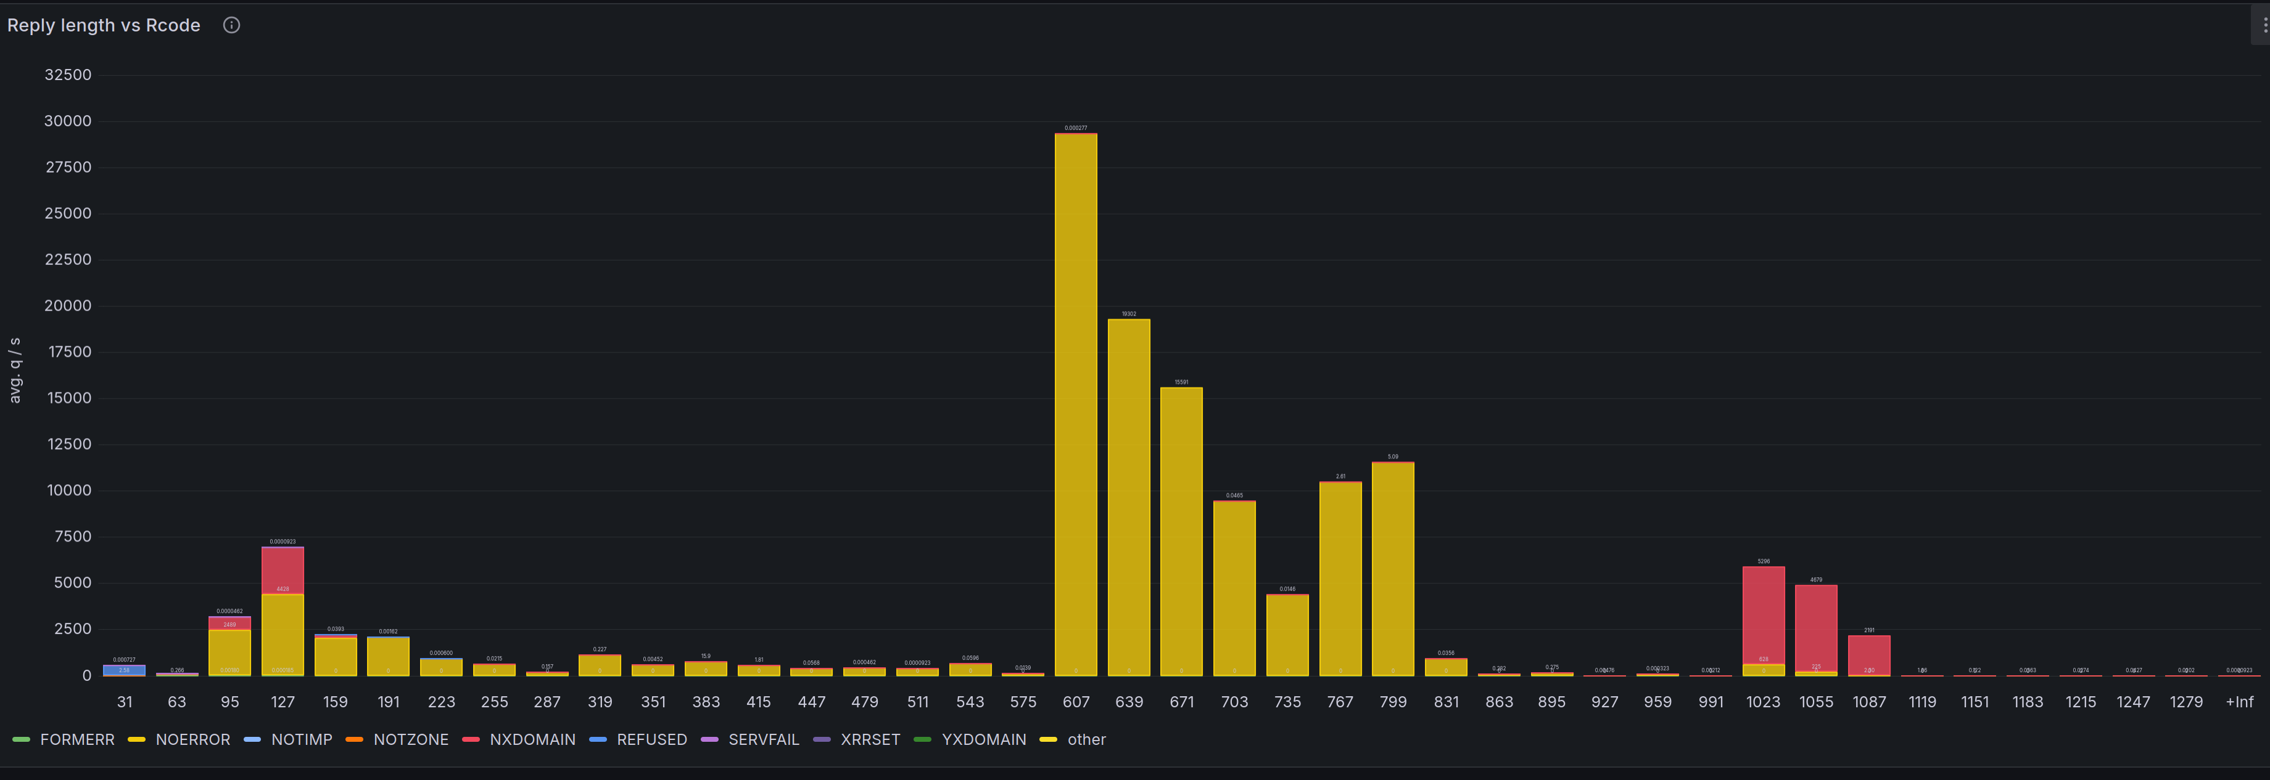
Hunger for more?
Check it out …..
  https://github.com/DENICeG/dscexporter

Slide 13

Q&A

Slide 14

ThanK You!

