Slide 1

Measuring Anycast Routing: Catchment, RTT, and Optimal routing of your DNS deployment
OARC-46, EDINBURGH, MAY’26
Remi Hendriks

Slide 2
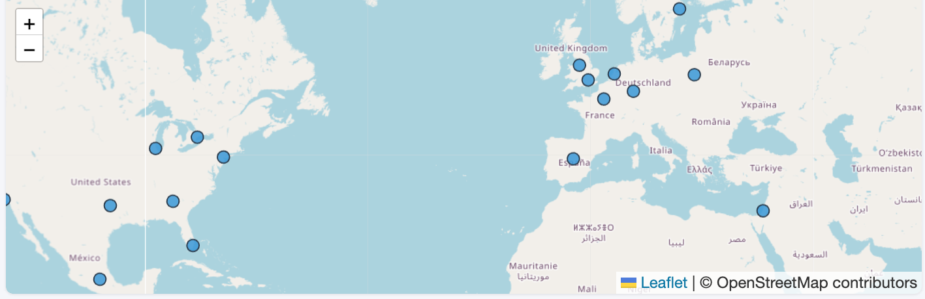
Introduction Motivation
Anycast: Making an IP address available in multiple Points of Presence (PoPs)
How? - Announcing an IP prefix at multiple locations using BGP
01/19
Notes:
Anycast is the practice of making an IP address available in multiple locations This is achieved by announcing a single IP prefix at each location using BGP
The main motivation is that it allows for load-distribution, improved resiliency, and it reduces latency

Slide 3
Introduction Motivation
Anycast: Making an IP address available in multiple Points of Presence (PoPs)
How? - Announcing an IP prefix at multiple locations using BGP
Why? - Distribute load
01/19
Notes:
Anycast is the practice of making an IP address available in multiple locations This is achieved by announcing a single IP prefix at each location using BGP
The main motivation is that it allows for load-distribution, improved resiliency, and it reduces latency

Slide 4
Introduction Motivation
Anycast: Making an IP address available in multiple Points of Presence (PoPs)
How? - Announcing an IP prefix at multiple locations using BGP
Why? - Distribute load, reduce latency
12ms
3ms
7ms
35ms
5ms
01/19
Notes:
Anycast is the practice of making an IP address available in multiple locations This is achieved by announcing a single IP prefix at each location using BGP
The main motivation is that it allows for load-distribution, improved resiliency, and it reduces latency

Slide 5
Introduction Motivation
Anycast: Making an IP address available in multiple Points of Presence (PoPs)
How? - Announcing an IP prefix at multiple locations using BGP
Why? - Distribute load, reduce latency, resiliency
01/19
Notes:
Anycast is the practice of making an IP address available in multiple locations This is achieved by announcing a single IP prefix at each location using BGP
The main motivation is that it allows for load-distribution, improved resiliency, and it reduces latency

Slide 6
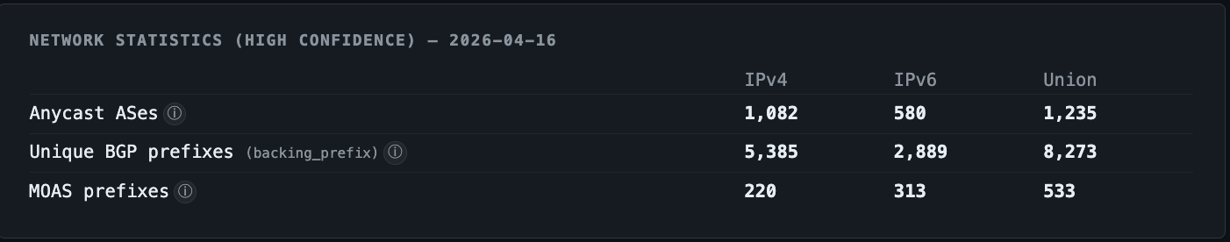
Introduction Anycast and the DNS
Anycast is widely used
Over 1,000 ASes deploy anycast
Statistics from manycast.net
02/19
Notes:
Anycast is the practice of making an IP address available in multiple locations This is achieved by announcing a single IP prefix at each location using BGP
The main motivation is that it allows for load-distribution, improved resiliency, and it reduces latency

Slide 7
Introduction Anycast and the DNS
Anycast is widely used
Over 1,000 ASes deploy anycast
63% of these run anycast DNS services
Statistics from manycast.net
02/19
Notes:
Anycast is the practice of making an IP address available in multiple locations This is achieved by announcing a single IP prefix at each location using BGP
The main motivation is that it allows for load-distribution, improved resiliency, and it reduces latency

Slide 8
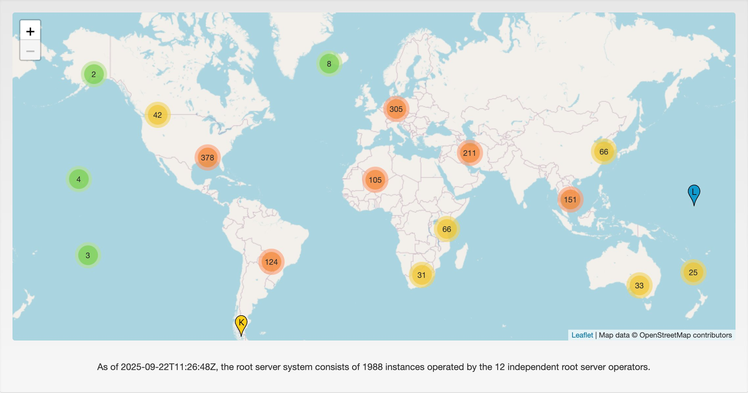
Introduction Anycast and the DNS
Anycast is widely used
Over 1,000 ASes deploy anycast
63% of these run anycast DNS services
DNS anycast deployments
All root letters
02/19
Source: root-servers.org
“All 12 DNS root-letters are deployed using anycast; combined totaling 1,988 sites”
Notes:
Anycast is the practice of making an IP address available in multiple locations This is achieved by announcing a single IP prefix at each location using BGP
The main motivation is that it allows for load-distribution, improved resiliency, and it reduces latency

Slide 9
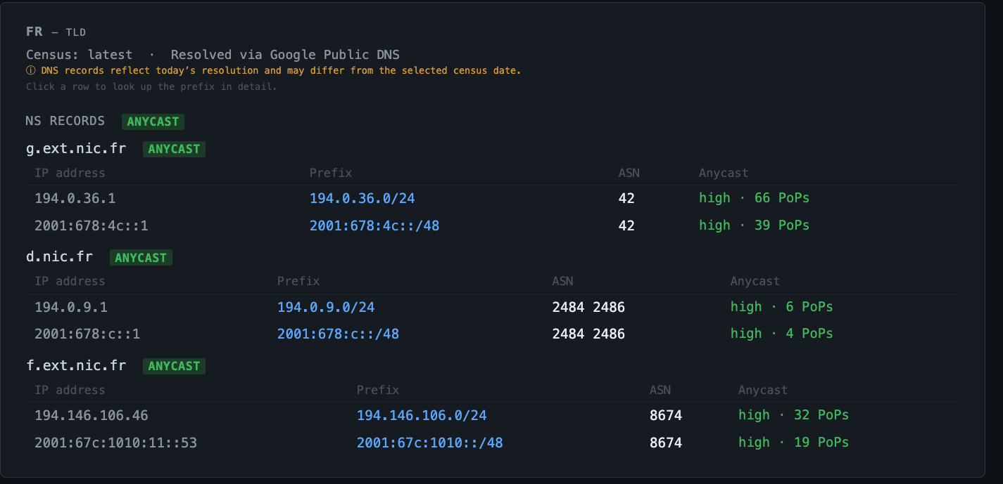
Introduction Anycast and the DNS
Anycast is widely used
Over 1,000 ASes deploy anycast
63% of these run anycast DNS services
DNS anycast deployments
All root letters
Auth NS (e.g., ccTLDs)
02/19
Source: manycast.net/?q=.fr
“Example: NS anycast deployments for .fr (France)”
Notes:
Anycast is the practice of making an IP address available in multiple locations This is achieved by announcing a single IP prefix at each location using BGP
The main motivation is that it allows for load-distribution, improved resiliency, and it reduces latency

Slide 10
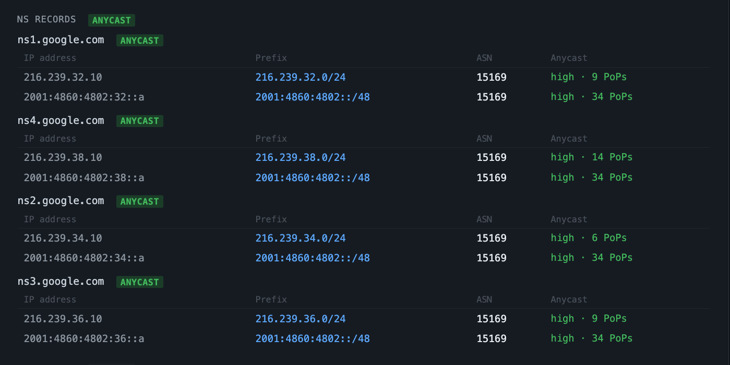
Introduction Anycast and the DNS
Anycast is widely used
Over 1,000 ASes deploy anycast
63% of these run anycast DNS services
DNS anycast deployments
All root letters
Auth NS (e.g., ccTLDs)
Second-level NS
02/19
Source: https://manycast.net/?q=google.com
“Example: NS anycast deployments for google.com”
Notes:
Anycast is the practice of making an IP address available in multiple locations This is achieved by announcing a single IP prefix at each location using BGP
The main motivation is that it allows for load-distribution, improved resiliency, and it reduces latency

Slide 11
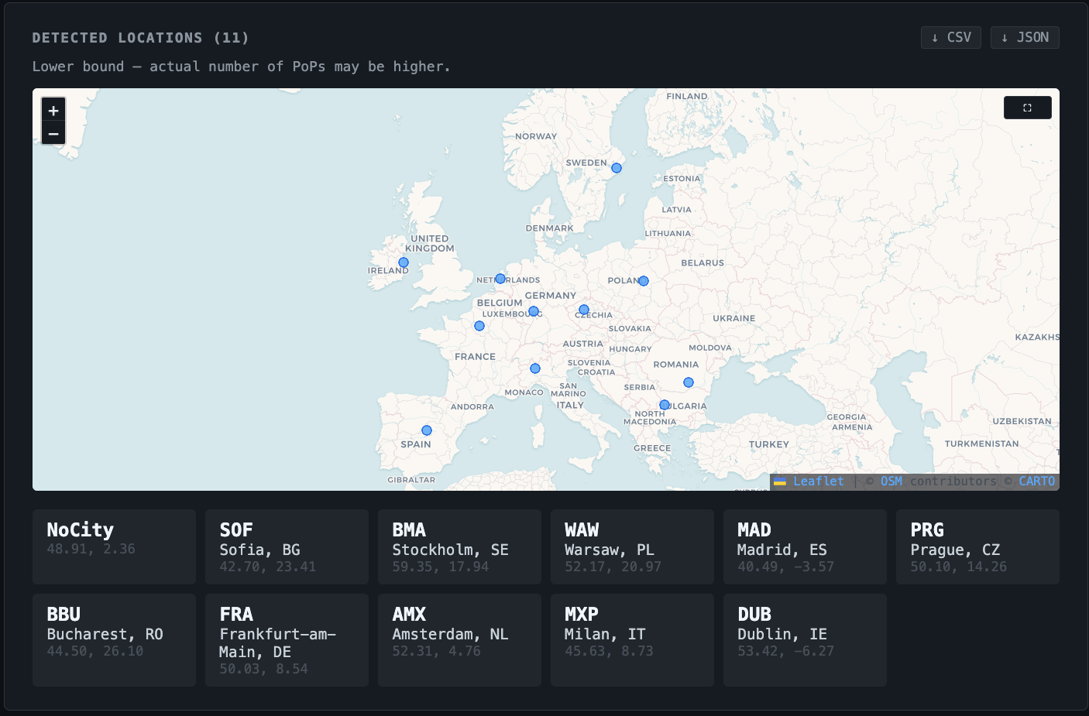
Introduction Anycast and the DNS
Anycast is widely used
Over 1,000 ASes deploy anycast
63% of these run anycast DNS services
DNS anycast deployments
All root letters
Auth NS (e.g., ccTLDs)
Second-level NS
Resolvers
02/19
Source: https://manycast.net/?q=86.54.11.1
“Example: DNS4EU public DNS resolver locations”
Notes:
Anycast is the practice of making an IP address available in multiple locations This is achieved by announcing a single IP prefix at each location using BGP
The main motivation is that it allows for load-distribution, improved resiliency, and it reduces latency

Slide 12
Introduction Problem Statement
Anycast relies on BGP to route clients
But.. BGP routes based on shortest path -> not performance
Transits may perform cold-potato routing toward distant PoPs
Remote-peering at IXPs can route client sub-optimally
03/19
Notes:
And Anycast is widely used
Critical internet infrastructure uses it, like the DNS
On the bottom right here you see the root letter deployments that combined have 2,000 sites
Another example are content delivery networks

Slide 13
Introduction Problem Statement
Anycast relies on BGP to route clients
But.. BGP routes based on shortest path -> not performance
Case A) Client routes to a distant PoP
03/19
Notes:
And Anycast is widely used
Critical internet infrastructure uses it, like the DNS
On the bottom right here you see the root letter deployments that combined have 2,000 sites
Another example are content delivery networks

Slide 14
Introduction Problem Statement
Anycast relies on BGP to route clients
But.. BGP routes based on shortest path -> not performance
Case B) Client routes to a nearby PoP, with a long/slow path
E.g., boomerang routing
03/19
Notes:
And Anycast is widely used
Critical internet infrastructure uses it, like the DNS
On the bottom right here you see the root letter deployments that combined have 2,000 sites
Another example are content delivery networks

Slide 15
Introduction Motivation
Anycast routing can be sub-optimal
Clients reaching distant PoPs
High latencies, long paths
Poor load distribution amongst PoPs
Performance metrics help with
Infrastructure (expansion) planning
Making traffic engineering decisions
But how to get these metrics?
04/19
Notes:
So as mentioned. Sub-optimal anycast routing hurts performance
Furthermore, the networks experiencing such behavior may change over time as Internet routing is dynamic
For this reason, anycast operators would need active traffic engineering to solve these cases
And to make traffic engineering decisions, performance metrics are needed

Slide 16
Monitoring DNS routing
Option 1) Passive DNS traffic analysis
Pros:
Data already available
No burden of active measurements
High coverage (all existing clients)
Cons:
Cannot prevent issues pro-actively
RTT unknown
*Can be inferred from DNS over TCP traffic (requires random truncation)
Not available when strategizing new PoP placements
05/19
Notes:
There is three main options to obtain these metrics
The first is with passive traffic analysis. But then you see problems when they happen, and you cannot pro-actively prevent them
Furthermore, if you run DNS over UDP you gain no metrics on the RTT that clients experience

Slide 17
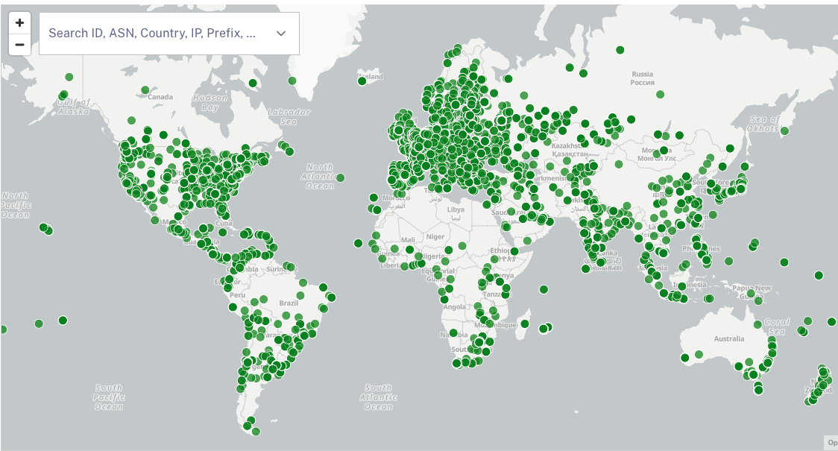
Monitoring DNS routing
Option 2) Probing platforms
Pros:
Can measure on-demand
E.g., to measure effects of traffic changes
RTTs available
Does not require user traffic
Experimental deployments/prefixes
Cons:
Rate-limiting restrictions
Often credit costs involved
Limited coverage
05/19
RIPE Atlas probe locations
Notes:
Next, you can use a probing platform like RIPE Atlas
But these platforms have a limited number of probes you can use
And there are restrictions in place as it is a shared platform.

Slide 18
Monitoring DNS routing
Option 3) Probing responsive hosts with anycast source IP
05/19
Notes:
The third option is to do active probing using your anycast source IP, which I will discuss more

Slide 19
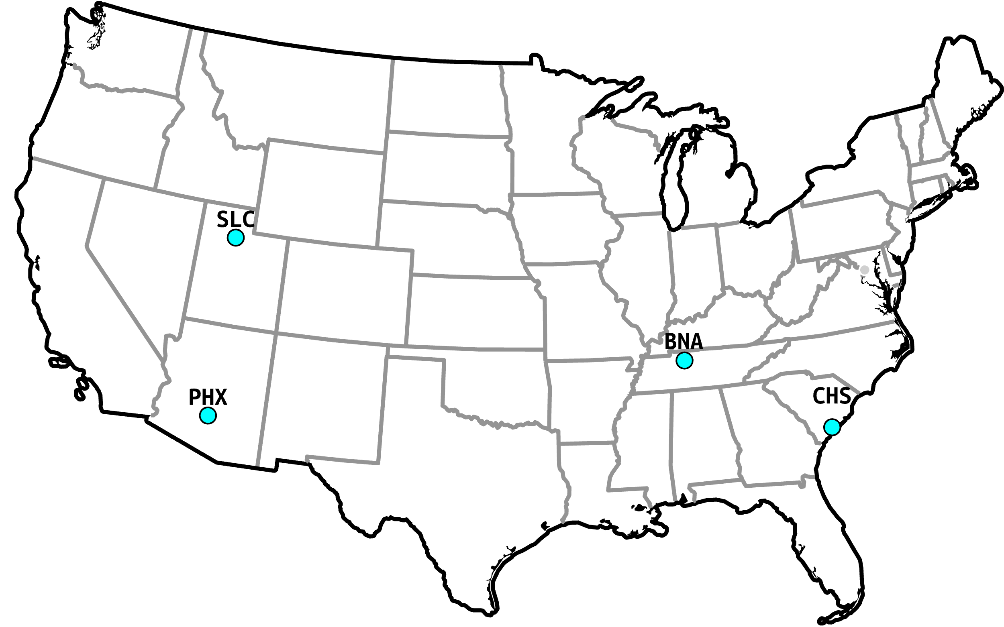
Previous work Verfploeter
Verfploeter maps anycast catchments [1]
I.e., which anycast site ‘catches’ which traffic
How?
Ping host with anycast source IP
See where the ping reply comes back
06/19
[1] https://dl.acm.org/doi/10.1145/3131365.3131371
Notes:
So our tooling builds on Verfploeter
Which allows operators to map anycast catchments
A catchment is a mapping of a client to the anycast site that ‘catches’ its traffic
This is achieved by sending a ping with an anycast source IP and see where the reply comes back
In this figure the light blue dots are the anycast deployment being measured

Slide 20
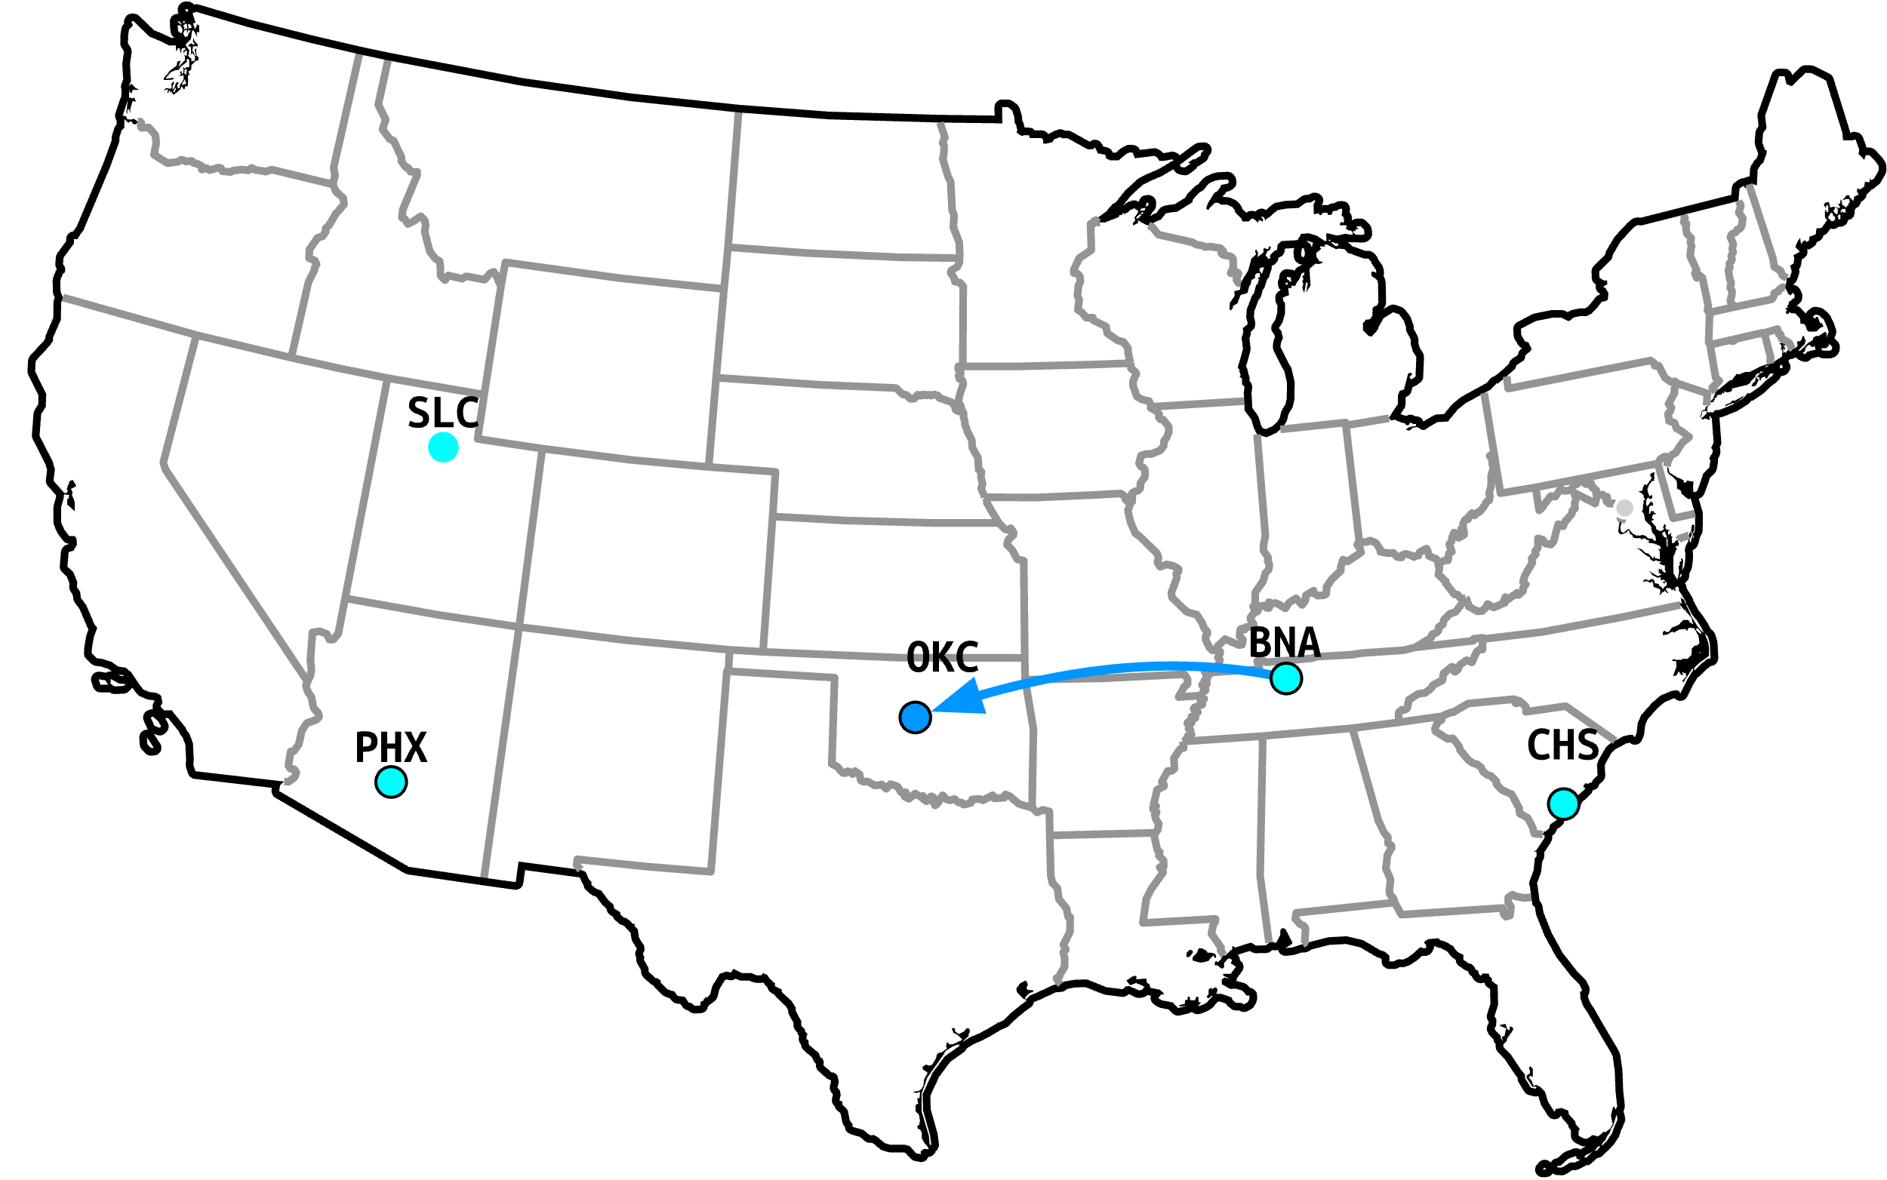
Previous work Verfploeter
Verfploeter maps anycast catchments [1]
I.e., which anycast site ‘catches’ which traffic
How?
Ping host with anycast source IP
See where the ping reply comes back
06/19
[1] https://dl.acm.org/doi/10.1145/3131365.3131371
Notes:
So you send a ping from the anycast deployment to this client

Slide 21
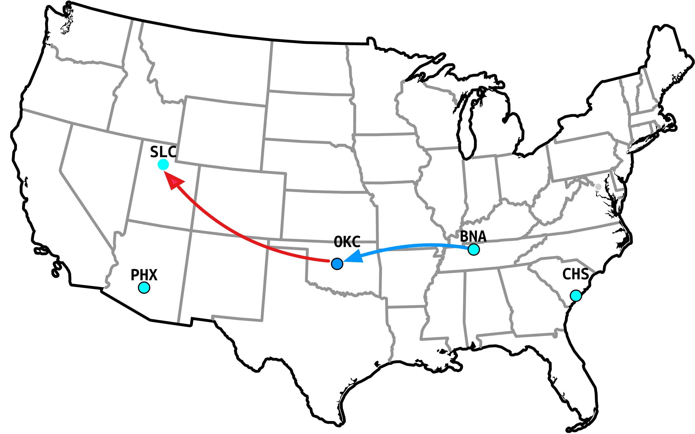
Previous work Verfploeter
Verfploeter maps anycast catchments [1]
I.e., which anycast site ‘catches’ which traffic
How?
Ping host with anycast source IP
See where the ping reply comes back
06/19
[1] https://dl.acm.org/doi/10.1145/3131365.3131371
Notes:
Then you see where its reply ends up
In this case the client located in Oklahoma city routes to the anycast site in Salt Lake City

Slide 22
Previous work Verfploeter
Verfploeter maps anycast catchments [1]
I.e., which anycast site ‘catches’ which traffic
How?
Ping host with anycast source IP
See where the ping reply comes back
Advantages
Covers 4 million /24s with ICMP responsive hosts
70k+ ASes
Can measure pro-actively / on-demand
Experimental prefixes, traffic changes, …
Disadvantages
Cannot measure RTTs
Not always clear what is the ‘optimal’ site
Nearby catchment does not guarantee a good path
Boomerang routing
06/19
[1] https://dl.acm.org/doi/10.1145/3131365.3131371
Notes:
Verfploeter allows operators to map a large number of hosts as there are many ping responsive hosts on the Internet
And it allows operators to measure proactively
But the problems are that it cannot measure RTT
It does not know what the optimal site would be; so in this case it is unclear which of the four locations would be best for this client
And finally, catchment can be deceiving if you think back about the long path through New York

Slide 23





Our open-source tooling
Builds on the anycast probing method
Designed as a ‘Swiss knife’
Large variety of supported measurements
Low resource usage
8 MB static binary or docker image
Supports TCP (SYNACK) and UDP
Increases coverage by 10%+
Measure catchments using multiple protocols
Supports IPv6
07/19
Notes:
To answer these concerns we built an improved Verfploeter that also allows for measuring the anycast RTT
And perform unicast probing to infer the optimal site
There is many types of measurements possible, which I will not go over due to time
It has a low resource usage
And it has a very small image size

Slide 24
Use cases Anycast RTT
Probe 1: assess catchment (discovery probe)
Probe 2: probe from catcher (measurement probe)
RTT = receive time – transmit time
8/19
Notes:
So the first features is measuring anycast RTT
Where you first send a discovery probe to see in which catchment the client resides

Slide 25
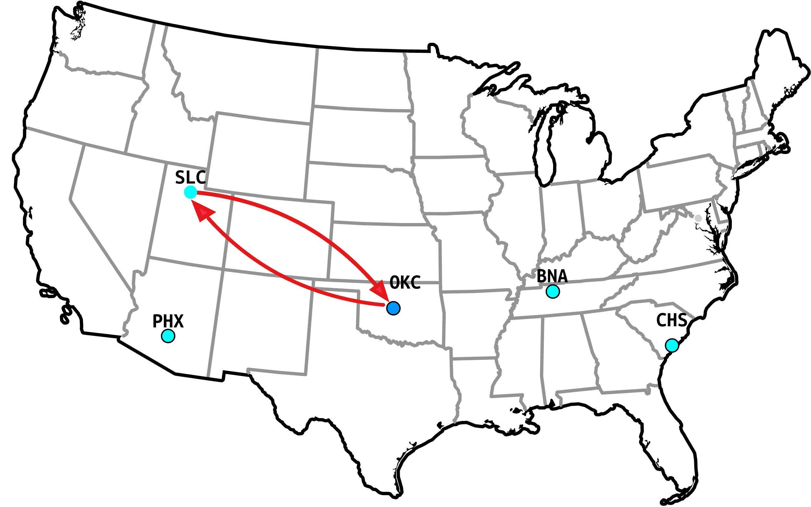
Use cases Anycast RTT
Probe 1: assess catchment (discovery probe)
Probe 2: probe from catcher (measurement probe)
RTT = receive time – transmit time
8/19
Notes:
Then you send a second ping from the catcher, and you can measure the RTT just like regular unicast ping

Slide 26
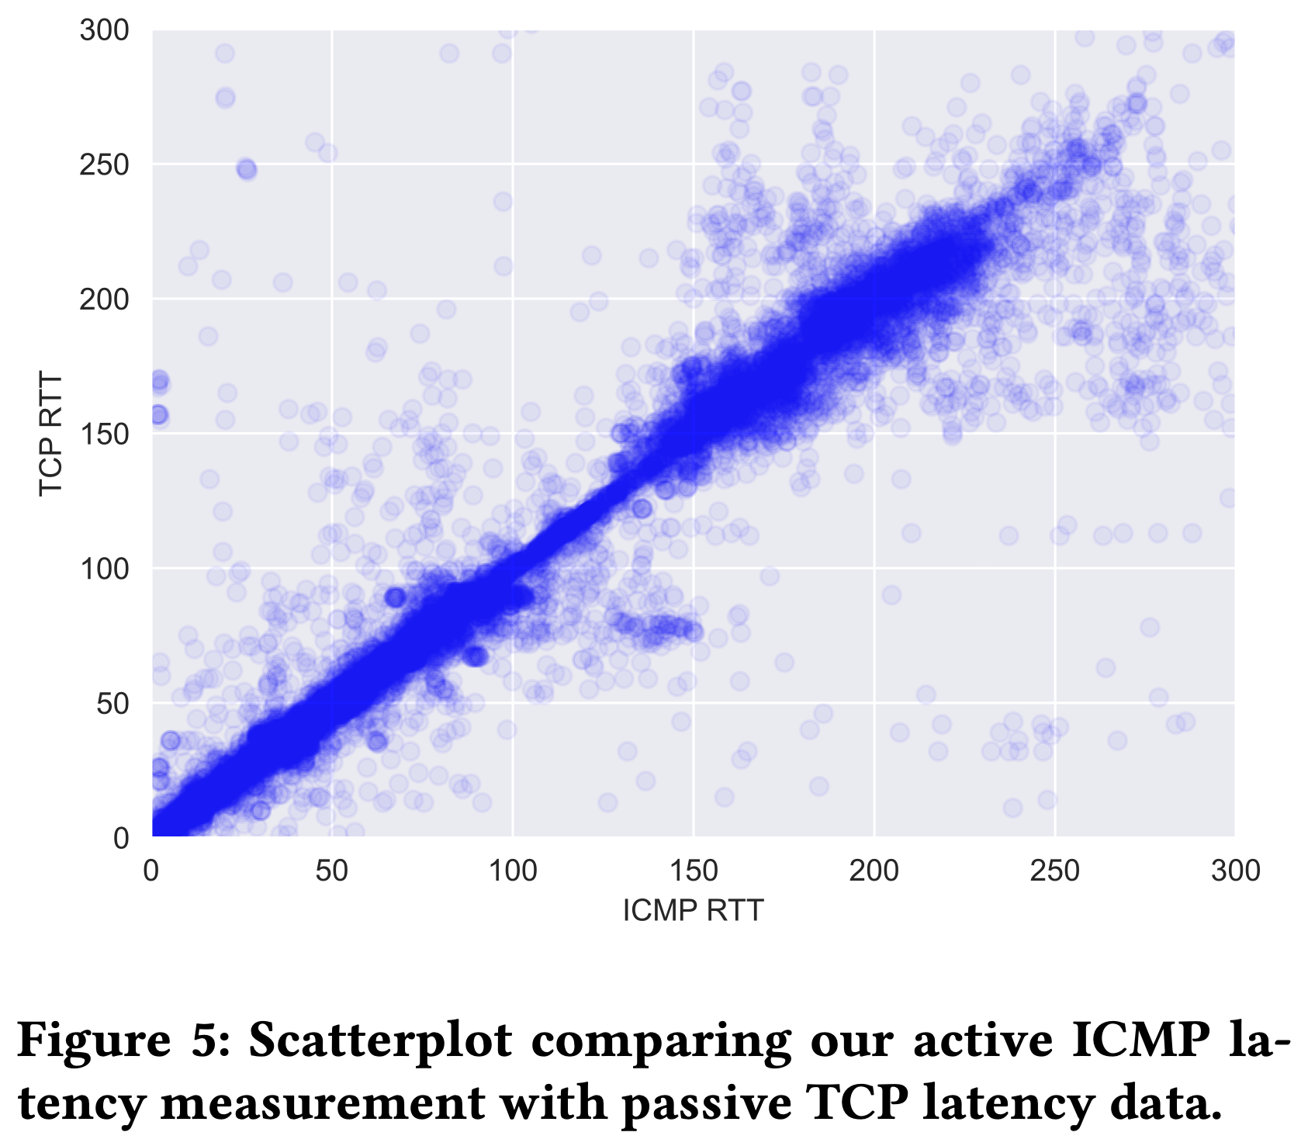
Validating Anycast RTTs
Data from SIDN
Tooling measures anycast RTTs (x-axis)
TCP handshake latencies (y-axis)
From DNS over TCP queries
Takeaways
Strong correlation
Measured RTTs are good indicators of performance
RTTs mostly protocol agnostic
Similar for both TCP and ICMP
9/19
Notes:
The tooling supports ping, TCP, and UDP probing and both IPv4 and Ipv6
We also implement a divide-and-conquer style measurement to do quick catchment measurements
We allow for measuring multiple prefixes simultaenously, such that you can do a side-by-side comparison.
For example you can duplicate an announcement, and then withdraw a site or add a site in the duplicate. And then compare what effects the change has on the catchments but also on the overall RTT
And much more

Slide 27
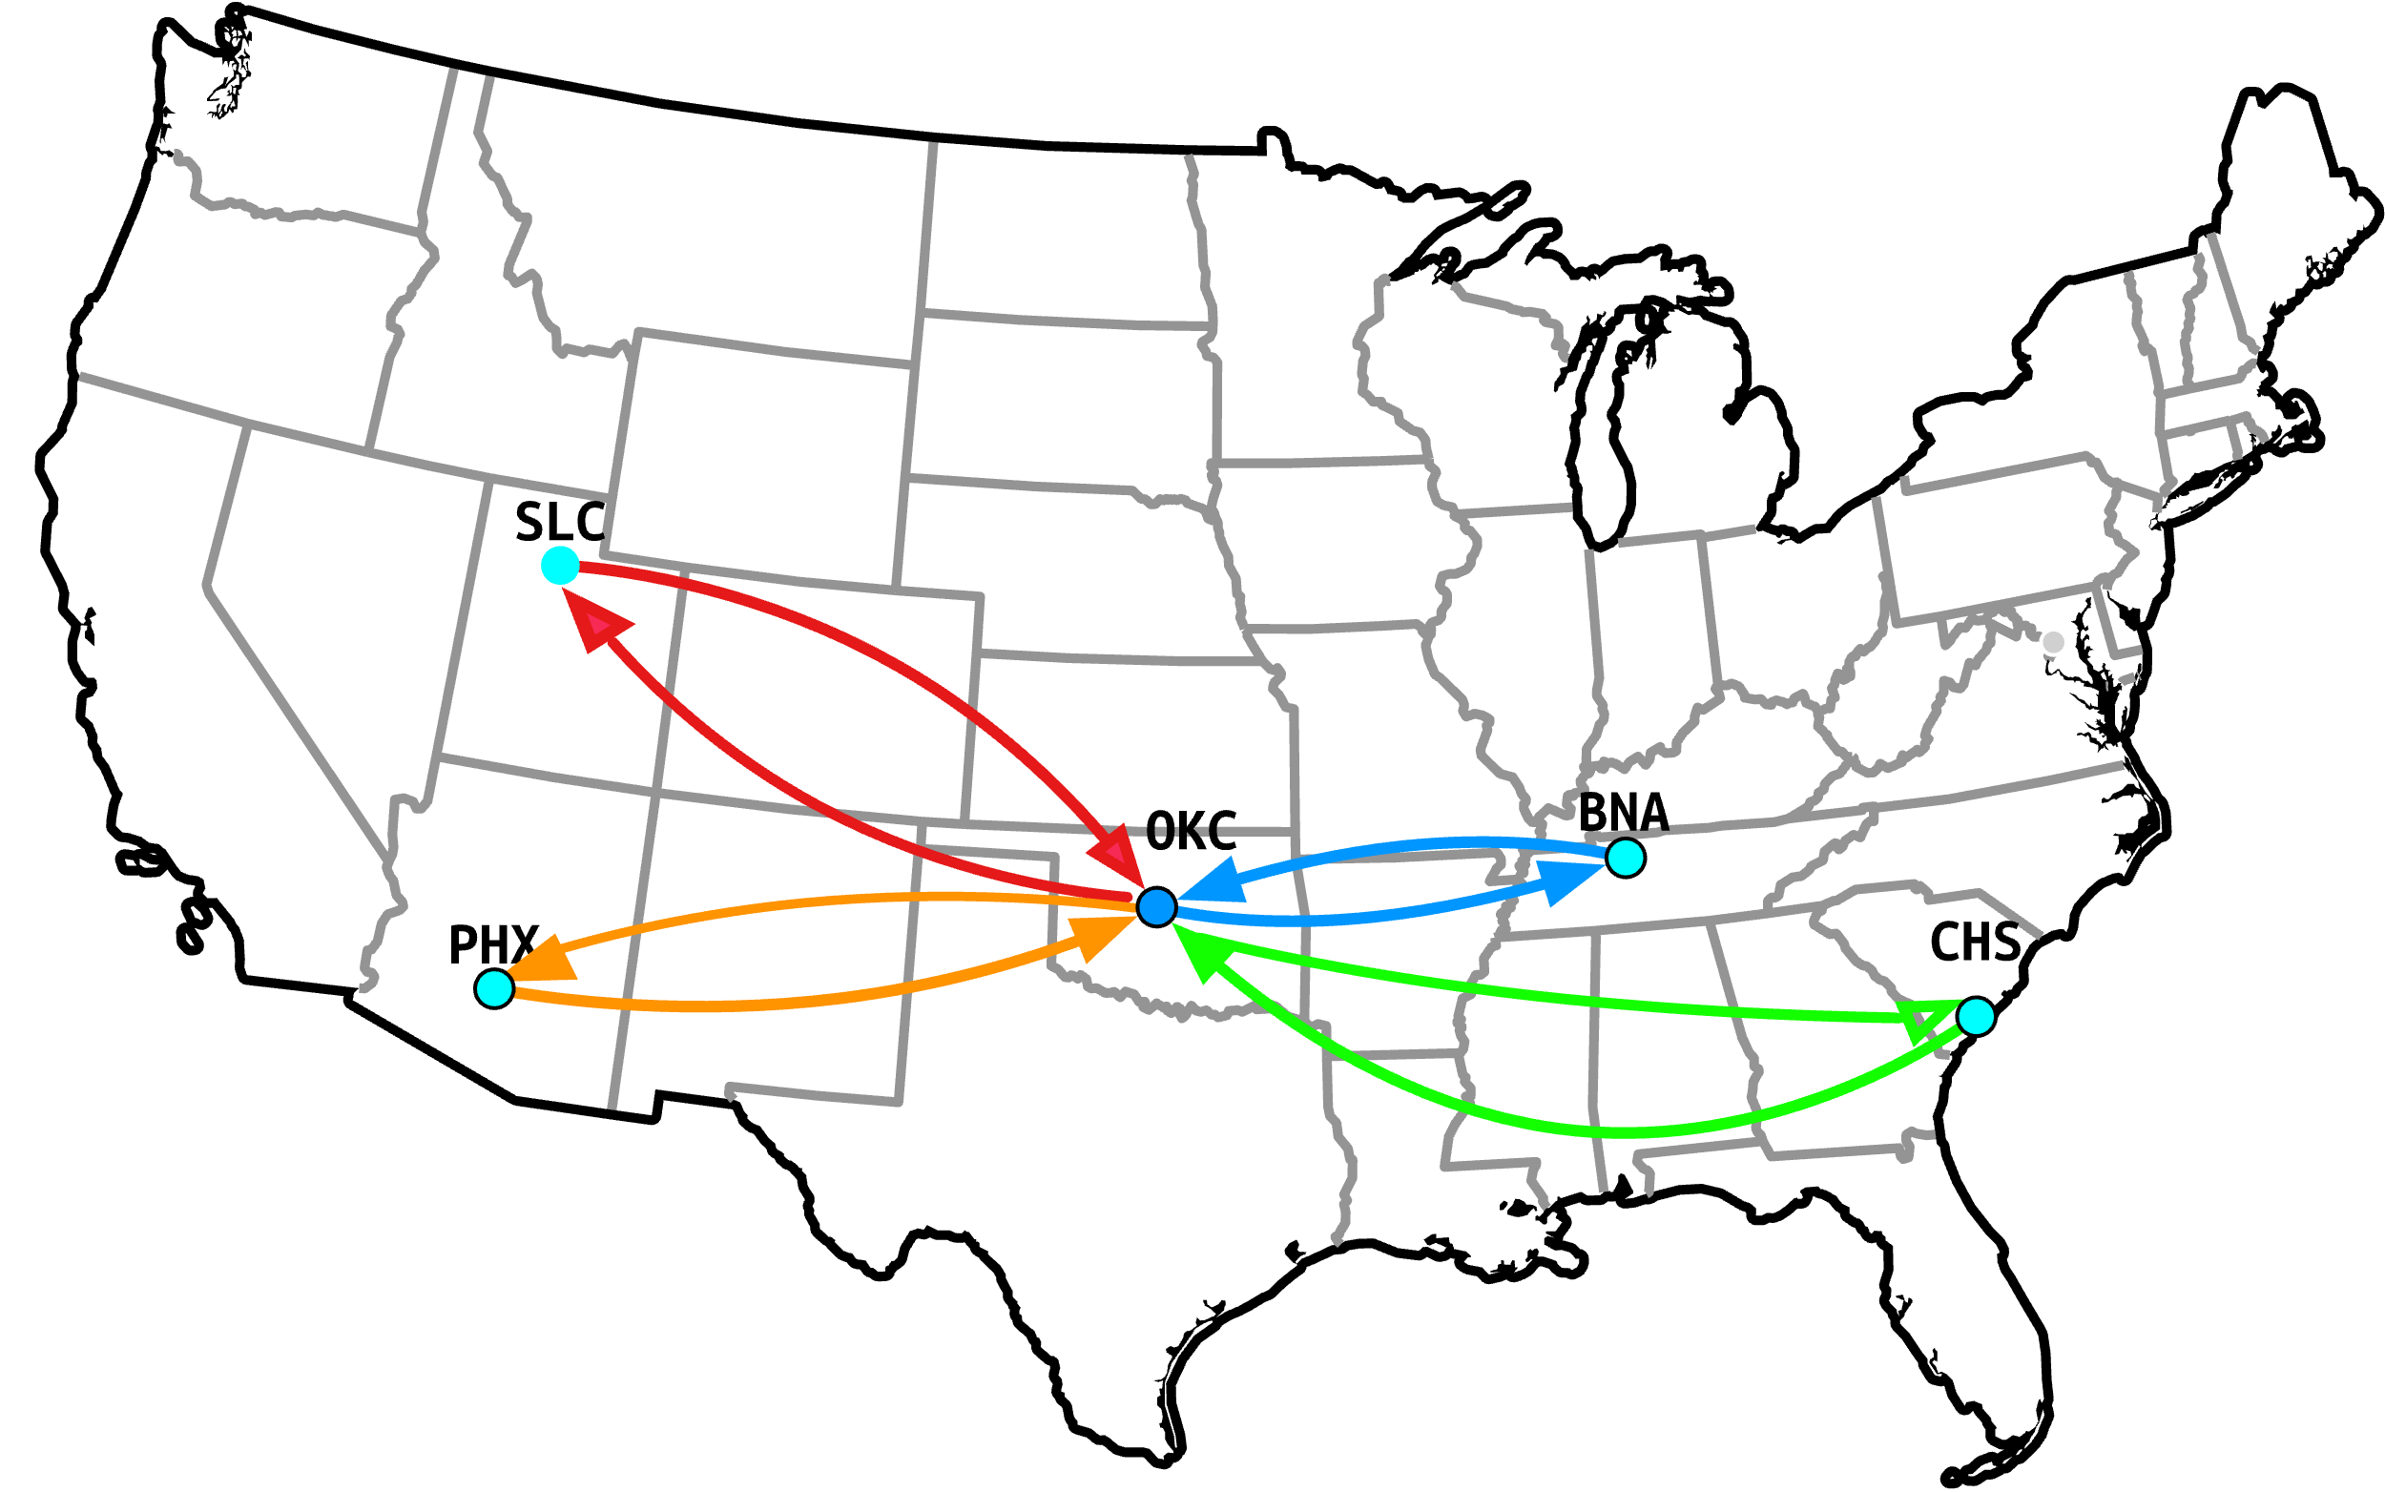
Use cases Inferring optimal Routing
Probe target from all VPs using unicast IPs
Measures RTT with all possible sites
Site with lowest RTT -> ‘optimal’ site
10/19
Notes:
The second main feature is measuring optimal routing
This is achieved by probing the client from all anycast sites using their unicast IPs
This gives the RTT that the client has to each individual anycast site

Slide 28
Use cases Inferring optimal Routing
Probe target from all VPs using unicast IPs
Measures RTT with all possible sites
Site with lowest RTT -> ‘optimal’ site
Allows for:
Identifying best site
Quantifying possible RTT improvement
10/19
Notes:
Knowing these RTTs allows you to know what the best anycast site would be
And also quantifying the possible improvement that can be gained by directing the client towards the nearest site

Slide 29
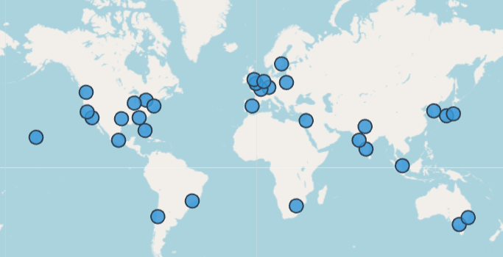
Results
Measurement results for our anycast testbed
Deployed with Vultr (32 PoPs)
Results meant to showcase the usefulness of the tooling
Representative for those that anycast their DNS using Vultr
11/19
Notes:
Knowing these RTTs allows you to know what the best anycast site would be
And also quantifying the possible improvement that can be gained by directing the client towards the nearest site

Slide 30
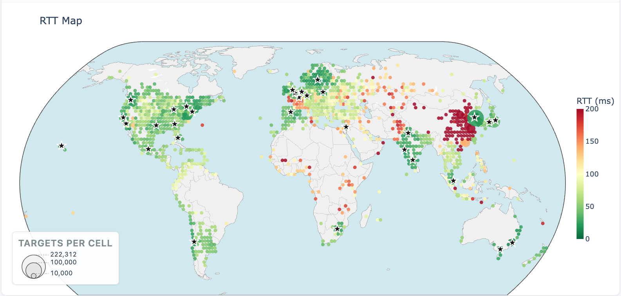
RTTs
Latencies experienced by networks connecting to Vultr
12/19
Notes:
The tooling supports ping, TCP, and UDP probing and both IPv4 and Ipv6
We also implement a divide-and-conquer style measurement to do quick catchment measurements
We allow for measuring multiple prefixes simultaenously, such that you can do a side-by-side comparison.
For example you can duplicate an announcement, and then withdraw a site or add a site in the duplicate. And then compare what effects the change has on the catchments but also on the overall RTT
And much more

Slide 31
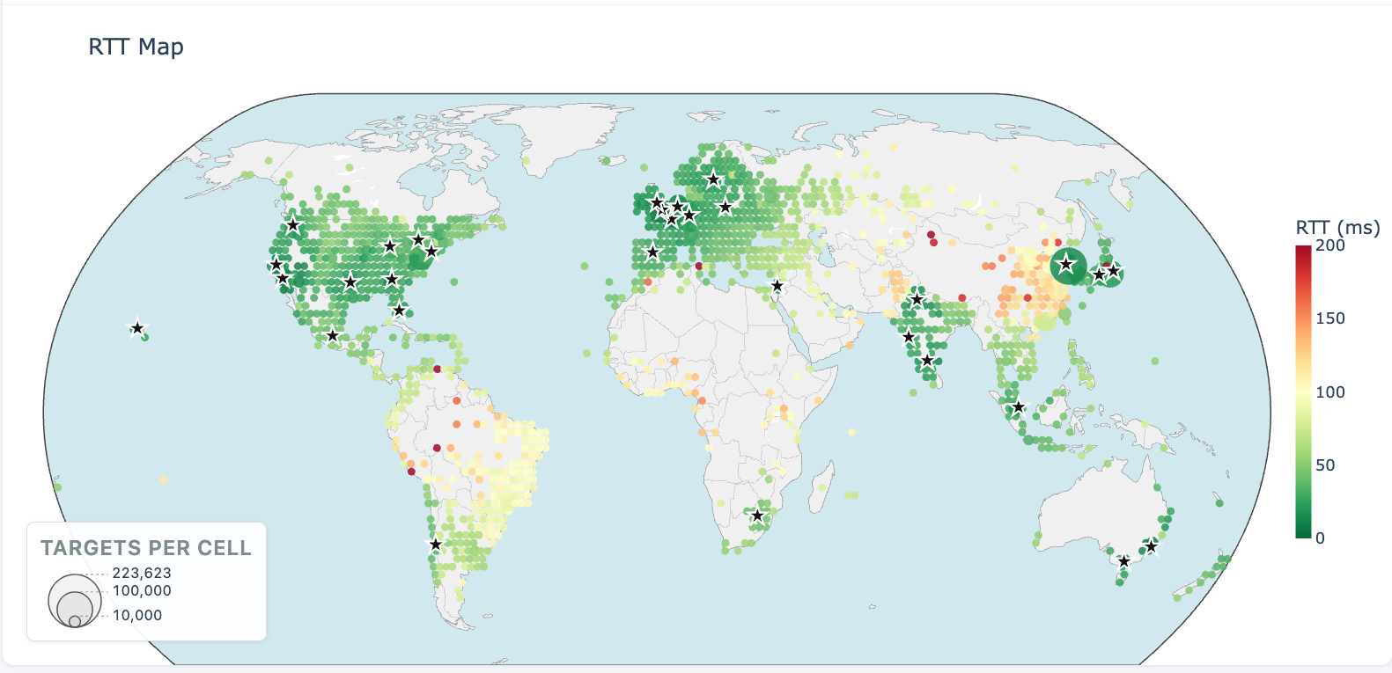
RTTs
Optimal latencies for networks towards Vultr
12/19
Notes:
The tooling supports ping, TCP, and UDP probing and both IPv4 and Ipv6
We also implement a divide-and-conquer style measurement to do quick catchment measurements
We allow for measuring multiple prefixes simultaenously, such that you can do a side-by-side comparison.
For example you can duplicate an announcement, and then withdraw a site or add a site in the duplicate. And then compare what effects the change has on the catchments but also on the overall RTT
And much more

Slide 32
RTTs
Optimal latencies for networks towards Vultr
Takeaways:
Latencies shows who routes good, who routes bad
Optimal latencies show who ‘could’ route good -> TE needed
And who ‘cannot’ route good -> PoP placement needed
12/19
Notes:
The tooling supports ping, TCP, and UDP probing and both IPv4 and Ipv6
We also implement a divide-and-conquer style measurement to do quick catchment measurements
We allow for measuring multiple prefixes simultaenously, such that you can do a side-by-side comparison.
For example you can duplicate an announcement, and then withdraw a site or add a site in the duplicate. And then compare what effects the change has on the catchments but also on the overall RTT
And much more

Slide 33
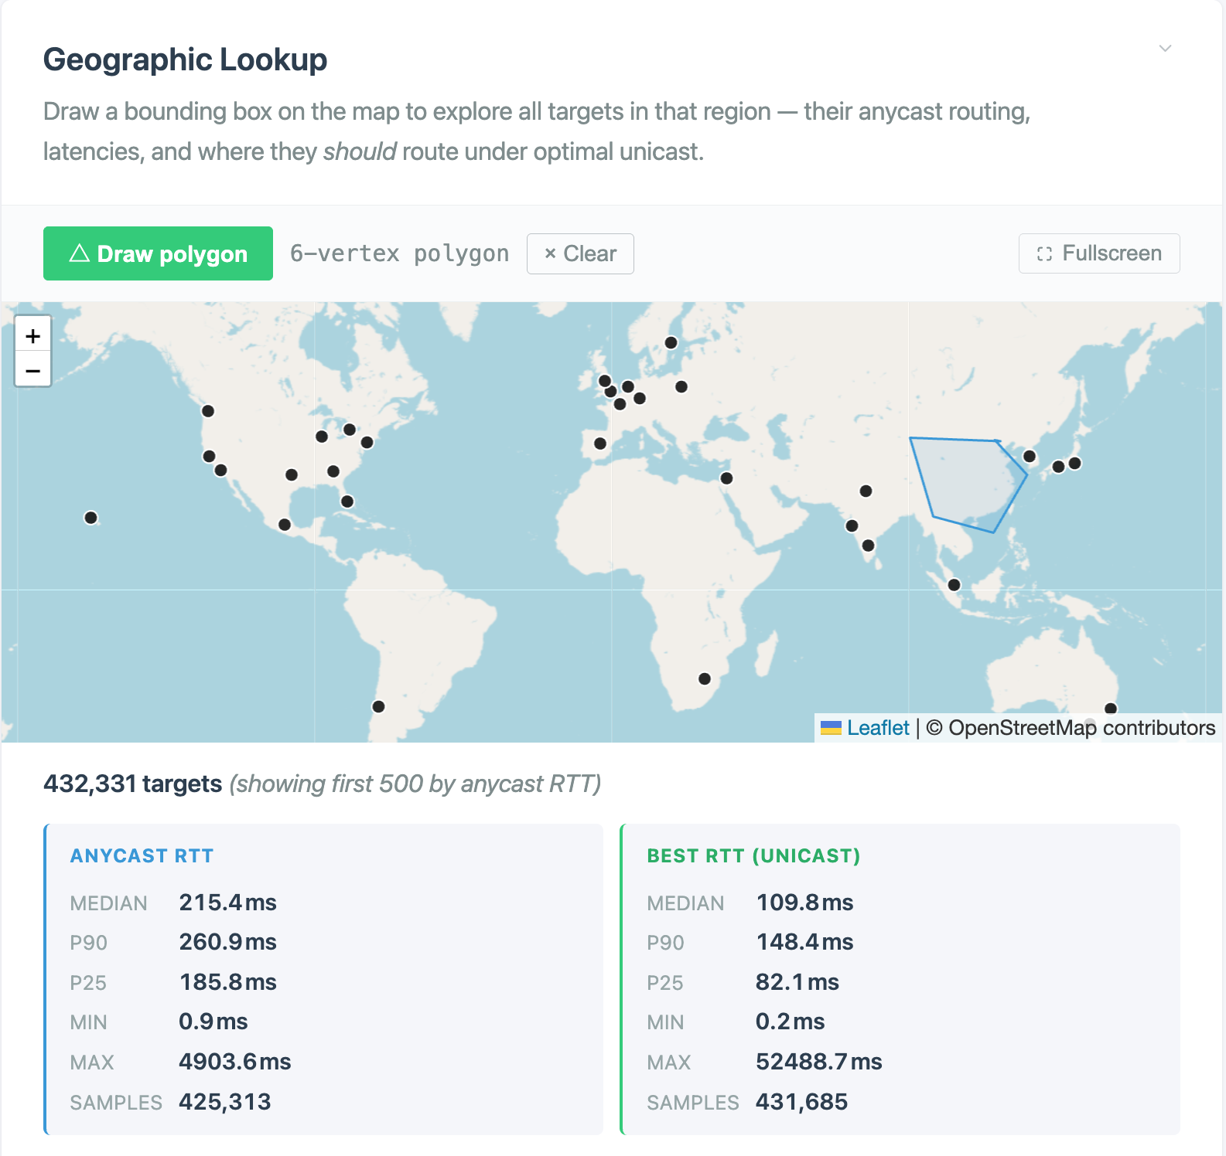
Quantifying Improvement
Zooming in on China
Horrible median RTT (215)
Optimal can lower it to 110
Still bad however..
If you anycast using Vultr
Expect poor connectivity with China
13/19
Notes:
The tooling supports ping, TCP, and UDP probing and both IPv4 and Ipv6
We also implement a divide-and-conquer style measurement to do quick catchment measurements
We allow for measuring multiple prefixes simultaenously, such that you can do a side-by-side comparison.
For example you can duplicate an announcement, and then withdraw a site or add a site in the duplicate. And then compare what effects the change has on the catchments but also on the overall RTT
And much more

Slide 34
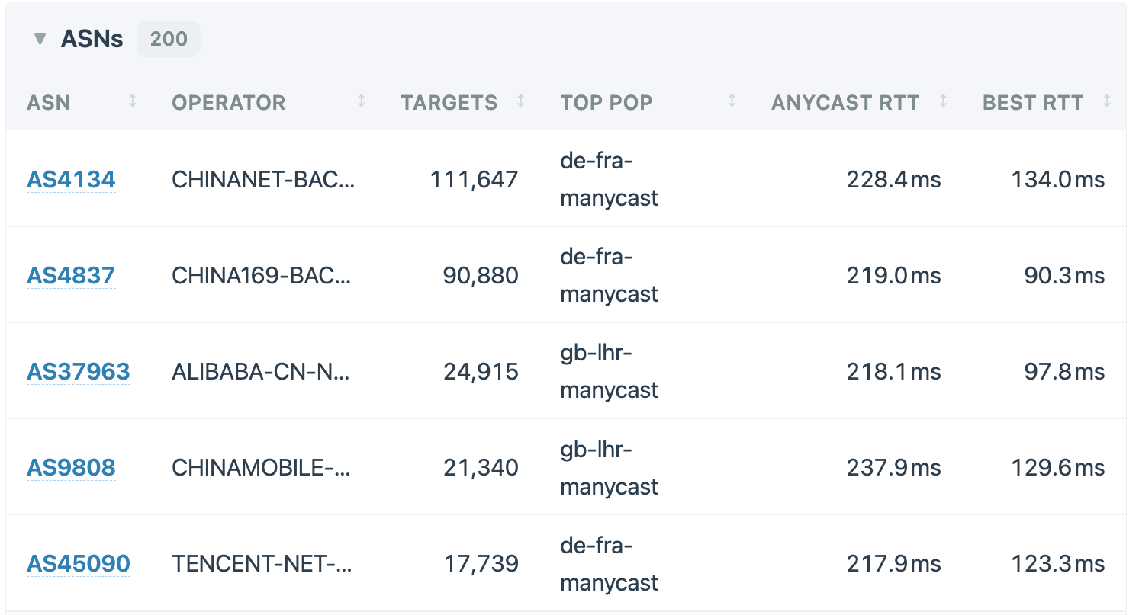
Quantifying Improvement
Zooming in on China
Horrible median RTT (215)
Optimal can lower it to 110
Still bad however..
13/19
Notes:
The tooling supports ping, TCP, and UDP probing and both IPv4 and Ipv6
We also implement a divide-and-conquer style measurement to do quick catchment measurements
We allow for measuring multiple prefixes simultaenously, such that you can do a side-by-side comparison.
For example you can duplicate an announcement, and then withdraw a site or add a site in the duplicate. And then compare what effects the change has on the catchments but also on the overall RTT
And much more

Slide 35
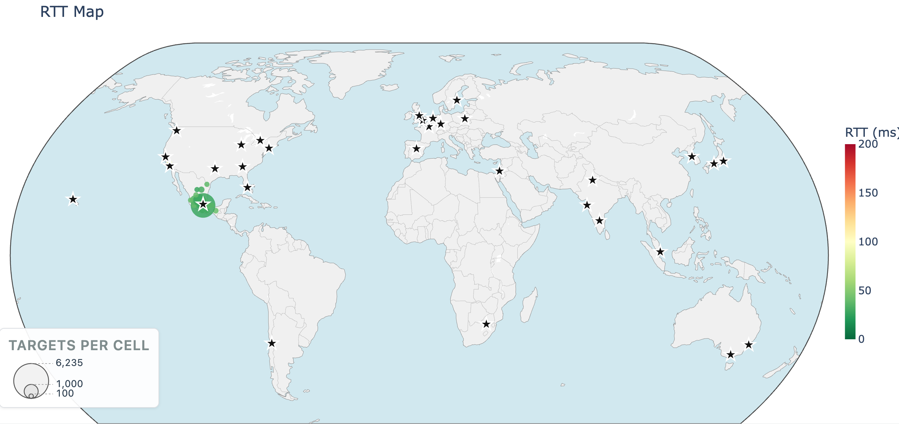
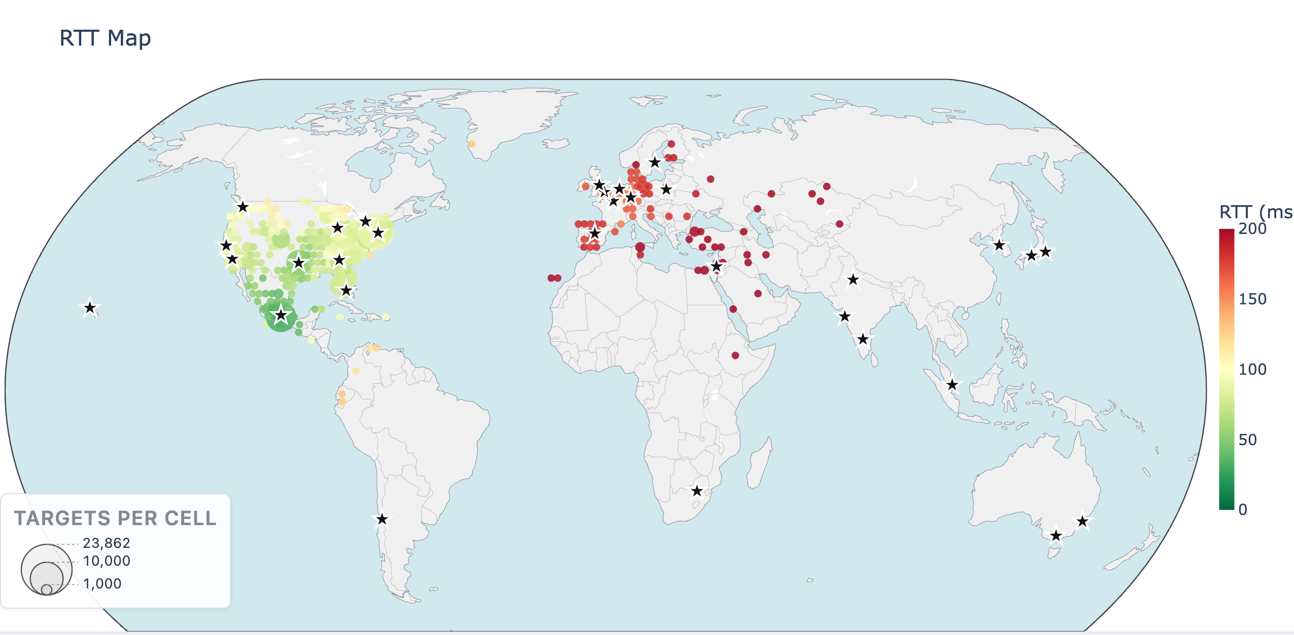
RTTs mx-mex
Actual (left) and optimal (right) RTTs for our second-largest PoP by catchment
RTTs are optimal for Mexican networks
But south US networks have good RTTs
RTT gain probably not worth the traffic engineering
14/19
Notes:
The tooling supports ping, TCP, and UDP probing and both IPv4 and Ipv6
We also implement a divide-and-conquer style measurement to do quick catchment measurements
We allow for measuring multiple prefixes simultaenously, such that you can do a side-by-side comparison.
For example you can duplicate an announcement, and then withdraw a site or add a site in the duplicate. And then compare what effects the change has on the catchments but also on the overall RTT
And much more

Slide 36
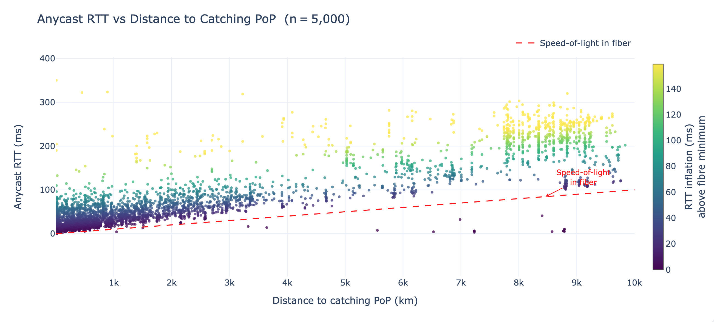
RTT against Catchment
Measured anycast RTTs (y-axes)
Distance from catching PoP (x-axis)
Using IPInfo
15/19
Notes:
The tooling supports ping, TCP, and UDP probing and both IPv4 and Ipv6
We also implement a divide-and-conquer style measurement to do quick catchment measurements
We allow for measuring multiple prefixes simultaenously, such that you can do a side-by-side comparison.
For example you can duplicate an announcement, and then withdraw a site or add a site in the duplicate. And then compare what effects the change has on the catchments but also on the overall RTT
And much more

Slide 37
RTT against Catchment
Measured anycast RTTs (y-axes)
Distance from catching PoP (x-axis)
Using IPInfo
Takeaways
Catchments can be misleading
Catchment inferred distance =/= path length
E.g., boomerang routes
RTT is a better indicator of performance
Accounts for congested links
Accounts for long paths (to nearby targets)
15/19
Notes:
The tooling supports ping, TCP, and UDP probing and both IPv4 and Ipv6
We also implement a divide-and-conquer style measurement to do quick catchment measurements
We allow for measuring multiple prefixes simultaenously, such that you can do a side-by-side comparison.
For example you can duplicate an announcement, and then withdraw a site or add a site in the duplicate. And then compare what effects the change has on the catchments but also on the overall RTT
And much more

Slide 38
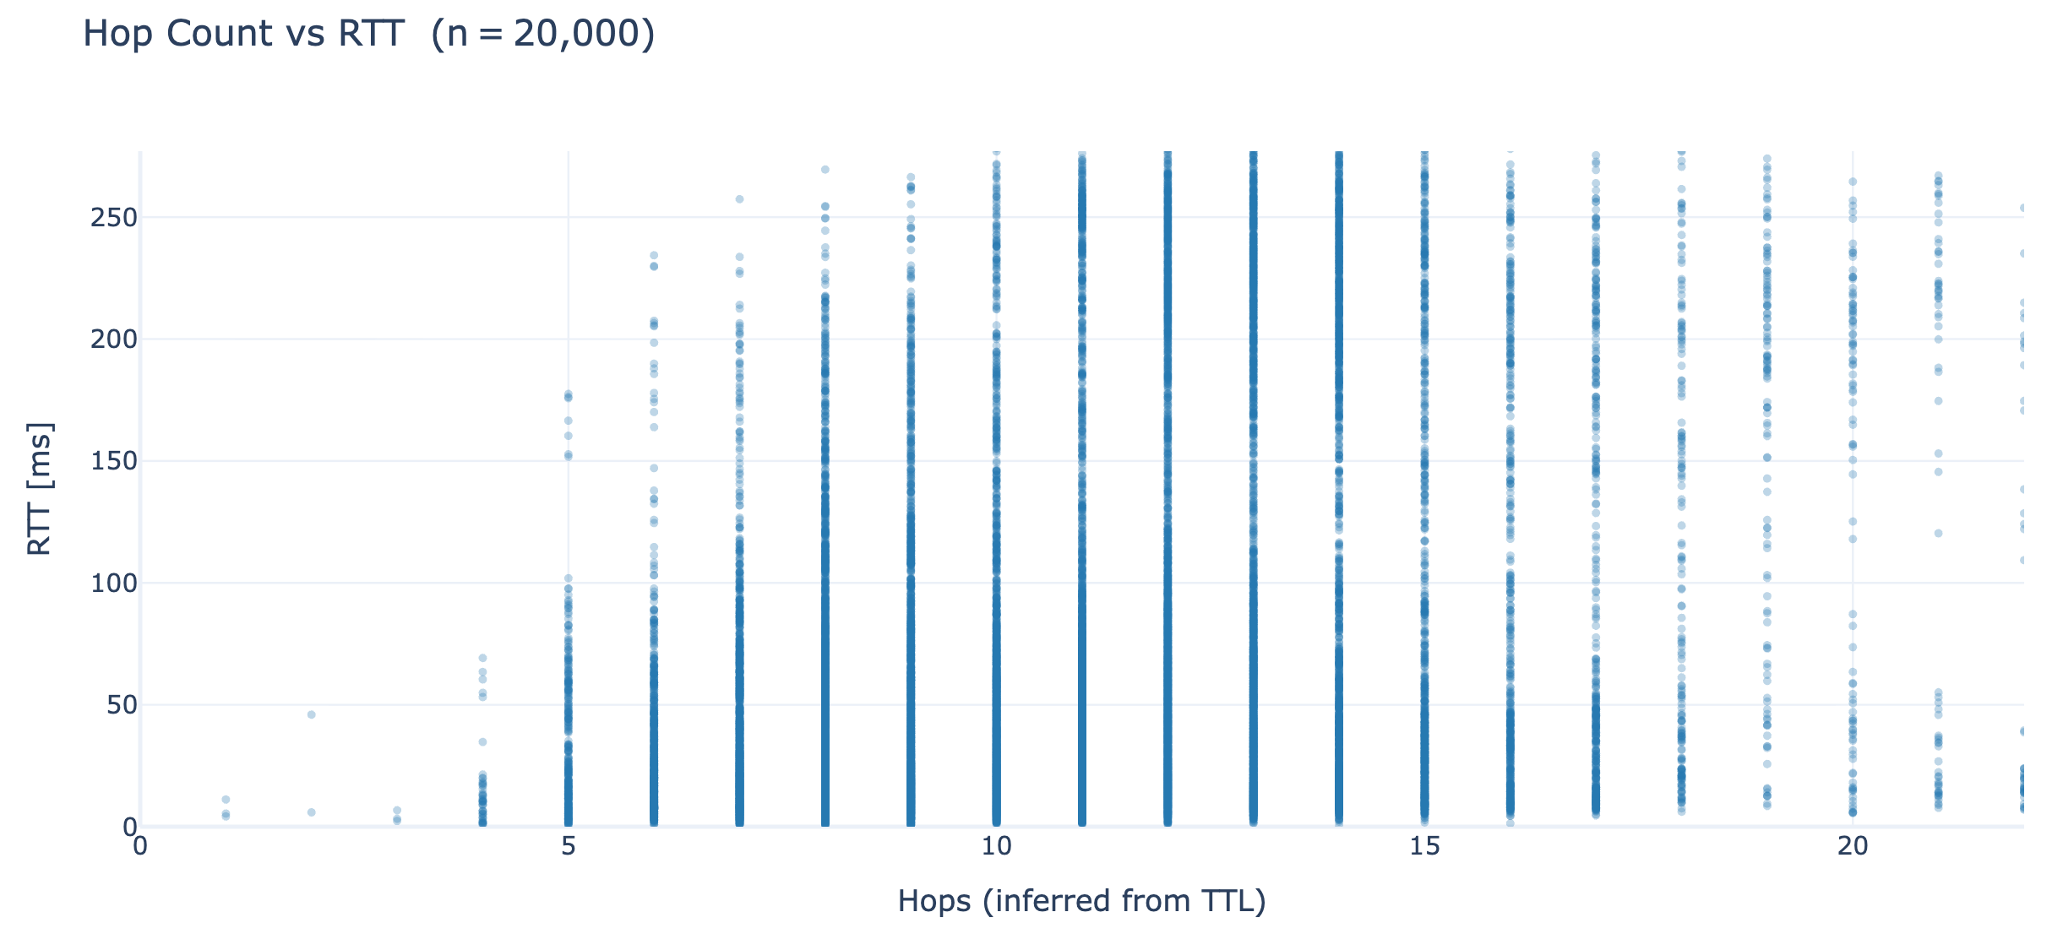
TTL as performance indicator
16/19
Notes:
The tooling supports ping, TCP, and UDP probing and both IPv4 and Ipv6
We also implement a divide-and-conquer style measurement to do quick catchment measurements
We allow for measuring multiple prefixes simultaenously, such that you can do a side-by-side comparison.
For example you can duplicate an announcement, and then withdraw a site or add a site in the duplicate. And then compare what effects the change has on the catchments but also on the overall RTT
And much more

Slide 39
TTL as performance indicator
TTL is a poor indicator of performance
E.g., tunneling (single hop -> large distance & RTT inflation)
If you optimize your DNS deployment for TTL
This will not improve performance for clients
Tooling gives better metrics
RTTs and catchments
16/19
Notes:
The tooling supports ping, TCP, and UDP probing and both IPv4 and Ipv6
We also implement a divide-and-conquer style measurement to do quick catchment measurements
We allow for measuring multiple prefixes simultaenously, such that you can do a side-by-side comparison.
For example you can duplicate an announcement, and then withdraw a site or add a site in the duplicate. And then compare what effects the change has on the catchments but also on the overall RTT
And much more

Slide 40
Other improvements
Anycast traceroute
Time exceeded replies can map additional networks
Helps with troubleshooting suboptimal paths
Measure networks experiencing anycast site flipping
17/19

Slide 41
Conclusion
We built MAnycastR (publicly available at github.com/rhendriks/MAnycastR)
Originally designed for research purposes
Anycast census
Showcases highlight its operational value
Catchment and latency mappings
Can help with TE decisions
And with PoP placement strategizing
Tooling might be helpful in attack mitigation
Measure traffic redirection results after applying them in production
18/19
Notes:
The tooling supports ping, TCP, and UDP probing and both IPv4 and Ipv6
We also implement a divide-and-conquer style measurement to do quick catchment measurements
We allow for measuring multiple prefixes simultaenously, such that you can do a side-by-side comparison.
For example you can duplicate an announcement, and then withdraw a site or add a site in the duplicate. And then compare what effects the change has on the catchments but also on the overall RTT
And much more

Slide 42
Q&A / Discussion
What do you (DNS operators) care about?
Does RTT matter for DNS anycast?
Do you optimize for short paths?
Is load-distribution more important?
Does this tooling help with realizing these goals?
What requirements do you have for using it?
What features would you like to see?
We are open to feedback from the community
Interested in active collaborations
Especially for measuring anycast routing in developing regions
Contact: remi.hendriks@utwente.nl
19/19
Notes:
The tooling supports ping, TCP, and UDP probing and both IPv4 and Ipv6
We also implement a divide-and-conquer style measurement to do quick catchment measurements
We allow for measuring multiple prefixes simultaenously, such that you can do a side-by-side comparison.
For example you can duplicate an announcement, and then withdraw a site or add a site in the duplicate. And then compare what effects the change has on the catchments but also on the overall RTT
And much more

Slide 44
Appendix slides
17/17
Notes:
The tooling supports ping, TCP, and UDP probing and both IPv4 and Ipv6
We also implement a divide-and-conquer style measurement to do quick catchment measurements
We allow for measuring multiple prefixes simultaenously, such that you can do a side-by-side comparison.
For example you can duplicate an announcement, and then withdraw a site or add a site in the duplicate. And then compare what effects the change has on the catchments but also on the overall RTT
And much more

Slide 45
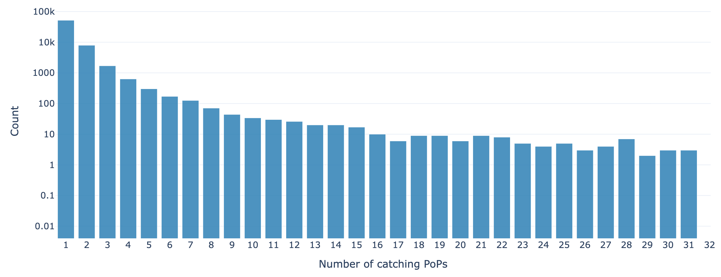
Catchment Analysis
Grouping catchments by ASN / announced BGP prefix
Most ASes/prefixes route consistently to the same PoP
Long tail -> ASes with private backbone / global presence
10/17
Notes:
The tooling supports ping, TCP, and UDP probing and both IPv4 and Ipv6
We also implement a divide-and-conquer style measurement to do quick catchment measurements
We allow for measuring multiple prefixes simultaenously, such that you can do a side-by-side comparison.
For example you can duplicate an announcement, and then withdraw a site or add a site in the duplicate. And then compare what effects the change has on the catchments but also on the overall RTT
And much more

Slide 46
Catchment Analysis
Grouping catchments by ASN / announced BGP prefix
Most ASes/prefixes route consistently to the same PoP
Long tail -> ASes with private backbone / global presence
Takeaway
82% of ASes have homogenous routing properties (same catchment for all networks)
18% require multiple TE decisions
Long tail (CDNs)
Recommendation
DNS operators must expect some networks (especially CDNs) to reach multiple PoPs
10/17
Notes:
The tooling supports ping, TCP, and UDP probing and both IPv4 and Ipv6
We also implement a divide-and-conquer style measurement to do quick catchment measurements
We allow for measuring multiple prefixes simultaenously, such that you can do a side-by-side comparison.
For example you can duplicate an announcement, and then withdraw a site or add a site in the duplicate. And then compare what effects the change has on the catchments but also on the overall RTT
And much more

Slide 47
Catchment Analysis
Grouping catchments by ASN / announced BGP prefix
Most ASes/prefixes route consistently to the same PoP
Long tail -> ASes with private backbone / global presence
Takeaway
82% of ASes consistently route to a single PoP
18% to multiple
Long tail (CDNs)
Recommendation
DNS operators must expect some networks (especially CDNs) to reach multiple PoPs
10/17
Notes:
The tooling supports ping, TCP, and UDP probing and both IPv4 and Ipv6
We also implement a divide-and-conquer style measurement to do quick catchment measurements
We allow for measuring multiple prefixes simultaenously, such that you can do a side-by-side comparison.
For example you can duplicate an announcement, and then withdraw a site or add a site in the duplicate. And then compare what effects the change has on the catchments but also on the overall RTT
And much more

Slide 48
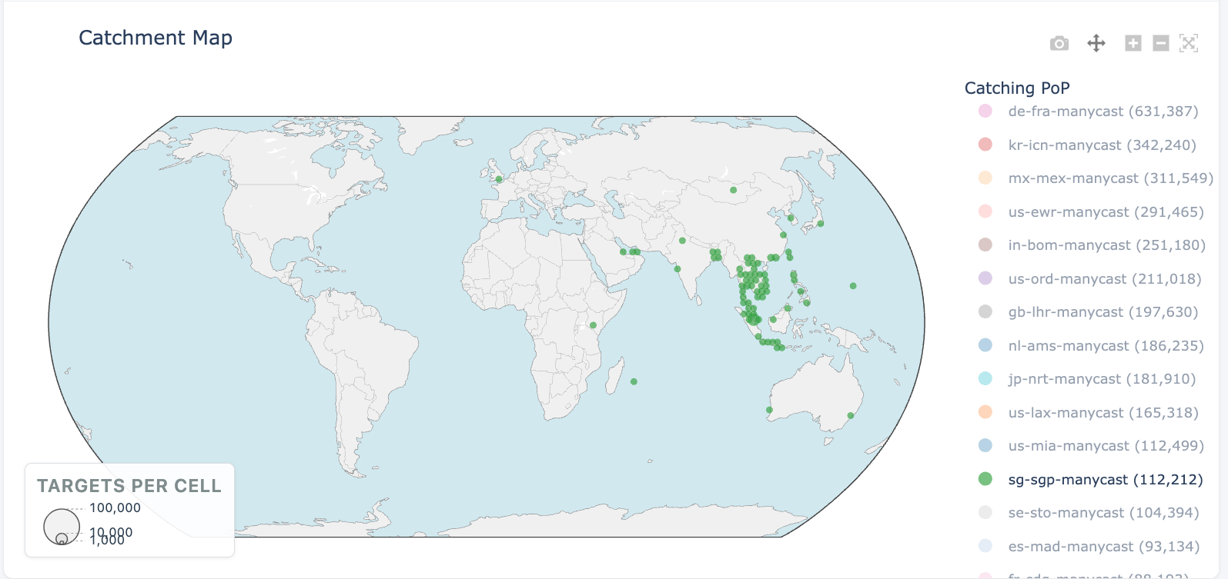
Catchments
07/17
Notes:
Knowing these RTTs allows you to know what the best anycast site would be
And also quantifying the possible improvement that can be gained by directing the client towards the nearest site

Slide 49
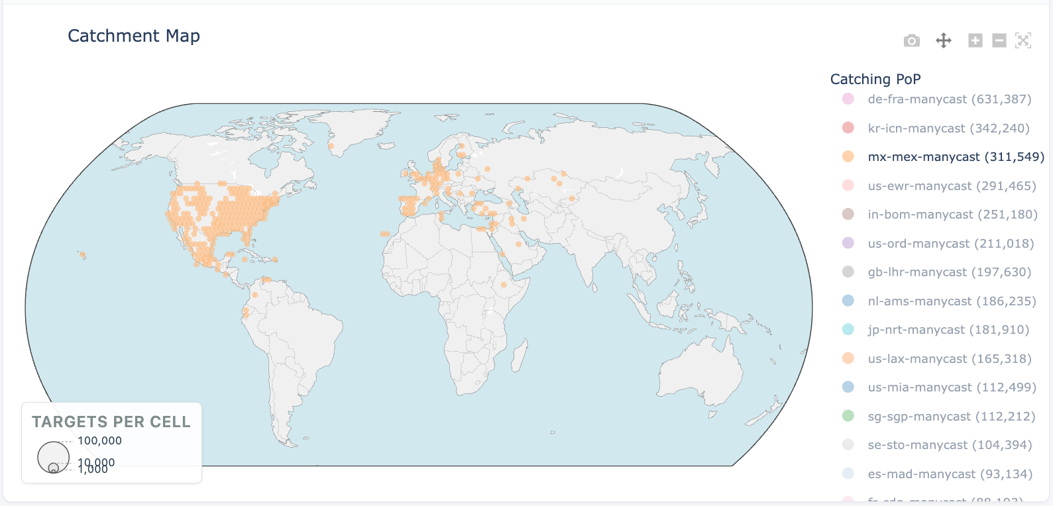
Catchments
07/17
Notes:
Knowing these RTTs allows you to know what the best anycast site would be
And also quantifying the possible improvement that can be gained by directing the client towards the nearest site

