Slide 1
A Go reimplementation of the Zonemaster DNS testing engine
Patrik Wallström, DNS-OARC, 2026-05-17
codeberg.org/pawal/gonemaster

Slide 2
Testing DNS delegations? Why?
There are a many reasons of why the quality of a DNS delegation matters:
Having a fully functional DNS delegation means your internet services are more likely to work as expected
There will be less noisy traffic on the internet
Mistakes happen easily – inform the user on how to avoid mistakes
Mistakes are even more likely to happen with DNSSEC
And it is also caring about the DNS ecosystem.
codeberg.org/pawal/gonemaster

Slide 3
The requirements on a tool to test DNS
So how do you measure a DNS delegation?
Simple answer: Send a huge amount of DNS queries to all involved servers!
… or by collecting a huge number of requirements for a fully functional DNS delegation, and then;
Convert the requirements into test case specifications, and then;
Implement these test case specifications into code, and then;
Run the code to see if a domain name follows the test case specifications.
codeberg.org/pawal/gonemaster

Slide 4
What is Gonemaster?
Gonemaster is a full Go reimplementation of the Zonemaster DNS delegation testing engine and CLI written in Perl.
Zonemaster was the standard for DNS zone quality checking — created by AFNIC & the Swedish Internet Foundation. Gonemaster brings the same rigor to the Go ecosystem.
DNSCheck was the first tool written by Patrik Fältström, later funded by IIS and rewritten by Jakob Schlyter.
Language
100% Go
Test cases
Zonemaster compatible
License
Open Source (BSD 2-Clause)
First release
January 2026
codeberg.org/pawal/gonemaster

Slide 5
The Test Case Specifications
Borrowed in large part from Zonemaster, and a few more specs added!
Basic - can we even resolve this
Address - nameserver IPs aren't private/reserved/bogon, reverse DNS resolves
Connectivity - reachability, transport, AS diversity
Consistency - nameservers give different answers
Delegation - parent and child disagree
DNSSEC - signatures, chains, algorithms
Nameserver - server behavior and conformance
Syntax - names and records well-formed
Zone - SOA, MX, SPF, apex hygiene
codeberg.org/pawal/gonemaster

Slide 6
Additional Test Cases
DNSSEC19 | Check DNSKEY records for known cryptographic weaknesses | Detects weak or compromised DNSKEYs, including ROCA, bad RSA parameters, small factors, and badkeys blocklist hits.
DNSSEC20 | NSEC/NSEC3 type bitmap at zone apex matches actual RR types | Checks that apex NSEC/NSEC3 bitmaps include RR types that actually exist.
DNSSEC21 | Parent zone's DS RRset is signed by a valid DNSKEY | Verifies the parent’s DS RRset RRSIG against parent DNSKEYs.
Nameserver16 | EDNS NSID option support | Queries authoritative nameservers with EDNS NSID and reports returned NSID values.
Zone12 | CSYNC RR at zone apex | Checks CSYNC presence, consistency, multiplicity, and serial validity.
Zone13 | SPF DNS lookup limit compliance | Checks SPF recursive DNS lookup count, loops, recursive errors, and deprecated ptr.
Zone14 | ZONEMD record at zone apex | Checks ZONEMD presence, cross-server consistency, serial match, duplicate scheme/hash pairs, and supported hashes.
codeberg.org/pawal/gonemaster

Slide 7
Why rewrite in Go?
The reason I chose Go was that it gives you the following nice properties:
Single static binary
Native concurrency
A well-defined Go library that is easy to embed in other Go software
miekg/dns gives you a DNS library that covers all modern DNS RFCs
A minimal amount of external dependencies
codeberg.org/pawal/gonemaster

Slide 8
The core functionality of Gonemaster
The functionality of Gonemaster as a command line tool:
INPUT a domain name
RUN a test of the DNS delegation of that domain name
OUTPUT a machine- och human-readable test result
The modular test cases are run in parallel Go routines, and the internal resolver is tunable with timeouts, retries, and cache.
$ gonemaster --domain example.com
$ gonemaster --json --domain example.com | jq
$ gonemaster --domain example.com --ns ns1.example.com/192.0.2.10
codeberg.org/pawal/gonemaster

Slide 9
Human-readable output
$ gonemaster sunet.se
Seconds Level Message
======= ======== =======
6.16 NOTICE Nameserver ns1.sunet.se has an IP address (2001:6b0:5a:4020::384) without PTR configured.
6.59 NOTICE The following name server(s) are announced in the same IPv6 prefix (2001:6b0::/32): "b.ns.kth.se/2001:6b0:1::250;ns1.sunet.se/2001:6b0:5a:4020::384;sunic.sunet.se/2001:6b0:7::2"
7.10 WARNING The following servers respond with the NSEC3 iteration value 5. The recommended practice is to set this value to 0. Fetched from name servers "b.ns.kth.se/130.237.72.250;b.ns.kth.se/2001:6b0:1::250;ns1.sunet.se/2001:6b0:5a:4020::384;ns1.sunet.se/89.47.185.240;server.nordu.net/193.10.252.19;server.nordu.net/2001:948:4:2::19;sunic.sunet.se/192.36.125.2;sunic.sunet.se/2001:6b0:7::2".
7.10 WARNING The following servers respond with a non-empty salt in NSEC3 (16 octets). The recommended practice is to use an empty salt. Fetched from name servers "b.ns.kth.se/130.237.72.250;b.ns.kth.se/2001:6b0:1::250;ns1.sunet.se/2001:6b0:5a:4020::384;ns1.sunet.se/89.47.185.240;server.nordu.net/193.10.252.19;server.nordu.net/2001:948:4:2::19;sunic.sunet.se/192.36.125.2;sunic.sunet.se/2001:6b0:7::2".
7.14 WARNING DNSKEY with tag 7636 and using algorithm 8 (RSA/SHA-256) has a size (1024) smaller than the recommended one (2048).
7.30 NOTICE The following name server(s) respond to software version query "version.bind" with string "9.18.44". Returned from name servers: "server.nordu.net/193.10.252.19;server.nordu.net/2001:948:4:2::19"
7.30 NOTICE The following name server(s) respond to software version query "version.bind" with string "bind@KTH". Returned from name servers: "b.ns.kth.se/130.237.72.250;b.ns.kth.se/2001:6b0:1::250"
7.30 NOTICE The following name server(s) respond to software version query "version.bind" with string "ns1 node1". Returned from name servers: "ns1.sunet.se/2001:6b0:5a:4020::384;ns1.sunet.se/89.47.185.240"
;sunic.sunet.se/2001:6b0:7::2"
codeberg.org/pawal/gonemaster

Slide 10
The Gonemaster Components
In addition to the CLI there are more components included:
The gonemaster-server
A server API together with an administration UI (optional)
Also includes a public UI - https://gonemaster.evilbit.de/
But more, it includes an Analysis UI
The gonemaster-client
For using to the server API
Start and control batch jobs
Fetching results
The gonemaster-nagios
For integration in monitoring tools such as Nagios, Icinga, etc.
codeberg.org/pawal/gonemaster

Slide 11
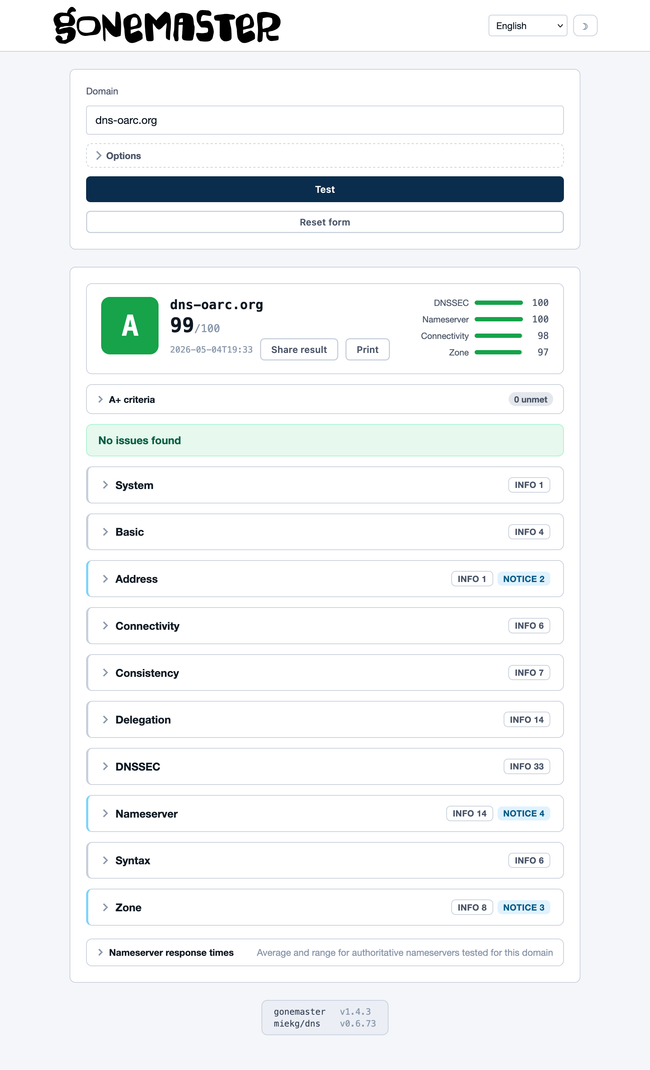
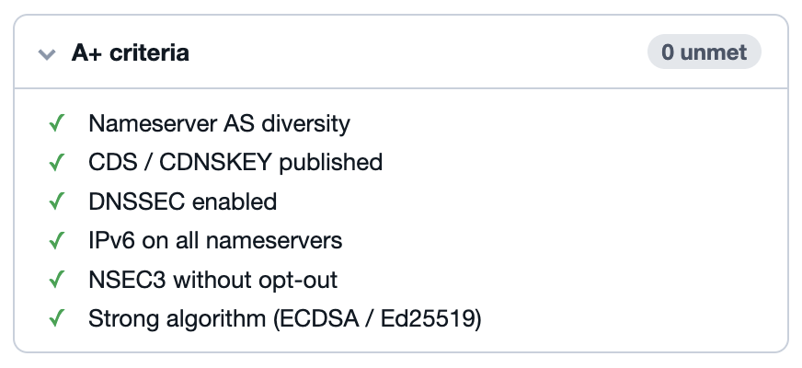
Public UI & Scoring
Severity | Penalty
NOTICE | 1
WARNING | 5
ERROR | 20
CRITICAL | Auto-F
Category | Weight | Modules
DNSSEC | 1.5 | DNSSEC
Nameserver health | 1.2 | Basic, Delegation, Nameserver
Connectivity | 1.0 | Connectivity, Address
Zone consistency | 0.8 | Zone, Consistency, Syntax
Entry
Category sub-score
Weighted aggregate
Grade
A+ | A | B | C | D | F
100 + bonus | 90 | 75 | 60 | 40 | 0

Slide 12
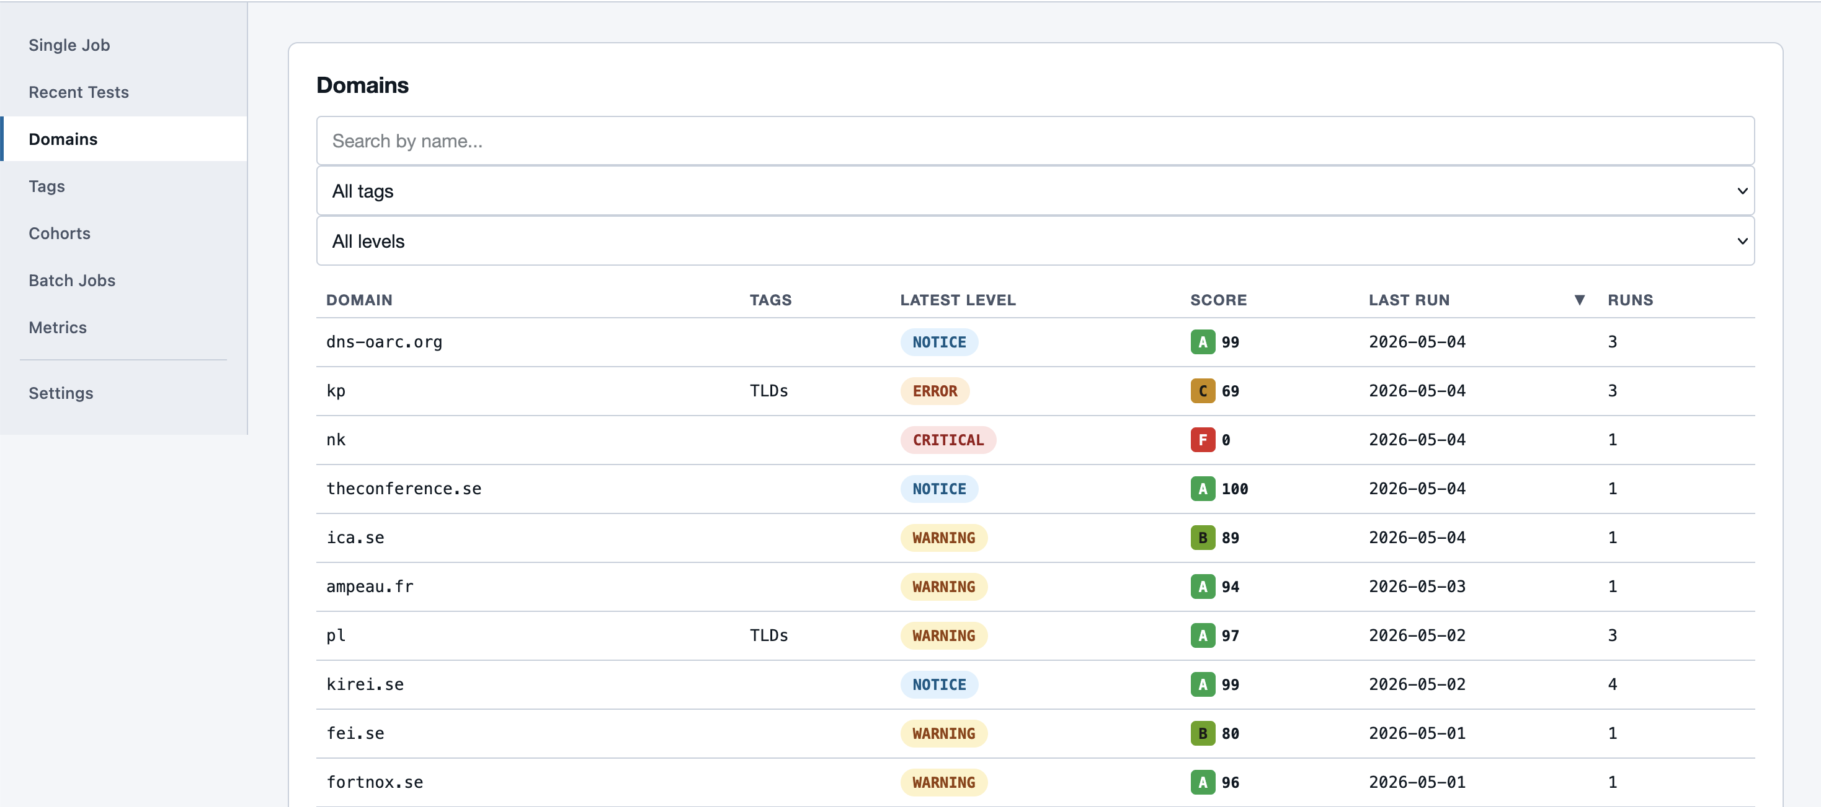
The Admin UI

Slide 13
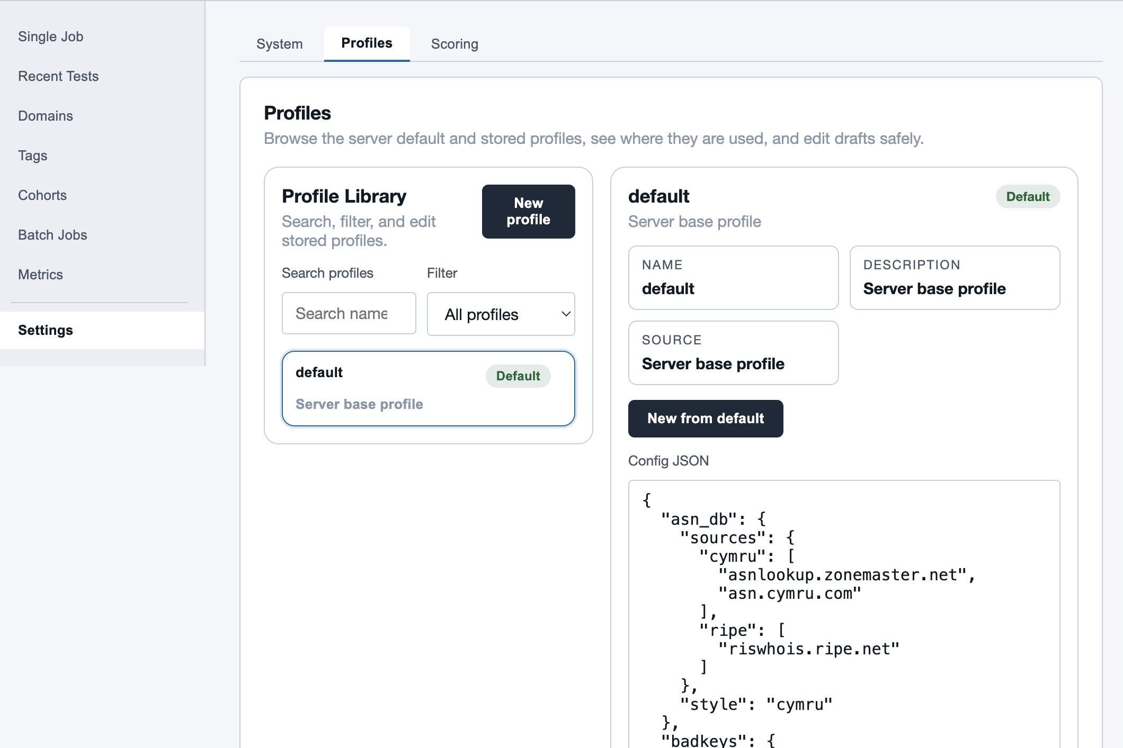
System Settings

Slide 14
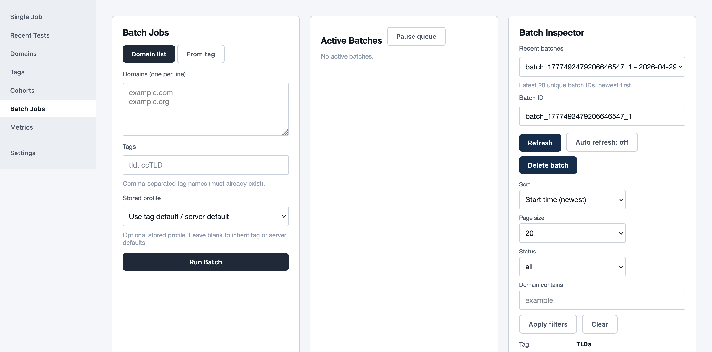
Batched Jobs

Slide 15
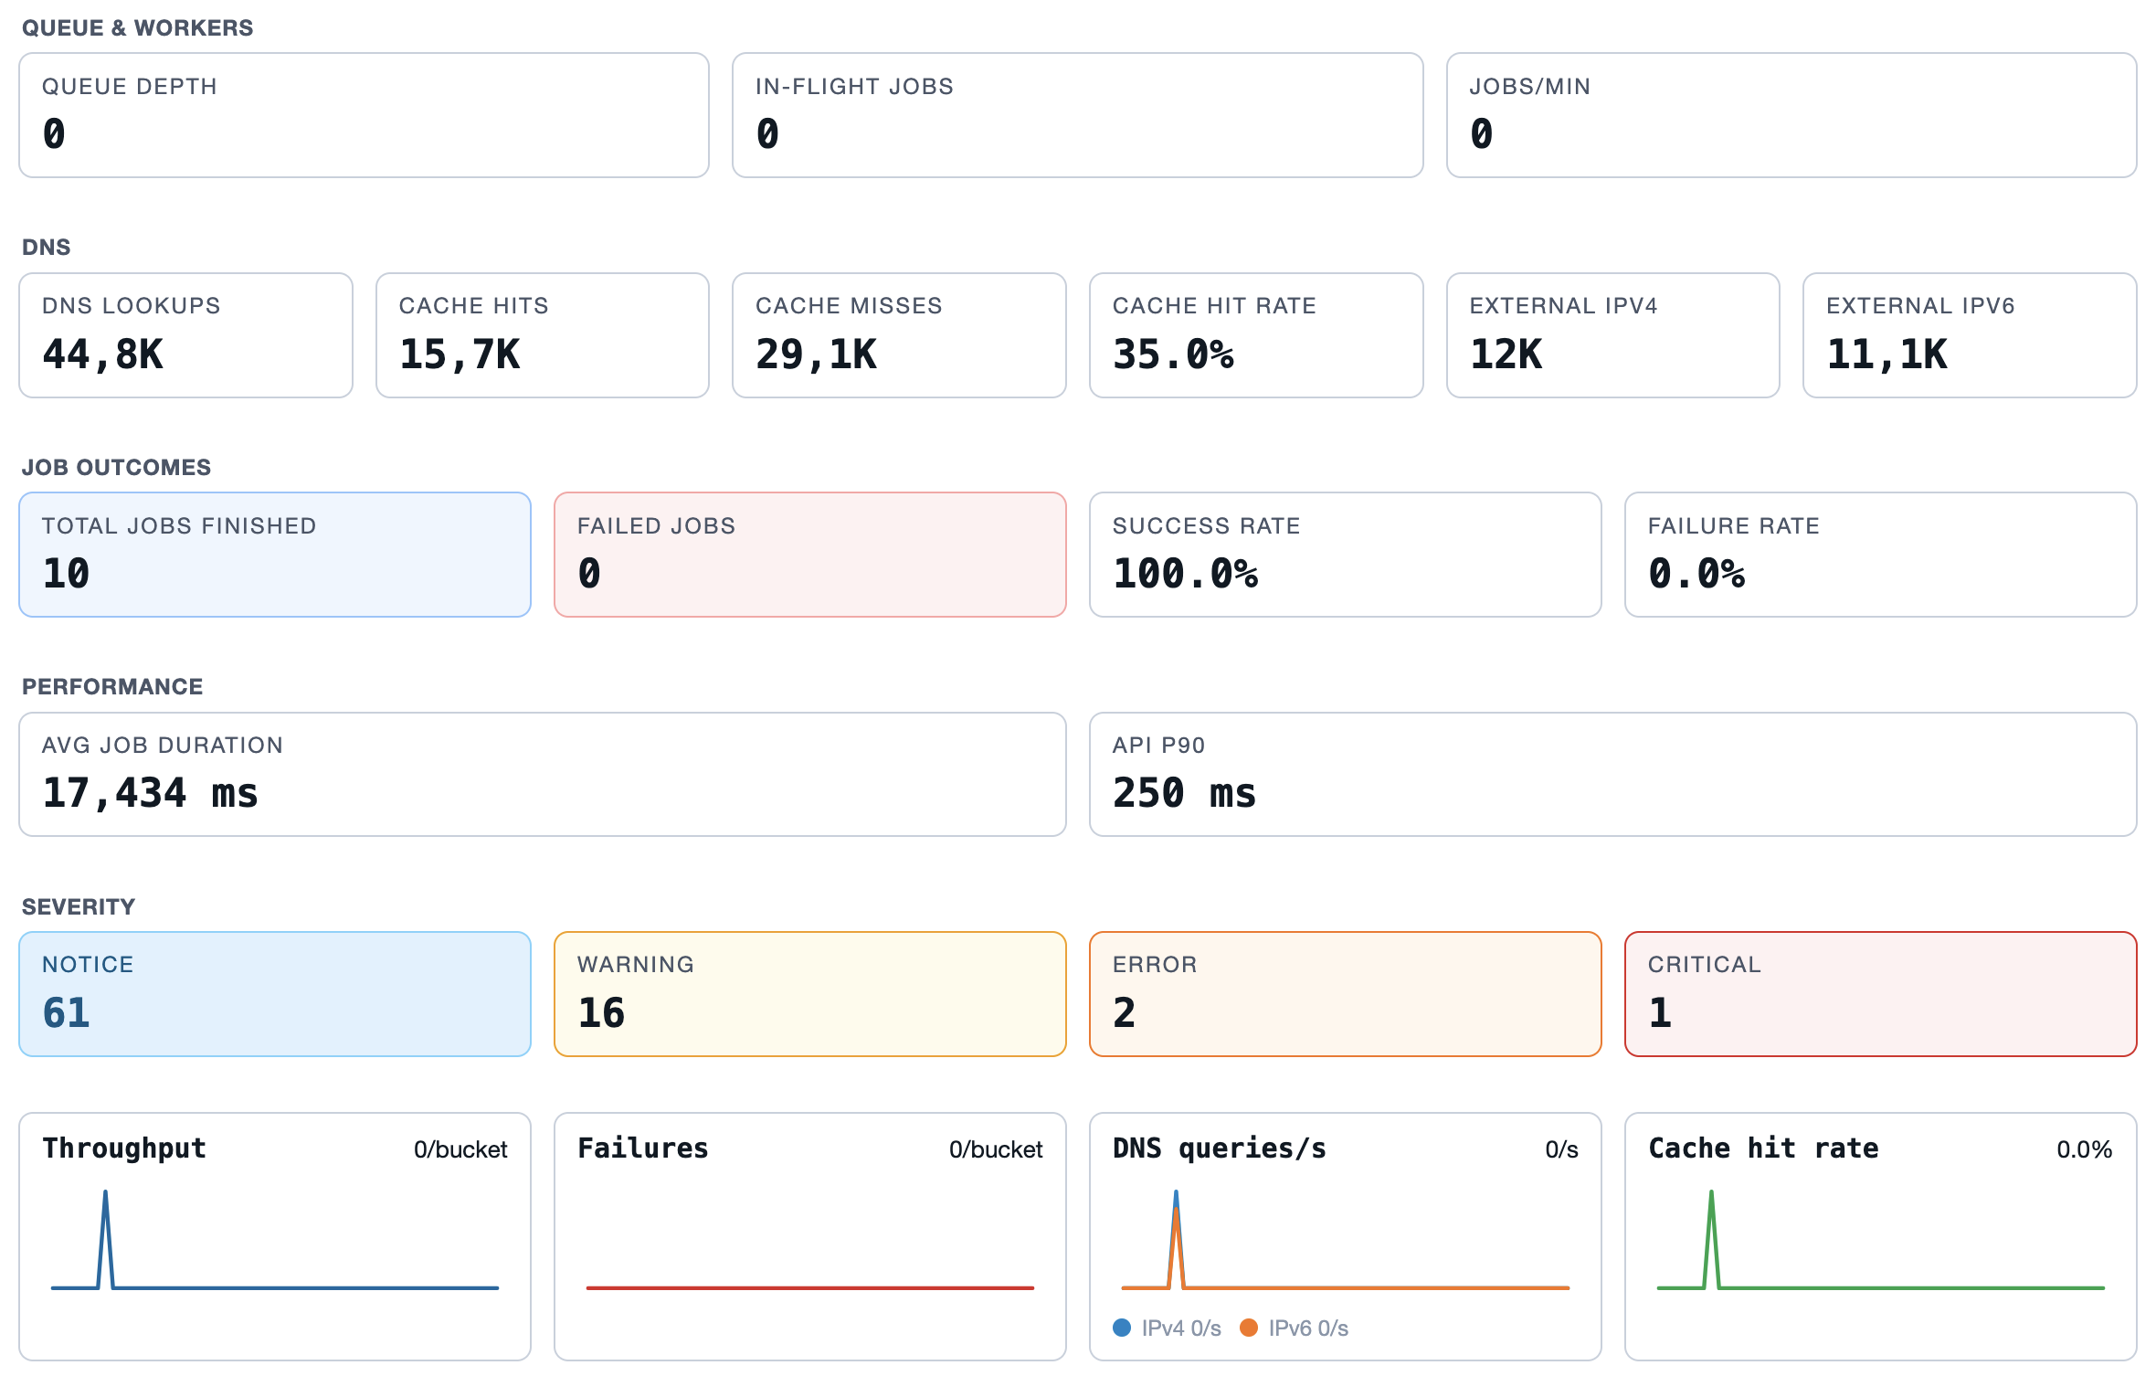

Slide 16
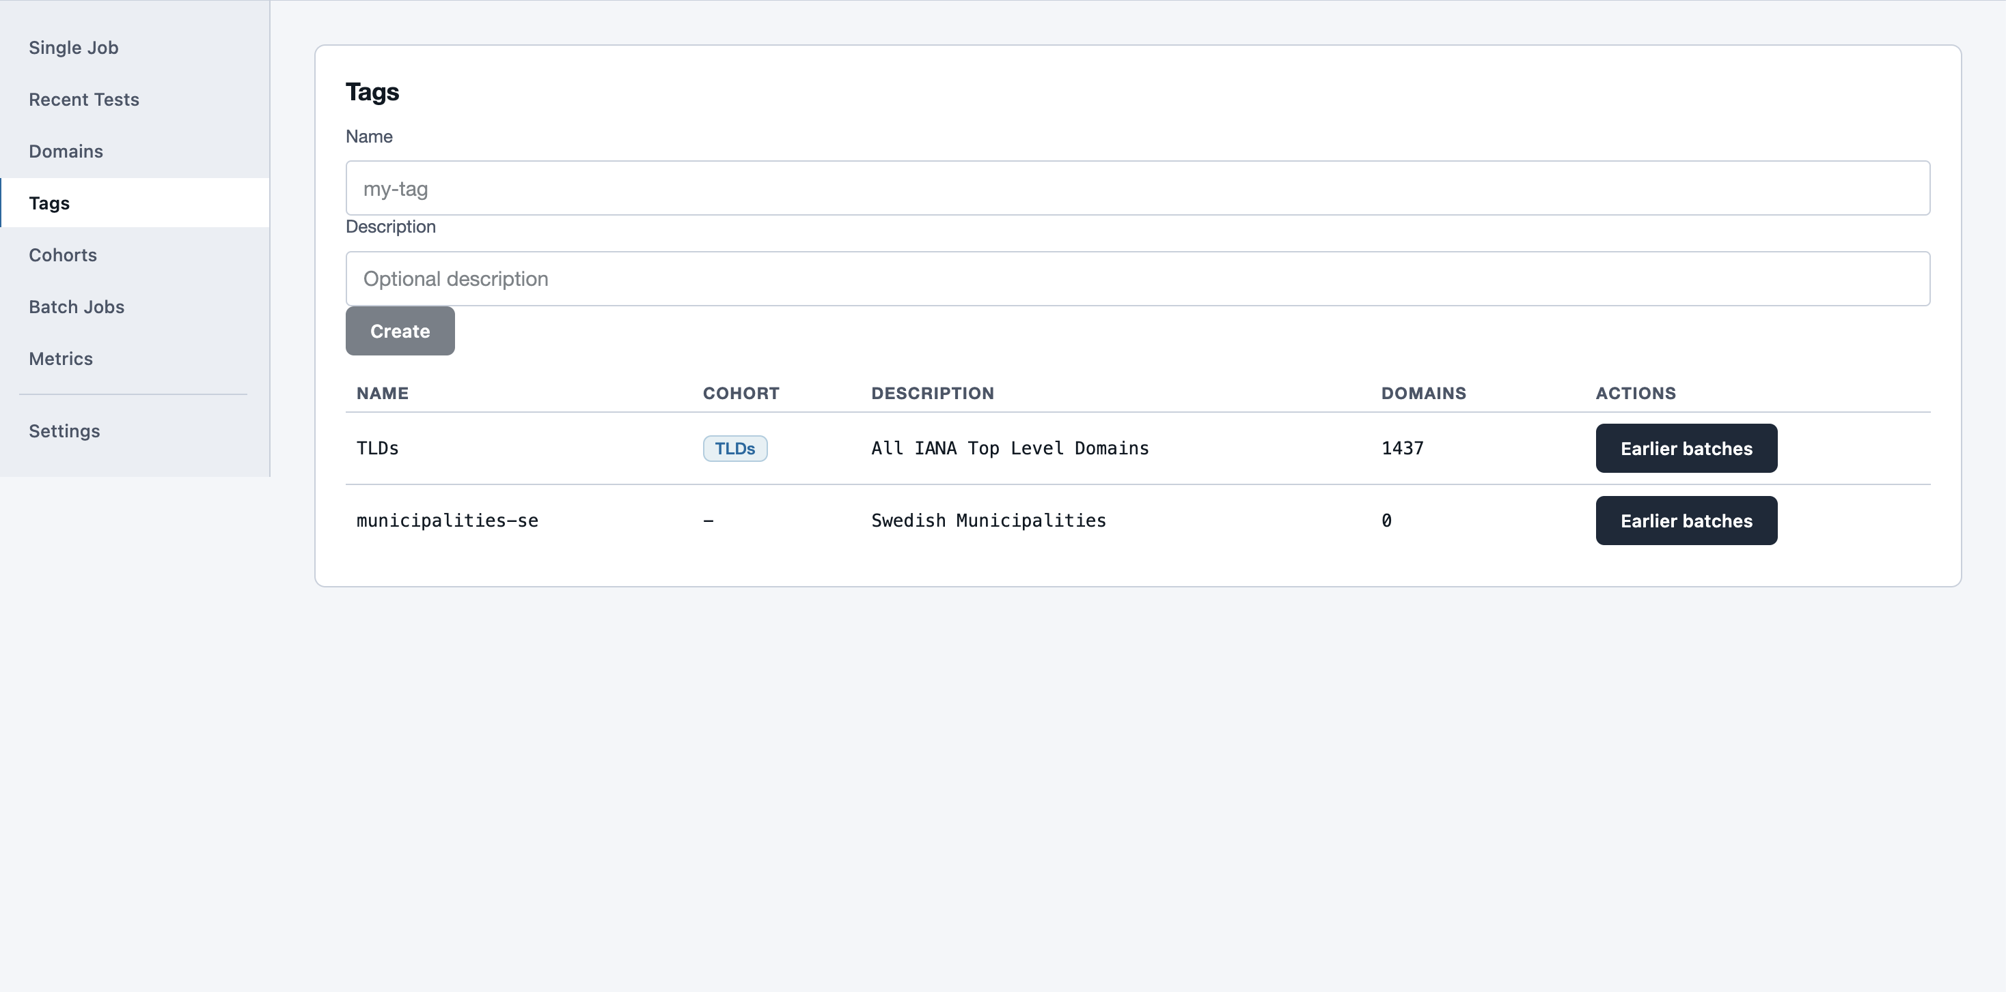
Tags – Tagged batches

Slide 17
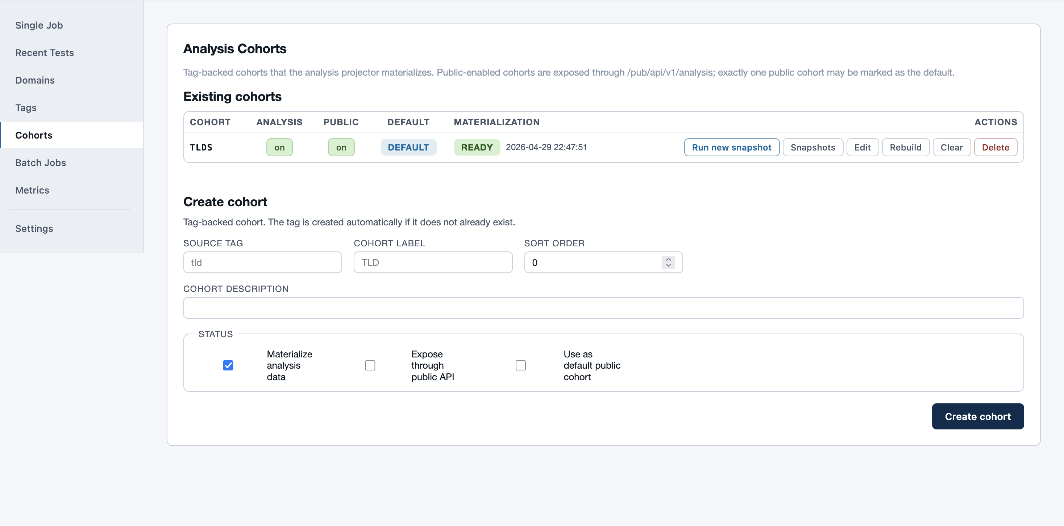
Cohorts – An analysis of a Tagged batch

Slide 18
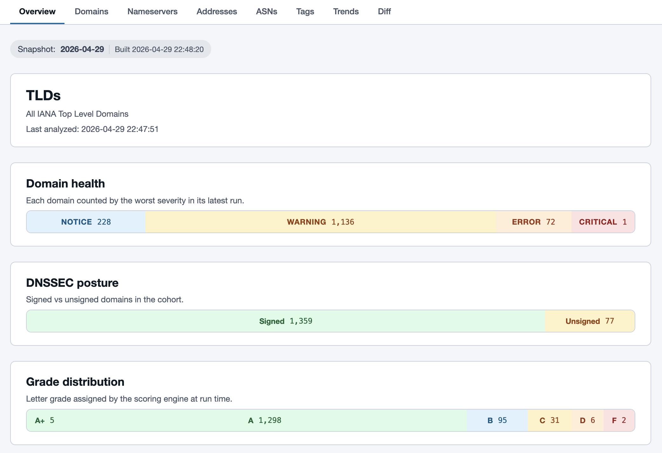

Slide 19
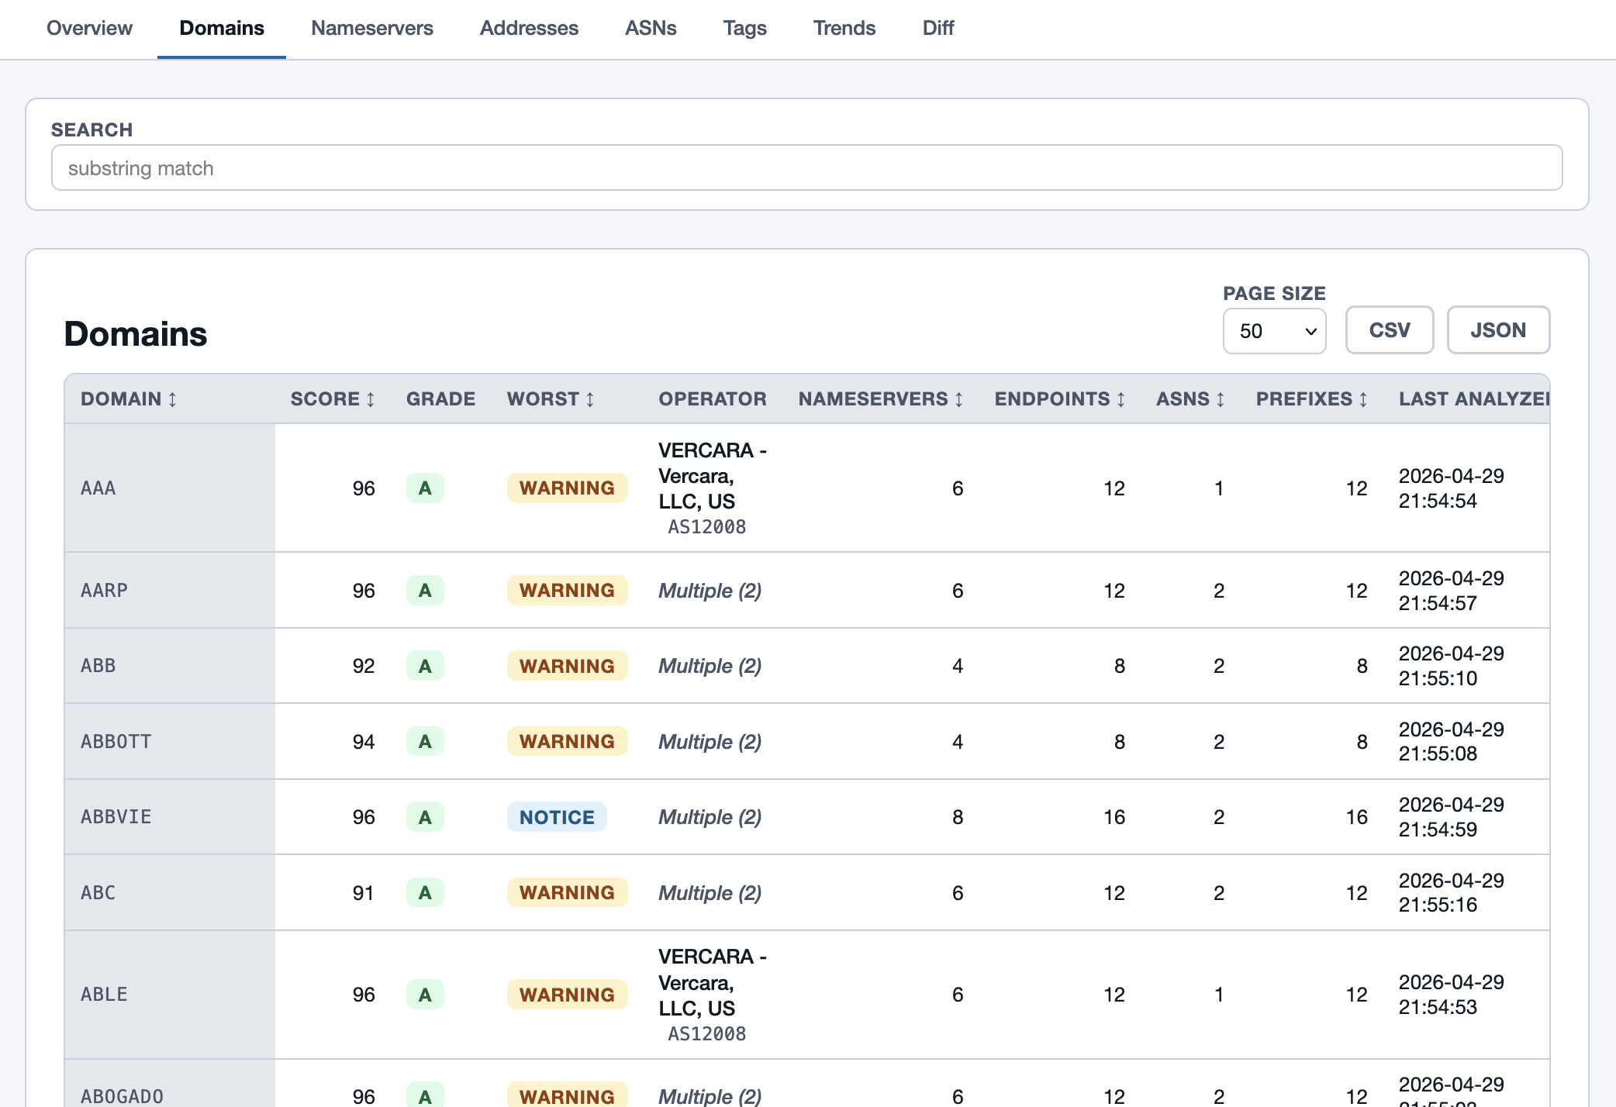

Slide 20
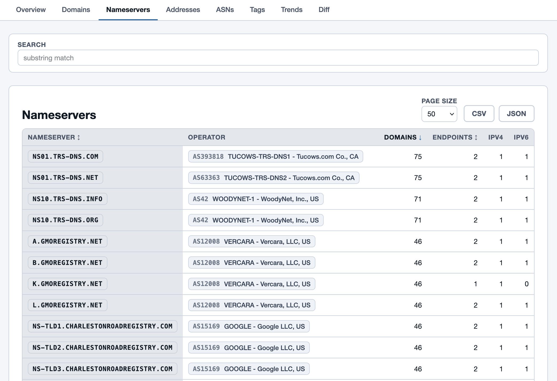

Slide 21
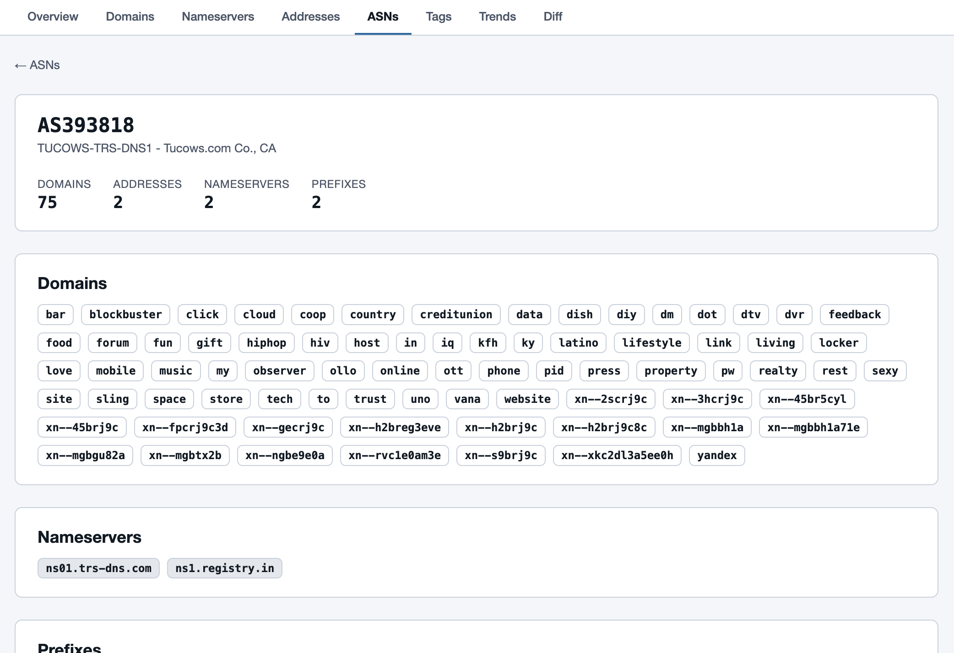

Slide 22
Cross-reference anything
Tags
Nameservers
Addresses
Prefixes
ASN
Domains
Upcoming in Analysis UI:
Better view of trends over time
Diffs between specific runs
codeberg.org/pawal/gonemaster

Slide 23
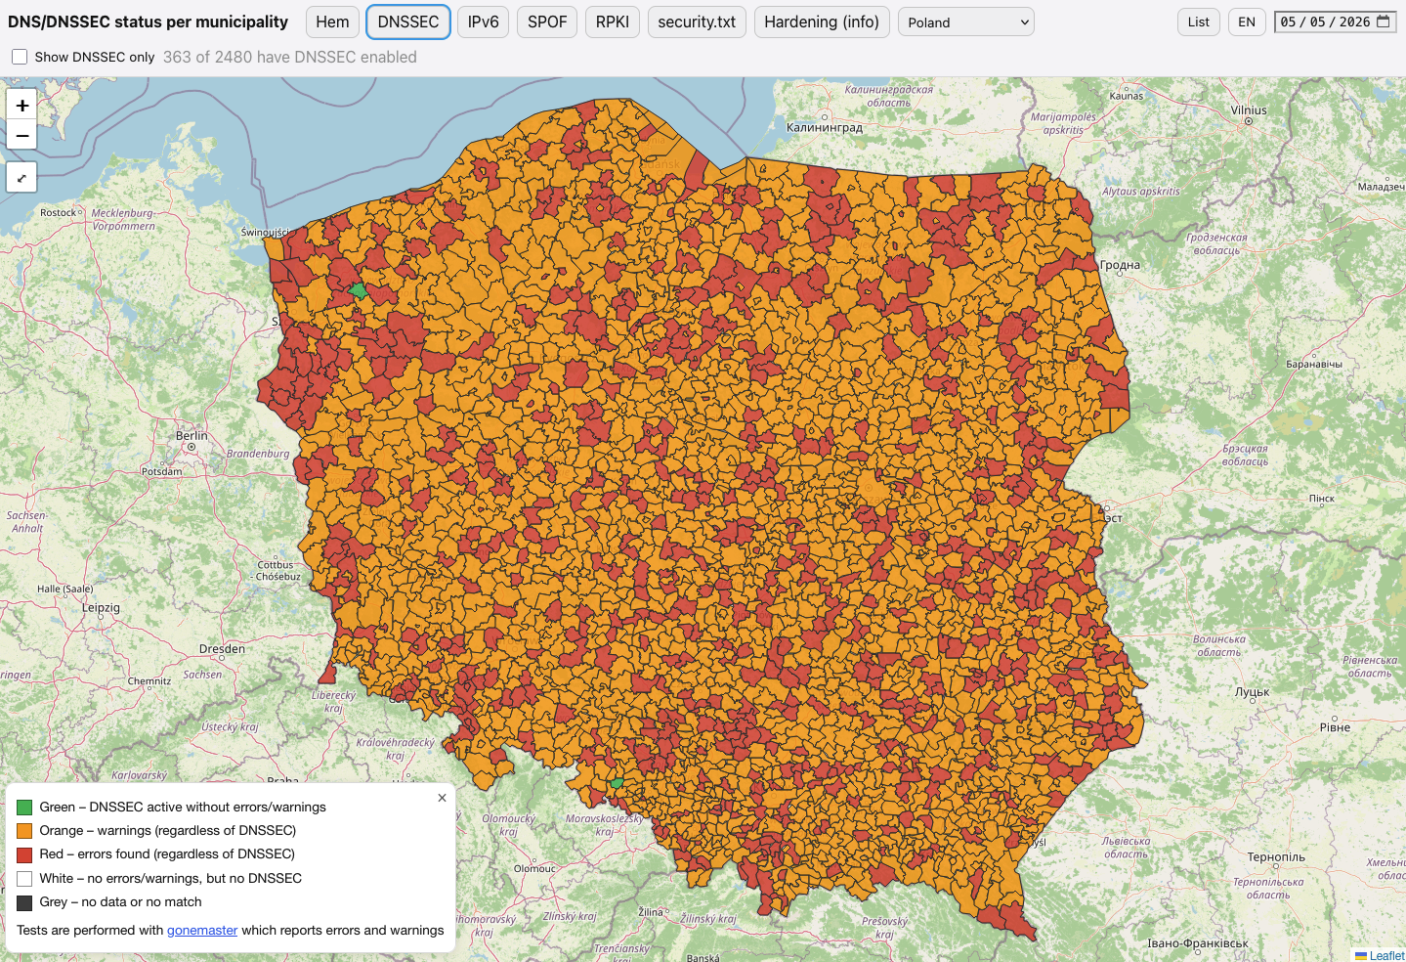
kommunermeddnssec.se

Slide 24

Links and questions!
Public UI: https://gonemaster.evilbit.de/
Analysis UI: https://gonemaster.evilbit.de/analysis/
Code: https://codeberg.org/pawal/gonemaster/
Tobbe: https://kommunermeddnssec.se/
Mail me: pawal@amplitut.de
codeberg.org/pawal/gonemaster

