Slide 1
Cascade: Beyond alpha
Ximon Eighteen - OARC 46
Notes:
Who I am.
Here today re Cascade.
But first, a little recap of how we got here…

Slide 2

Open Source DNS
OpenDNSSEC
Notes:
We make DNS software.
One being OpenDNSSEC.
Served us well for 16 years but …

Slide 3
Goodbye OpenDNSSEC…
3 October 2025
October 2027
Formal announcement
of OpenDNSSEC
End-of-Life
Ongoing support for OpenDNSSEC.
Critical bug fixes and security updates.
No new features will be developed.
No further updates or support will be provided.
Notes:
Things change.
Difficult to maintain and extend OpenDNSSEC.
Best use of our resources now is to make something new…

Slide 4
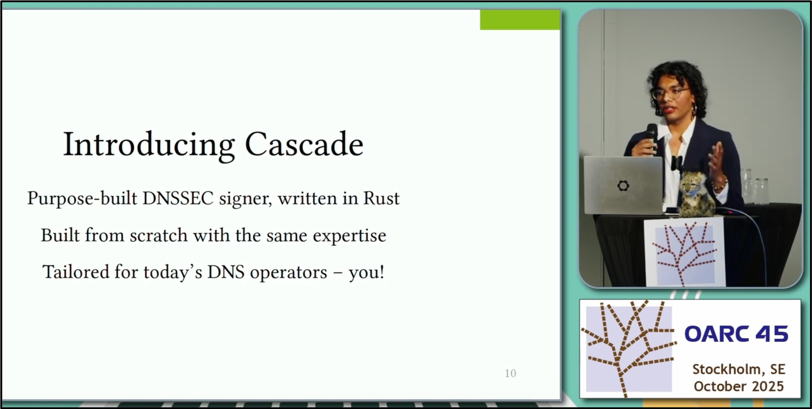
…Hello Cascade
Notes:
So, hey Cascade!
Alpha release.
But then what?

Slide 5
OARC 45 46
Alpha
Beta
Notes:
Brings us back to today.
Cascade progress update.
Very much appreciate the help we get…

Slide 6

Thankyou!
& alpha testers!
Nominet DNS Fund
Notes:
JP Mens.
Stéphane Bortzmeyer.

Slide 7
Recap: Cascade Architecture
Notes:
So, what is Cascade, quick intro.
No DB, optional HSM, built-in review, separate key manager.

Slide 8
Beyond Alpha
Re-designed to be more robust.
Deterministic incremental signing.
Persistence and restoration of signed zones.
Zone transfer improvements.
Monitoring via Prometheus metrics.
Support for more DNS record types.
Maintenance mode.
NEW
NEW
NEW
NEW
NEW
NEW

Slide 9
Deterministic Incremental Signing
Signs only changes to the zone, regenerating the NSEC(3) chain if needed.
Why? Speed, predictable resource usage, IXFR size.
Predictable resigning, chunk by chunk at specific intervals.
Integrated with automated key roll support.
Notes:
- TODO: Add defrag diagram?

Slide 10
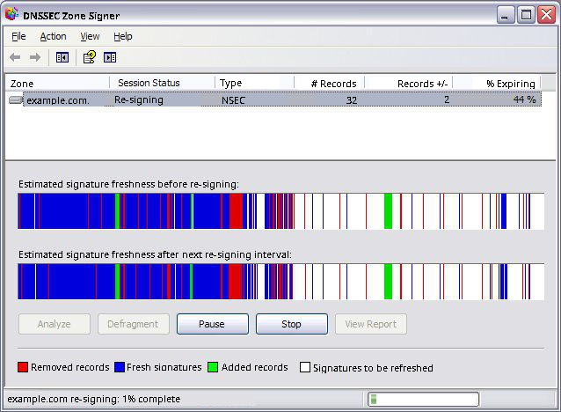
Deterministic Incremental Signing
Signs only changes to the zone, regenerating the NSEC(3) chain if needed.
Why? Speed, predictable resource usage, IXFR size.
Predictable resigning, chunk by chunk at specific intervals.
Integrated with automated key roll support.
Notes:
- TODO: Add defrag diagram?

Slide 11
Zone Transfer Improvements
Added support for:
RFC 1995 Incremental Zone Transfer in DNS
RFC 1996 A Mechanism for Prompt Notification of Zone Changes (DNS NOTIFY)
RFC 8945 Secret Key Transaction Authentication for DNS (TSIG)
Notes:
NOTIFY in/out: trigger Cascade and downstream name servers to refresh their copy of upstream zones.
IXFR in/out: reduce zone transfer time, re-sign only changed records.
TSIG in/out: authenticate zone transfer related communication with up and downstream name servers.

Slide 12
For OpenDNSSEC Users
ods2cascade
Generates Cascade configuration and setup commands tailored to your OpenDNSSEC deployment.
Requires read-only access to your OpenDNSSEC configuration and state (files and database).
Does NOT make changes to your setup.
Notes:
Ods2cascade: tool to assist with migration from OpenDNSSEC.
Need a specific OpenDNSSEC feature in Cascade? Let us know!

Slide 13
Production Ready June 2026
Beta release available now-ish.
For TLD operators with a few large zones.
Not (yet) intended for operators with many small zones.
Available as DEB and RPM packages or to build from sources.
Contact us for support with migration.

Slide 14
Cascade: Beyond alpha
Demo time!
Notes:
Arya showed: startup, SystemD, config file, SoftHSM, zone status, review hooks.
Use large text! YubiHSM? NSD upstream with TSIG, Cascade inc signing, NSD downstream with TSIG, remove

Slide 15

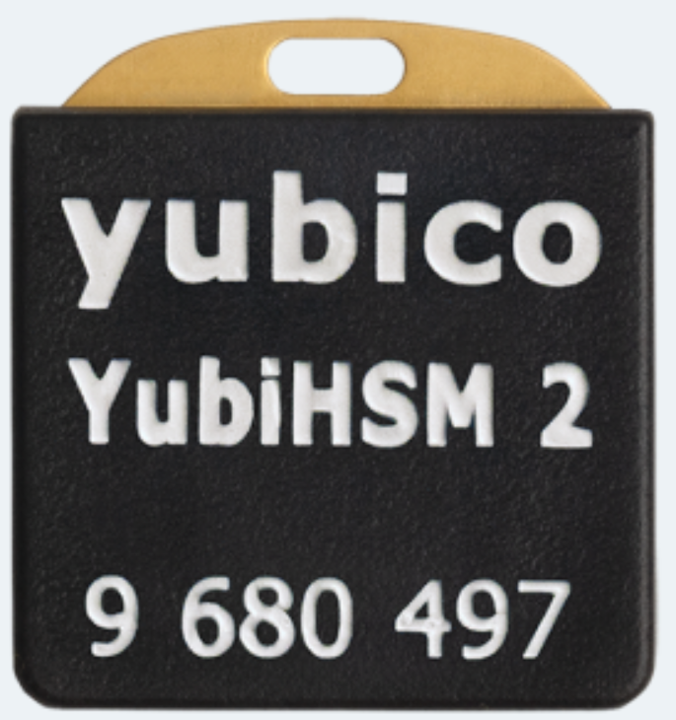


Demo Setup
Edinburgh
Amsterdam
Cascade
Cascade HSM Bridge
Cascade
Cascade

Slide 16
Cascade: Beyond alpha
Coming June 2026
Check it out at [docs.]cascade.nlnetlabs.nl
Join us at community.nlnetlabs.nl

