Slide 1
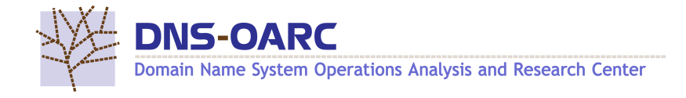

Misty Registry: An Empirical Study of Flawed Domain Registry Operation
Mingming Zhang, Yunyi Zhang, Baojun Liu, Haixin Duan, Min Zhang,
Fan Shi, and Chengxi Xu
Yunyi Zhang
Tsinghua University
Notes:
Hello, everyone. I’m Yunyi from Tsinghua University.
I’m glad to be here to present the exciting new research from my colleagues.
I‘ll be walking you through their empirical work on the security flaws of domain registry operation.

Slide 2
Overview
A top-down security analysis at the domain registry level
  Revealing domain status overlaps and complex operation triggers (e.g., ICANN policies, registrar/registrant settings).
Uncovered three flawed operation practices
  Redundant domain creation
  Siloed DNS host management
  Insufficient domain deletion
Impact of theses flawed practices
  6 mainstream registry backends and 812 TLDs face security risks
  More than 1.6M domain names are at risk of domain takeover and hijacking.
Notes:
This work presents a top-down analysis of domain name registration from the perspective of domain registries. We reveal a range of complex factors that influence the operations of domain name objects.
Through empirical analysis, we identify three flawed operational practices spanning the domain lifecycle — including creation, management, and deletion. These flaws are present in six major registry backends and expose over 1.6 million domain names to risks of takeover and hijacking.

Slide 3



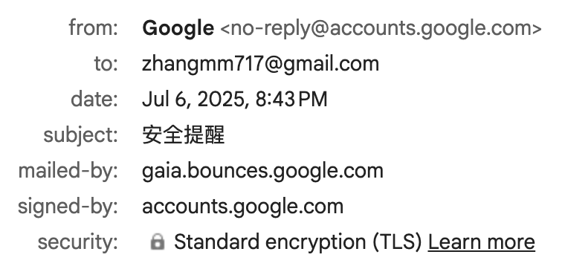




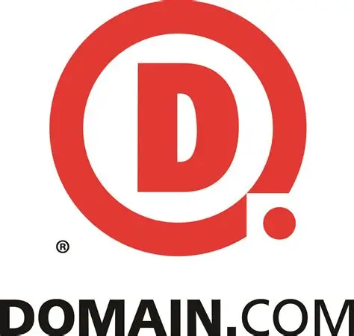

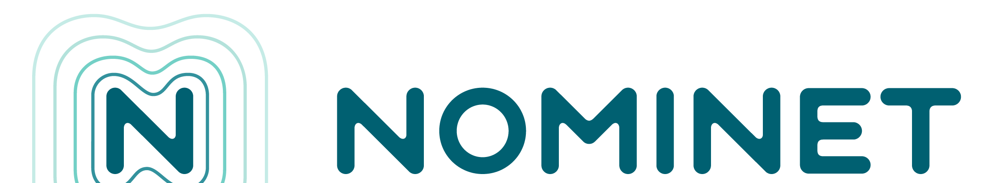
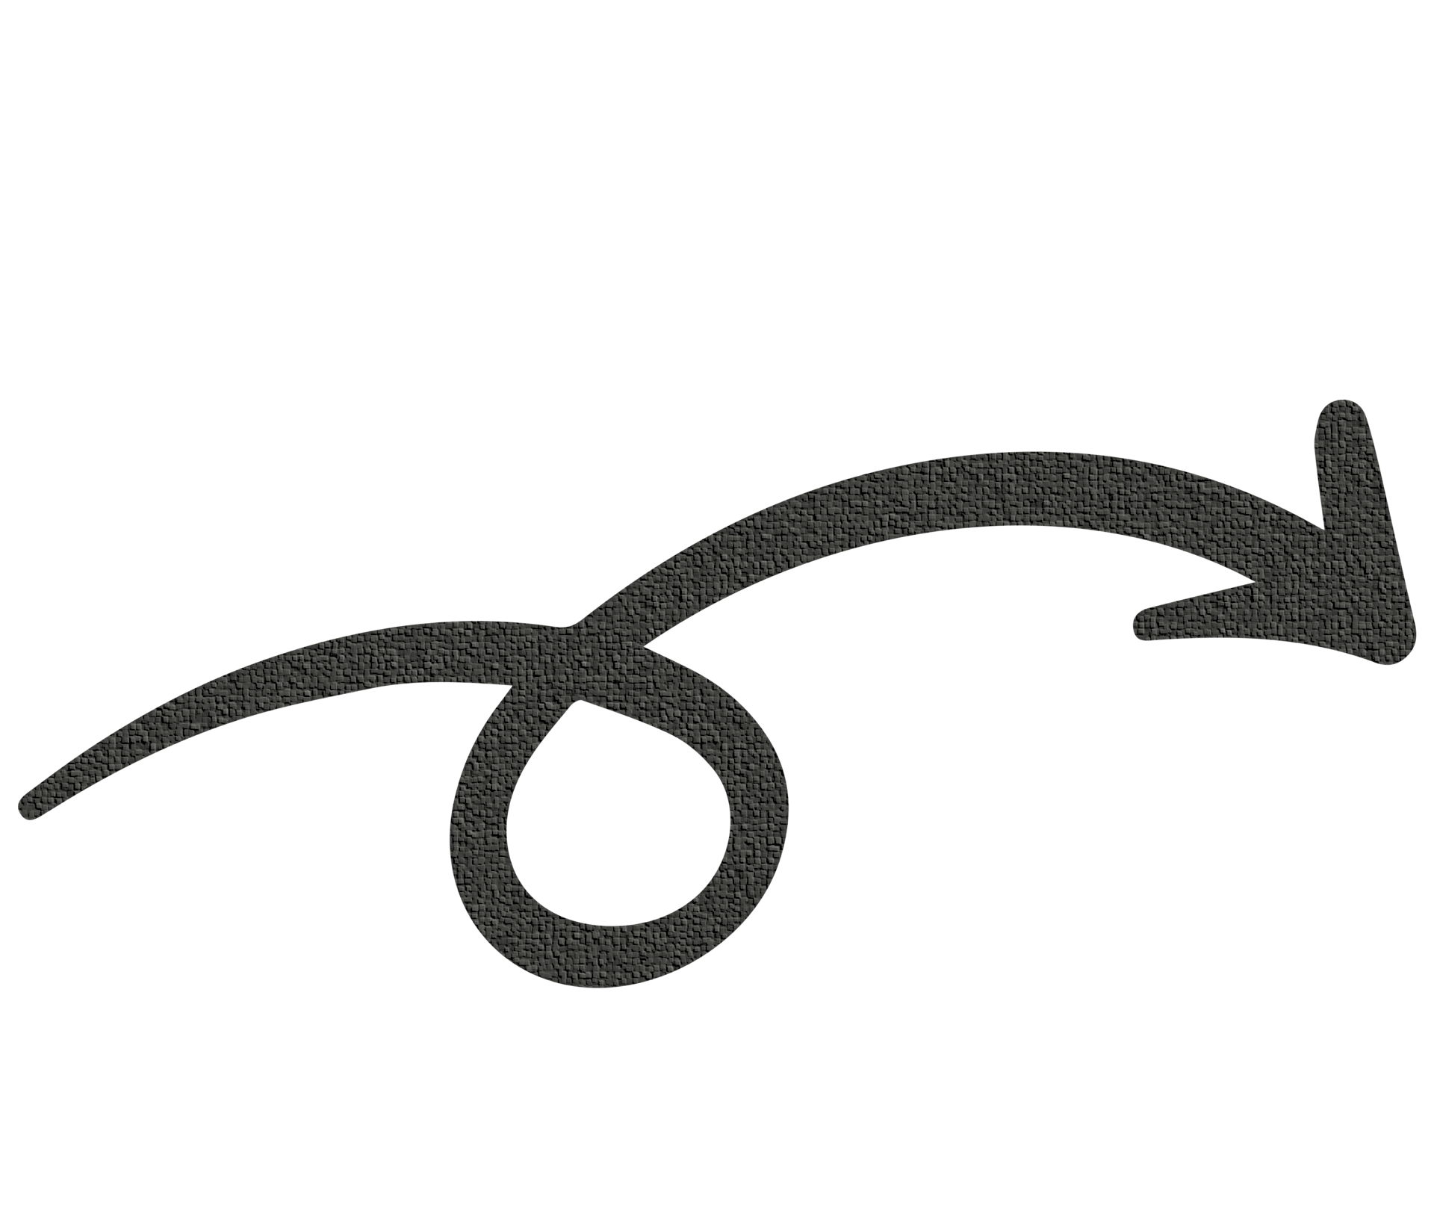
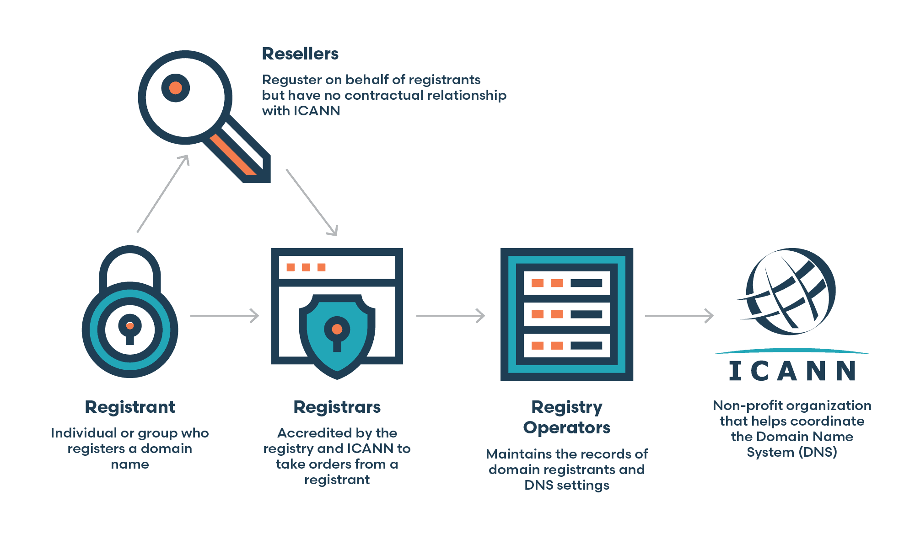

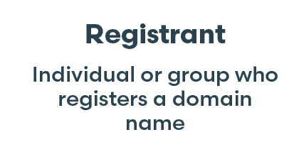
Domain Name: The Gateway of Our Digital Life
Domain Names: Vital identifiers for Internet services
https://www.usenix.org
Website Access
Email Communication
Managed by Registrars & Registries
The ultimate authority for TLDs. A single flaw can impact millions.
Notes:
Domain names serve as essential digital identifiers in our daily lives. We rely on them to access websites, send emails, and connect to a wide range of online services.
Users typically acquire domain names through registrars, such as GoDaddy or Namecheap. The ultimate authority of domain registration lies with domain registries like VeriSign. They are responsible for managing top-level domains and maintaining the integrity of registration records. Because registries oversee entire namespaces, any vulnerability or misconfiguration at the registry level can have widespread consequences—potentially affecting millions of domains and their users.

Slide 4
Domain Name Management
Registrars and registries follow the Extensible Provisioning Protocol (EPP) across the domain name lifecycle, managing domain resource objects via EPP interfaces and commands.
Domain Name Lifecycle
Registration 1-10 years
Auto renew grace period
Redemption period
Pending delete
Available
Available
Domain still resolving
Domain remove from the zone
EPP Status Code | RDAP Status Mapping
addPeriod | add period
autoRenewPeriod | auto renew period
inactive | inactive
ok | active
pendingCreate | pendingCreate
EPP Status Codes reflect the phase in the domain lifecycle
Standards define 18 status codes
[STD69, RFC 3915]
Notes:
Registrars and registries exchange domain name data and manage the domain lifecycle through the Extensible Provisioning Protocol (EPP).
EPP status codes reflect a domain’s lifecycle phase and what actions are allowed. The table show some status cose.

Slide 5
Unregistered Domain Names in DNS
xn--4gq220j14gckc.top（一谕终见.top）
xn--4gqz56iuyholb.top（一諭終見.top）
Registered with Alibaba Cloud
Notes:
We all know that a domain has to be registered before it can be used. But we’ve found something strange—some domains are accessible even though they’re not registered.
Here’s an example: the domain on the left is registered with Alibaba Cloud, and its website works as expected. But the one on the right doesn’t show up in any registration data, yet its website is still online.
Pretty odd, right? We suspect there may be some unrecorded activity at the registry level causing this.
---------------
注册后域名才能被使用，这是我们的常识。
但是，我们却发现了一些非常奇怪的域名，他们没有被注册，却可以访问。
这里给出了一个例子。
左边的域名是在阿里云注册，我们可以访问他的网页。
右边的域名，我们无法找到他的注册数据，但是却可以访问他的网页。
这是非常奇怪的？我们怀疑是注册局某些未记录的操作导致了这个问题。

Slide 6
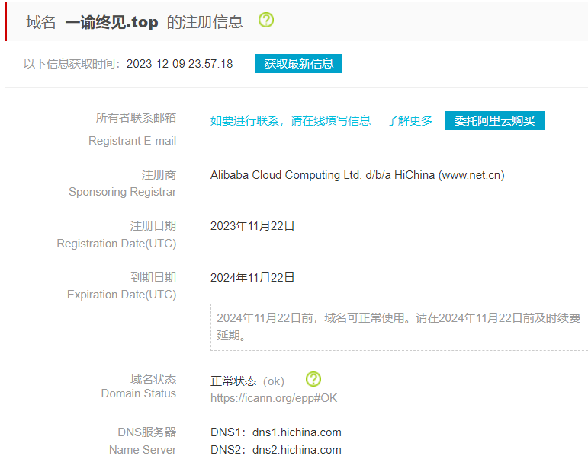
Unregistered Domain Names in DNS
xn--4gq220j14gckc.top（一谕终见.top）
xn--4gqz56iuyholb.top（一諭終見.top）
Registered with Alibaba Cloud
domain name registration data
Notes:
We all know that a domain has to be registered before it can be used. But we’ve found something strange—some domains are accessible even though they’re not registered.
Here’s an example: the domain on the left is registered with Alibaba Cloud, and its website works as expected. But the one on the right doesn’t show up in any registration data, yet its website is still online.
Pretty odd, right? We suspect there may be some unrecorded activity at the registry level causing this.
---------------
注册后域名才能被使用，这是我们的常识。
但是，我们却发现了一些非常奇怪的域名，他们没有被注册，却可以访问。
这里给出了一个例子。
左边的域名是在阿里云注册，我们可以访问他的网页。
右边的域名，我们无法找到他的注册数据，但是却可以访问他的网页。
这是非常奇怪的？我们怀疑是注册局某些未记录的操作导致了这个问题。

Slide 7
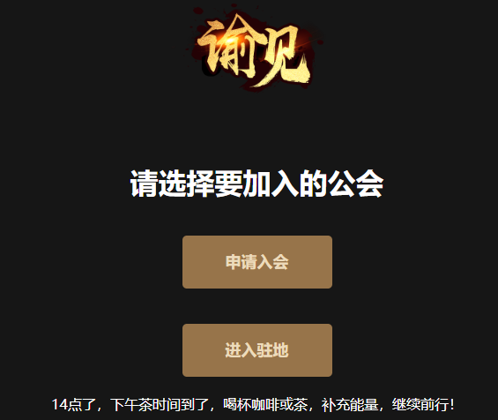
Unregistered Domain Names in DNS
xn--4gq220j14gckc.top（一谕终见.top）
xn--4gqz56iuyholb.top（一諭終見.top）
Registered with Alibaba Cloud
Webpage
Notes:
We all know that a domain has to be registered before it can be used. But we’ve found something strange—some domains are accessible even though they’re not registered.
Here’s an example: the domain on the left is registered with Alibaba Cloud, and its website works as expected. But the one on the right doesn’t show up in any registration data, yet its website is still online.
Pretty odd, right? We suspect there may be some unrecorded activity at the registry level causing this.
---------------
注册后域名才能被使用，这是我们的常识。
但是，我们却发现了一些非常奇怪的域名，他们没有被注册，却可以访问。
这里给出了一个例子。
左边的域名是在阿里云注册，我们可以访问他的网页。
右边的域名，我们无法找到他的注册数据，但是却可以访问他的网页。
这是非常奇怪的？我们怀疑是注册局某些未记录的操作导致了这个问题。

Slide 8
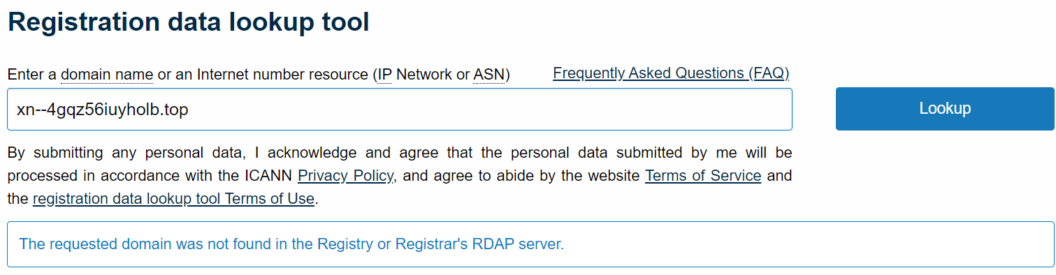
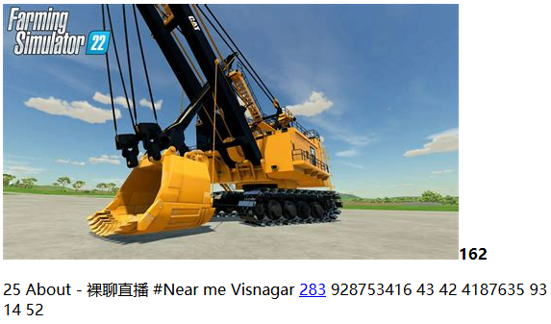
Unregistered Domain Names in DNS
xn--4gq220j14gckc.top（一谕终见.top）
xn--4gqz56iuyholb.top（一諭終見.top）
Registered with Alibaba Cloud
Unable to find the registration data
Webpage
However, it is possible to access its website.
Notes:
We all know that a domain has to be registered before it can be used. But we’ve found something strange—some domains are accessible even though they’re not registered.
Here’s an example: the domain on the left is registered with Alibaba Cloud, and its website works as expected. But the one on the right doesn’t show up in any registration data, yet its website is still online.
Pretty odd, right? We suspect there may be some unrecorded activity at the registry level causing this.
---------------
注册后域名才能被使用，这是我们的常识。
但是，我们却发现了一些非常奇怪的域名，他们没有被注册，却可以访问。
这里给出了一个例子。
左边的域名是在阿里云注册，我们可以访问他的网页。
右边的域名，我们无法找到他的注册数据，但是却可以访问他的网页。
这是非常奇怪的？我们怀疑是注册局某些未记录的操作导致了这个问题。

Slide 9
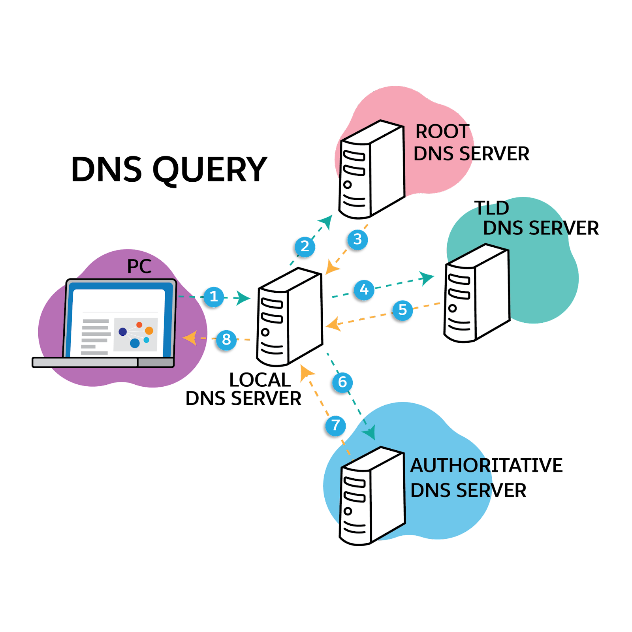
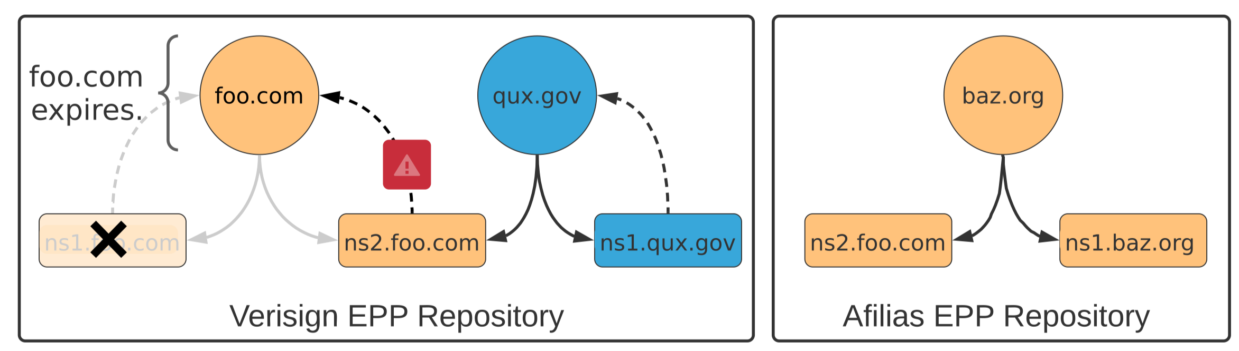


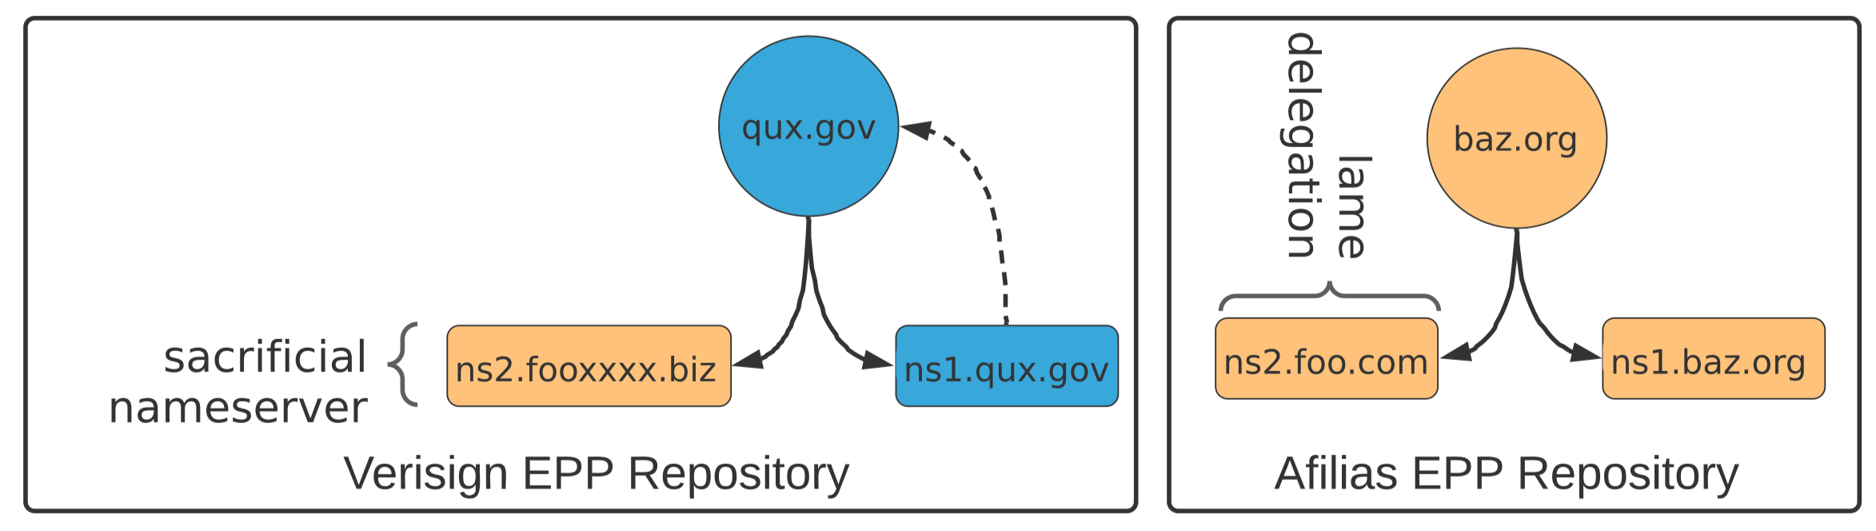

Threats Involving Domain Name Management
Hijacking domains by sacrificial nameservers [IMC 2021]
Controlling the TLD by controlling the EPP server [1]
EPP server
The undocumented registrar practices of the registration bureau pose a risk of domain name hijacking.
Registry software implementation flaw caused TLDs to be compromised.
[1] hackcompute 2023, https://hackcompute.com/hacking-epp-servers/
Notes:
Previous incidents have shown threats involving domain management.
A paper from IMC 2021 showed that undocumented operations at some registries left a large number of domains vulnerable to hijacking.
And in 2023, a blog post revealed flaws in EPP server implementations that could allow attackers to gain control over the entire top-level domains."
Building on these incidents, we attempt to conduct a thorough analysis of how domain registries operate.
---------------
我们为什么这么想呢？
因为注册局之前确实发生过这样的事。
IMC21的一篇文章揭露了注册局未记录的一些操作导致大量域名面临域名劫持风险。
2023年，一篇博客披露了EPP服务器的实现缺陷，可以获得顶级域的管理权限。

Slide 10






However, Registry Security Remains Underexplored
Challenges
  The EPP implementations are diverse and opaque.
  Access is restricted to accredited registrars.
EPP Implementation and Operation
Accredited
Domain Registrars
Domain Registry
Notes:
Registry security is still underexplored, mainly because EPP implementations vary and are often opaque; And access is limited to accredited registrars.

Slide 11
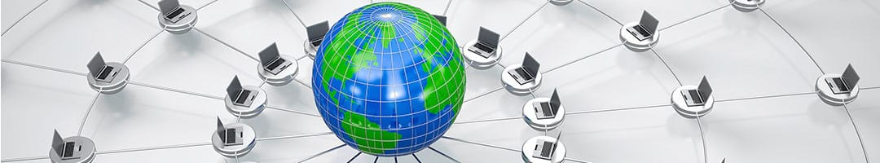



Infer inside operations from an outside view
Publicly updated domain data enables coarse inference of EPP operations.
Public TLD
Zonefiles
Registration Information
Registration Interfaces
Registration time
NS configurations
Historical & Active status code
...
EPP Implementation and Operation
Accredited
Domain Registrars
Domain Registry
Notes:
We set out to find a way to roughly infer internal operations using public data—like TLD zone files, registration records, and registrar interfaces.

Slide 12
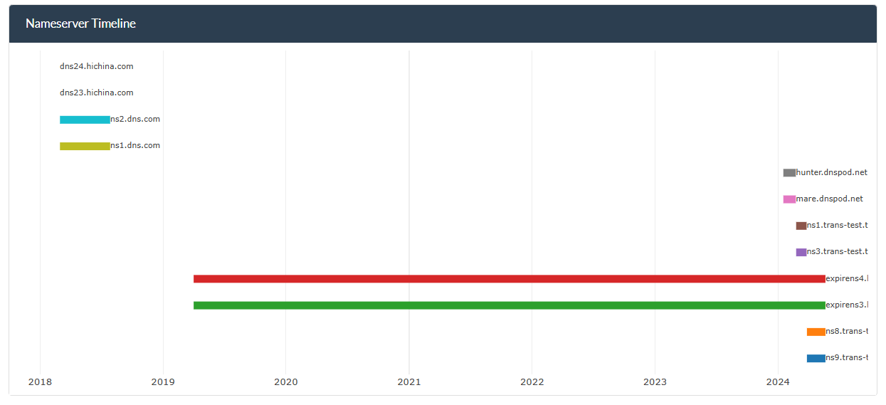
Infer inside operations from an outside view
All changes to a domain name’s delegation records involve the Registry
  The registrant initiates the changes, and the Registry provides assistance.
  The Registry makes changes on its own initiative
An example
Notes:
Here’s an example.
We observed that all changes to domain delegation records ultimately involves the registry, either supporting a request from the registrant or registrar, or initiating the update itself.
-----------------------
这里给出了一个域名授权记录更改的例子。
域名授权记录的每一次更改都与注册局有关。
可能是注册者申请，注册局协助修改。
也可能是注册局自主修改。

Slide 13
Infer inside operations from an outside view
All changes to a domain name’s delegation records involve the Registry
  The registrant initiates the changes, and the Registry provides assistance.
  The Registry makes changes on its own initiative
An example
domain name is idle
Notes:
Here’s an example.
We observed that all changes to domain delegation records ultimately involves the registry, either supporting a request from the registrant or registrar, or initiating the update itself.
-----------------------
这里给出了一个域名授权记录更改的例子。
域名授权记录的每一次更改都与注册局有关。
可能是注册者申请，注册局协助修改。
也可能是注册局自主修改。

Slide 14
Infer inside operations from an outside view
All changes to a domain name’s delegation records involve the Registry
  The registrant initiates the changes, and the Registry provides assistance.
  The Registry makes changes on its own initiative
An example
Modification of the Domain Name Delegation Records
domain name is idle
Notes:
Here’s an example.
We observed that all changes to domain delegation records ultimately involves the registry, either supporting a request from the registrant or registrar, or initiating the update itself.
-----------------------
这里给出了一个域名授权记录更改的例子。
域名授权记录的每一次更改都与注册局有关。
可能是注册者申请，注册局协助修改。
也可能是注册局自主修改。

Slide 15






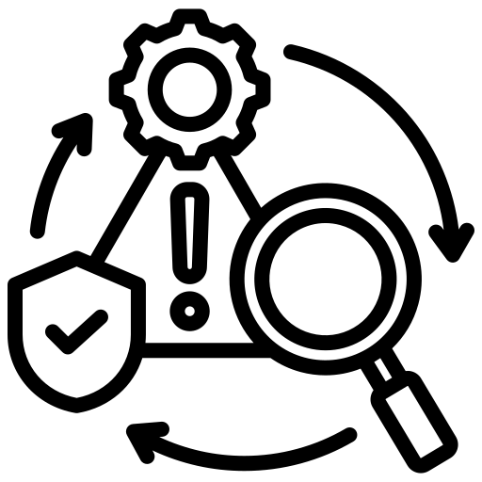
Pipeline
Analyze domain name status using publicly available authorization and registration data
Public Dataset
Domain Status
Flaws
Domain existence status
TLD
zonefile
extract
analyze
Creation
Phase
1,000+
Management
Phase
Registration data
Static
registration status
Dynamic registration status
Deletion Phase
7 billion
Notes:
Building on these ideas, we designed the following analysis process.
First, we collected zone files from over 1,000 top-level domains and over 7 billion domain registration records.
Next, we extracted delegation records and checked each domain’s existence and registration status.
Finally, we analyzed operation flaws across three key phases: domain creation, management, and deletion.
-------------------
基于上述思想，我们设计了如下的流程，
我们首先收集了1000多个顶级域的区域文件，和超过70亿的域名注册历史数据，
然后，提取每个域名的授权记录，构建域名状态，然后分析域名创建、管理和删除三个关键阶段的缺陷

Slide 16
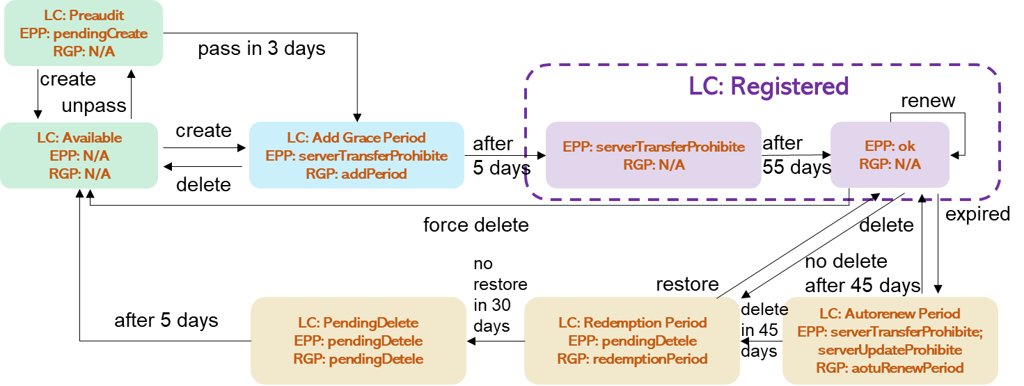
Uncover three registry operation flaws
Redundant domain creation
Siloed DNS host management
Insufficient domain deletion
Notes:
Through this process, we uncovered three flaws in registry operations, which I’ll go over next.

Slide 17
Creation Phase: The "Twin Domain" Trap
When a registrant registers an internationalized domain name, the registry automatically adds the corresponding twin domain without notifying the registrant.
IDN Variant
PrimaryDomain: 测试.example, xn--0zwm56d.example (Punycode)
TwinDomain: 測試.example, xn--g6w251d.example (Punycode)
PrimaryDomain creation
TwinDomain creation
Notes:
In the domain creation phase, we find an interesting issue.
@When someone registers an internationalized domain name,
@some registries or registrars automatically add the corresponding IDN variant to the zone file,
@and configure both domains with identical name servers, without informing the registrant.
We call the registered domain’s variant a TwinDomain. Here's an example.
The PrimaryDomain and its TwinDomain represent the same name or entity, but use different character sets—like Simplified and Traditional Chinese.
Unlike homograph domains, these IDN variants typically belong to the same owner.
------------------
在域名注册阶段，我们发现当注册者注册国际化域名时，一些注册局/注册商会自动添加相应的变体域名，我们称为之双子域名，而不通知注册者。
被添加的域名与注册域名相同的含义，但是由不同字符组成，比如中文中的简体和繁体
下面这张图展示了整个步骤。1

Slide 18

Creation Phase: The "Twin Domain" Trap
When a registrant registers an internationalized domain name, the registry automatically adds the corresponding twin domain without notifying the registrant.
IDN Variant
PrimaryDomain: 测试.example, xn--0zwm56d.example (Punycode)
TwinDomain: 測試.example, xn--g6w251d.example (Punycode)
PrimaryDomain creation
TwinDomain creation
1. Buy
PrimaryDomain
Registry/ Registrar
Registrant
Notes:
In the domain creation phase, we find an interesting issue.
@When someone registers an internationalized domain name,
@some registries or registrars automatically add the corresponding IDN variant to the zone file,
@and configure both domains with identical name servers, without informing the registrant.
We call the registered domain’s variant a TwinDomain. Here's an example.
The PrimaryDomain and its TwinDomain represent the same name or entity, but use different character sets—like Simplified and Traditional Chinese.
Unlike homograph domains, these IDN variants typically belong to the same owner.
------------------
在域名注册阶段，我们发现当注册者注册国际化域名时，一些注册局/注册商会自动添加相应的变体域名，我们称为之双子域名，而不通知注册者。
被添加的域名与注册域名相同的含义，但是由不同字符组成，比如中文中的简体和繁体
下面这张图展示了整个步骤。1

Slide 19
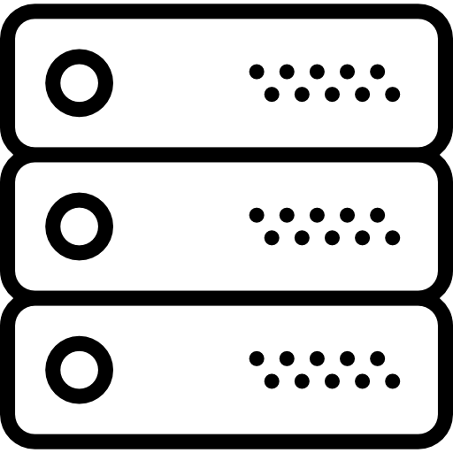
Creation Phase: The "Twin Domain" Trap
When a registrant registers an internationalized domain name, the registry automatically adds the corresponding twin domain without notifying the registrant.
IDN Variant
PrimaryDomain: 测试.example, xn--0zwm56d.example (Punycode)
TwinDomain: 測試.example, xn--g6w251d.example (Punycode)
PrimaryDomain creation
TwinDomain creation
2a. Create PrimaryDomain
and set NS
1. Buy
PrimaryDomain
Registry/ Registrar
TLD Zone File
xn--0zwm56d.example NS ns.provider.example
xn--g6w251d.example NS ns.provider.example
TLD Nameserver
Registrant
2a. Create
TwinDomain and set NS
Notes:
In the domain creation phase, we find an interesting issue.
@When someone registers an internationalized domain name,
@some registries or registrars automatically add the corresponding IDN variant to the zone file,
@and configure both domains with identical name servers, without informing the registrant.
We call the registered domain’s variant a TwinDomain. Here's an example.
The PrimaryDomain and its TwinDomain represent the same name or entity, but use different character sets—like Simplified and Traditional Chinese.
Unlike homograph domains, these IDN variants typically belong to the same owner.
------------------
在域名注册阶段，我们发现当注册者注册国际化域名时，一些注册局/注册商会自动添加相应的变体域名，我们称为之双子域名，而不通知注册者。
被添加的域名与注册域名相同的含义，但是由不同字符组成，比如中文中的简体和繁体
下面这张图展示了整个步骤。1

Slide 20
Creation Phase: The "Twin Domain" Trap
When a registrant registers an internationalized domain name, the registry automatically adds the corresponding twin domain without notifying the registrant.
IDN Variant
PrimaryDomain: 测试.example, xn--0zwm56d.example (Punycode)
TwinDomain: 測試.example, xn--g6w251d.example (Punycode)
PrimaryDomain creation
TwinDomain creation
2a. Create PrimaryDomain
and set NS
1. Buy
PrimaryDomain
Registry/ Registrar
TLD Zone File
xn--0zwm56d.example NS ns.provider.example
xn--g6w251d.example NS ns.provider.example
TLD Nameserver
Registrant
2a. Create
TwinDomain and set NS
Configure TwinDomain to use the same name servers (NS) as the PrimaryDomain
Notes:
In the domain creation phase, we find an interesting issue.
@When someone registers an internationalized domain name,
@some registries or registrars automatically add the corresponding IDN variant to the zone file,
@and configure both domains with identical name servers, without informing the registrant.
We call the registered domain’s variant a TwinDomain. Here's an example.
The PrimaryDomain and its TwinDomain represent the same name or entity, but use different character sets—like Simplified and Traditional Chinese.
Unlike homograph domains, these IDN variants typically belong to the same owner.
------------------
在域名注册阶段，我们发现当注册者注册国际化域名时，一些注册局/注册商会自动添加相应的变体域名，我们称为之双子域名，而不通知注册者。
被添加的域名与注册域名相同的含义，但是由不同字符组成，比如中文中的简体和繁体
下面这张图展示了整个步骤。1

Slide 21

Creation Phase: The "Twin Domain" Trap
Attackers exploit twin domains to carry out abuse activities at zero cost.
1. The registrant deploys only 测试.example on the hosting provider and does not deploy 測試.example, as they are unaware of its existence.
Threat Model
2. The attacker unauthorizedly hosts the domain 測試.example on the hosting provider and gains control over it.
PrimaryDomain: 测试.example, xn--0zwm56d.example (Punycode)
TwinDomain: 測試.example, xn--g6w251d.example (Punycode)
PrimaryDomain creation
TwinDomain creation
2a. Create PrimaryDomain
and set NS
1. Buy
PrimaryDomain
Registry/ Registrar
TLD Zone File
xn--0zwm56d.example NS ns.provider.example
xn--g6w251d.example NS ns.provider.example
TLD Nameserver
Registrant
2a. Create
TwinDomain and set NS
2c. Deploy
TwinDomain
2b. Deploy
PrimaryDomain
3a. Configure
PrimaryDomain
SLD Zone File
Hosting
Provider
xn--0zwm56d.example NS ns.provider.example
xn--0zwm56d.example A 1.2.3.4
SLD Nameserver
Notes:
The concern is that, we found attackers can exploit TwinDomains for malicious purposes—at zero cost.
Here’s how it works:
@If a registrant hosts their PrimaryDomain with a provider that allows users to deploy any domain without ownership verification,
and the registry or registrar automatically syncs the same name server settings to the TwinDomain,
then the TwinDomain is also delegated to that provider.
@At this point, an attacker can simply claim the TwinDomain on the same hosting platform and point it to a malicious IP—effectively abusing the domain without ever registering it.
------------------------
进一步地，我们发现攻击者可以利用这些双子域名零成本实现滥用活动。
下面展示了我们的威胁模型。
如果注册者目前使用了DNS托管服务商，且该服务商允许用户非授权的托管任意域名，则攻击者可以滥用双子域名。

Slide 22

Creation Phase: The "Twin Domain" Trap
Attackers exploit twin domains to carry out abuse activities at zero cost.
1. The registrant deploys only 测试.example on the hosting provider and does not deploy 測試.example, as they are unaware of its existence.
Threat Model
2. The attacker unauthorizedly hosts the domain 測試.example on the hosting provider and gains control over it.
PrimaryDomain: 测试.example, xn--0zwm56d.example (Punycode)
TwinDomain: 測試.example, xn--g6w251d.example (Punycode)
PrimaryDomain creation
TwinDomain creation
2a. Create PrimaryDomain
and set NS
1. Buy
PrimaryDomain
Registry/ Registrar
TLD Zone File
xn--0zwm56d.example NS ns.provider.example
xn--g6w251d.example NS ns.provider.example
TLD Nameserver
Registrant
2a. Create
TwinDomain and set NS
2c. Deploy
TwinDomain
2b. Deploy
PrimaryDomain
3a. Configure
PrimaryDomain
SLD Zone File
Hosting
Provider
xn--0zwm56d.example NS ns.provider.example
xn--0zwm56d.example A 1.2.3.4
SLD Nameserver
xn--g6w251d.example NS ns.provider.example
xn--g6w251d.example A a.t.t.k
❶ Deploy
TwinDomain
❷ Configure
TwinDomain
Attacker
Resolve TwinDomain to attacker’s IP.
Notes:
The concern is that, we found attackers can exploit TwinDomains for malicious purposes—at zero cost.
Here’s how it works:
@If a registrant hosts their PrimaryDomain with a provider that allows users to deploy any domain without ownership verification,
and the registry or registrar automatically syncs the same name server settings to the TwinDomain,
then the TwinDomain is also delegated to that provider.
@At this point, an attacker can simply claim the TwinDomain on the same hosting platform and point it to a malicious IP—effectively abusing the domain without ever registering it.
------------------------
进一步地，我们发现攻击者可以利用这些双子域名零成本实现滥用活动。
下面展示了我们的威胁模型。
如果注册者目前使用了DNS托管服务商，且该服务商允许用户非授权的托管任意域名，则攻击者可以滥用双子域名。

Slide 23
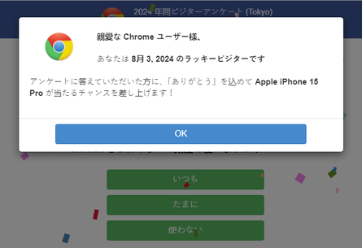
Creation Phase: The "Twin Domain" Trap
We identified 8,866 sets of twin domains, include domains under .top, .商城, .wang, .我爱你, and .com.
Among them, 6,017 are vulnerable to potential domain takeover, and some have already been exploited.
Impact
xn--4gqz56iuyholb.top（一諭終見.top）
A twin domain was used for multiple fraudulent activities within a month
Twin domains are actively being abused
Notes:
We found over 8,000 pairs of TwinDomains—and more than 6,000 of them were at risk of being taken over.
Even more concerning, we discovered some TwinDomains were already being actively abused.
As the example here, one of them was used for a range of malicious activities—all within just a single month.
-------
通过大规模的评估，我们发现了8866组双子域名，其中6017个域名存在被劫持风险。
同时，我们还发现，双子域名已经被攻击者积极的滥用。
如左边图所示，在间隔一个月之后，我们发现一个双子域名被滥用于不同的恶意活动。

Slide 24
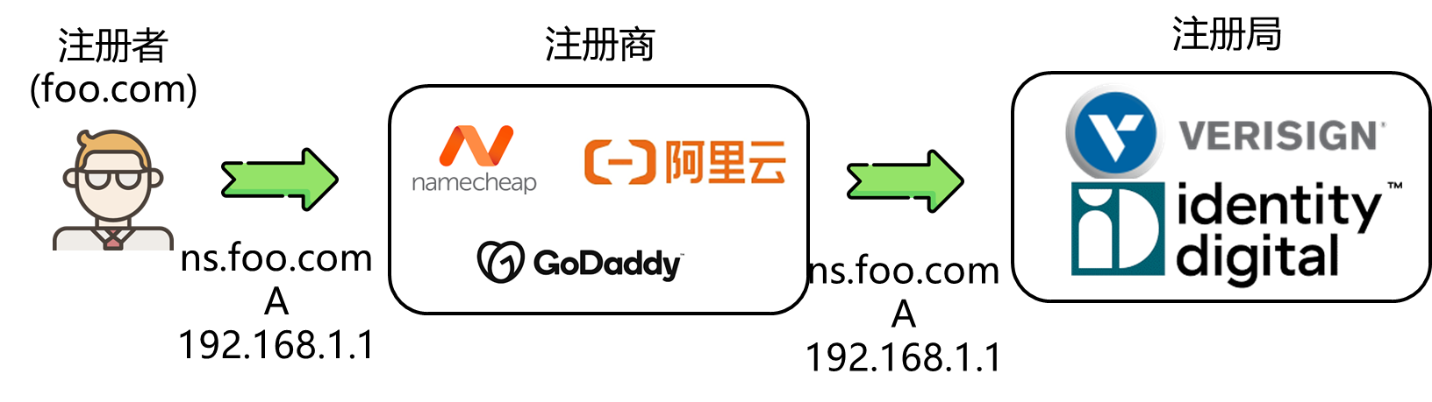
Management Phase: Unchecked Host Objects
Some registries often add all registrant-configured host objects to zone files without proper checks or purging.
.
Root
Register Glue Record
.com
.net
TLD
example.com
SLD
Notes:
During the domain creation phase, we noticed something unusual
@some registries add every host object submitted by registrars directly into the zone file, without doing proper checks or cleanup.
@Through data-driven analysis, we summarize two common modes registries handle host objects:
One mode is to add them to the zone file as soon as they're registered.
---------------------
在域名管理阶段，
我们发现有些注册局经常将所有注册器配置的主机对象添加到区域文件中，而不进行适当的检查或清除。
通过分析，我们总结了两种对胶水记录的管理模式。
模式1，只要注册就写到区域文件中

Slide 25
Management Phase: Unchecked Host Objects
Some registries often add all registrant-configured host objects to zone files without proper checks or purging.
.
Root
Register Glue Record
.com
.net
TLD
example.com
SLD
Mode 1
Write to zone file whenever you register the hosts objects: top, com
host object:
<ns1,ip1>
registrar
<check>
<create>
zone file
Notes:
During the domain creation phase, we noticed something unusual
@some registries add every host object submitted by registrars directly into the zone file, without doing proper checks or cleanup.
@Through data-driven analysis, we summarize two common modes registries handle host objects:
One mode is to add them to the zone file as soon as they're registered.
---------------------
在域名管理阶段，
我们发现有些注册局经常将所有注册器配置的主机对象添加到区域文件中，而不进行适当的检查或清除。
通过分析，我们总结了两种对胶水记录的管理模式。
模式1，只要注册就写到区域文件中

Slide 26
Management Phase: Unchecked Host Objects
Some registries often add all registrant-configured host objects to zone files without proper checks or purging.
.
Root
Register Glue Record
.com
.net
TLD
example.com
SLD
Mode 1
Write to zone file whenever you register the hosts objects: top, com
host object:
<ns1,ip1>
registrar
<check>
<create>
zone file
Notes:
During the domain creation phase, we noticed something unusual
@some registries add every host object submitted by registrars directly into the zone file, without doing proper checks or cleanup.
@Through data-driven analysis, we summarize two common modes registries handle host objects:
One mode is to add them to the zone file as soon as they're registered.
---------------------
在域名管理阶段，
我们发现有些注册局经常将所有注册器配置的主机对象添加到区域文件中，而不进行适当的检查或清除。
通过分析，我们总结了两种对胶水记录的管理模式。
模式1，只要注册就写到区域文件中

Slide 27
Management Phase: Unchecked Host Objects
Some registries often add all registrant-configured host objects to zone files without proper checks or purging.
.
Root
Register Glue Record
.com
.net
TLD
example.com
SLD
host object:
<ns1,ip1>
Host object database
Mode2
Write to zone file only when used by in-domain delegations, such as .xyz, .site
registrar
<check>
<create>
domain ns:
<domain1,ns1>
In-domain delegation ：
<check>
<update>
google.com NS ns1.google.com
zone file
Notes:
The other is more cautious—it only adds them when they’re actually used in an in-domain delegation.

Slide 28
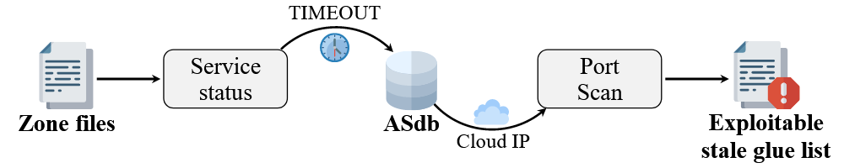
Management Phase: Unchecked Host Objects
Identifying
stale glue records [1]
1k+
80,251 stale glue records that can be exploited, affecting 1,600,253 domain, including .com, .org, .net
Impact
All Glue Records 2,303,951 (100%)
TLD | # glue record | ratio
.com | 47,593 | 13.34%
.org | 18,926 | 6.58%
.info | 4,157 | 4.31%
.net | 3,707 | 7.84%
.top | 1,645 | 12.11%
Abandoned 532,363 (23.11%)
Active Glue Records 1,771,588 (76.89%)
Lack in-domain delegation 963,182 (54.37%)
Exploitable stale glue records 80,251 (8,33%)
[1] Zhang et al., Rethinking the Security Threats of Stale DNS Glue Records, USENIX Security 2024
Notes:
Using the method we introduced last year to identify stale glue records,
we analyzed over 1,000 top-level domains and found that Mode-1 led to around 80k stale glue records that attackers could potentially exploit.
@Our findings show that the registry’s glue record management strategy is the key factor behind the large number of stale glue records

Slide 29
Management Phase: Unchecked Host Objects
Identifying
stale glue records [1]
1k+
80,251 stale glue records that can be exploited, affecting 1,600,253 domain, including .com, .org, .net
Impact
All Glue Records 2,303,951 (100%)
TLD | # glue record | ratio
.com | 47,593 | 13.34%
.org | 18,926 | 6.58%
.info | 4,157 | 4.31%
.net | 3,707 | 7.84%
.top | 1,645 | 12.11%
Abandoned 532,363 (23.11%)
Active Glue Records 1,771,588 (76.89%)
Lack in-domain delegation 963,182 (54.37%)
Exploitable stale glue records 80,251 (8,33%)
We confirmed that the registry’s glue record management strategy is the key factor leading to a large number of stale glue records
[1] Zhang et al., Rethinking the Security Threats of Stale DNS Glue Records, USENIX Security 2024
Notes:
Using the method we introduced last year to identify stale glue records,
we analyzed over 1,000 top-level domains and found that Mode-1 led to around 80k stale glue records that attackers could potentially exploit.
@Our findings show that the registry’s glue record management strategy is the key factor behind the large number of stale glue records

Slide 30
Deletion Phase: Relic Domains and Hijacking Risks
When a domain name expires, the registry needs to clean up all resource records related to the domain name.
Notes:
Let’s review the domain name lifecycle.
When a domain expires, the registry is supposed to clean up all the resource records linked to it.
But what if that cleanup doesn’t happen properly? What could go wrong?

Slide 31
Deletion Phase: Relic Domains and Hijacking Risks
After a domain name expires, some of its delegation records remain uncleared.
untapped relic domains
resurrected relic domains
relic domain
The new registrar/registrant does not have authority over the old delegation records. It can add new records but cannot delete zombie records.
The NS records in WHOIS are inconsistent with the NS records in the zone file.
The domain's delegation record has lost its administrator, so it remains in the zone file.
No WHOIS, but the NS record exists
 | NS (zone) | NS (WHOIS) | Expiry Date | Static Registration Status | Dynamic Registration Status
exa.com | ns.foo.com | ns.exa.com | 2025-04-08 | registered | registered
exa.com | ns.exa.com
bar.com | ns.bar.com | / | 2023-03-08 | unregistered | unregistered
Inconsistent
NS records
domain not registered
Notes:
We found that in some cases, even after a domain expires, its delegation records are still left behind in the zone file. We call these relic domains.
Depending on their current status, we break them into two types: untapped and resurrected relic domains：
1. Untapped relic domains haven’t been re-registered after expiring. Since there’s no admin anymore, their delegation records just sit in the zone file, unmanaged.
2. Resurrected relic domains have been re-registered—but the new registrar doesn’t control the old delegation records. They can add new ones, but they can’t remove the leftover, or ‘zombie’, records.
This table shows examples of the resource records and registration status for both types.
The domain exa.com has different NS records in the zone file and WHOIS record, which means there are legacy delegation records in the zone file.
The domain name bar.com is not registered, but there is an NS record in the zone file.
------------------------
我们发现，域名过期后，一些域名的权威资源记录没有被清理，我们将这些域名称之为 遗迹域名。
根据遗迹域名的当前注册状态，我们将其划分为两种类型，untapped relic domains 和 resurrected relic domains.
untapped relic domains : 过期之后还没有被重新注册，The domain's delegation record has lost its administrator, so it remains in the zone file.
resurrected relic domains: 过期之后又被重新注册，The new registrar does not have authority over the old delegation records. It can add new records but cannot delete zombie records.
下面展示了两种域名的资源记录和注册状态样例。

Slide 32
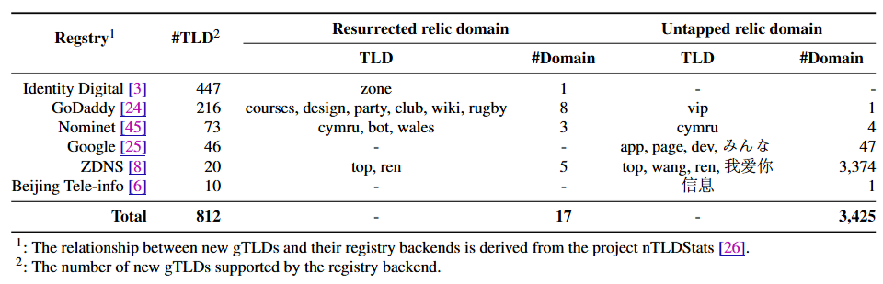
Deletion Phase: Relic Domains and Hijacking Risks
Impact in the wild
Untapped
relic domains
3,425 domains confirmed, covering 11 TLDs, including top，app，vip, 我爱你.
Registrie backends: GoDaddy、Nominet、Google、ZDNS 和 Beijing Tele-infoNetwork
Resurrected
relic domains
19 domains confirmed, covering 13 TLDs, including top，ren, courses，biz，cymru
Registrie backends : Identity Digital、GoDaddy、Nominet 和 ZDNS
The affected registrie backends serve a total of 812 TLDs
Notes:
By looking at domain delegation records and status data, we found over 3k untapped relic domains across 11 TLDs—like .top, .app, and .vip.
We also identified 19 resurrected relic domains spread across 13 TLDs.
Altogether, these cases involve six major registry backends, including big names like Google and ZDNS."
-----------------------------
利用域名授权记录和注册状态的差异性分析，我们共发现了3,425个untapped relic domains，覆盖了11个顶级域，如 top，app，vip, 我爱你
19 个resurrected relic domains，涉及13个顶级域。
这些顶级域共涉及了6个主流的注册局后端，包括Google, ZDNS。
进一步地，我们统计了这些注册局后端服务的顶级域，发现他们共服务了812个顶级域，意味着超过半数的顶级域都受该问题的影响。

Slide 33
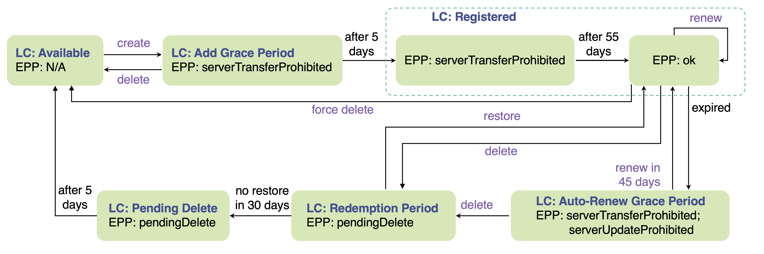
Deletion Phase: Relic Domains and Hijacking Risks
The pendingDelete status and
the serverHold status of the
domain overlap, causing the
software to be unable to clean
up the delegation records normally.
Root Cause Analysis
serverHold
Notes:
To figure out what was causing these relic domains, we teamed up with a registry service provider.
We found that when a domain enters the pendingDelete phase，@and also has a serverHold status due to some issue, the overlap between these two statuses can confuse the system.
As a result, the software fails to properly delete the delegation records.
We responsibly disclosed this issue to all affected registries.
Currently, both Google and ZDNS have identified the problem and fixed it.
-------------
为了确定遗迹域名产生的原因，我们与一家注册局服务商合作，最终发现，是域名生命周期中删除阶段pendingDelete （要过期）状态和 serverHold（有一些异常） 状态的重合导致软件无法正常删除域名的授权记录。
我们对所有注册局进行了负责任的披露，目前谷歌和zdns已经确定并修复了该问题。

Slide 34
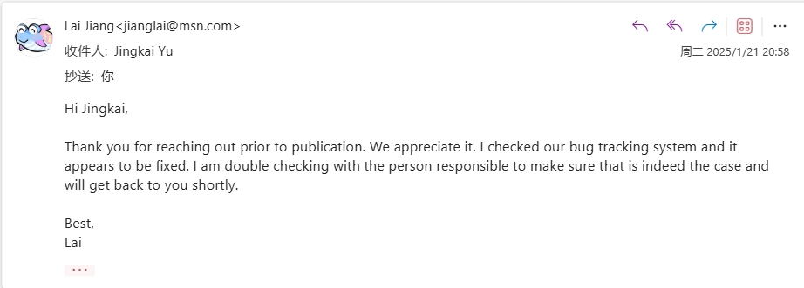
Deletion Phase: Relic Domains and Hijacking Risks
The pendingDelete status and
the serverHold status of the
domain overlap, causing the
software to be unable to clean
up the delegation records normally.
Root Cause Analysis
serverHold
Google and ZDNS have confirmed the issue and have completed the fix
Disclosure
34
Notes:
To figure out what was causing these relic domains, we teamed up with a registry service provider.
We found that when a domain enters the pendingDelete phase，@and also has a serverHold status due to some issue, the overlap between these two statuses can confuse the system.
As a result, the software fails to properly delete the delegation records.
We responsibly disclosed this issue to all affected registries.
Currently, both Google and ZDNS have identified the problem and fixed it.
-------------
为了确定遗迹域名产生的原因，我们与一家注册局服务商合作，最终发现，是域名生命周期中删除阶段pendingDelete （要过期）状态和 serverHold（有一些异常） 状态的重合导致软件无法正常删除域名的授权记录。
我们对所有注册局进行了负责任的披露，目前谷歌和zdns已经确定并修复了该问题。

Slide 35
Stale and Dangling records are harmful, But …
Dangling record risk was first identified in 2016
Zombie awakening attack (2020)
XDAuth attack (2024)
Sitting Ducks attack (2024)
Dangling resource records are being widely abused.
35
Notes:
无论是hi注册者、注册商和注册局的什么操作，最终导致的都是stale or dangling 的资源记录。
我们都任务他们是有害的，但是我们却一直都在逃避，将其归结在用户操作错误上。
我们在回顾一下。
Dangling 风险在2016年被提出，并且在近几年持续有新的风险被披露。
并且有研究表明，dangling 风险正在被广泛的滥用。
我认为我们是时候来通过技术方案缓解这个风险了。我们都不会想下一个十年我们仍于该威胁同行。
陈旧的/遗弃的资源记录被利用并不是一件新鲜事。
Dangling record 威胁在10年前就已经被披露。
我们的最近几项研究工作以及2024年Infoblox and Eclypsium 联合披露的Sitting Ducks attack，都表明风险依然存在，并且正在被利用。
很多时候大多数服务商都认为这是一个管理问题，这是域名注册者的失误导致的风险。
每个人都会犯错，特别是面对大规模的复杂的资源记录配置。
你无法改变人，但是我们可以改变方案。
是时候来通过技术方案缓解这个风险了。我们都不会想下一个十年我们仍于该威胁同行。
There is evidence indicating that...

Slide 36
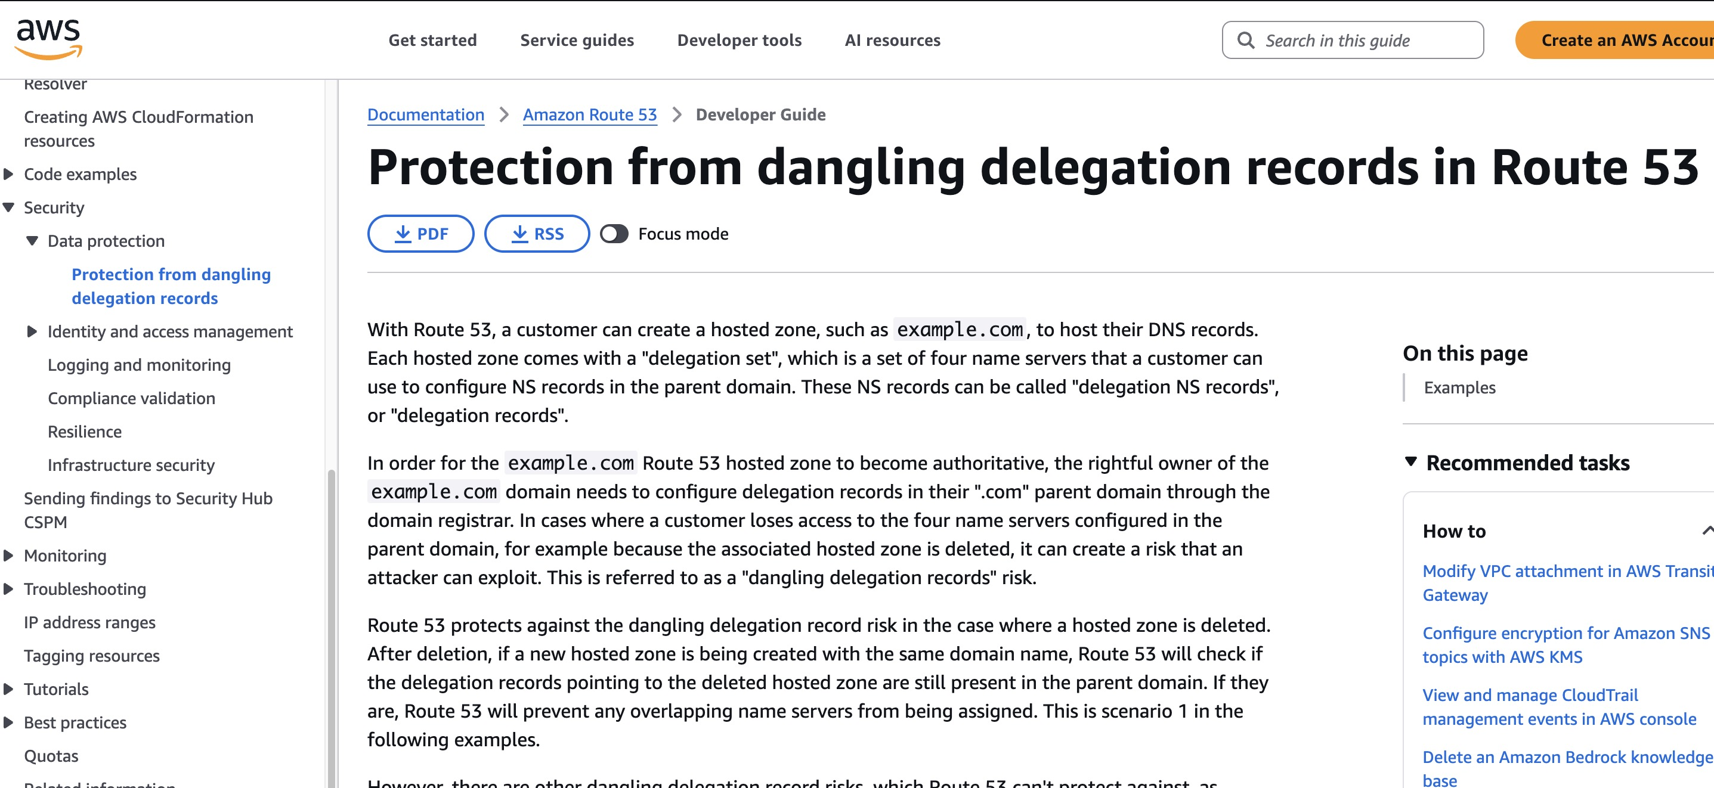
We can do it …
EXAMPLE
Route 53 protects child.example.com from dangling delegation records risk by preventing <ns1>, <ns2>, <ns3>, and <ns4> from being assigned to newly created hosted zones with the same domain name.
36
Notes:
一些厂商已经做了很多的努力，比如AWS、google等。他们通过安全的NS分配算法来避免攻击者获取必要的攻击资源。
但是很多厂商没有足够大的资源池来实现，他们通常为全部用户提供相同的NS集合。
我们的分析中已经发现有个别厂商通过一些操作已经较好的规避了该风险，比如 AWS, google cloud.
他们通过安全的NS分配算法来避免攻击者获取必要的资源。
方案是有效的，但是很难推广至所有服务商。
这里我们提出一个更加轻量级的方案，服务取消确认。
Dangling record 威胁的核心在于停止服务的资源记录没有被清除。
因此，我们设计了一套验证策略。
在用户尝试取消托管服务时，服务商增加一项额外的验证，只有用户已经删除或者更改了资源记录，才真正将服务撤销。
这样可以强制用户删除停止服务的资源记录。
同时对于当前服务商的服务逻辑也不会造成破坏。
【开放的检测服务】：受限的，

Slide 37
How to do it …
在本服务商注册，可以直接检查注册信息
域名所有权验证通过，激活服务，分配 NS
所有权校验一致
分配 NS
是否是本服务商NS
N
TXT 记录校验
所有权校验不一致
托管冲突
检查现有 NS
Y
N
将域名 NS 初始化，即验证域名所有权，又保证域名的可解析性
无本服务商NS
Y
检查现有 NS
托管取消
N
检查域名现有 NS， 避免攻击者的接管
37
Notes:
Dangling record 威胁的核心在于停止服务的资源记录没有被清除。
因此，我们设计了一套验证策略。
在用户尝试取消托管服务时，服务商增加一项额外的验证，只有用户已经删除或者更改了资源记录，才真正将服务撤销。
这样可以强制用户删除停止服务的资源记录。
同时对于当前服务商的服务逻辑也不会造成破坏。
【开放的检测服务】：受限的，

Slide 38
在本服务商注册，可以直接检查注册信息
域名所有权验证通过，激活服务，分配 NS
域名
是否在本服务商注册
Y
所有权校验一致
分配 NS
N
检查域名现有 NS（ip）， 避免攻击者的接管
检查现有 NS(ip)
是否是本服务商NS
N
Y
TXT 记录校验
N
所有权校验不一致
托管冲突
Y
将域名 NS 初始化，即验证域名所有权，又保证域名的可解析性
取消历史托管
N
通过 TXT 记录验证域名的所有权

Slide 39
How to do it …
Double Clear
FIRST: When a user intends to host a domain
No
When domain hosting providers assign specific Name Servers (NS) to a user, they first perform an NS check to verify if any stale or legacy NS records exist.
Allocating NS
Whether it is an in-house NS
Check NS
Hosting Conflict
Yes
GOAL: prevent vulnerable domains from being exploited by malicious actors
SECOND: When a user terminates the hosting service
The provider enforces the removal of the domain's NS records through an active verification mechanism.
The existence of in-house NS
Yes
Service Termination
Check NS
No
GOAL: inhibit the creation of additional dangling records at the source
Notes:
Dangling record 威胁的核心在于停止服务的资源记录没有被清除。
因此，我们设计了一套验证策略，我们称之为double clear
在用户尝试取消托管服务时，服务商增加一项额外的验证，只有用户已经删除或者更改了资源记录，才真正将服务撤销。
这样可以强制用户删除停止服务的资源记录。
同时对于当前服务商的服务逻辑也不会造成破坏。
【开放的检测服务】：受限的，

Slide 40
Thank You & Get in Touch!
Emails:
yunyizhang@mail.tsinghua.edu.cn
Yunyi Zhang
Notes:
That brings us to the end of this presentation. Thank you so much for your attention!
If you're interested in this work, or if you have any questions, please don't hesitate to reach out to the authors via these emails.

