Slide 1
Root KSK Rollover 2026
An Operator’s Readiness Checklist
Roy Arends, ICANN
DNS-OARC May 2026

Slide 2
Why You Should Care
DNSSEC validation depends on root trust anchor
The root has been signed since 2010
First rollover since 2018
Second rollover since the start
Automated root KSK rollover depends on RFC5011 processes
This is a planned, routine event
Your job: make sure your resolvers follow along
Our intent is to rollover ever 3 years.

Slide 3
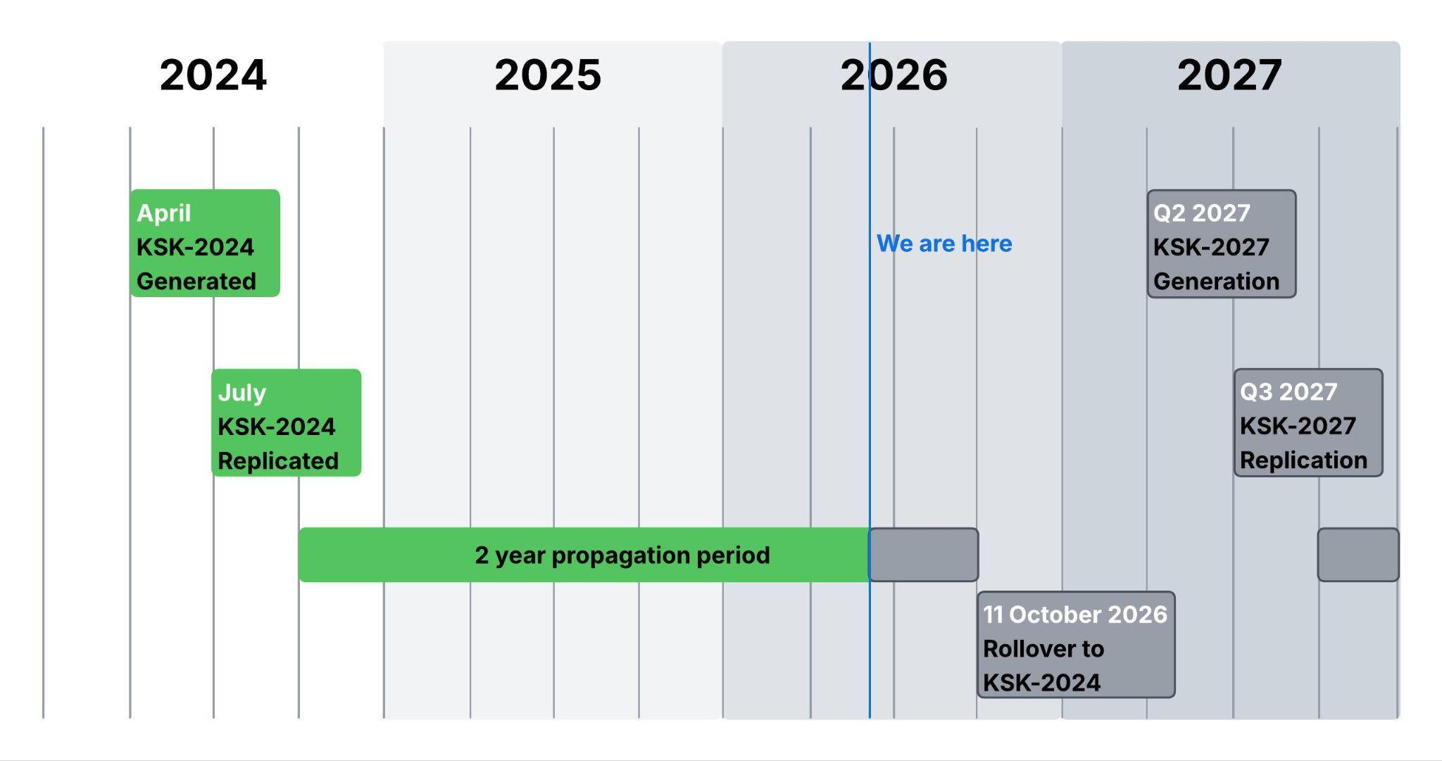
Timeline

Slide 4
How does “5011” work
A new KSK is published, the current KSK signs the set of keys
A set contains zone and key signing keys
After a while the new KSK signs the set of keys
It becomes the current key
The old key will still be present
After a while the old KSK will have the “revoke” bit set
This is a signal to validators that the old KSK is invalid.
After a while the old KSK will be removed from the set of keys.

Slide 5
How long is “a while”
January 11, 2025: DNSKEY “KSK-2024” in the root zone
February 10, 2025: KSK-2024 should be trusted via 5011
October 11, 2026: KSK-2024 will start signing KSK-2017 will stop signing
January 11, 2027: KSK-2017 is scheduled to be revoked

Slide 6
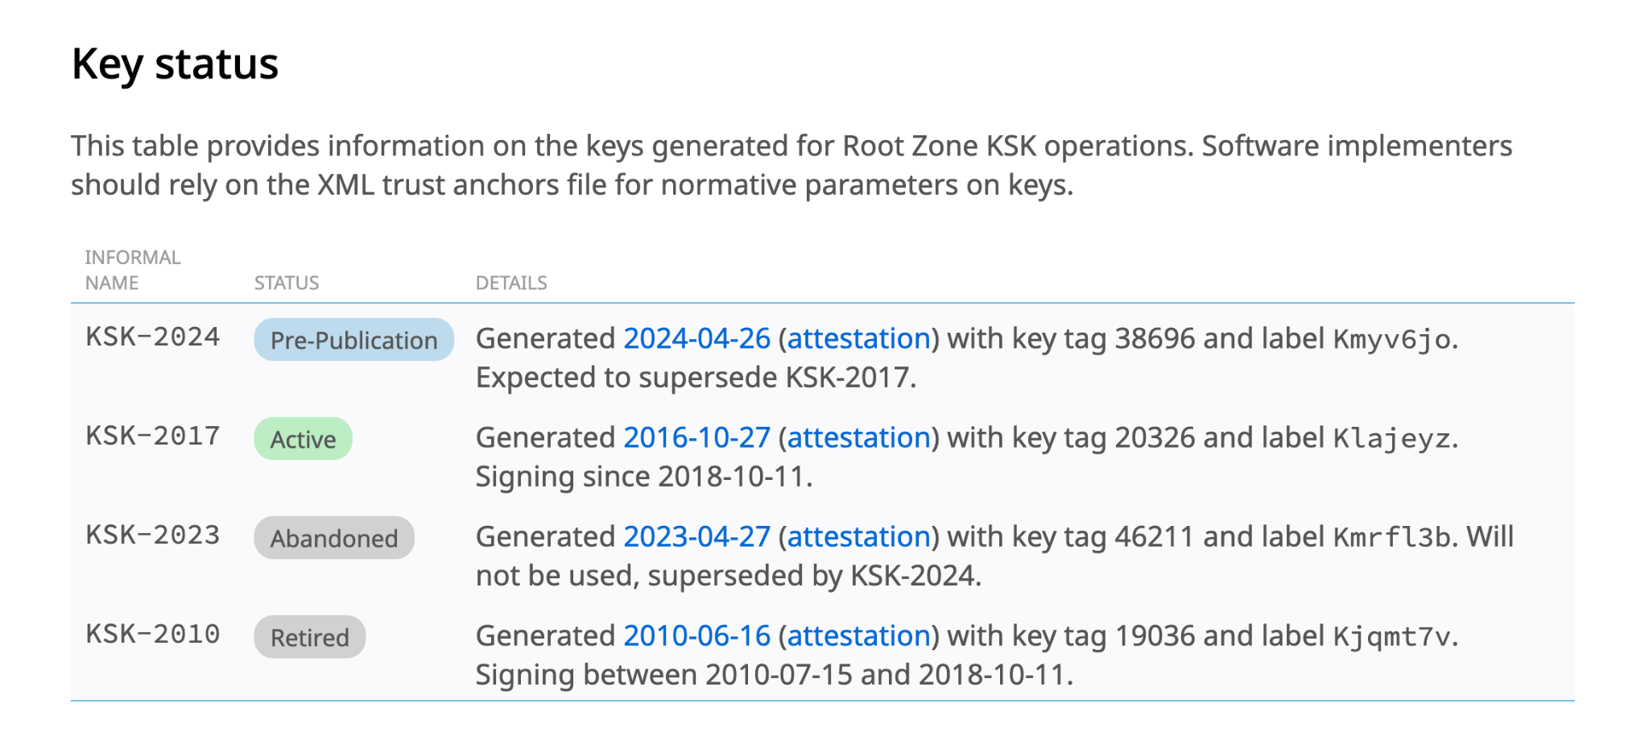
DNS Trust Anchor Availability
The trust anchor is available for distribution (XML file)
Most users adopt it automatically via software updates
Published in the root zone since 11 January 2025
See RFC7958
https://www.iana.org/dnssec/files

Slide 7
Check if your software is up to date
Resolver | First Release with KSK-2024 | RFC 5011 | Key File
Unbound | 1.21.0 (August 15, 2024) | Yes | root.key
Knot Resolver | 5.7.4 / 6.0.8 (Late 2024) | Yes | root.keys
BIND | 9.18.33 / 9.20.4 (January 2025) | Yes | bind.keys / managed-keys.bind
PowerDNS Recursor | 5.2.0-alpha1 (Nov 11, 2024) / 5.2.0 (Jan 14, 2025) | No | Built-in only

Slide 8
Questions

