Slide 1

POPAI: (DNS) POisoning Prevention System Past & Future
Yehuda Afek, Harel Berger, Anat Bremler Barr
OARC-46 Edinburgh May 16 2026

Slide 2
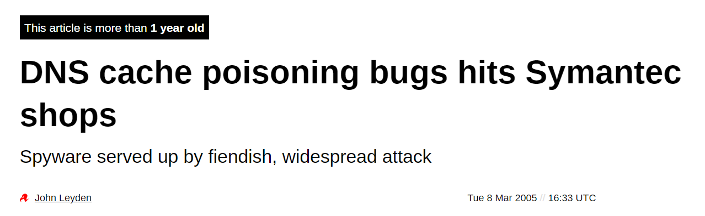
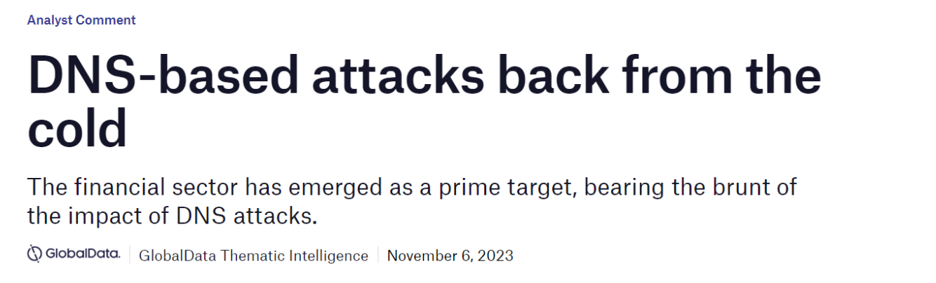
Motivation - DNS Cache Poisoning is still kicking…
DNS CVEs
DNS Cache Poisoning Remains Pervasive — and Highly Dangerous
CVE-2023-30464
CVE-2023-28457
CVE-2021-43105
CVE-2021-3448
CVE-2020-25684
CVE-2017-12132
CVE-2008-3217
CVE-2008-1447
CVE-2008-1454
CVE-2008-1146
CVE-2007-2926
CVE-2002-2211
CVE-2002-2212
2023
CVE-2002-2213
[TuDoor Attack: Systematically Exploring and Exploiting Logic Vulnerabilities in DNS Response Pre-processing with Malformed Packets
SP-2024 Xiang Li; Wei Xu; Baojun Liu; Mingming Zhang; Zhou Li; Jia Zhang[
Notes:
Widespread Persistnet
Remains a Common Threat
DNS Cache Poisoning Persists Across Networks
DNS Cache Poisoning Continues to Spread
DNS Cache Poisoning Remains a Common Threat
DNS Cache Poisoning Is Far From Over
Still a Broad and Ongoing Risk
Persistent DNS Cache Poisoning Threat
DNS Cache Poisoning Is Still a Systemic Problem
Persistent DNS Cache Poisoning Threat
DNS Cache Poisoning Is Still a Systemic Problem

Slide 3
PoPAI POisoning Prevention by Authentication & Integrity
IPS/FW module
Fast & Efficient
Detection & Mitigation
of *all* Statistical DNS Poisoning attacks
Past & Future
zero FN and negligible FP

Slide 4

PoPAI *all* Statistical DNS Poisoning attacks
We do not detect or mitigate
Session hijacking attacks:
MITM poisoning attacks
BGP hijacking attacks
Standard Statistical attacks
Fragmentation attacks
Out-of-Bailiwick attacks
1st statistical
2nd Fragment
3rd Out-of-Bailiwick

Slide 5
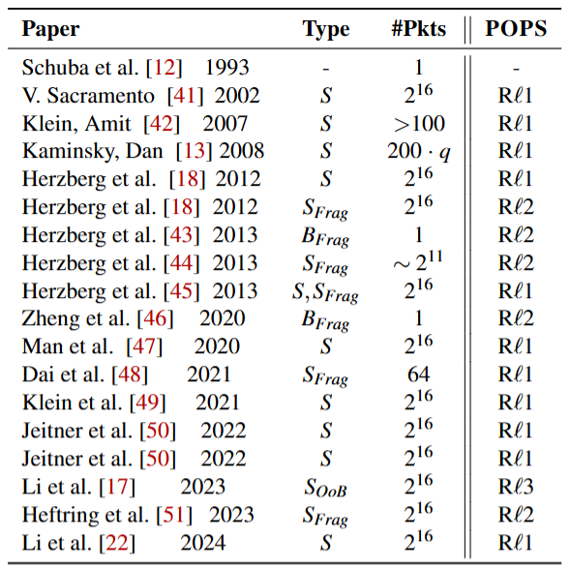
Past
ⱱ
ⱱ
ⱱ
ⱱ
Detection Module vs. Attacks
ⱱ
ⱱ
ⱱ
ⱱ
ⱱ
ⱱ
ⱱ
ⱱ
ⱱ
ⱱ
ⱱ
ⱱ
ⱱ

Slide 6
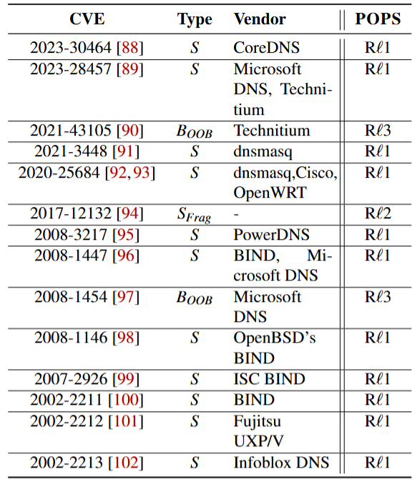
Past
Mitigated CVEs

Slide 7
PoPAI
Future
Past &
Mythos-ready for the DNS Vulnerability Storm
disclosure ←→ exploitation time is shrinking!

Slide 8



High level DNS request
Client A
UDP !
Recursive
Resolver
Rqst bank.com ?
Rqst bank.com ?
Authoritative Name Server
1.2.3.4
bank.com=1.2.3.4

Slide 9


Statistical Poisoning Attack
1st statistical
1st statistical
Client A
UDP !
Recursive
Resolver
Rqst bank.com ?
Rqst bank.com ?
Authoritative Name Server
8.5.7.6
1.2.3.4
bank.com=1.2.3.4
Same Domain?
Same Port#?
Same TXID?
bank.com=8.5.7.6
$$2^{16}$$
Attacker

Slide 10


PoPAI Detection
1st statistical
Client A
UDP !
Recursive
Resolver
Rqst bank.com ?
Rqst bank.com ?
Authoritative Name Server
>5
bank.com=1.2.3.4
>5 ➔Block any UDP bank.com response
bank.com=8.5.7.6
PoPAI
$$2^{16}$$
Attacker

Slide 11


PoPAI Mitigation
1st statistical
Client A
UDP !
Recursive
Resolver
Rqst bank.com ?
TCP !
Rqst bank.com ?
Rqst bank.com ?
Authoritative Name Server
1.2.3.4
Set TC=‘1’ true
TCP !
bank.com=1.2.3.4
>5 ➔Block any UDP bank.com response
bank.com=8.5.7.6
?
PoPAI
$$2^{16}$$
Attacker

Slide 12
PoPAI Statistical attacks
1st statistical
Detection: minimize false negatives (FN) & negligible false positive, 0.0076% (FP)
(>#5 Packets)
Mitigation: zero FN * & zero FP
===============================================================
All together: zero FN
In conclusion:
Blocks 99.993% of attacks with zero false negatives!
Fast & efficient
& negligible FP (0.0076%)
*Assuming resolvers respond \w TCP on TC bit
(all large ones. > 97% [Moura et.al. 21] [Bhowmick et.al.23])

Slide 13
DNS Fragmentation Response
2nd Fragmentation
Fragmentation
Fragments
Client A
UDP !
Recursive
Resolver
Rqst bank.com ?
1st Frag
Rqst bank.com ?
2nd Fragment bank-1.2.3.4
Authoritative Name Server
bank.com=1.2.3.4
2nd Fragment bank.com=1.2.3.4
1st Fragment <DNS zone info>
IP-ID? (e.g., per Dest)

Slide 14
Fragmentation Poisoning Attack
2nd Fragmentation
Client A
UDP !
Recursive
Resolver
Rqst bank.com ?
1st Frag
Rqst bank.com ?
2nd Fragment bank-8.5.7.6
Authoritative Name Server
bank.com=8.5.7.6
1st Fragment bank.com=1.2.3.4
IP-ID? (e.g., per Dest)
2nd Fragment bank.com=8.5.7.6
Some Frag attacks correctly guess the IP-ID !!
$$2^{16}$$
Attacker

Slide 15
Fragmentation Poisoning Attack
2nd Fragmentation
Detection & Mitigation
Client A
UDP !
Recursive
Resolver
Rqst bank.com ?
TCP !
Rqst bank.com ?
Rqst bank.com ?
Authoritative Name Server
bank.com=1.2.3.4
Set TC=‘1’ true
TCP !
1st Fragment bank.com=1.2.3.4
bank.com=1.2.3.4
Block any Fragment
2nd Fragment bank.com=8.5.7.6
?
PoPAI
Attacker

Slide 16
PoPAI Fragmentation attack
2nd Fragmentation
Detection: 100% false negatives (FN) & 0% false positive
Mitigation: zero FN * & zero FP
=========================================================
All together: zero FN
In conclusion:
Blocks 100% of fragmentation attacks with zero false negatives!
Fast & efficient
& zero FP
*Assuming resolvers respond \w TCP on TC bit
(all large ones. > 97% [Moura et.al. 21] [Bhowmick et.al.23])

Slide 17
In--Bailiwick DNS response
3rd Out-of-Bailiwick
In--Bailiwick
Client A
UDP !
Recursive
Resolver
Rqst foo.bar.com ?
Rqst bank.com ?
Rqst foo.bar.com ?
Authoritative Name Server
In-Bailiwick !
bank.com=1.2.3.4
Foo.bar.com=4.3.2.1
Answer: foo.bar.com A 4.3.2.1
-------------
Auth: bank.com NS ns1.bserver.com
-------
Rqst bank.com ?
foo.bar.com A 4.3.2.1
bank.com NS ns1.bserver.com
ns1.bserver.com A 6.6.6.6
bank.com=1.2.3.4
Add: ns1.bserver.com A 6.6.6.6
Glue Record
6.6.6.6

Slide 18
Out-of-Bailiwick Poisoning Attack
3rd Out-of-Bailiwick
Client A
UDP !
Recursive
Resolver
Rqst bank.com ?
Rqst foo.bar.com ?
Authoritative Name Server
Out-O-Bailiwick!
bank.com=8.5.7.6
Rqst bank.com ?
Answer: foo.bar.com A 4.3.2.1
-------------
Auth: bank.com NS ns1.attacker.net
-------
bank.com=8.5.7.6
foo.bar.com A 4.3.2.1
bank.com NS ns1.attacker.net
ns1.attacker.net A 7.7.7.7
Add: ns1.attacker.net A 7.7.7.7
Glue Record
Rqst foo.bar.com ?
Attacker
7.7.7.7

Slide 19
Out-of-Bailiwick Poisoning Attack
3rd Out-of-Bailiwick
Client A
UDP !
Mitigation
Recursive
Resolver
Rqst foo.bar.com ?
Authoritative Name Server
Answer: foo.bar.com A 4.3.2.1
-------------
Auth: bank.com NS ns1.attacker.net
-------
Drop all Out-of-Bailiwick responses
Add: ns1.attacker.net A 7.7.7.7
Rqst foo.bar.com ?
Attacker
Detection Rule (Rl3) – glue RRs outside of target domain

Slide 20
PoPAI Three detection rules
Rl1 Catches attack after 5 packets!
Using CMS, Minimum Memory (~4Kbit)
Rl2 - Fragmentation Attacks – any fragment.
Rl3 - Out of Bailiwick Attacks – any out-of-bailiwick
= glue RRs outside the target domain
1st statistical
>5
2nd Fragment
3rd Out-of-Bailiwick

Slide 21


Comparison to Suricata/Snort
Suricata & Snort
Passive IDSs
Cannot aggregate by domain name
POPAI detection:
2x – 5x faster than Suricata/Snort
5%–10% of packets analyzed by Suricata/Snort
Suricata/Snort 10×–20× more False Negatives than PoPAI

Slide 22
Conclusions POPAI:
Simple Detection of DNS cache poisoning attacks (3 rules).
Mitigation - TC Flag →TCP, Data Erasure ~0 FN, 0 FP.
POPAI mitigates FUTURE poisoning attacks, haven’t yet seen
POPAI mitigation works with any detection method
various combinations are considered.

Slide 23
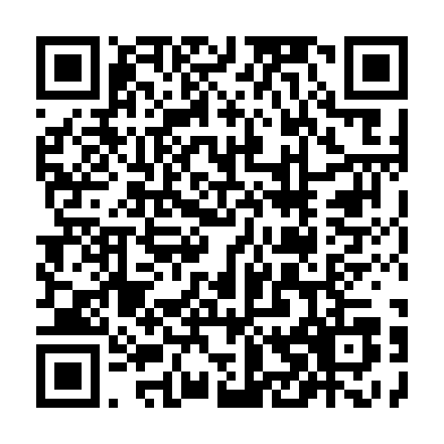
Thank you for listening!
Open Source code:
https://zenodo.org/records/15688589
For more information
https://deepness-lab.org
yehuda.afek@gmail.com

