Slide 1

Another Man’s Treasure:
Security and Privacy Risks of Junk DNS Queries
Elizabeth Boswell, Colin Perkins

Slide 2
What is AS112?
Junk queries: queries with no meaningful response, e.g. reverse DNS queries for private addresses
AS112: anycast DNS deployment that captures junk queries
Diverts them from .arpa/in-addr.arpa nameservers
Responds with NXDOMAIN
Nameserver for reverse mappings of RFC1918 private addresses and link-local IPv4 addresses, home.arpa and service.arpa
Reverse mapping: 203.0.113.23 → 23.113.0.203.in-addr.arpa
Reverse DNS (rDNS) query: PTR query for the reverse mapping

Slide 3
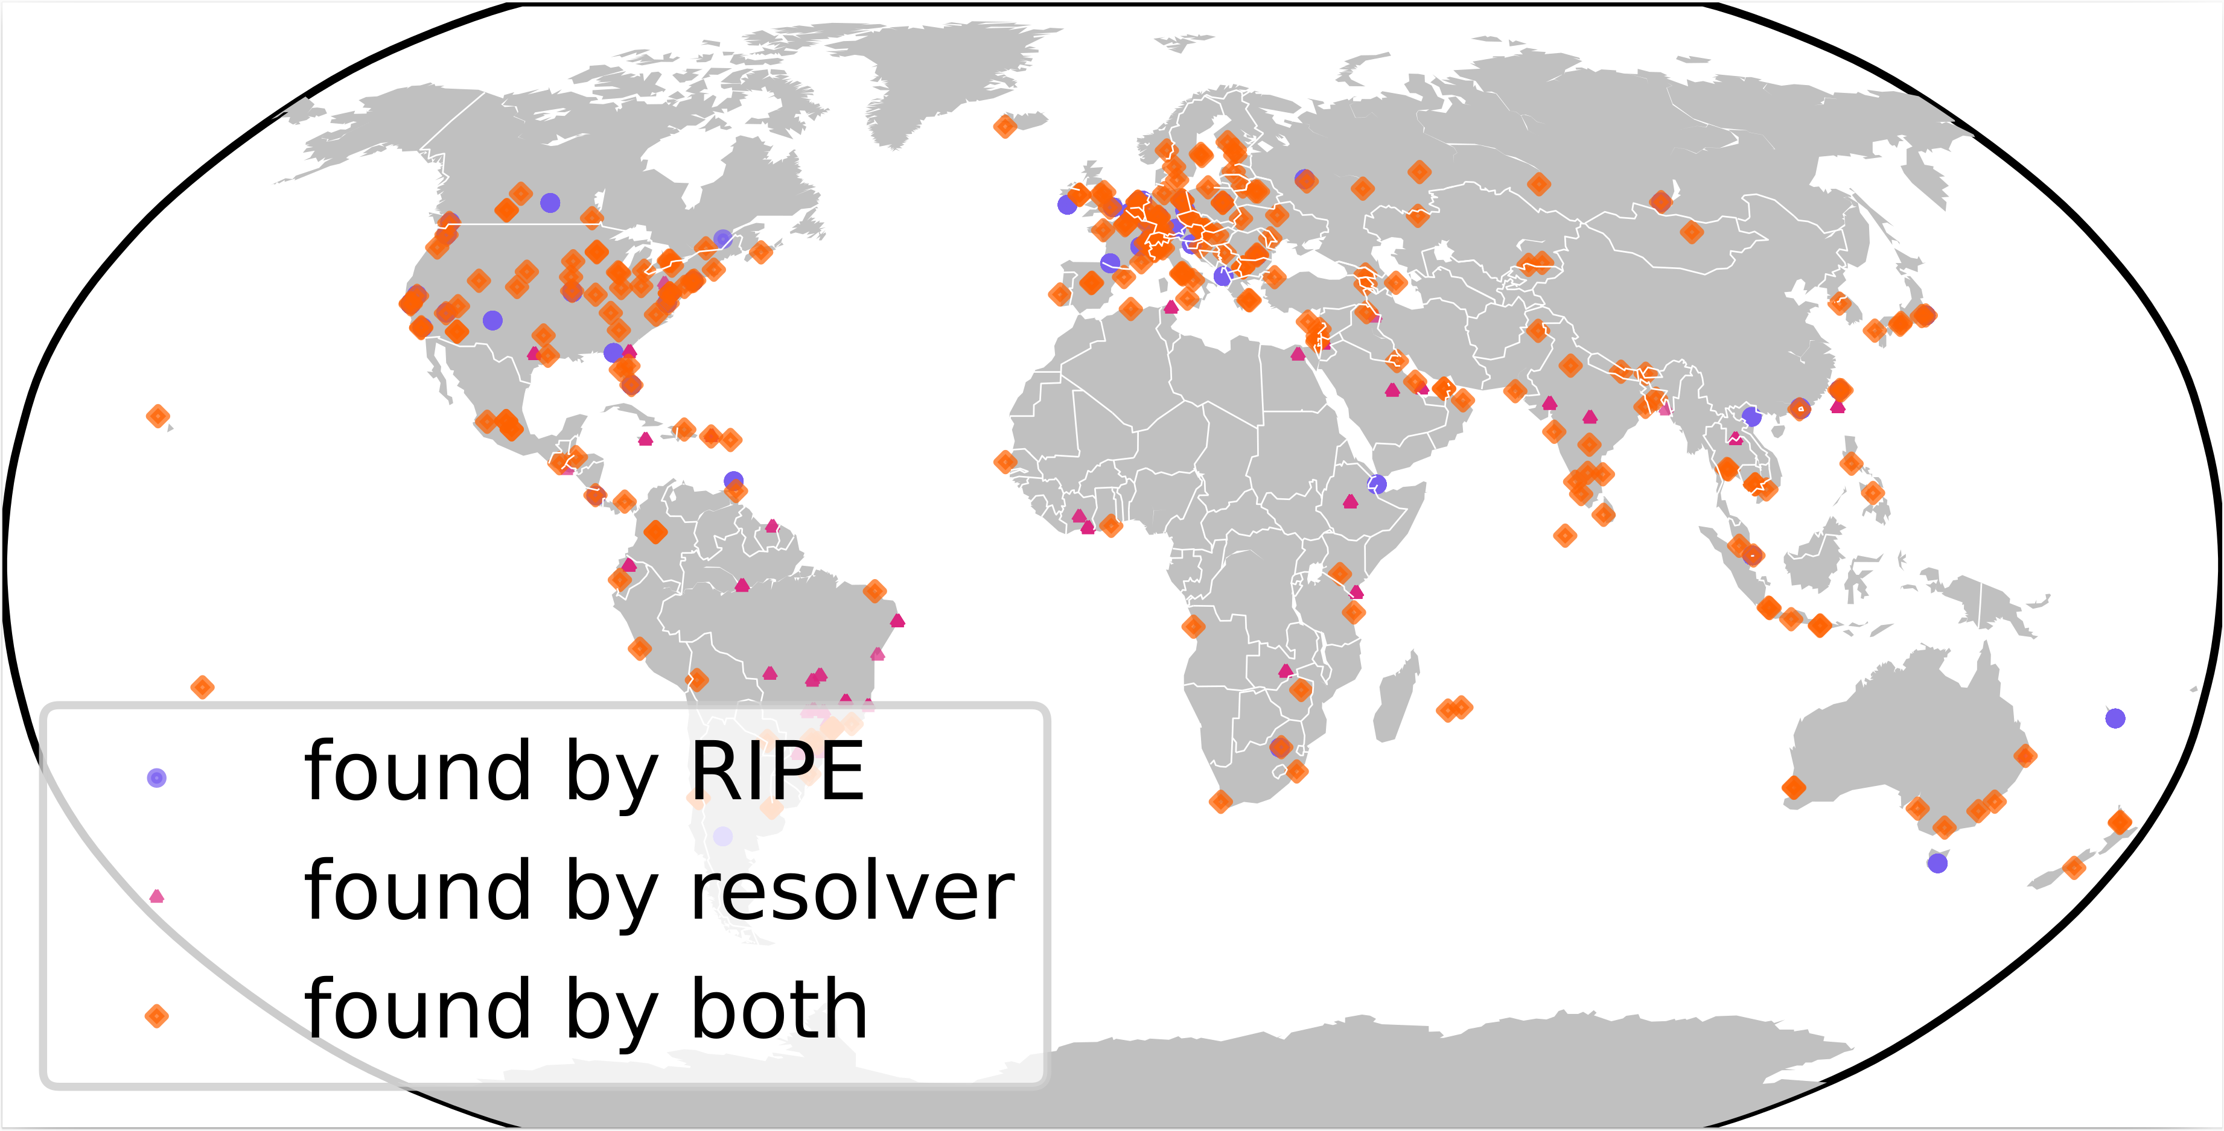
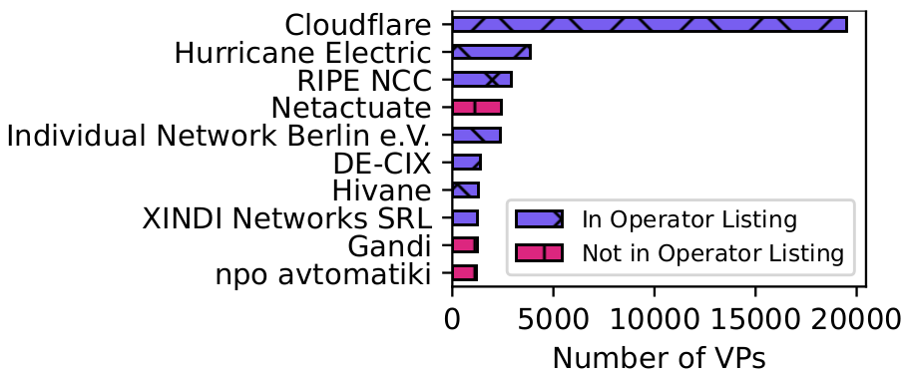
Who runs AS112?
Volunteer-run network
Anyone can add a site! Loosely coordinated by DNS-OARC
We found 469 AS112 sites, run by 97 operators
Cloudflare: 216 sites
More on this work at RIPE DNS-WG

Slide 4
What queries go to AS112?
AS112 is volunteer-run and uncoordinated
Relies on assumption that AS112 traffic is harmless
Our questions:
What queries are sent to AS112?
What could a malicious operator do with these queries?
Work in progress, these are preliminary results

Slide 5
Our Dataset
DNS-OARC Day in The Life 2025 data (8-10 April 2025)
RIPE NCC site (Amsterdam): ~542M requests, ~246K clients
WIDE site (Osaka): 2,252M requests, ~145K clients
TIX site (Dar es Salaam): ~4M requests, ~2K clients
In total: 2,799,058,875 requests, 393,183 clients
We found:
Reverse DNS queries
DNS Dynamic updates
Service Discovery queries
Lame-delegated queries

Slide 6
RFC1918 Reverse Mapping Queries
Most requests are for reverse mappings of RFC1918 private addresses
37.62% PTR (rDNS) queries for RFC1918 addresses
27.09% are other queries for RFC1918 reverse mappings (excluding service queries)
33.8% other query types (e.g. A, SOA, NS)
50.04% of form _.1.0.168.192.in-addr.arpa (malformed service query?)
Queries for personal devices, 9.69% contain substring “iphone”

Slide 7
DNS Dynamic Updates
DNS Dynamic updates change contents of zone, e.g. used by DHCP
Sent to AS112 if:
Host uses private IP address, updates its reverse mapping
Local DNS doesn’t serve the reverse mapping zone
Studied in 2003 and 2006 [1,2]
5.80% of requests are dynamic updates
Plus 0.57% TKEY queries to secure updates
Malicious AS112 operator could learn local network configuration, and track individual users
[1] [1] Broido, A., Nemeth, E. and claffy, kc 2003. Spectroscopy of private DNS update sources. Proceedings the Third IEEE Workshop on Internet Applications. WIAPP 2003 (Jun. 2003), 19–29.
[2] [1] Broido, A., Shang, H., Fomenkov, M., Hyun, Y. and Claffy, K.C. 2006. The Windows of Private DNS Updates. ACM SIGCOMM Computer Communication Review. 36, 3 (2006).

Slide 8
Service Discovery Queries and Service Queries (1/3)
Interaction between AS112 and DNS-Based Service Discovery
Client discovers services by sending SRV/TXT queries of the form
_<service name>._<protocol>.<local domain> to the local DNS
e.g. _ipp._udp.example.com
Client has to first discover the <local domain>, through PTR queries of the form lb._dns-sd._udp.<bootstrap domain>
This bootstrap domain can be the reverse mapping of the local address
Queries go to AS112 if local address is RFC1918 private address, and local DNS does not serve this zone!

Slide 9
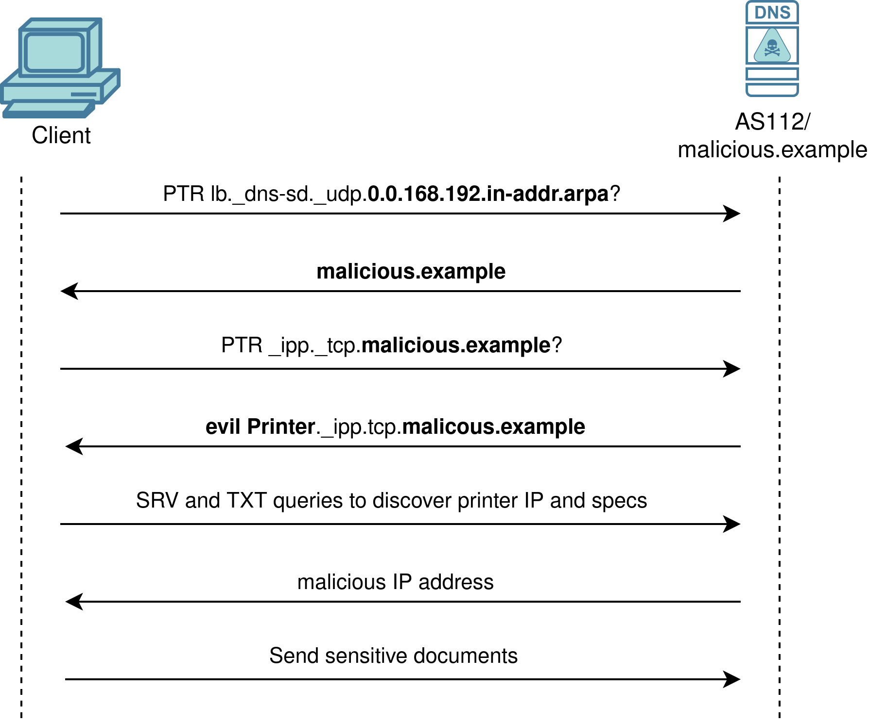
Service Discovery Queries and Service Queries (2/3)
18.17% of requests are Service Discovery Queries
Malicious attacker could misuse these queries to spoof the service
Return a bogus local domain, then return bogus IP address for the service
Fails if service is authenticated

Slide 10
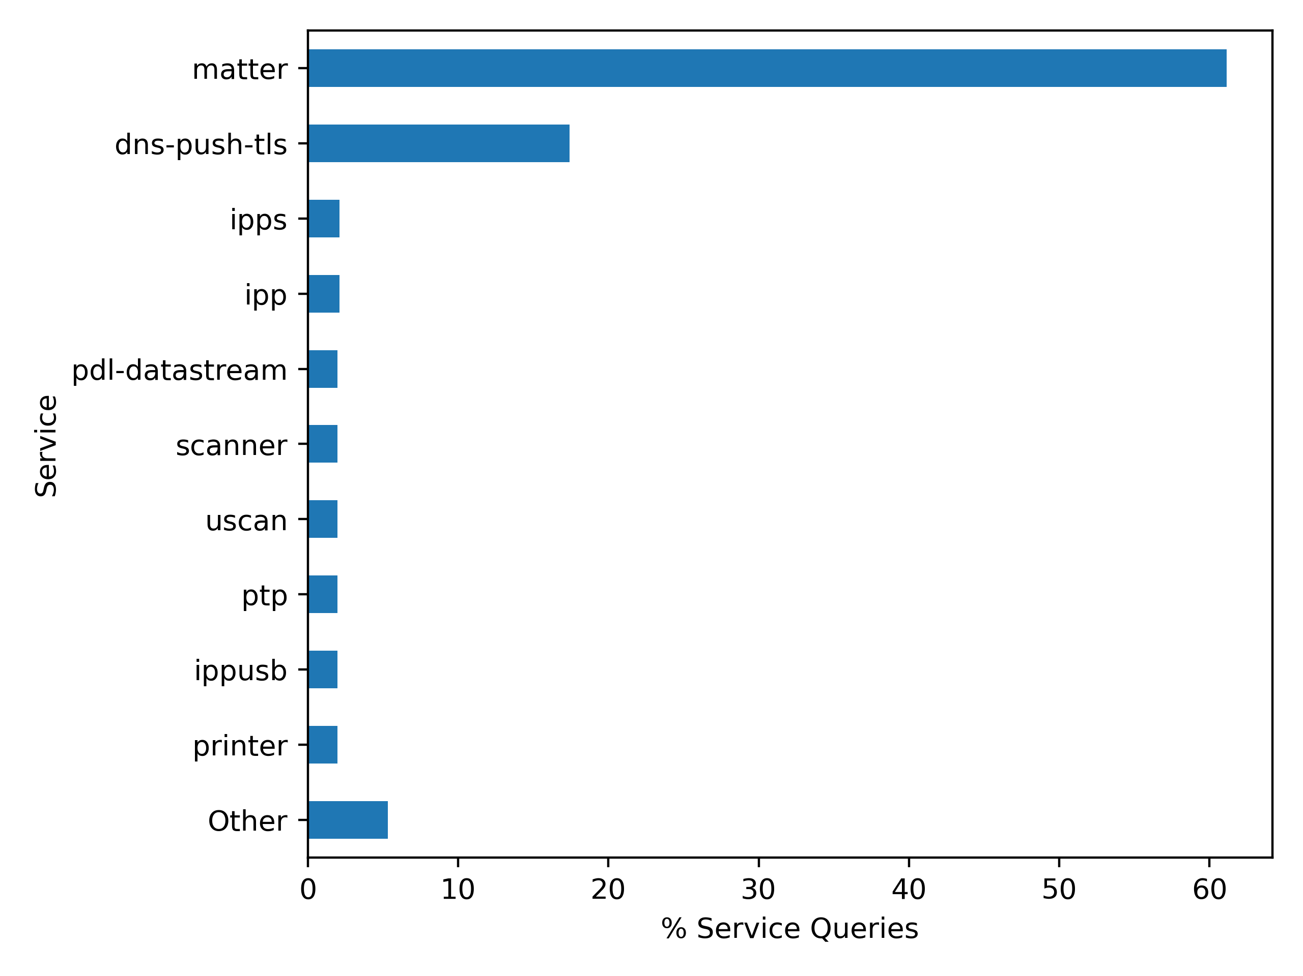
Service Discovery Queries and Service Queries (3/3)
6.71% of requests contain a service name
320 services
“matter” was the most common (61.13%)
Can be used to spoof local services if service is not authenticated

Slide 11
Lame-delegated Queries
0.35% of requests are for domains not delegated to AS112, with public TLDs
Malicious operator could respond and spoof the site
38,447 domains; 43% of queries are for strepsils[.]top (malware/phishing domain!)
Why are these queries going to AS112?
Historical zone files and WHOIS for ~20k domains (from VirusTotal and DNS Coffee)
~95% were delegated to AS112 in the zone files (lame delegation)
Of these, ~75% use the same registrar (Hosting Concepts B.V.), 24.90% contain “bet|poker|gambl|win|slot|casino|kasino”
Has anyone heard of this?

Slide 12
Conclusions
~2.8B queries from three AS112 sites
Found dynamic updates, service queries and lame delegated queries
AS112 does not only receive “harmless” reverse DNS queries
Elizabeth Boswell, University of Glasgow
OARC Mattermost: @eb22
e.boswell.2@research.gla.ac.uk
https://www.gla.ac.uk/pgrs/elizabethboswell/

