Slide 1

Modeling DNS Queries and Caching to Evaluate the Merits of QNAME Minimization
Casey Deccio, Robert Richardson,
Nathaniel Bennett, Nathan Craddock
Brigham Young University
OARC 46
Edinburgh, United Kingdom
May 16, 2026

Slide 2
Background: DNS Name Resolution
Stub Resolver
Recursive Resolver
Authoritative Servers
a.b.foo.com/A
root
a.b.foo.com/A
REC QUERIES
AUTH QUERIES
a.b.foo.com/A
192.0.2.1
com
a.b.foo.com/A
192.0.2.1
foo.com

Slide 3
QNAME Minimization Principles
a.b.foo.com/A
root
Provide referrals towards the answer
a.b.foo.com/A
REC QUERIES
AUTH QUERIES
a.b.foo.com/A
Full QNAME/QTYPE not necessary
192.0.2.1
com
a.b.foo.com/A
192.0.2.1
Provide the actual answer
foo.com
Full QNAME/QTYPE necessary

Slide 4

Research Question
Can we quantify the utility of QNAME minimization?
Methodology
Develop a model of queries, caching, and leakage
Apply the model to a set of recursive queries
https://www.vectorstock.com/royalty-free-vector/man-with-question-mark-flat-icon-pictogram-vector-4920218

Slide 5
Caching Dynamics
Authoritative Server
(foo.com)
Authoritative Server
(com)
Recursive
Resolver
Time
TTL
TTL
Query for a.b.foo.com/A
TTL for a.b.foo.com/A
TTL
REC QUERIES
AUTH QUERIES
Query for c.d.foo.com/A
T
TTL
TTL for c.d.foo.com/A
TTL
TTL
TTL for foo.com/NS
TTL
TTL

Slide 6
Caching Dynamics - Observations
Authoritative Server
(foo.com)
Recursive
Resolver
Time
During Time Period T:
When recursive queries > TTLs:
auth queries = TTLs
TTL
REC QUERIES
AUTH QUERIES
T
TTL

Slide 7
Caching Dynamics - Observations
Authoritative Server
(foo.com)
Recursive
Resolver
Time
During Time Period T:
When recursive queries > TTLs:
auth queries = TTLs
TTL
When recursive queries ≤ TTLs:
auth queries = recursive queries
REC QUERIES
AUTH QUERIES
T
TTL
TTL
TTL

Slide 8
Caching Dynamics - Observations
Authoritative Server
(foo.com)
Authoritative Server
(com)
Recursive
Resolver
Time
During Time Period T:
When auth queries > NS TTLs:
auth queries to parent = TTLs
(not shown)
When auth queries ≤ NS TTLs
auth queries to parent = auth queries
TTL
T
AUTH QUERIES
TTL

Slide 9
Per-Query Leakage (Auth. Queries)
root
2
1
com
net
Queries leaked to parent is based on number of auth. queries and NS TTL.
2
2
foo.com
bar.com
…
…

Slide 10
Probabilistic Per-Query Leakage (Auth Queries)
root
0.20, 0.60
Query
Probability
Expected
Queries
2
1
com
net
0.30, 1.2
Fraction
of Queries
Auth.
Queries
2
2
foo.com
bar.com
0.60, 3

Slide 11
Probabilistic Per-Zone Leakage
root
0.33, 1
Query
Probability
Expected
Queries
2
1
com
net
0.50, 2
Fraction
of Queries
Auth.
Queries
2
2
foo.com
bar.com
1.0, 5

Slide 12

Privacy Boundaries - Principle
root
Leakage across boundary must suggest that a new entity can observe queries.
com
foo
bar
sub
sub
www
www
https://www.flaticon.com/free-icon/eyes_7835667

Slide 13
Privacy Boundaries – Implemented Heuristic
root
Zone Boundary
Zone boundary must exist.
Set of ASes for parent (NS) servers includes at least one AS that is distinct from the set of ASes for child (NS) servers.
com
Privacy Boundary
foo
bar
sub
sub
www
www
No privacy boundary!

Slide 14
Measurement Dataset
One week of recursive queries from BYU’s campus network.
Queries anonymized to preserve privacy.
Recursive
Resolver
Time
Recursive Queries | 5.0B
QNAME-QTYPE Pairs | 5.8M
QNAMEs | 3.5M
DNS Zones | 347K
Privacy Boundary Groups | 290K
Parent Domain is root | 492 (0.2%)
Parent Domain is TLD | 254K (87%)
Parent Domain is below TLD | 36K (12%)
REC QUERIES
T

Slide 15


Results (Yay! and meh.)
For 87% of privacy domains (96% of queries) the parent is a TLD.
Yay! TLDs could be considered potential aggregators of query info.
Meh. Parent domains always see the QNAME’s domain anyway.
For half (50%) of privacy domains, all QNAMEs are leaked to parent.
Yay! QNAME minimization keeps QNAMEs to minimal disclosure.
Meh. 74% of QNAMEs are associated with fewer than five recursive queries
Meh. For 98% of privacy domains, only 10 or fewer QNAMEs leaked to parent.
For 99% of privacy domains, QNAME leakage rate to root is ≤65%
Yay! QNAME minimization keeps the root from seeing these queries.
Meh. For half of privacy domains, only a single QNAME is represented
Meh. Only 1.7% of privacy domains leak one or more QNAMEs to root servers.
https://www.flaticon.com/free-icons/excited
https://www.flaticon.com/free-icons/bored

Slide 16
Other QNAME Minimization Costs
root
Root server queries provide a rich data source to the Internet community (DITL).
Queries at root represent a sample of recursive queries issued.
Value diminished by QNAME minimization.
QNAME minimization has been a contributor to attacks.
“CAMP: Compositional amplification attacks against DNS” [Duan, USENIX Security 2024].
…
…

Slide 17
Summary
Recursive
Resolver
Caching and leakage can be modeled.
There are pros and cons to QNAME minimization.
Pro: modest privacy gains
Con: decreased utility of internet community datasets
Time
REC QUERIES
T

Slide 18
Hard Questions
Do organizations understand the costs and benefits of QNAME minimization?
Did organizations ask for QNAME minimization?
Is this something that organizations are enabling or disabling explicitly? Or is it typically based on default configuration behavior?
What do organizations gain or lose by continuing the practice?
Who controls the destiny of QNAME minimization?
Notes:
It might be argued that many organizations understand
neither the benefits nor the costs of QNAME minimization; a
typical DNS resolver deployment involves installation with its
default features, making changes only if problems are detected.
If this is the case, then the matter of QNAME minimization is
less about individual organizations and more about the Internet
standards community and software developers. Thus, while
we have presented both a theoretical and an empirical study
of QNAME minimization, whether the trend continues is a
matter most likely handled by those entities.

Slide 19
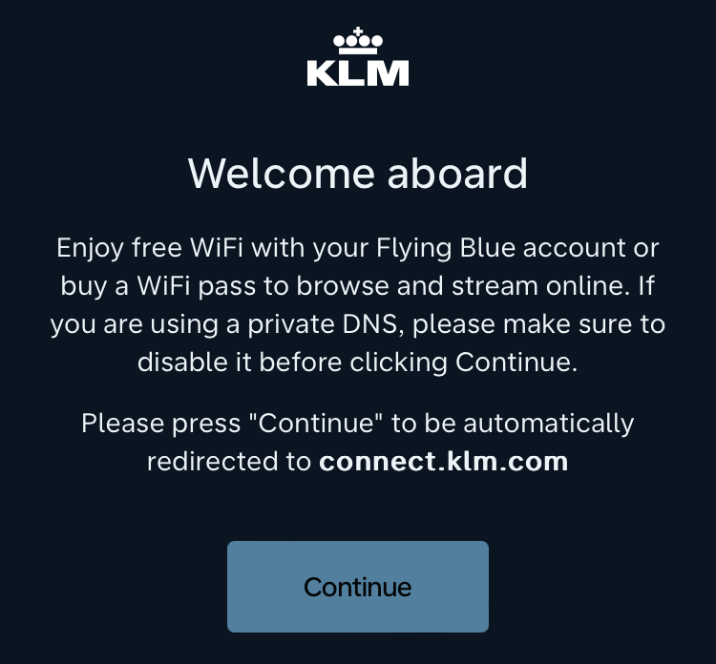
“If you are using a private DNS, please make sure to disable it…”

Slide 20
Questions?
casey@byu.edu

