Slide 1

Are your Zones Resolvable?
Detecting DNS(SEC) Misconfigurations with Formal Reasoning
Department of Computer Science
Felix Linker
ETH Zurich
Yue Huang
HKUST(GZ)
David Basin
ETH Zurich
Huayi Duan
HKUST(GZ)

Slide 2
DNS Zone Configuration Errors are a Problem
They even have names!
Lame Delegation
Rewrite Blackholing

Slide 3

DNS Zone Configuration Errors are a Problem

Slide 4

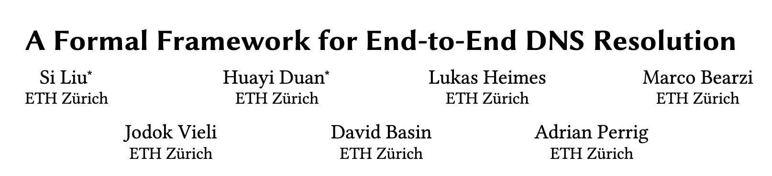
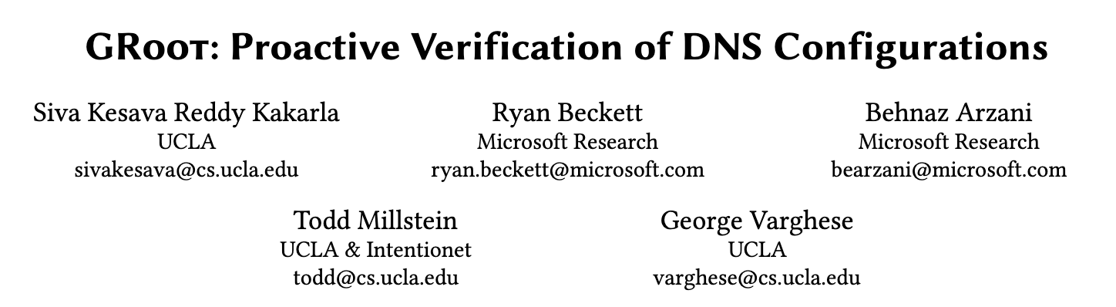
Formal Reasoning has been suggested
Zone Files
Formal Reasoning
Configuration Errors

Slide 5
Formal Reasoning has been suggested
Zone Files
Formal Reasoning
Configuration Errors
Two problems with these approaches
Verify absence of some errors
DNSSEC not supported

Slide 6
Formal Reasoning has been suggested
Zone Files
Formal Reasoning
Configuration Errors
Two problems with these approaches
Verify absence of some errors
DNSSEC not supported

Slide 7
Formal Reasoning has been suggested
Zone Files
Formal Reasoning
Configuration Errors
Two problems with these approaches
You have to know what you’re looking for
Verify absence of some errors
DNSSEC not supported

Slide 8
Formal Reasoning has been suggested
Zone Files
Formal Reasoning
Configuration Errors
Two problems with these approaches
Issues like DENIC outage require DNSSEC
Verify absence of some errors
DNSSEC not supported

Slide 9
A New Formal Model to Detect DNS Misconfigurations
Can detect errors without explicitly looking for them
Support for DNSSEC
Implemented
Evaluated
Correctness Proofs
DNS Interoperability
…more on this later…

Slide 10
Agenda
Which property do we target?
How does our model work?
How well does our model work?
How could our model be used?

Slide 11
Which property do we target?

Slide 12
Which property do we target?
Resolvability
characterized by
?
?
?
Zone Configuration
Queries that should
have an answer

Slide 13
Which property do we target?
Difference? Configuration error!
compute
?
compare
?
?
?
!
?
Zone Configuration
Queries that
have an answer
Queries that should
have an answer

Slide 14
Which property do we target?
Hard to get
compute
?
compare
?
?
?
!
?
Zone Configuration
Queries that
have an answer
Queries that should
have an answer

Slide 15
Which property do we target?
compute
?
compare
?
!
?
Zone Configuration
Queries that
have an answer
Queries that should
have an answer

Slide 16
Which property do we target?
compute
?
?
!
Zone Configuration
Queries that
have an answer

Slide 17
Which property do we target?
compute
?
?
!
Zone Configuration
Queries that
have an answer
Change-impact analysis
update
compute
?
?
!
Zone Configuration
Queries that
have an answer

Slide 18
Which property do we target?
compute
?
?
!
Zone Configuration
Queries that
have an answer
Anything not resolvable anymore?
update
compute
?
?
!
Zone Configuration
Queries that
have an answer

Slide 19
Which property do we target?
compute
?
?
!
Zone Configuration
Queries that
have an answer
What is newly resolvable?
update
compute
?
?
!
Zone Configuration
Queries that
have an answer

Slide 20
Which property do we target?
compute
?
?
!
Zone Configuration
Queries that
have an answer
Resolvability change-impact analysis
What is newly resolvable?
update
compute
?
?
!
Zone Configuration
Queries that
have an answer

Slide 21
Which property do we target?
Requires interpretation
Resolvability change-impact analysis

Slide 22
Which property do we target?
Requires interpretation
Resolvability change-impact analysis
Could have detected
…changes which should preserve resolvability

Slide 23
How does our model work?

Slide 24
How does our model work?
Zone Files - New & Old
+
“Root” zone
+
”Root” trust anchors
Compiler
Formal Model
Reasoning

Slide 25
How does our model work?
Zone Files - New & Old
+
“Root” zone
+
”Root” trust anchors
Compiler
Formal Model
Reasoning

Slide 26

How does our model work?
Zone Files - New & Old
Compiler
Formal Model
(Constraint) Logic Program
Example:
pos_num(0)
pos_num(next(N)) $←$ pos_num(N)
Fact
Rule

Slide 27
How does our model work?
Zone Files - New & Old
Compiler
Formal Model
(Constraint) Logic Program
Example:
pos_num(0)
pos_num(next(N)) $←$ pos_num(N)
Query:
pos_num(X)?
pos_num(0), pos_num(next(0)), …

Slide 28

How does our model work?
Zone Files - New & Old
Compiler
Formal Model
(Constraint) Logic Program
Example:
pos_num(N) $←$ N >= 0
Constraint
Handled by constraint solver
Good for:
  Cryptography / DNSSEC
  Representing infinity
Query:
pos_num(X)?
X >= 0

Slide 29
How does our model work?
Zone Files - New & Old
Compiler
Formal Model
compile as fact
for each RRSet
Logic Program
compile as rule
NS
RRSIG
CNAME
DNAME

Slide 30
How does our model work?
Zone Files - New & Old
Compiler
Formal Model
resolves(nses, type, zone, name, data, alias, val, auth)
compile as fact
for each RRSet
Logic Program
compile as rule

Slide 31
How does our model work?
Zone Files - New & Old
Compiler
Formal Model
resolves(nses, type, zone, name, data, alias, val, auth)
name servers
RR type
zone
name
response data
alias followed?
performing validation?
response signed?
Query
Response

Slide 32
How does our model work?
Zone Files - New & Old
Compiler
Formal Model
resolves(nses, type, zone, name, data, alias, val, auth)
Scope of Model
Abstract from:
  Transport, headers, etc.
  NSes serving inconsistent data
  Cache
Goal: What would resolvers conclude given input data?

Slide 33
How does our model work?
Zone Files - New & Old
Compiler
Formal Model
resolves(nses, type, zone, name, data, alias, val, auth)
project for change-impact analysis
resolvable(type, name, val)

Slide 34
How does our model work? – Example
Old
*.short. TXT "hello"
*.lo…ong. TXT "hello"
New
short. DNAME lo…ong.
*.lo…ong. TXT "hello"
change
Impact?
Newly resolvable?
Nothing
Not resolvable anymore?
resolvable(TXT, ….short.) $←$ not(isName(….lo…ong.)), isName(….short.)

Slide 35
How does our model work? – Example
Old
*.short. TXT "hello"
*.lo…ong. TXT "hello"
New
short. DNAME lo…ong.
*.lo…ong. TXT "hello"
change
Impact?
Newly resolvable?
….lo…ong.
too long
….short.
within bounds
Nothing
Not resolvable anymore?
resolvable(TXT, ….short.) $←$ not(isName(….lo…ong.)), isName(….short.)

Slide 36
How does our model work? – Example
Old
*.short. TXT "hello"
*.lo…ong. TXT "hello"
New
short. DNAME lo…ong.
*.lo…ong. TXT "hello"
change
Impact?
Generalizes to:
Signed zones
Aliases in different zones
Newly resolvable?
Nothing
Not resolvable anymore?
resolvable(TXT, ….short.) $←$ not(isName(….lo…ong.)), isName(….short.)

Slide 37
How does our model work?
Formal Model
Reasoning
Offline Reasoning
Querying Mode
1
2
Correctness
Proofs
Illustrates
Completeness
Model is executable
Infer follow-up queries from rules
Interoperable with real DNS
Change-impact analysis
Configuration errors

Slide 38
How well does our model work?

Slide 39
How well does our model work?
Offline Reasoning
Querying Mode
1
2
Correctness
Proofs
But faithful?

Slide 40
How well does our model work?
Offline Reasoning
Querying Mode
1
2
Covering corner cases
But no DNSSEC
Load into Bind
Query with Bind
Synthesize Root
+
Sign
Compare
Queries/Responses
Load into Knot
Query with Knot
Ferret Dataset
(Zone Files)
Analyze with tool

Slide 41
How well does our model work?
Offline Reasoning
Querying Mode
1
2
dig +trace
Sample subset
Compare Responses
Query with tool
Bind 100k Queries
(for A/B Testing)

Slide 42
How well does our model work?
Offline Reasoning
Querying Mode
1
2
Results
Compilation + reasoning work
Faithful* model of the DNS

Slide 43
How well does our model work?
Offline Reasoning
Querying Mode
1
2
Results
Many fixed bugs
Handling of referral data
DNAME and NS interactions
…and more…
Some accepted inconsistencies
Data below delegations
No CNAME synthesis
…and more…

Slide 44
How well does our model work?
Can we identify configuration errors? Yes!
Cyclic Zone Dependency
Inconsistent Delegations
Wildcard Shadowing
Incomplete New Zone Cut
Lame Delegation
Missing NS Addresses
Rewrite Blackholing
Rewrite Loop

Slide 45
How well does our model work?
Can we identify configuration errors? Yes!
Cyclic Zone Dependency
Inconsistent Delegations
Wildcard Shadowing
Incomplete New Zone Cut
Lame Delegation
Missing NS Addresses
Rewrite Blackholing
Rewrite Loop

Slide 46
How well does our model work? – Limitations
Performance Limitations
Some DNAME rewrites
Querying times out
Examples
  Root zone: infeasible
  google.com: 1.77 s
But: Reasoning naïve
Model
Limited denial of existence
  Yes: Unsigned children
  No: Signed wildcards
Weak DNSSEC coverage
Next focus

Slide 47
How could our model be used?

Slide 48
How could our model be used?
Regression Testing
For updates that preserve resolvability
New Zone Cuts
Key Rollover

Slide 49
How could our model be used?
independent
Formal Model
Reasoning
Standards Updates
Change-impact of NS vs. DELEG
Compatible with Standard Engines
Provide integration for SWI-Prolog
Useful for DNSSEC validation
…exploring prototype with ISC

Slide 50
A New Formal Model to Detect DNS Misconfigurations
Resolvability Change-Impact Analysis
Can detect errors without explicitly looking for them
Support for DNSSEC
Implemented
Evaluated
Correctness Proofs
DNS Interoperability
Highly advanced but ongoing work
Invite feedback & experiments
reach out
felixlinker.de

