Slide 1
How Long Is Too Long?
Right-Sizing QNAME Minimization
Adam Phelps
Prashanth Suvarna
Sean Mooney
DNS-OARC 47 · Vancouver
1

Slide 2
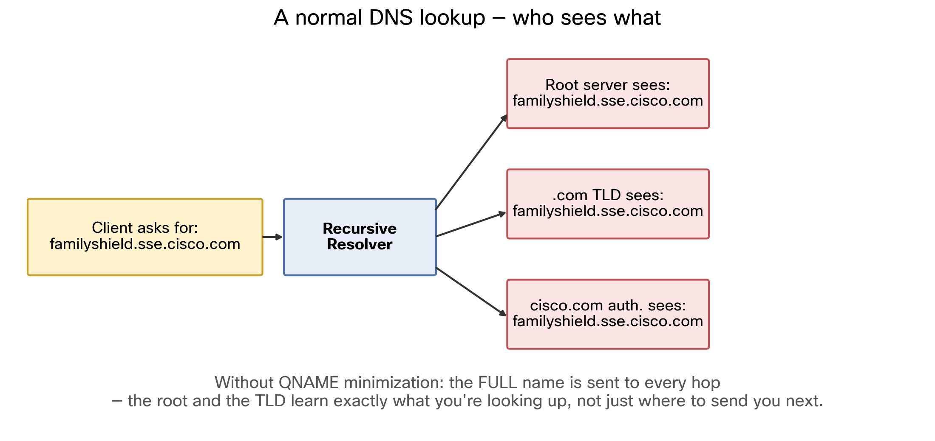

A Normal DNS Lookup
2

Slide 3
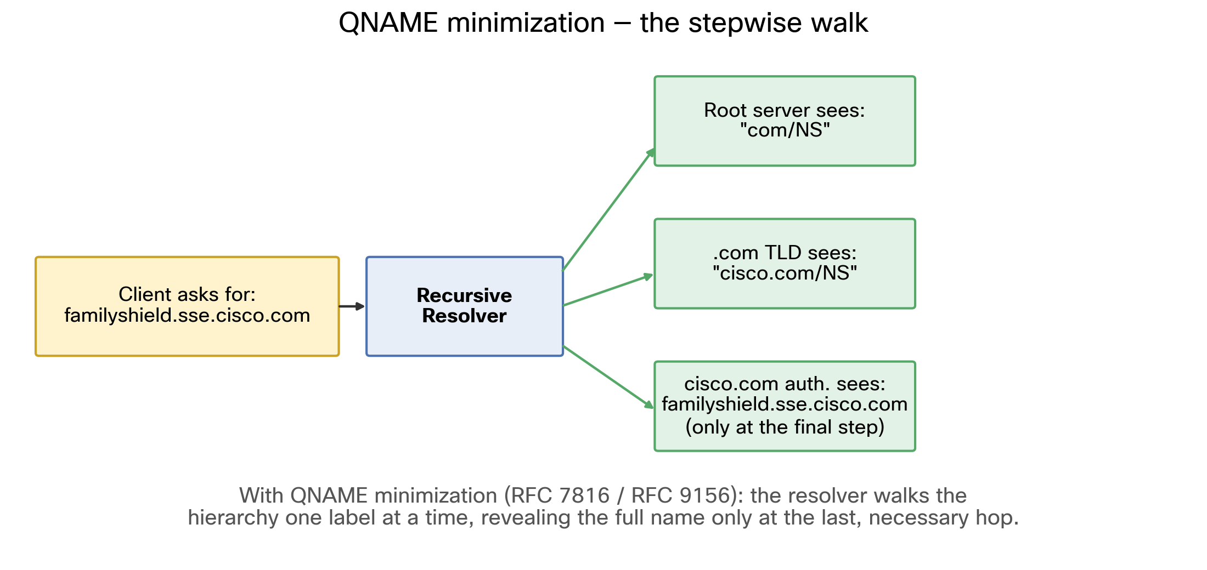
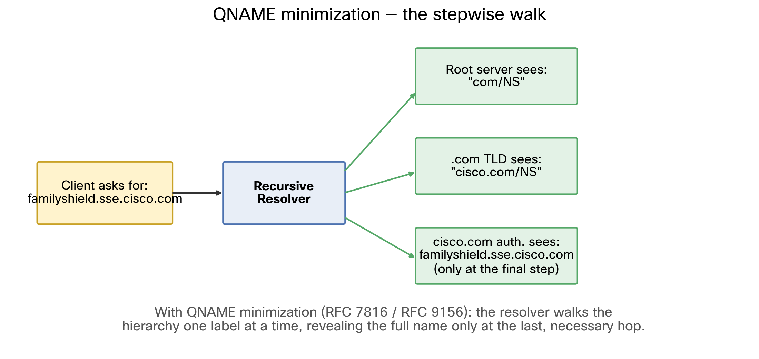
QNAME Minimization: The Walk
3

Slide 4
The Open Question
RFC 9156: a cap is required
Recommended value: 10
Prior art (draft-levine-qmin-performance) measures traffic increase, not label depth
No fleet-scale label depth census available
4

Slide 5
Methodology
48 datacenters, worldwide
3 trillion client queries
934 billion upstream-resolved target names
Two passive counters
Zero behavior change
5

Slide 6
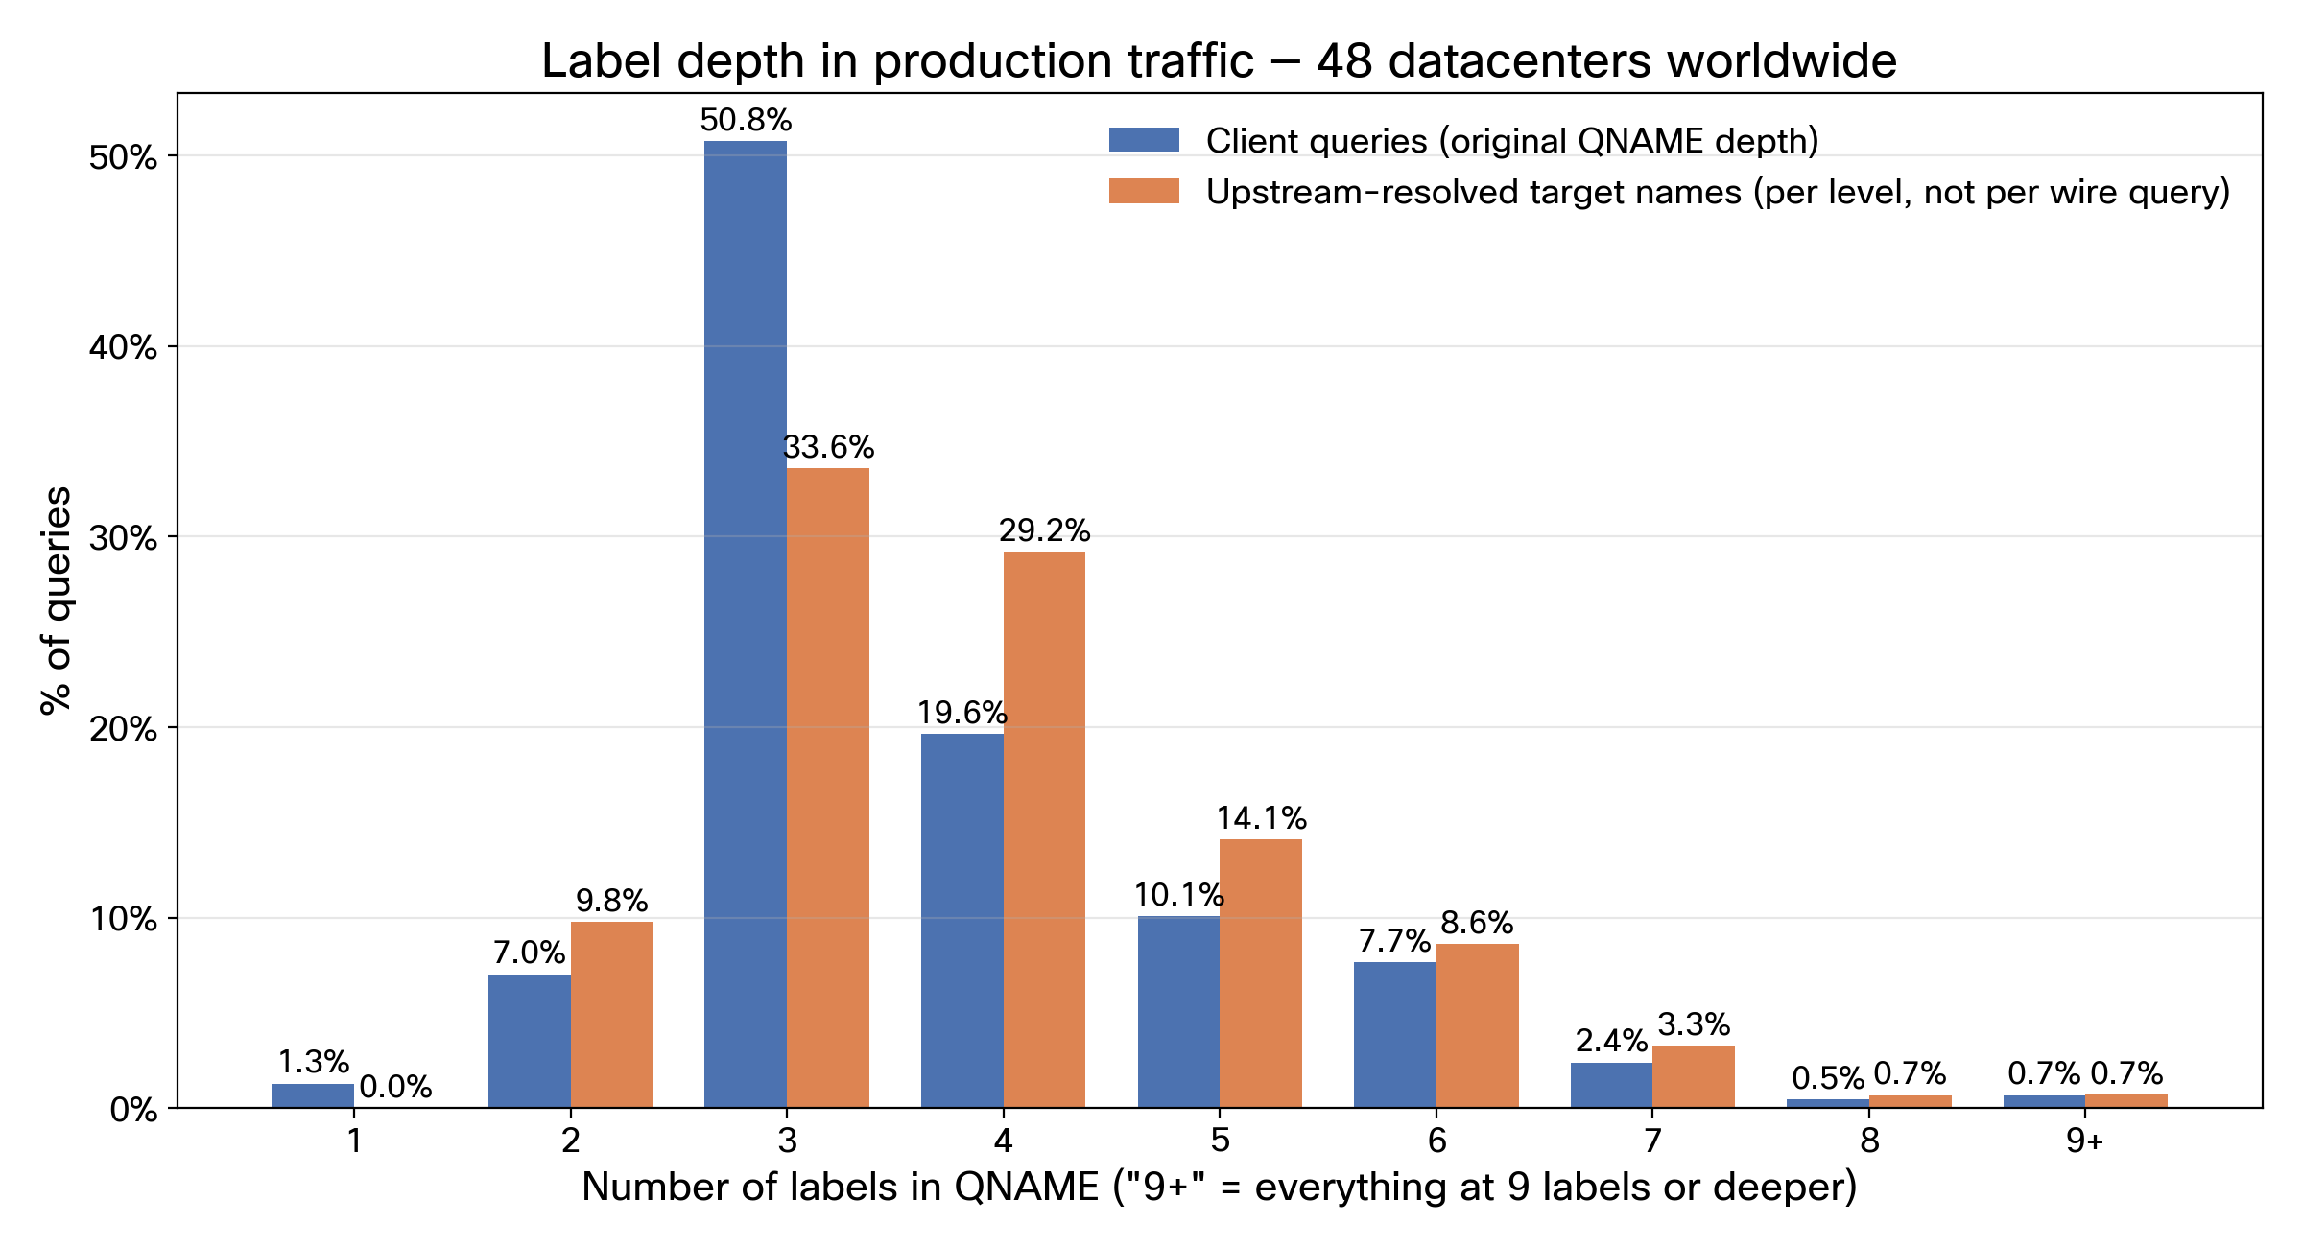
How Deep Are Real DNS Queries?
6

Slide 7
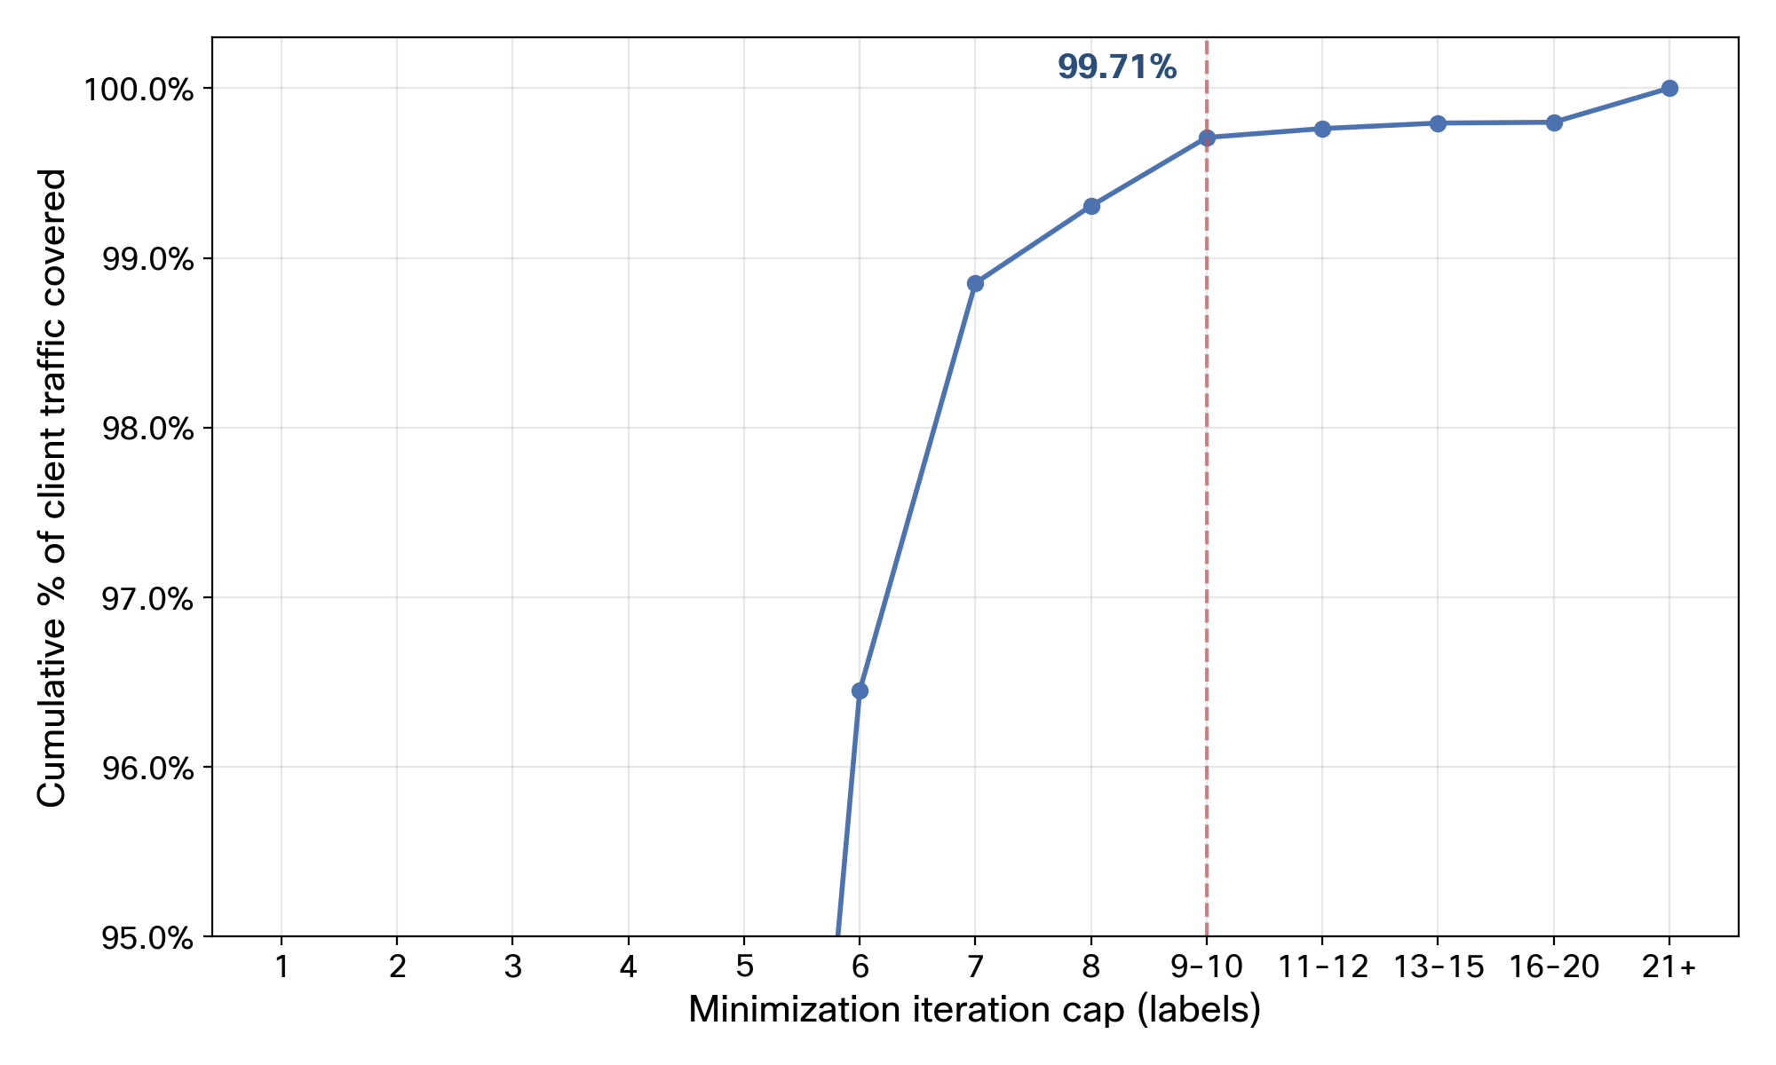
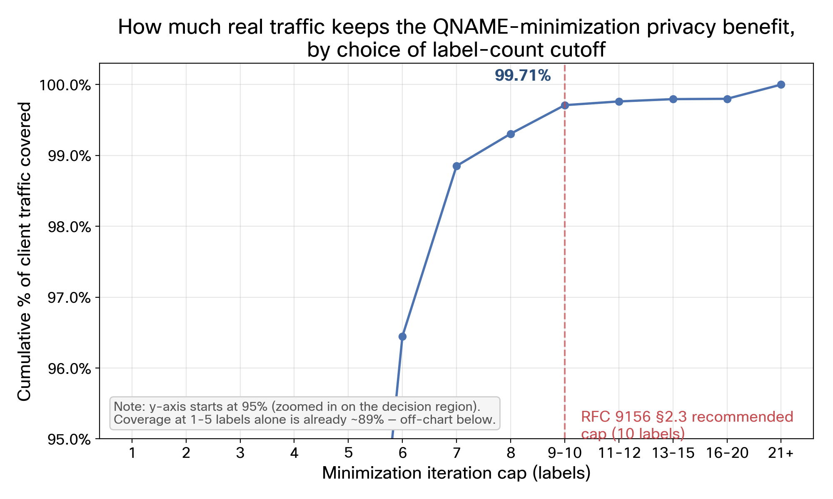
How Much Traffic Keeps the Privacy Benefit?
7

Slide 8
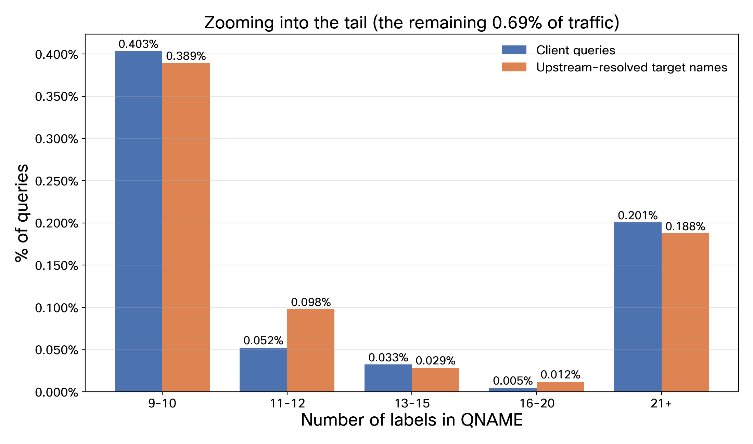
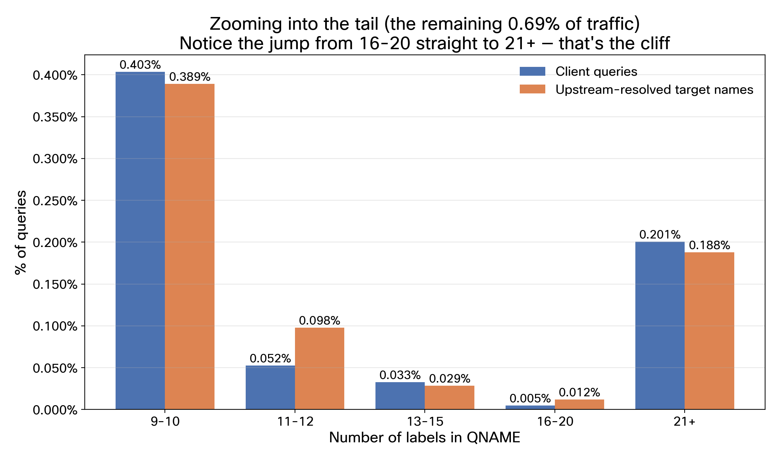
A Cliff, Not a Taper
8

Slide 9
The Standard Already Knew
Real PTR: dns.opendns.com's AAAA, reversed —
5.3.0.0.0.0.0.0.0.0.0.0.0.0.0.0.0.0.0.0.5.3.0.0.9.1.1.0.0.2.6.2.ip6.arpa (34 labels)
Cisco Umbrella's top-1M list does contain real 34-label ip6.arpa entries
Confirms a known case, not a new discovery
Non-PTR examples, same list — a repeated-label chain under mobile.de, at several real depths:
(38 labels) c047.c047.c047...c047.c047.mobile.de
There is a wildcard at mobile.de
9

Slide 10
An Honest Caveat
Two separate counters, never linked per query
Counter A ("client"): depth of the original question — one count per query
Counter B ("lookup"): depth of the target name at each resolution step that wasn't a full cache hit — the original name, an NS hostname, a CNAME target, a DS/DNSKEY name — NOT the length of the minimized query actually on the wire
So one client query can log several lookup samples, each at a different, often unrelated depth — not one sample per wire query
Conclusion: you can't divide B by A, bucket-by-bucket, to get "amplification caused by depth-N queries
10

Slide 11
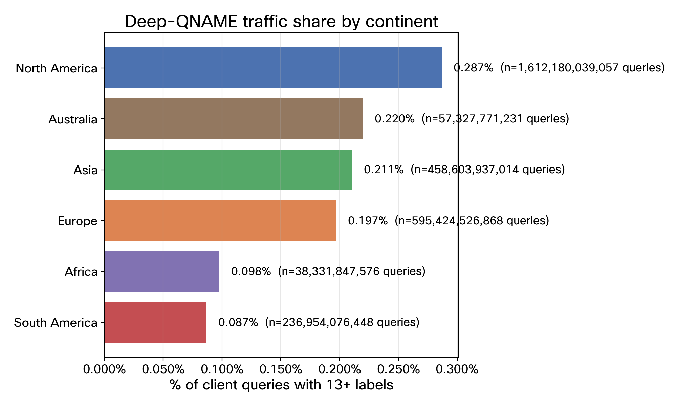
Is This Uniform Worldwide?
11

Slide 12
The Dallas Anomaly
13-20 label queries only — a sliver of total traffic
83% of Dallas's queries in the 13-20 label bucket miss cache and go upstream
Everywhere else: only 2-6% of elevated 13-20 traffic goes upstream
Dallas alone carries 69.8% of the fleet's entire upstream load at this depth
12

Slide 13
What a Cutoff Protects
A label-count cap only matters where deep queries aren't cached — that's the traffic worth protecting.
Reaches authorities:
Denver
Palo Alto
Rio de Janeiro
Hong Kong
Chennai
London
Stays in cache:
Madrid
Prague
Dublin
Mexico City
Seattle
13

Slide 14
Recommendation
Recommended iteration cap: 8-10 labels
No carve-out for reverse DNS
Check your own fleet
Methodology: cheap, replicable
RFC 9156 (2021) recommended 10. Our research says they got it right
14

Slide 15
Thank You
15

